Slide 1
Conditional operator
A very compact if-else.
(condition) ? expression2 : expression3
means
if (condition)
expression2
else
expression3

Slide 2
Array Pointers Chapter 7
Problem Solving & Program Design in C
Eighth Edition
Jeri R. Hanly & Elliot B. Koffman

Slide 3
Chapter Objectives
To learn how to declare and use arrays for storing collections of values of the same type
To understand how to use a subscript to reference the individual values in an array
To learn how to process the elements of an array in sequential order using loops

Slide 4
Chapter Objectives
To understand how to pass individual array elements and entire arrays through function arguments
To learn a method for searching an array
To learn a method for sorting an array
To learn how to use multidimensional arrays for storing tables of data
To understand the concept of parallel arrays
To learn how to declare and use your own data types

Slide 5
Basic Terminology
data structure
a composite of related data items stored under the same name
array
a collection of data items of the same type

Slide 6
Declaring and Referencing Arrays
array element
a data item that is part of an array
subscripted variable
a variable followed by a subscript in brackets, designating an array element
array subscript
a value or expression enclosed in brackets after the array name, specifying which array element to access

Slide 7
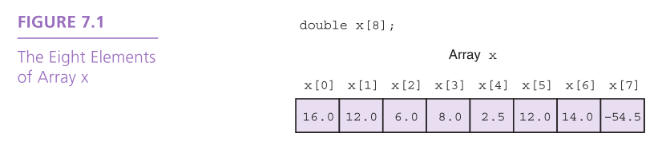

Slide 8
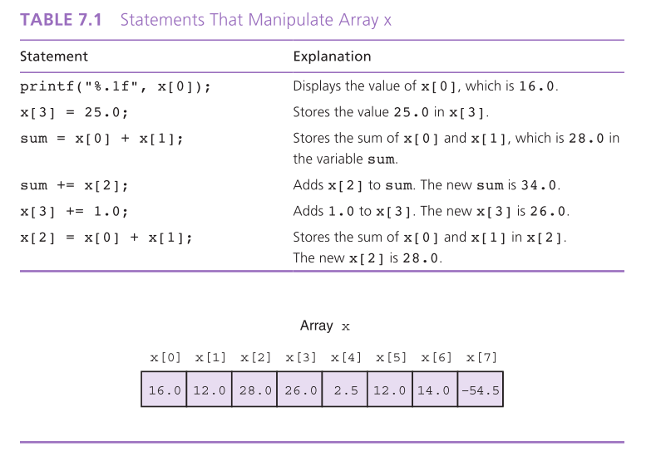

Slide 9
Array Initialization
int prime_lt_100[] = {2, 3, 5, 7, 11, 13, 17, 19,
23, 29, 31, 37, 41, 43, 47, 53, 59, 61, 67, 71, 73, 79, 83, 89, 97}
char vowels[] = {‘a’, ‘e’, ‘i’, ‘o’, ‘u’, ‘y’}

Slide 10
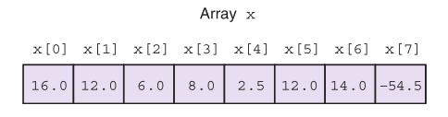
Array Subscripts
Syntax: aname [subscript]
Examples: x[3]
x[i + 1]

Slide 11
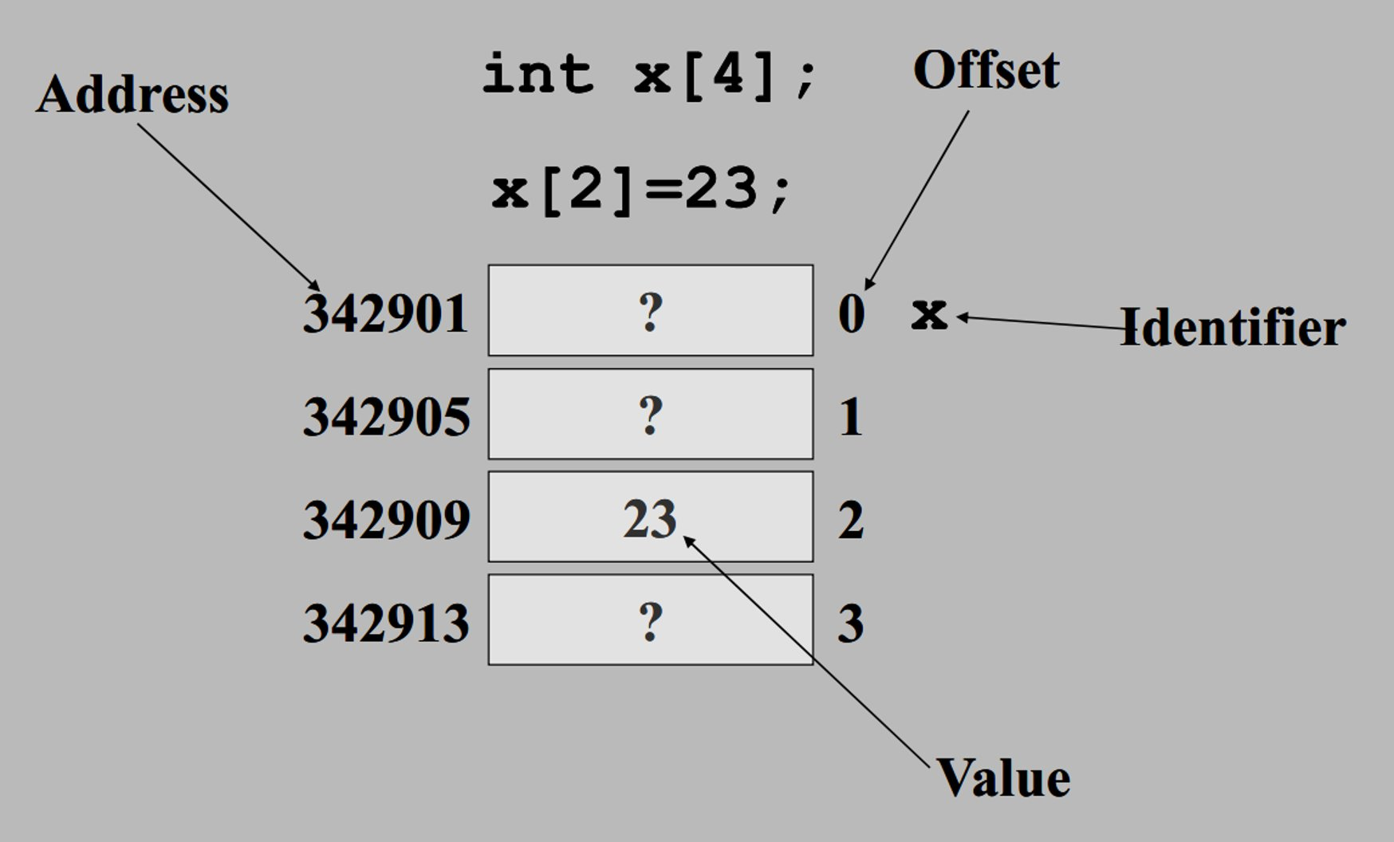

Slide 12
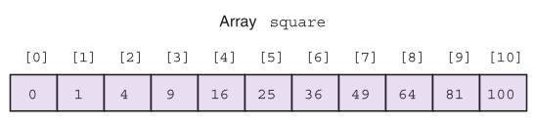
Using for Loops for Sequential Access
for (i = 0; i < SIZE; ++i)
square[i] = i * i;

Slide 13
What’s at x[5]?

Slide 14
Partially Filled Arrays
A program may need to process many lists of similar data but the lists may not all be the same length.
In order to reuse an array for processing more than one data set, you can declare an array large enough to hold the largest data set anticipated.
Then your program should keep track of how many array elements are actually in use.

Slide 15
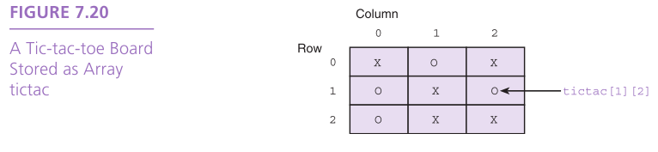
Multidimensional Arrays
multidimensional array
type arr_name[dim1val][dim2val]
tictac[3][3]

Slide 16
Using Array Elements as Function Arguments
scanf(“%lf”, &x[i]);

Slide 17
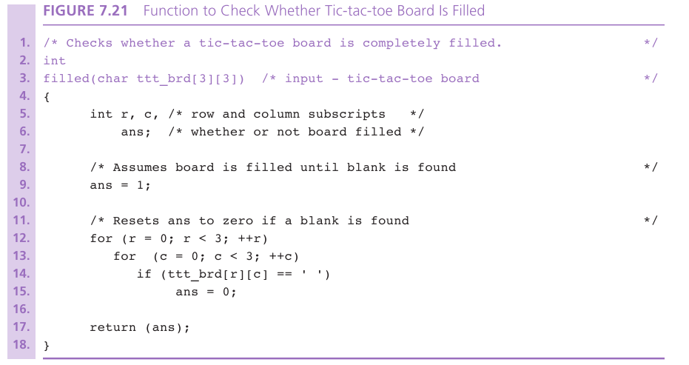

Slide 18
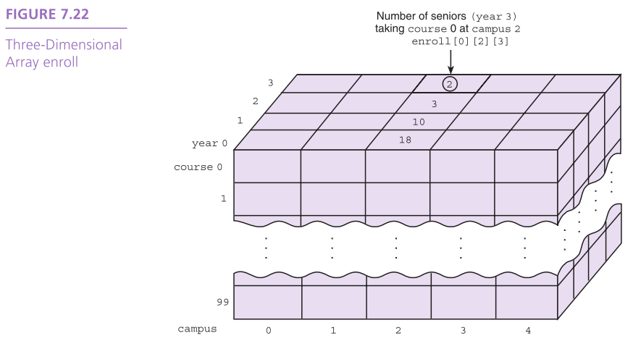

Slide 19
Array Arguments
We can write functions that have arrays as arguments.
Such functions can manipulate some, or all, of the elements corresponding to an actual array argument.

Slide 20
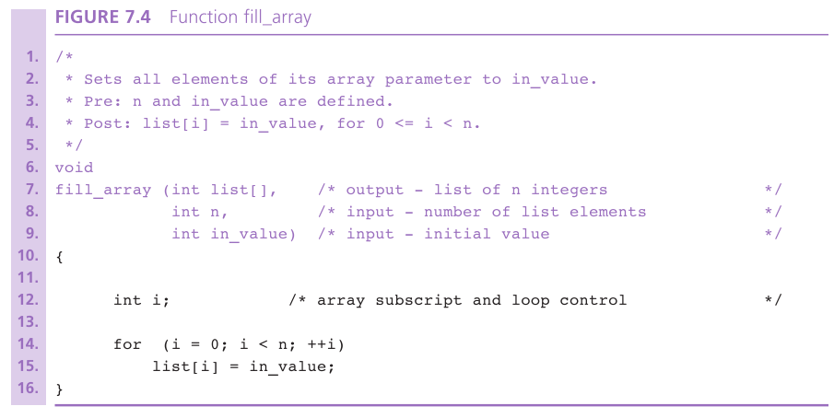

Slide 21
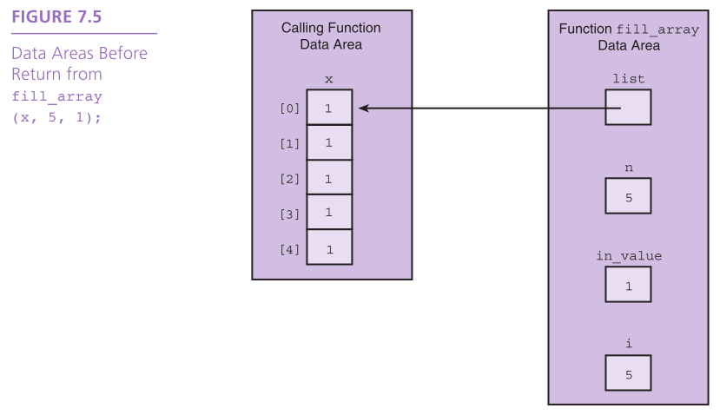

Slide 22
Arrays as Input Arguments
ANSI C provides a qualifier that we can include in the declaration of the array formal parameter in order to notify the C compiler that the array is only an input to the function and the function does not intend to modify the array.
The qualifier const allows the compiler to mark as an error any attempt to change an array element within the function.

Slide 23
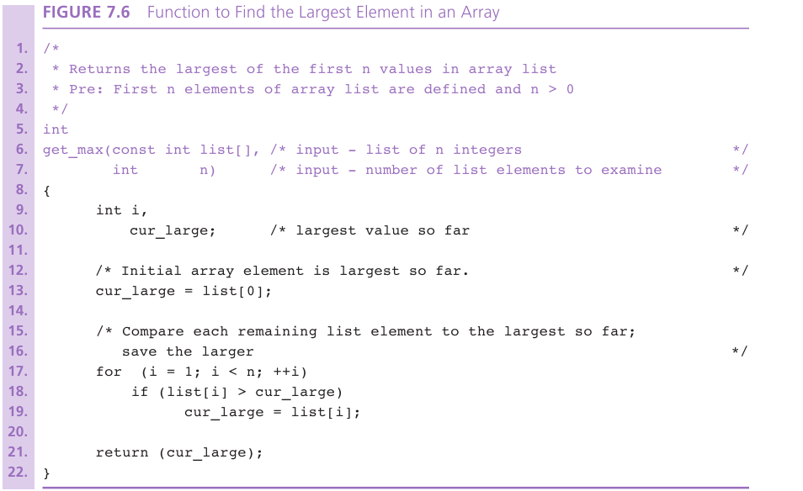

Slide 24
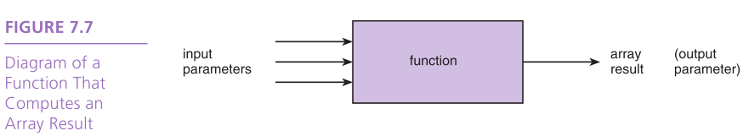
Returning an Array Result
In C, it is not legal for a function’s return type to be an array.
You need to use an output parameter to send your array back to the calling module.

Slide 25
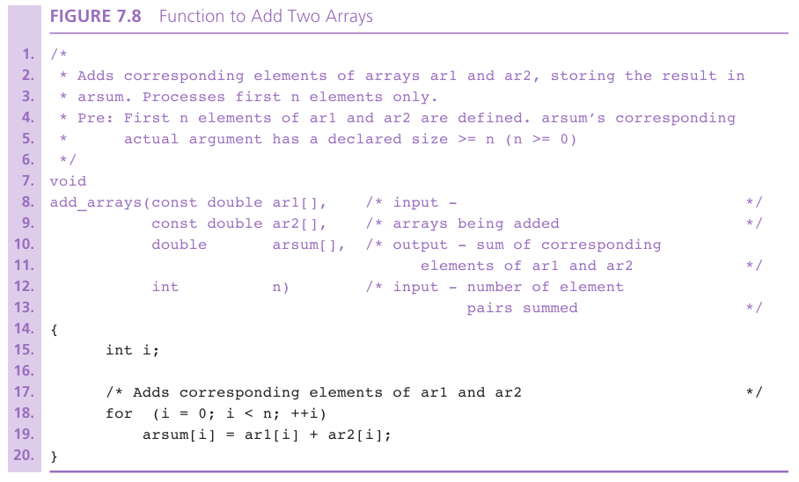

Slide 26
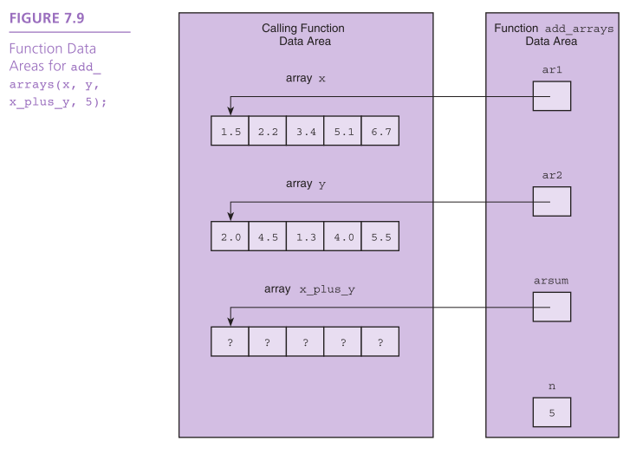

Slide 27
Array Search
Assume the target has not been found.
Start with the initial array element.
repeat while the target is not found and there are more array elements
if the current element matches the target
Set a flag to indicate that the target has been found
else
Advance to the next array element.
if the target was found
Return the target index as the search result
else
Return -1 as the search result.

Slide 28
Selection Sort
for each value of fill from 0 to n-2
Find index_of_min, the index of the smallest element in the unsorted subarray list[fill] through list[n-1]
if fill is not the position of the smallest element (index_of_min)
Exchange the smallest element with the one at position fill.

Slide 29
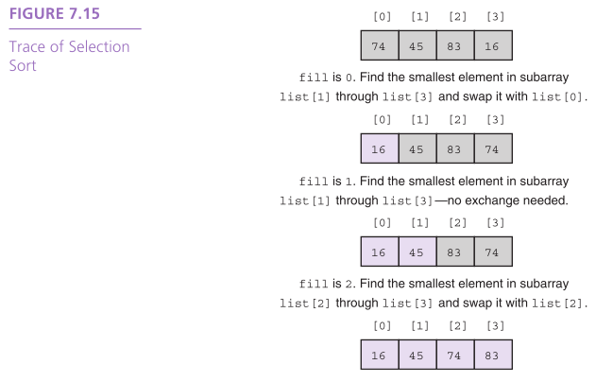

Slide 30
Wrap Up
A data structure is a grouping of related data items in memory.
An array is a data structure used to store a collection of data items of the same type.

