Slide 1
Strings Chapter 8
Problem Solving & Program Design in C
Eighth Edition
Jeri R. Hanly & Elliot B. Koffman

Slide 2
Chapter Objectives
To understand how a string constant is stored in an array of characters
To learn about the placeholder %s and how it is used in printf and scanf operations
To learn some of the operations that can be performed on strings such as copying strings extracting substrings, and joining strings using functions from the library string

Slide 3
String Basics
A blank in a string is a valid character.
null character
character ‘\0’ that marks the end of a string in C
A string in C is implemented as an array.
char string_var[30];
char str[20] = “Initial value”;
An array of strings is a 2-dimensional array of characters in which each row is a string.

Slide 4
Input/Output
printf and scanf can handle string arguments
use %s as the placeholder in the format string
char president[20];
scanf(“%s\n”, president);
printf(“%s\n”, president);

Slide 5
Initializing Strings
sizeof() gives size in bytes
strlen() gives length of string
char string[16] = “hello world”;
char *str = “hello world”;
char s[] = “hello world”;

Slide 6
Initializing Strings
sizeof() gives size in bytes
strlen() gives length of string
char string[16] = “hello world”;
char *str = “hello world”;
char s[] = “hello world”;
h | e | l | l | o |  | w | o | r | l | d | \0
0x7ffc48aef660
h | e | l | l | o |  | w | o | r | l | d | \0
h | e | l | l | o |  | w | o | r | l | d | \0

Slide 7
Initializing Strings
sizeof() gives size in bytes
strlen() gives length of string
char string[16] = “hello world”;
char *str = “hello world”;
char s[] = “hello world”;
sizeof() is 16
strlen() is 11
h | e | l | l | o |  | w | o | r | l | d | \0
sizeof() is 8
strlen() is 11
0x7ffc48aef660
h | e | l | l | o |  | w | o | r | l | d | \0
sizeof() is 12
strlen() is 11
h | e | l | l | o |  | w | o | r | l | d | \0

Slide 8
Buffer Overflow
more data is stored in an array than its declared size allows
a very dangerous condition
unlikely to be flagged as an error by either the compiler or the run-time system
char string[8] = “hello world”;
h | e | l | l | o |  | w | o | r | l | d | \0

Slide 9
String Assignment
strcpy
copies string in second argument into its first argument
strcpy(s1, “hello”);
subject to buffer overflow
strncpy
takes an argument specifying the number of chars to copy
if the string to be copies is shorter, the remaining characters stored are null
strncpy(s2, “inevitable”, 5);
= does not work!

Slide 10
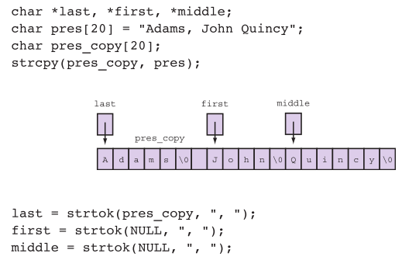
String tokenization

Slide 11
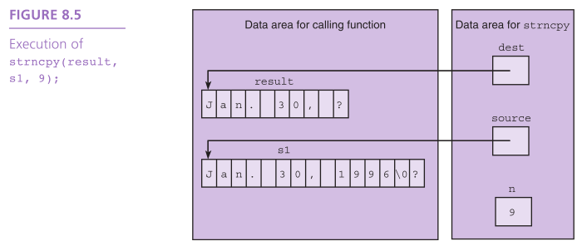
Substrings

Slide 12
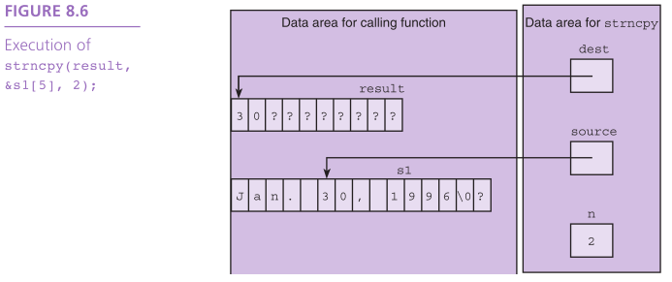
Substrings

Slide 13
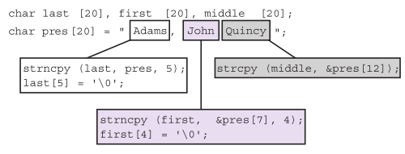
Substrings

Slide 14
Substrings
J | o | h | n | \0 | ? | ? | ? | ? | ? | ? | ? | ? | ? | ? | ? | ? | ? | ? | ?

Slide 15
String Terminology
string length
in a character array, the number of characters before the first null character
empty string
a string of length zero
the first character of the string is the null character
J | o | h | n | ? | ? | ? | ? | ? | ? | ? | ? | ? | ? | ? | ? | ? | ? | ? | ?

Slide 16
Scanning a Full Line
For interactive input of one complete line of data, use the fgets function from stdio.
Arguments: destination string, max characters to read, input
Output: destination string or NULL if nothing read
The \n character is stored if space.
fgets(<dest_string>, <num_chars>, <input>)

Slide 17



Scanning a Full Line with gets
subject to buffer overflow – we use fgets

Slide 18
String Comparison
a
b | l | u | e | \0
b
b | l | a | c | k | \0
c
b | l | u | e | \0 | ? | ? | ? | ? | ?
d
b | l | u | e | \0 | ? | ? | ? | ? | ? | ? | ? | ? | ? | ? | ? | ? | ? | ? | ?

Slide 19
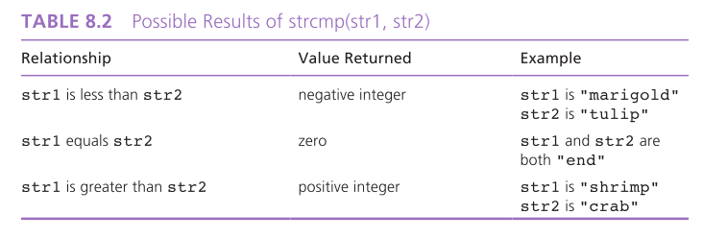
String Comparison

Slide 20
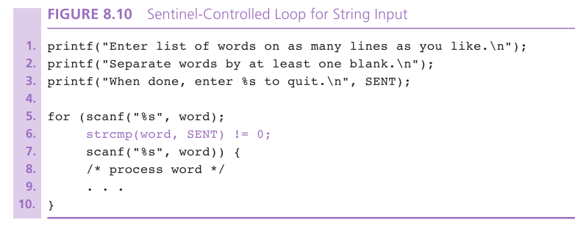

Slide 21
Arrays of Pointers
When sorting a list of strings, there is a lot of copying of characters from one memory cell to another.
3 operations for every exchange
C represents every array by its starting address.
Consider an array of pointers, each element the address of a character string.

Slide 22
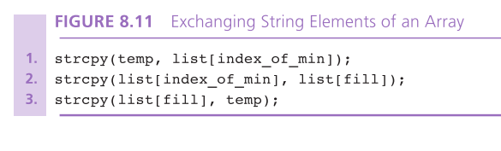

Slide 23
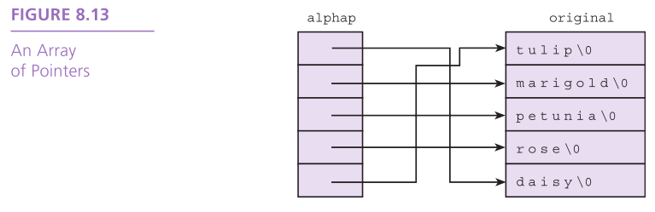

Slide 24

Concatenation
strcat
appends source to the end of dest
assumes that sufficient space is allocated for the first argument to allow addition of the extra characters
s1 = “hello”;
strcat(s1, “and more”);

Slide 25

Concatenation
strncat
appends up to n characters of source to the end of dest, adding the null character if necessary
assumes that sufficient space is allocated for the first argument to allow addition of the extra characters
s1 = “hello”;
strncat(s1, “and more”, 5);

Slide 26
Concatenation
char k1[15] = “John “,
k2[15] = “Jacqueline “,
last[15] = “Kennedy”;
strcat(k1,last);
strcat(k2,last);
e421
e412
e403

Slide 27
Concatenation
char k1[15] = “John “,
k2[15] = “Jacqueline “,
last[15] = “Kennedy”;
strcat(k1,last);
strcat(k2,last);
e421
J
o
h
n
0
e412
J
a
c
q
u
e
l
i
n
e
0
e403
K
e
n
n
e
d
y
0

Slide 28
Concatenation
char k1[15] = “John “,
k2[15] = “Jacqueline “,
last[15] = “Kennedy”;
strcat(k1,last);
strcat(k2,last);
e421
J
o
h
n
K
e
n
n
e
d
y
0
e412
J
a
c
q
u
e
l
i
n
e
0
e403
K
e
n
n
e
d
y
0

Slide 29
Concatenation
char k1[15] = “John “,
k2[15] = “Jacqueline “,
last[15] = “Kennedy”;
strcat(k1,last);
strcat(k2,last);
e421
e
d
y
0
K
e
n
n
e
d
y
0
overflow!
e412
J
a
c
q
u
e
l
i
n
e
K
e
n
n
e403
K
e
n
n
e
d
y
0

Slide 30
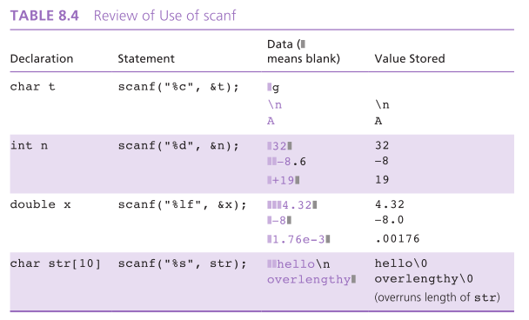
String-to-Number and Number-to-String Conversions

Slide 31
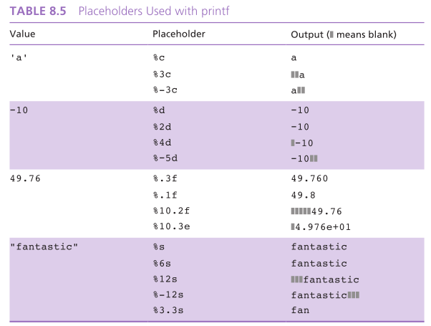
String-to-Number and Number-to-String Conversions

Slide 32
String-to-Number and Number-to-String Conversions
number to string: sprintf
string to number: sscanf
char s[20];
int mon = 8, day = 23, year = 1914;
sprintf(s, “%d/%d/%d”, mon, day, year);
int num;
double val;
char word[10];
sscanf(“85 96.2 hello”, “%d%lf%s”, &num, &val, word);

Slide 33
Things to remember
Strings are just arrays of characters
The string.h library provides functions for working with strings
String variables are character pointers

