Slide 1
Recursion Chapter 9
Problem Solving & Program Design in C
Eighth Edition
Jeri R. Hanly & Elliot B. Koffman

Slide 2
Chapter Objectives
To understand how recursion is used as a problem solving tool
To learn how to write and trace recursive functions
To see how to implement mathematical functions with recursive definitions as C functions
To learn how to use recursion to solve problems involving arrays and string
To learn how to write a recursive sort function
To understand a recursive solution to the Towers of Hanoi Problem

Slide 3
Recursion
A recursive function is one that calls itself or that is part of a cycle in the sequence of function calls.
The ability to invoke itself enables a recursive function to be repeated with different parameter values.

Slide 4
Recursion
It can be used an an alternative to looping.
Recursion is typically used to specify a natural, simple solution that would otherwise be very difficult to solve.

Slide 5
The Nature of Recursion
One or more simple cases of the problem have a straightforward, nonrecursive solution.
The other cases can be redefined in terms of problems that are closer to the simple cases.

Slide 6
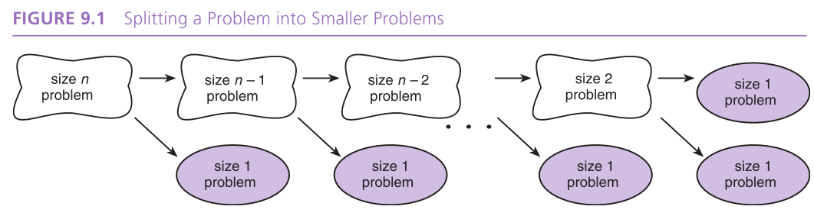

Slide 7
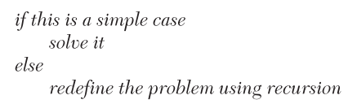
The Nature of Recursion
By applying this redefinition process every time the recursive function is called, eventually the problem is reduced entirely to simple cases, which are relatively easy to solve.

Slide 8
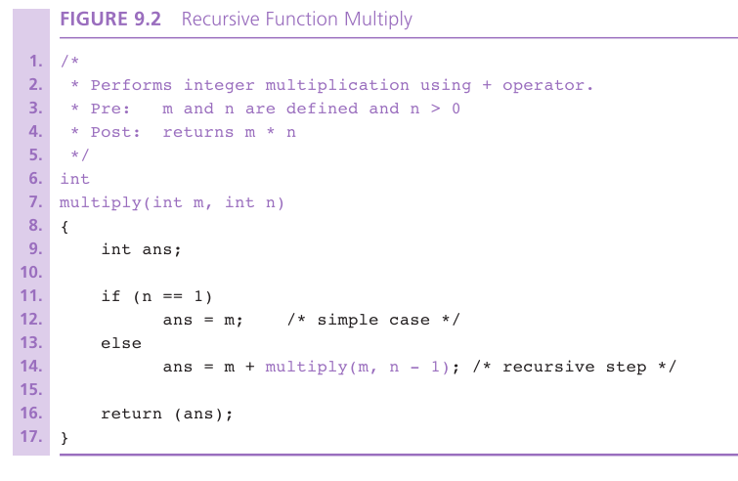

Slide 9
Example
Develop a function to count the number of times a particular character appears in a string.
count(‘s’, “Mississippi sassafrs”);

Slide 10
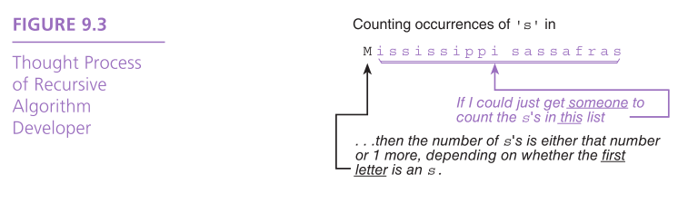

Slide 11
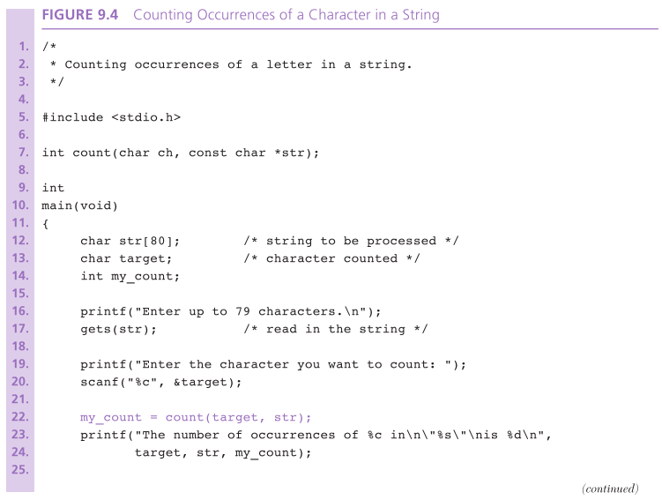

Slide 12
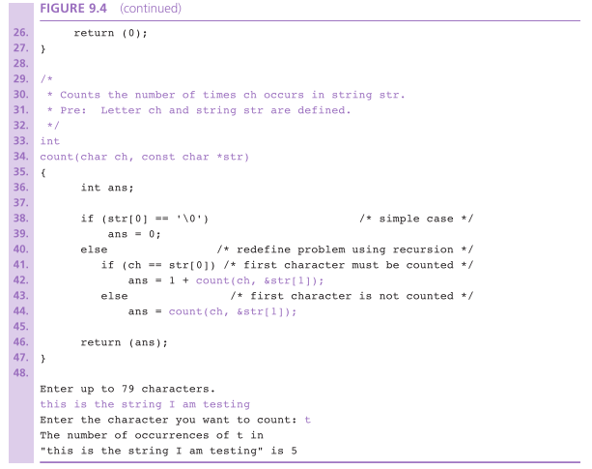

Slide 13
Tracing Recursive Functions
activation frame
representation of one call to a function
terminating condition
a condition that is true when a recursive algorithm is processing a simple case
system stack
area of memory where parameters and local variables are allocated when a function is called and deallocated when the function returns

Slide 14
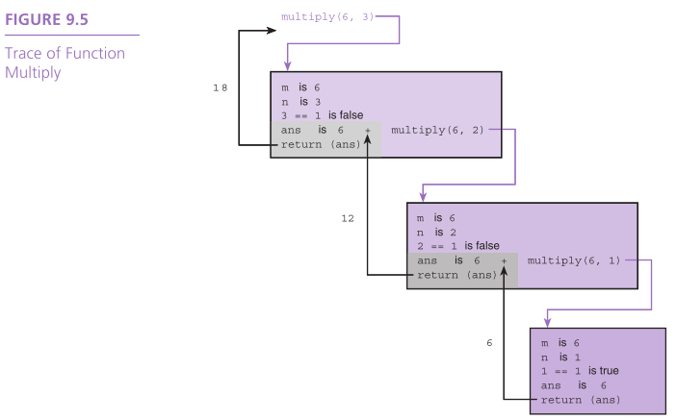

Slide 15
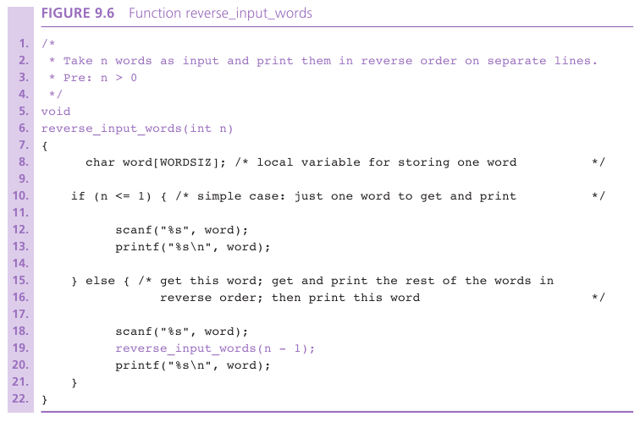

Slide 16
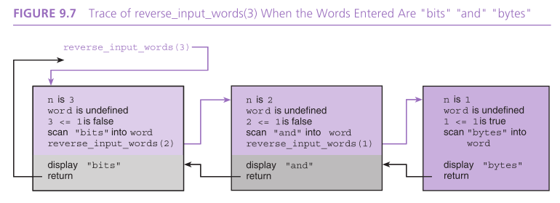

Slide 17
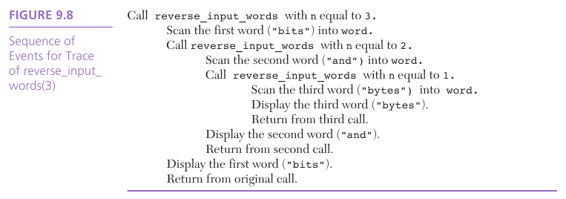

Slide 18
Parameter and Local Variable Stacks
stack
a data structure in which the last data item added is the first data item processed
C keeps track of the values of variables from different recursive function calls by using a stack data structure.

Slide 19
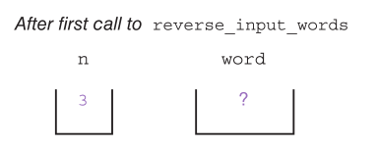
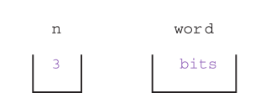

Slide 20
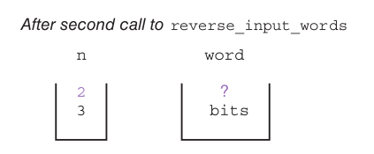
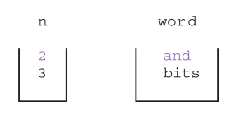

Slide 21
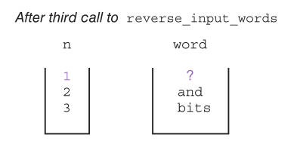
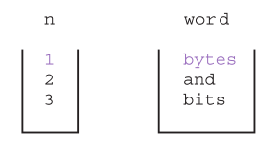

Slide 22
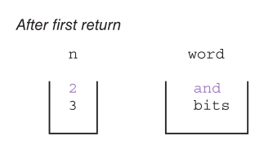
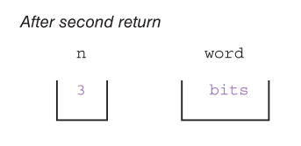

Slide 23
Implementation of Parameter Stacks in C
The compiler actually maintains a single system stack for the tasks we’ve just shown.
system stack
area or memory where parameters and local variables are allocated when a function is called and deallocated when the function returns

Slide 24
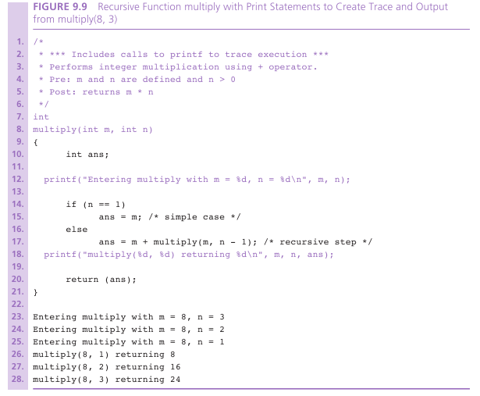

Slide 25
Mathematical Functions
recursive factorial
iterative factorial
recursive fibonacci
recursive gcd

Slide 26
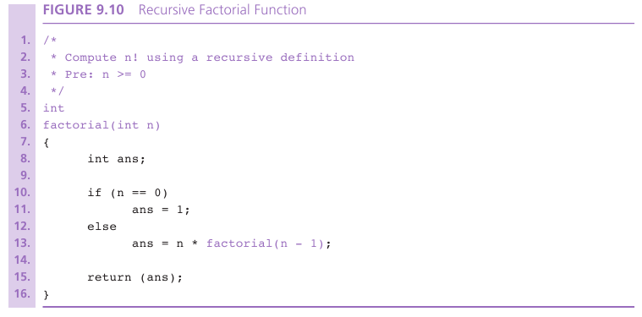

Slide 27
Factorial
0! is 1
n! is n x (n – 1)!
for n > 0
ex., 4 ! is 4 x 3!
4 x 3 x 2 x 1 is 24

Slide 28
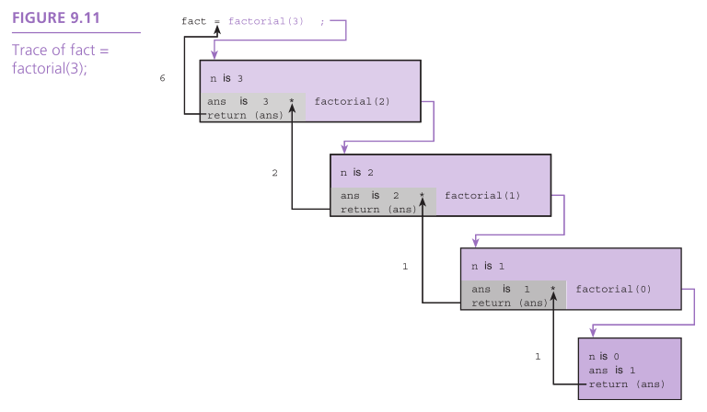

Slide 29
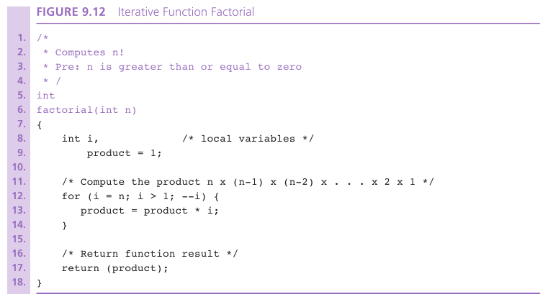

Slide 30
Fibonacci
Sequence is 1, 1, 2, 3, 5, 8, 13, 21, 34, ...
Fibonacci₁ is 1
Fibonacci₂ is 1
Fibonacci_{n} is Fibonacci_{n-2} + Fibonacci_{n-1} for n > 2

Slide 31
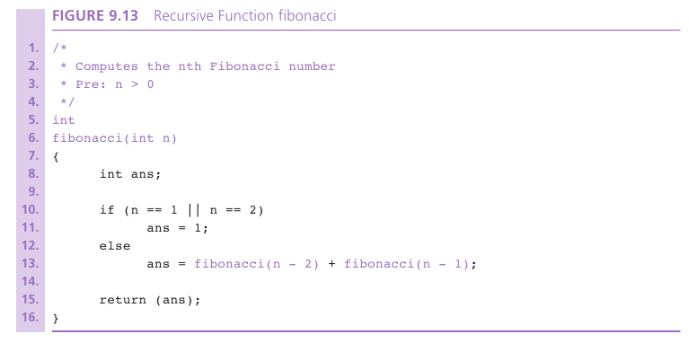

Slide 32
GCD
greatest common divisor of two integers is the largest integer that divides them both evenly
gcd(m,n) is n if n divides m evenly
gcd(m,n) is gcd(n, remainder of m divided by n) otherwise

Slide 33
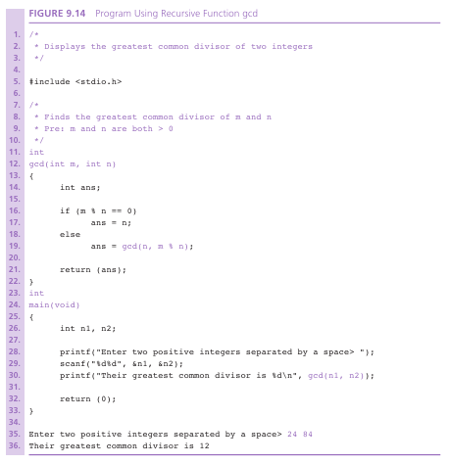

Slide 34
Finding Capital Letters in a String
Case Study

Slide 35
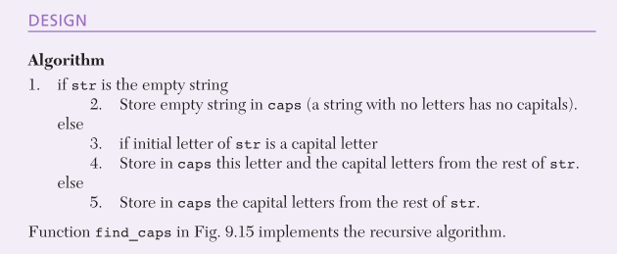

Slide 36
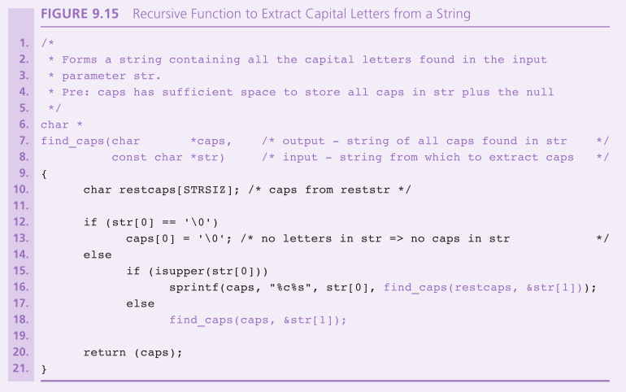

Slide 37
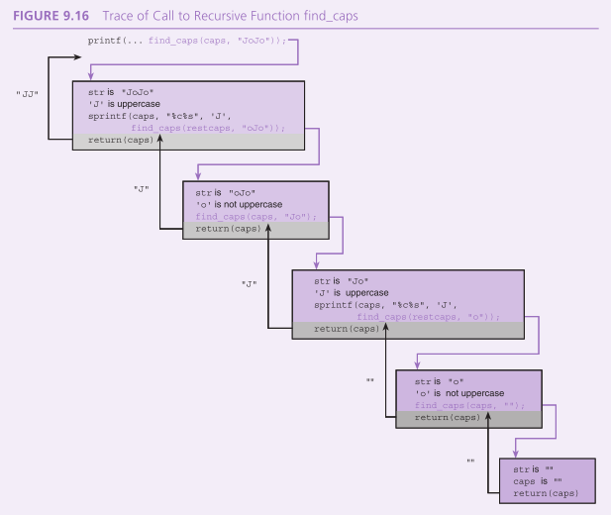

Slide 38
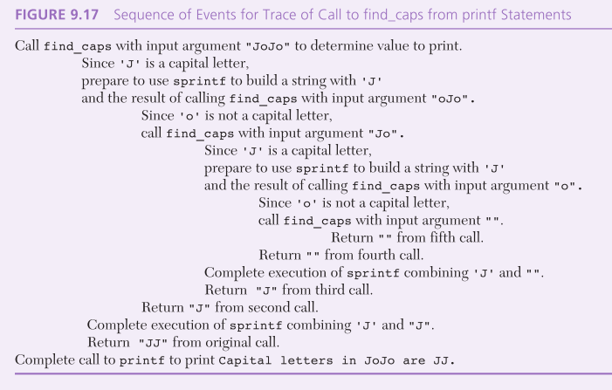

Slide 39
Recursive Selection Sort
Case Study

Slide 40
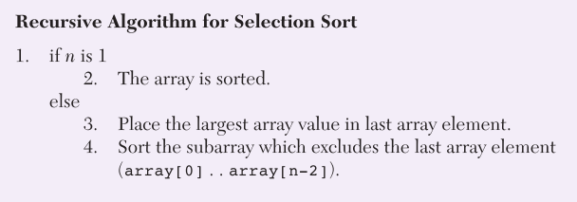
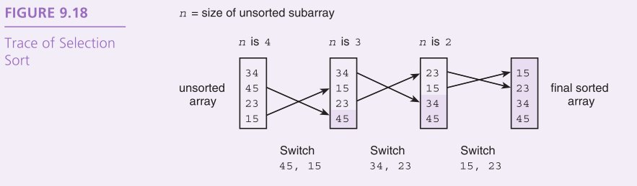

Slide 41
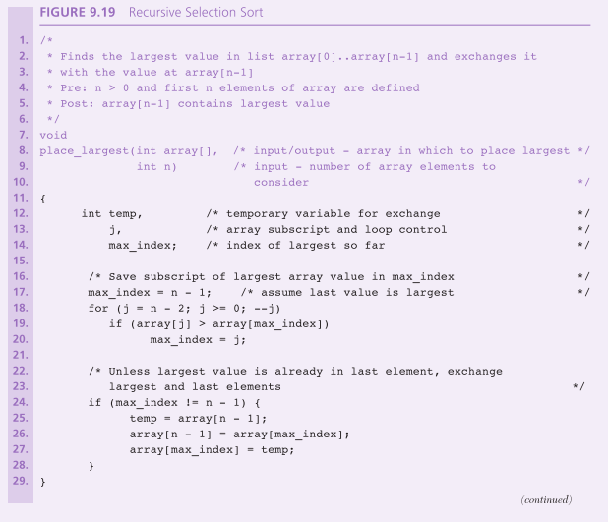

Slide 42
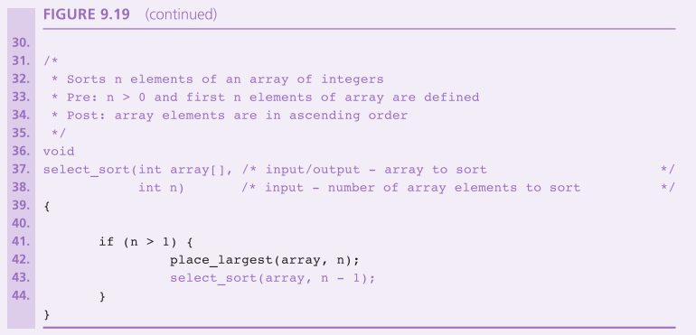

Slide 43
Operations on Sets
Case Study

Slide 44
Problem
Develop a group of functions to perform the
∈ (is an element of),
⊆ (is a subset of), and
∪ (union) operations
on sets of characters.
Also develop functions to
check that a certain set is valid (no duplicate characters)
check for the empty set
print a set in standard set notation

Slide 45
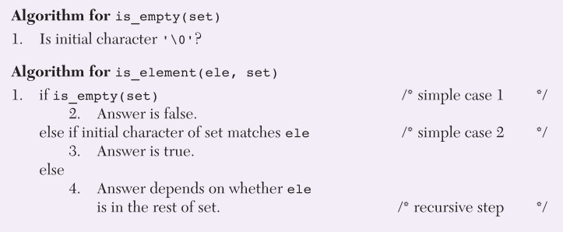

Slide 46
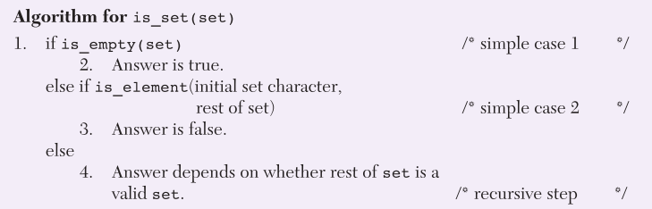

Slide 47
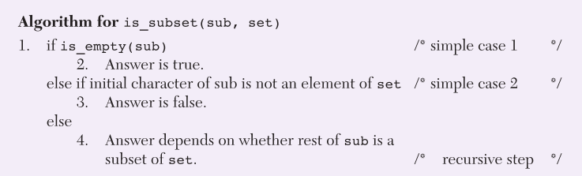

Slide 48
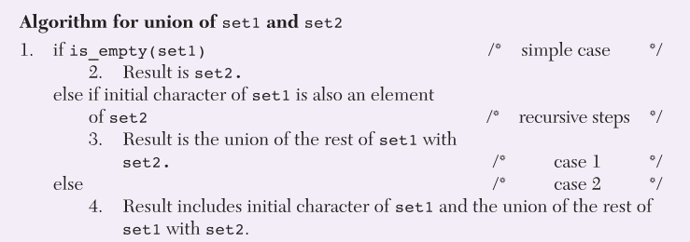

Slide 49
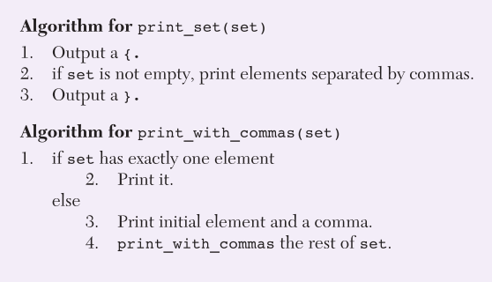

Slide 50
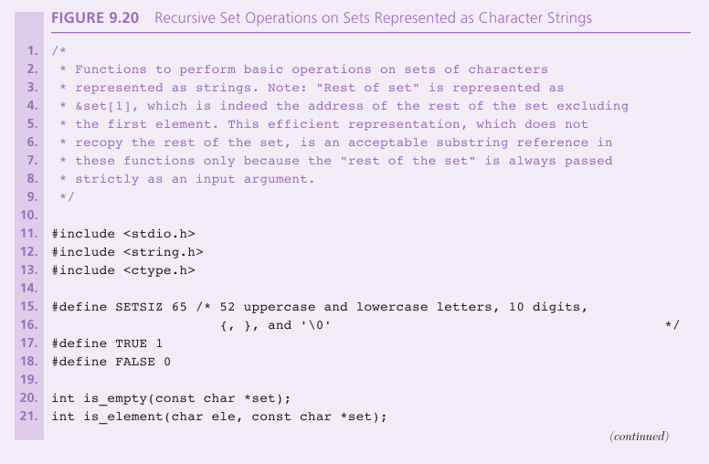

Slide 51
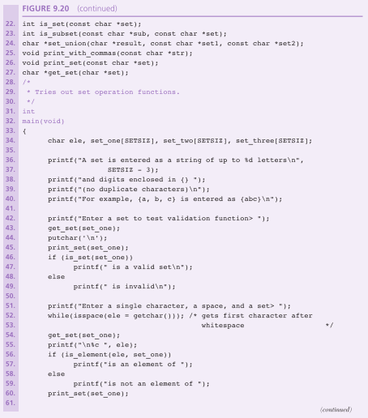

Slide 52
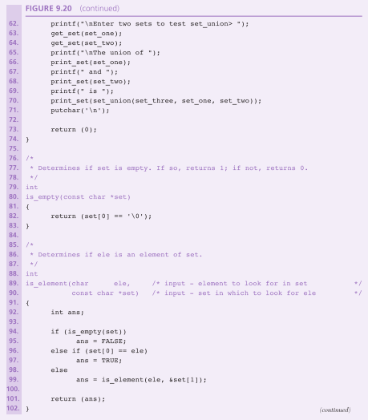

Slide 53
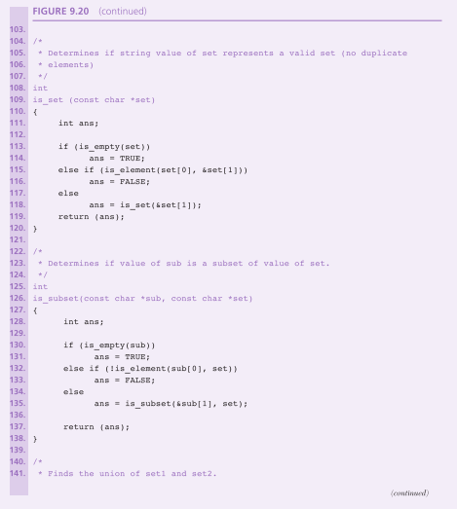

Slide 54
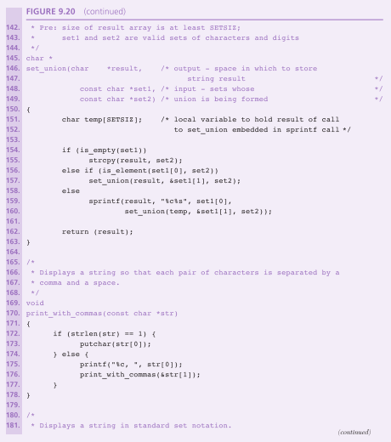

Slide 55
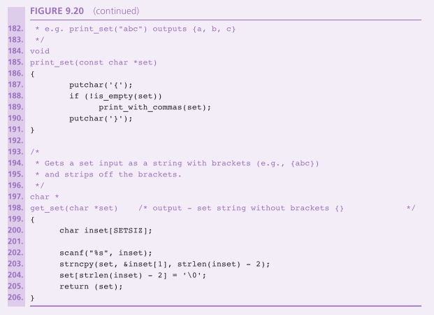

Slide 56
Towers of Hanoi
Classic Case Study in Recursion

Slide 57
Problem
Move n disks from Peg A to peg C using peg B as needed.
The following conditions apply:
Only one disk at a time may be moved, and this disk must be the top disk on a peg.
A larger disk can never be placed on top of a smaller disk.

Slide 58
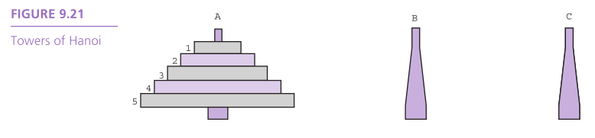
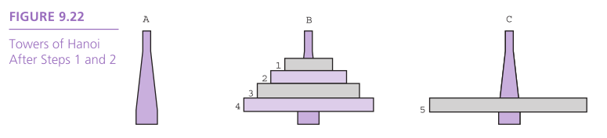
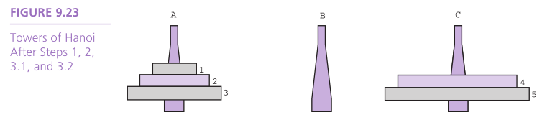

Slide 59
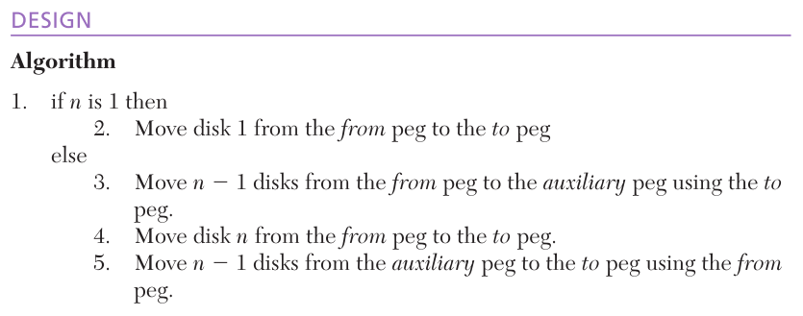

Slide 60
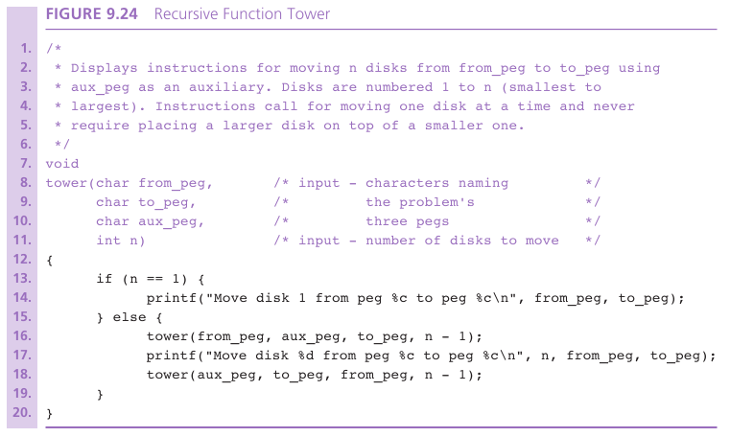

Slide 61
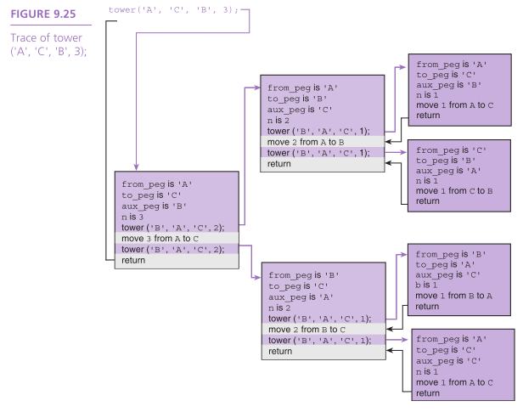

Slide 62
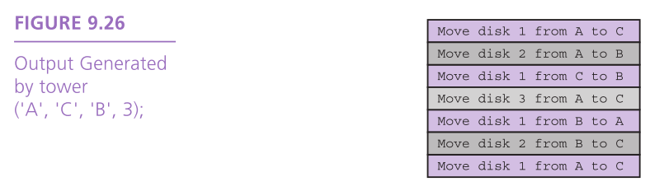

Slide 63
Wrap Up
A recursive function either calls itself or initiates a sequence of function calls in which it may be called again.
Designing a recursive solution involves identifying simple cases with straightforward solutions, then redefining more complex cases in terms of problems that are closer to simple cases.

Slide 64
Wrap Up
Recursive functions depend on the fact that or each call to a function, space is allocated on the stack for the unction’s parameters and local variables.

