Slide 1
CSCI 112 Final review

Slide 2
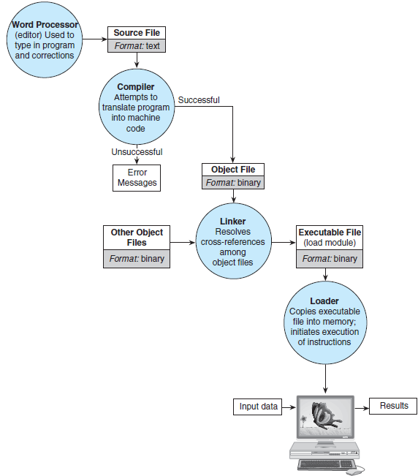

Slide 4
Creating an executable
gcc –o exe myprogram.c –Wall
Makefile
lab7: lab7.o funcs.o
gcc lab7.o funcs.o -o lab7
lab7.o: lab7.c lab7.h
gcc -c lab7.c -Wall
funcs.o: funcs.c lab7.h
gcc -c funcs.c -Wall

Slide 6
What happens when we run our executable file?
int main(void) {
int* nump;
nump = malloc(sizeof(int));
*nump = 10;
free(nump);
}
Stack memory
main
int* nump:
int: 10
Heap memory

Slide 7
Reading in data
Method of input | What C program looks like | How to run executable
Redirection | scanf(“%d”, &myint); scanf(“%s”, myword); | ./exe < input.txt
Open file in C | FILE* myfile; myfile = fopen(“input.txt”, “w”) fscanf(myfile, “%d”,&myint); fgets(line, 100 myfile); | ./exe
Command line argument | int main(int argc, char* argv[]) { int num_args = argc – 1; char* first_arg = argv[1]; | ./exe FirstArg SecondArg

Slide 8
Passing by value vs. passing by reference
Arrays and strings are always passed by reference
Ints, chars, doubles, pointers are passed by value, but you can pass in pointers to them to pass by value
Let’s look at values_vs_reference.c

