Slide 1
Strings Chapter 8
Problem Solving & Program Design in C
Eighth Edition
Jeri R. Hanly & Elliot B. Koffman

Slide 2
Chapter Objectives
To understand how a string constant is stored in an array of characters
To learn about the placeholder %s and how it is used in printf and scanf operations
To learn some of the operations that can be performed on strings such as copying strings extracting substrings, and joining strings using functions from the library string

Slide 3
String Basics
null character
character ‘\0’ that marks the end of a string in C
A string in C is implemented as an array.
char string_var[30];
char str[20] = “Initial value”;
An array of strings is a 2-dimensional array of characters in which each row is a string.
String library string.h

Slide 4
Input/Output
printf and scanf can handle string arguments
use %s as the placeholder in the format string
char president[20];
scanf(“%s\n”, president);
printf(“%s\n”, president);

Slide 5
Initializing Strings
sizeof() gives size in bytes
strlen() gives length of string
char string[16] = “hello world”;
char *str = “hello world”;
char s[] = “hello world”;

Slide 6
Initializing Strings
sizeof() gives size in bytes
strlen() gives length of string
char string[16] = “hello world”;
char *str = “hello world”;
char s[] = “hello world”;
h | e | l | l | o |  | w | o | r | l | d | \0
0x7ffc48aef660
h | e | l | l | o |  | w | o | r | l | d | \0
h | e | l | l | o |  | w | o | r | l | d | \0

Slide 7
Initializing Strings
sizeof() gives size in bytes
strlen() gives length of string
char string[16] = “hello world”;
char *str = “hello world”;
char s[] = “hello world”;
sizeof() is 16
strlen() is 11
h | e | l | l | o |  | w | o | r | l | d | \0
sizeof() is 8
strlen() is 11
0x7ffc48aef660
h | e | l | l | o |  | w | o | r | l | d | \0
sizeof() is 12
strlen() is 11
h | e | l | l | o |  | w | o | r | l | d | \0

Slide 8
String Terminology
string length
in a character array, the number of characters before the first null character
empty string
a string of length zero
the first character of the string is the null character
J | o | h | n | ? | ? | ? | ? | ? | ? | ? | ? | ? | ? | ? | ? | ? | ? | ? | ?

Slide 9
Scanning a Full Line
For interactive input of one complete line of data, use the fgets function from stdio.
Arguments: destination string, max characters to read, input
Output: destination string or NULL if nothing read
The \n character is stored if space.
fgets(<dest_string>, <num_chars>, <input>)

Slide 10
Strings Review 10/11
In C, strings are…

Slide 11
Strings Review 10/11
In C, strings are…
To store an array of strings, we need a…

Slide 12
Strings Review 10/11
In C, strings are…
To store an array of strings, we need a…
All strings must end with the…

Slide 13
Strings Review 10/11
In C, strings are…
To store an array of strings, we need a…
All strings must end with the…
We can read in a full line (including spaces) as a string using the function…

Slide 14
String Assignment
strcpy
copies string in second argument into its first argument
strcpy(s1, “hello”);
subject to buffer overflow
strncpy
takes an argument specifying the number of chars to copy
if the string to be copies is shorter, the remaining characters stored are null
strncpy(s2, “inevitable”, 5);
= does not work!

Slide 15
String Comparison
a
b | l | u | e | \0
b
b | l | a | c | k | \0
c
b | l | u | e | \0 | ? | ? | ? | ? | ?
d
b | l | u | e | \0 | ? | ? | ? | ? | ? | ? | ? | ? | ? | ? | ? | ? | ? | ? | ?

Slide 16
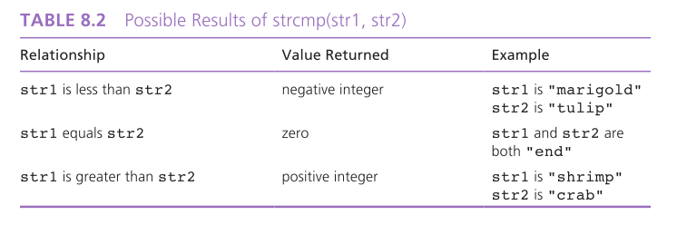
String Comparison

Slide 17
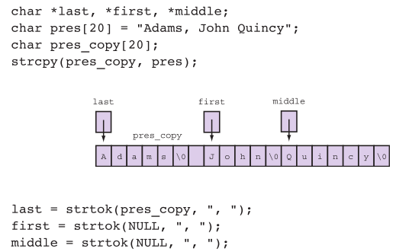
String tokenization

Slide 18
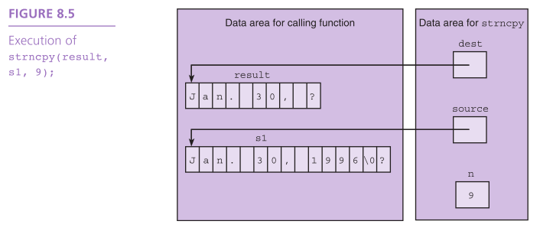
Substrings

Slide 19
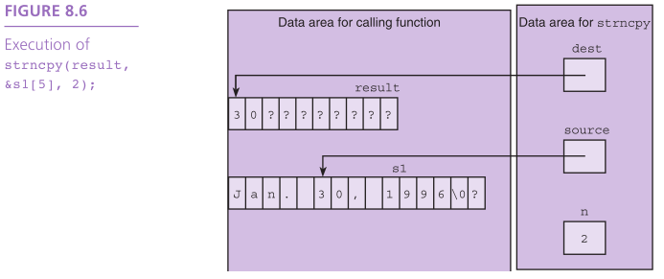
Substrings

Slide 20
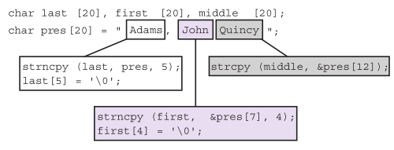
Substrings

Slide 21
Substrings
J | o | h | n | \0 | ? | ? | ? | ? | ? | ? | ? | ? | ? | ? | ? | ? | ? | ? | ?

Slide 22
Buffer Overflow
more data is stored in an array than its declared size allows
a very dangerous condition
unlikely to be flagged as an error by either the compiler or the run-time system
char string[8] = “hello world”;
h | e | l | l | o |  | w | o | r | l | d | \0

Slide 23

Concatenation
strcat
appends source to the end of dest
assumes that sufficient space is allocated for the first argument to allow addition of the extra characters
s1 = “hello”;
strcat(s1, “and more”);

Slide 24

Concatenation
strncat
appends up to n characters of source to the end of dest, adding the null character if necessary
assumes that sufficient space is allocated for the first argument to allow addition of the extra characters
s1 = “hello”;
strncat(s1, “and more”, 5);

Slide 25
Concatenation
char k1[15] = “John “,
k2[15] = “Jacqueline “,
last[15] = “Kennedy”;
strcat(k1,last);
strcat(k2,last);
0xe421
0xe412
0xe403

Slide 26
Concatenation
char k1[15] = “John “,
k2[15] = “Jacqueline “,
last[15] = “Kennedy”;
strcat(k1,last);
strcat(k2,last);
0xe421
J
o
h
n
0
0xe412
J
a
c
q
u
e
l
i
n
e
0
0xe403
K
e
n
n
e
d
y
0

Slide 27
Concatenation
char k1[15] = “John “,
k2[15] = “Jacqueline “,
last[15] = “Kennedy”;
strcat(k1,last);
strcat(k2,last);
0xe421
J
o
h
n
K
e
n
n
e
d
y
0
0xe412
J
a
c
q
u
e
l
i
n
e
0
0xe403
K
e
n
n
e
d
y
0

Slide 28
Concatenation
char k1[15] = “John “,
k2[15] = “Jacqueline “,
last[15] = “Kennedy”;
strcat(k1,last);
strcat(k2,last);
0xe421
e
d
y
0
K
e
n
n
e
d
y
0
overflow!
0xe412
J
a
c
q
u
e
l
i
n
e
K
e
n
n
0xe403
K
e
n
n
e
d
y
0

Slide 29
Arrays of Pointers
When sorting a list of strings, there is a lot of copying of characters from one memory cell to another.
3 operations for every exchange
C represents every array by its starting address.
Consider an array of pointers, each element the address of a character string.

Slide 30
flowers
t | u | l | i | p | \0 | ? | ? | ? | ?
m | a | r | i | g | o | l | d | \0 | ?
p | e | t | u | n | i | a | \0 | ? | ?
r | o | s | e | \0 | ? | ? | ? | ? | ?
d | a | i | s | y | \0 | ? | ? | ? | ?

Slide 31
flowers
t | u | l | i | p | \0 | ? | ? | ? | ?
m | a | r | i | g | o | l | d | \0 | ?
p | e | t | u | n | i | a | \0 | ? | ?
r | o | s | e | \0 | ? | ? | ? | ? | ?
d | a | i | s | y | \0 | ? | ? | ? | ?

Slide 32
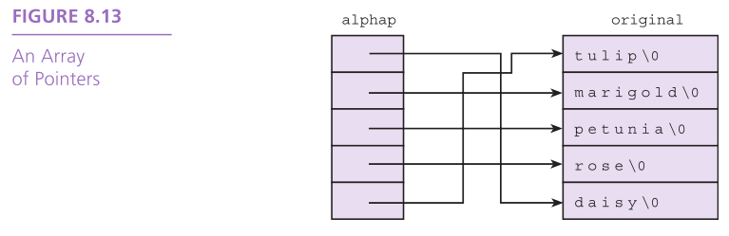

Slide 33
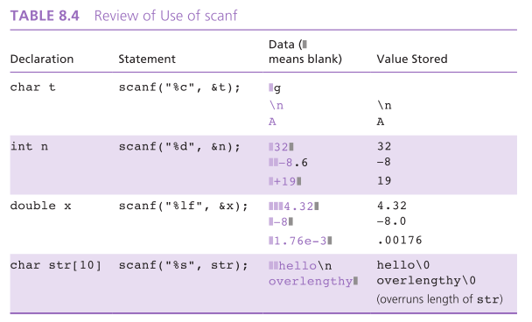
String-to-Number and Number-to-String Conversions

Slide 34
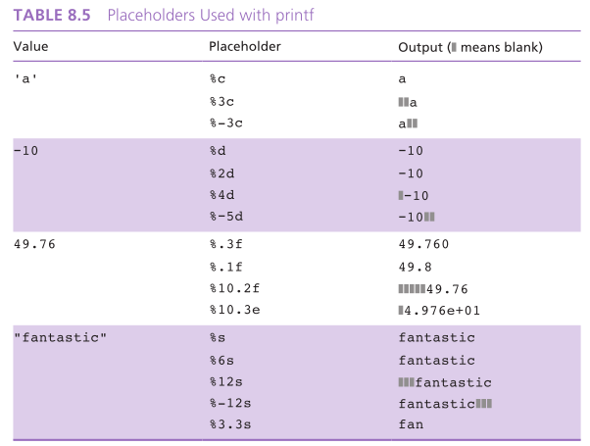
String-to-Number and Number-to-String Conversions

Slide 35
String-to-Number and Number-to-String Conversions
number to string: sprintf
string to number: sscanf
char s[20];
int mon = 8, day = 23, year = 1914;
sprintf(s, “%d/%d/%d”, mon, day, year);
int num;
double val;
char word[10];
sscanf(“85 96.2 hello”, “%d%lf%s”, &num, &val, word);

Slide 36
Things to remember
Strings are just arrays of characters
The string.h library provides functions for working with strings
String variables are character pointers

