Slide 1
Pointers and Dynamic Data Structures Chapter 13
Problem Solving & Program Design in C
Eighth Edition
Jeri R. Hanly & Elliot B. Koffman

Slide 2
Chapter Objectives
To understand dynamic allocation on the heap
To learn how to use pointers to access structs
To learn how to use pointers to build linked data structures
To understand how to use and implement a linked list

Slide 3
Previous uses of pointers…
Reference to data
Output parameters
Arrays and strings
File pointers

Slide 4
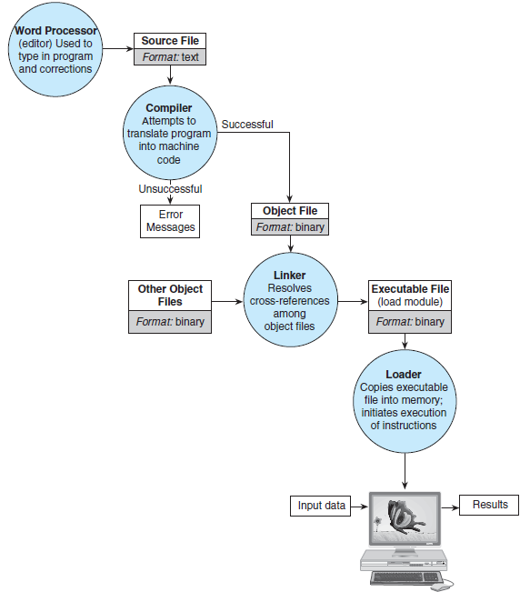

Slide 5
What happens when we run our executable file?
func1(int x) {
x += 1;
return(x);
}
int main(void) {
int n = 10;
n = func1(n);
return(0);
}
Stack memory

Slide 6
What happens when we run our executable file?
func1(int x) {
x += 1;
return(x);
}
int main(void) {
int n = 10;
n = func1(n);
return(0);
}
Stack memory
main
int n: 10

Slide 7
What happens when we run our executable file?
func1(int x) {
x += 1;
return(x);
}
int main(void) {
int n = 10;
n = func1(n);
return(0);
}
Stack memory
main
int n: 10
func1
int x: 10

Slide 8
What happens when we run our executable file?
func1(int x) {
x += 1;
return(x);
}
int main(void) {
int n = 10;
n = func1(n);
return(0);
}
Stack memory
main
int n: 10
func1
int x: 11

Slide 9
What happens when we run our executable file?
func1(int x) {
x += 1;
return(x);
}
int main(void) {
int n = 10;
n = func1(n);
return(0);
}
Stack memory
main
int n: 11

Slide 10
What happens when we run our executable file?
func1(int x) {
x += 1;
return(x);
}
int main(void) {
int n = 10;
n = func1(n);
return(0);
}
Stack memory

Slide 11
What happens when we run our executable file?
Stack memory

Slide 12
What happens when we run our executable file?
int main(void) {
int* nump;
nump = malloc(sizeof(int));
*nump = 10;
free(nump);
}
Stack memory
Heap memory

Slide 13
What happens when we run our executable file?
int main(void) {
int* nump;
nump = malloc(sizeof(int));
*nump = 10;
free(nump);
}
Stack memory
main
int* nump: ??
Heap memory

Slide 14
What happens when we run our executable file?
int main(void) {
int* nump;
nump = malloc(sizeof(int));
*nump = 10;
free(nump);
}
Stack memory
main
int* nump:
int: ??
Heap memory

Slide 15
What happens when we run our executable file?
int main(void) {
int* nump;
nump = malloc(sizeof(int));
*nump = 10;
free(nump);
}
Stack memory
main
int* nump:
int: 10
Heap memory

Slide 16
What happens when we run our executable file?
int main(void) {
int* nump;
nump = malloc(sizeof(int));
*nump = 10;
free(nump);
}
Stack memory
main
int* nump:
Heap memory

Slide 17
What happens when we run our executable file?
int main(void) {
int* nump;
nump = malloc(sizeof(int));
*nump = 10;
free(nump);
}
Stack memory
Heap memory

Slide 18
What happens when we run our executable file?
int main(void) {
int* nump;
nump = malloc(sizeof(int));
*nump = 10;
free(nump);
*nump++;
}
Stack memory
main
int* nump:
Heap memory

Slide 19
What happens when we run our executable file?
int main(void) {
int* nump;
nump = malloc(sizeof(int));
*nump = 10;
free(nump);
*nump++;
}
Stack memory
main
int* nump:
undefined behavior!
Heap memory

Slide 20
Dynamic Memory Allocation
heap
region of memory in which function malloc dynamically allocates blocks of storage
stack
region of memory in which function data areas are allocated and reclaimed

Slide 21
Important functions
malloc(<amnt of memory to reserve>)
calloc(<num>, <amnt of memory to reserve>)
free(pointer)
These are all from stdlib.h.

Slide 22
What happens when we run our executable file?
int main(void) {
int* nump;
nump = malloc(sizeof(int));
*nump = 10;
char* string1;
string1 = calloc(10, sizeof(char));
strcpy(string1, “hello”);
free(nump);
}
Stack memory
Heap memory

Slide 23
What happens when we run our executable file?
int main(void) {
int* nump;
nump = malloc(sizeof(int));
*nump = 10;
char* string1;
string1 = calloc(10, sizeof(char));
strcpy(string1, “hello”);
free(nump);
}
Stack memory
Heap memory

Slide 24
What happens when we run our executable file?
int main(void) {
int* nump;
nump = malloc(sizeof(int));
*nump = 10;
char* string1;
string1 = calloc(10, sizeof(char));
strcpy(string1, “hello”);
free(nump);
}
Stack memory
main
Heap memory

Slide 25
What happens when we run our executable file?
int main(void) {
int* nump;
nump = malloc(sizeof(int));
*nump = 10;
char* string1;
string1 = calloc(10, sizeof(char));
strcpy(string1, “hello”);
free(nump);
}
Stack memory
main
int* nump: ??
Heap memory

Slide 26
What happens when we run our executable file?
int main(void) {
int* nump;
nump = malloc(sizeof(int));
*nump = 10;
char* string1;
string1 = calloc(10, sizeof(char));
strcpy(string1, “hello”);
free(nump);
}
Stack memory
main
int* nump:
int: ??
Heap memory

Slide 27
What happens when we run our executable file?
int main(void) {
int* nump;
nump = malloc(sizeof(int));
*nump = 10;
char* string1;
string1 = calloc(10, sizeof(char));
strcpy(string1, “hello”);
free(nump);
}
Stack memory
main
int* nump:
int: 10
Heap memory

Slide 28
What happens when we run our executable file?
int main(void) {
int* nump;
nump = malloc(sizeof(int));
*nump = 10;
char* string1;
string1 = calloc(10, sizeof(char));
strcpy(string1, “hello”);
free(nump);
}
Stack memory
main
int* nump:
char* s1: ??
int: 10
Heap memory

Slide 29
What happens when we run our executable file?
int main(void) {
int* nump;
nump = malloc(sizeof(int));
*nump = 10;
char* string1;
string1 = calloc(10, sizeof(char));
strcpy(string1, “hello”);
free(nump);
}
Stack memory
main
int* nump:
char* s1:
int: 10
? | ? | ? | ? | ? | ? | ? | ? | ? | ?
Heap memory

Slide 30
What happens when we run our executable file?
int main(void) {
int* nump;
nump = malloc(sizeof(int));
*nump = 10;
char* string1;
string1 = calloc(10, sizeof(char));
strcpy(string1, “hello”);
free(nump);
}
Stack memory
main
int* nump:
char* s1:
int: 10
? | ? | ? | ? | ? | ? | ? | ? | ? | ?
Heap memory

Slide 31
What happens when we run our executable file?
int main(void) {
int* nump;
nump = malloc(sizeof(int));
*nump = 10;
char* string1;
string1 = calloc(10, sizeof(char));
strcpy(string1, “hello”);
free(nump);
}
Stack memory
main
int* nump:
char* s1:
int: 10
h | e | l | l | o | /0 | ? | ? | ? | ?
Heap memory

Slide 32
What happens when we run our executable file?
int main(void) {
int* nump;
nump = malloc(sizeof(int));
*nump = 10;
char* string1;
string1 = calloc(10, sizeof(char));
strcpy(string1, “hello”);
free(nump);
}
Stack memory
h | e | l | l | o | /0 | ? | ? | ? | ?
Heap memory

Slide 33
What happens when we run our executable file?
int main(void) {
int* nump;
nump = malloc(sizeof(int));
*nump = 10;
char* string1;
string1 = calloc(10, sizeof(char));
strcpy(string1, “hello”);
free(nump);
}
Stack memory
😥
h | e | l | l | o | /0 | ? | ? | ? | ?
Heap memory

Slide 34
Memory leaks
When not all heap memory is freed before the end of a program
If time, we’ll see a program (valgrind) that can check for memory leaks
(in reality, for a short-running program, not freeing our memory would be okay…but we want to be in the habit of freeing memory!)

Slide 35
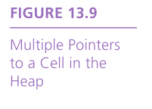
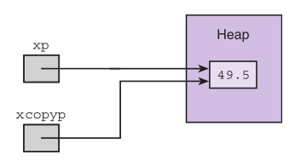
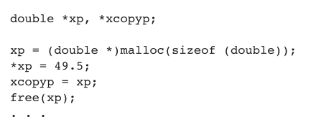

Slide 36
Linked Lists
linked list
a sequence of nodes in which each node but the last contains the address of the next node
empty list
a list of no nodes
represented in C by the pointer NULL, whose value is zero
list head
the first element in a linked list

Slide 37
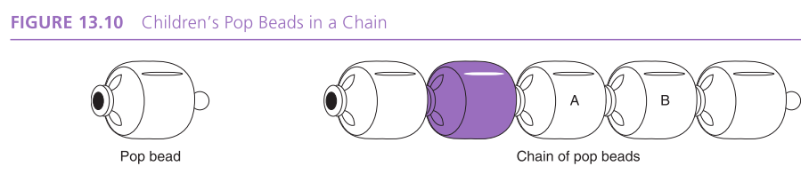
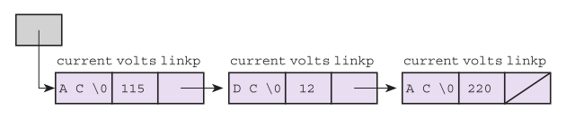

Slide 38
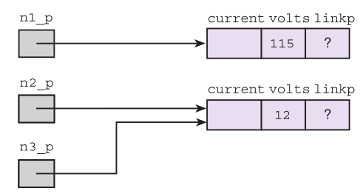
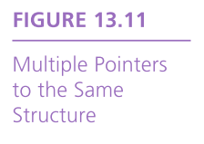
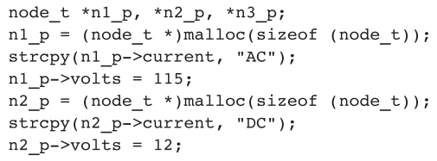


Slide 39
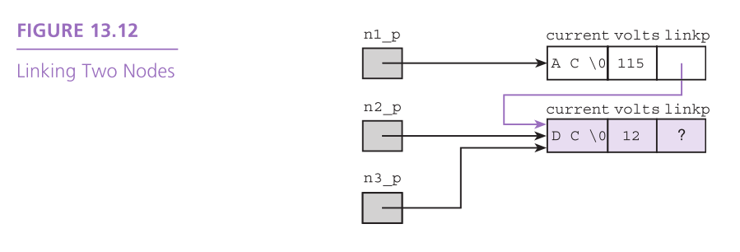

Slide 40
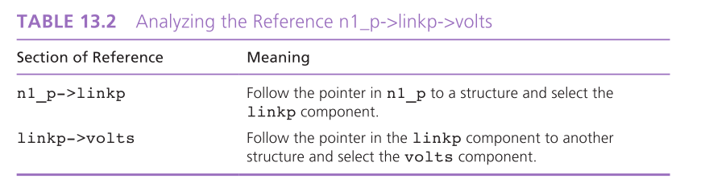

Slide 41
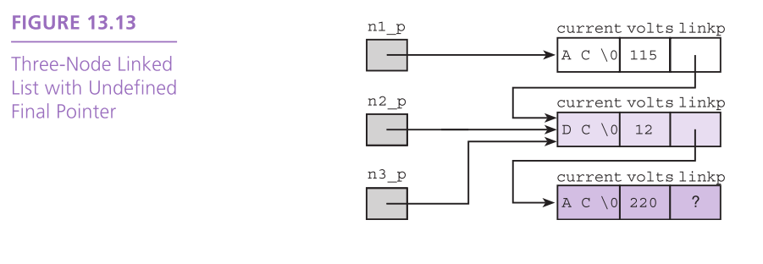

Slide 42
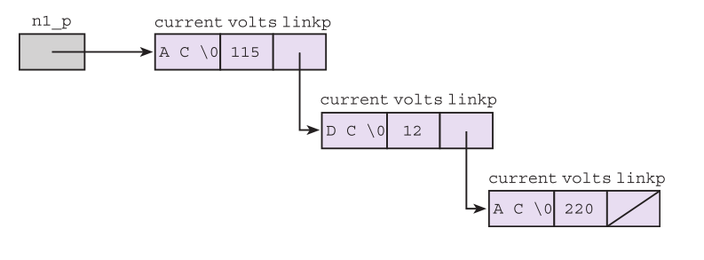
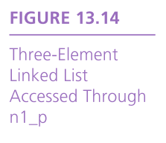

Slide 43
digit* create_new_digit(int d) {
digit* new = malloc(sizeof(digit));
new->d = d;
new->next = NULL;
return(new);
}
int main(void) {
digit* head;
head = create_new_digit(1);
head->next =
create_new_digit(2);
head->next->next =
create_new_digit(3);
}
Stack memory
Heap memory

Slide 44
digit* create_new_digit(int d) {
digit* new = malloc(sizeof(digit));
new->d = d;
new->next = NULL;
return(new);
}
int main(void) {
digit* head;
head = create_new_digit(1);
head->next =
create_new_digit(2);
head->next->next =
create_new_digit(3);
}
Stack memory
main
Heap memory

Slide 45
digit* create_new_digit(int d) {
digit* new = malloc(sizeof(digit));
new->d = d;
new->next = NULL;
return(new);
}
int main(void) {
digit* head;
head = create_new_digit(1);
head->next =
create_new_digit(2);
head->next->next =
create_new_digit(3);
}
Stack memory
main
digit* head: ??
Heap memory

Slide 46
digit* create_new_digit(int d) {
digit* new = malloc(sizeof(digit));
new->d = d;
new->next = NULL;
return(new);
}
int main(void) {
digit* head;
head = create_new_digit(1);
head->next =
create_new_digit(2);
head->next->next =
create_new_digit(3);
}
Stack memory
main
digit* head: ??
create_new_digit
int d: 1
Heap memory

Slide 47
digit* create_new_digit(int d) {
digit* new = malloc(sizeof(digit));
new->d = d;
new->next = NULL;
return(new);
}
int main(void) {
digit* head;
head = create_new_digit(1);
head->next =
create_new_digit(2);
head->next->next =
create_new_digit(3);
}
Stack memory
main
digit* head: ??
create_new_digit
int d: 1
digit* new:
?? | ??
Heap memory

Slide 48
digit* create_new_digit(int d) {
digit* new = malloc(sizeof(digit));
new->d = d;
new->next = NULL;
return(new);
}
int main(void) {
digit* head;
head = create_new_digit(1);
head->next =
create_new_digit(2);
head->next->next =
create_new_digit(3);
}
Stack memory
main
digit* head: ??
create_new_digit
int d: 1
digit* new:
1 | ??
Heap memory

Slide 49
digit* create_new_digit(int d) {
digit* new = malloc(sizeof(digit));
new->d = d;
new->next = NULL;
return(new);
}
int main(void) {
digit* head;
head = create_new_digit(1);
head->next =
create_new_digit(2);
head->next->next =
create_new_digit(3);
}
Stack memory
main
digit* head: ??
create_new_digit
int d: 1
digit* new:
1 | NULL
Heap memory

Slide 50
digit* create_new_digit(int d) {
digit* new = malloc(sizeof(digit));
new->d = d;
new->next = NULL;
return(new);
}
int main(void) {
digit* head;
head = create_new_digit(1);
head->next =
create_new_digit(2);
head->next->next =
create_new_digit(3);
}
Stack memory
main
digit* head:
1 | NULL
Heap memory

Slide 51
digit* create_new_digit(int d) {
digit* new = malloc(sizeof(digit));
new->d = d;
new->next = NULL;
return(new);
}
int main(void) {
digit* head;
head = create_new_digit(1);
head->next =
create_new_digit(2);
head->next->next =
create_new_digit(3);
}
Stack memory
main
digit* head:
create_new_digit
int d: 2
1 | NULL
Heap memory

Slide 52
digit* create_new_digit(int d) {
digit* new = malloc(sizeof(digit));
new->d = d;
new->next = NULL;
return(new);
}
int main(void) {
digit* head;
head = create_new_digit(1);
head->next =
create_new_digit(2);
head->next->next =
create_new_digit(3);
}
Stack memory
main
digit* head:
create_new_digit
int d: 2
1 | NULL
Heap memory

Slide 53
digit* create_new_digit(int d) {
digit* new = malloc(sizeof(digit));
new->d = d;
new->next = NULL;
return(new);
}
int main(void) {
digit* head;
head = create_new_digit(1);
head->next =
create_new_digit(2);
head->next->next =
create_new_digit(3);
}
Stack memory
main
digit* head:
create_new_digit
int d: 2
digit* new:
1 | NULL
?? | ??
Heap memory

Slide 54
digit* create_new_digit(int d) {
digit* new = malloc(sizeof(digit));
new->d = d;
new->next = NULL;
return(new);
}
int main(void) {
digit* head;
head = create_new_digit(1);
head->next =
create_new_digit(2);
head->next->next =
create_new_digit(3);
}
Stack memory
main
digit* head:
create_new_digit
int d: 2
digit* new:
1 | NULL
2
Heap memory

Slide 55
digit* create_new_digit(int d) {
digit* new = malloc(sizeof(digit));
new->d = d;
new->next = NULL;
return(new);
}
int main(void) {
digit* head;
head = create_new_digit(1);
head->next =
create_new_digit(2);
head->next->next =
create_new_digit(3);
}
Stack memory
main
digit* head:
create_new_digit
int d: 2
digit* new:
1 | NULL
2 | NULL
Heap memory

Slide 56
digit* create_new_digit(int d) {
digit* new = malloc(sizeof(digit));
new->d = d;
new->next = NULL;
return(new);
}
int main(void) {
digit* head;
head = create_new_digit(1);
head->next =
create_new_digit(2);
head->next->next =
create_new_digit(3);
}
Stack memory
main
digit* head:
1
2 | NULL
Heap memory

Slide 57
digit* create_new_digit(int d) {
digit* new = malloc(sizeof(digit));
new->d = d;
new->next = NULL;
return(new);
}
int main(void) {
digit* head;
head = create_new_digit(1);
head->next =
create_new_digit(2);
head->next->next =
create_new_digit(3);
}
Stack memory
main
digit* head:
1
2
3 | NULL
Heap memory

Slide 58
Inserting a node at end of list
head
1
2
3 | NULL

Slide 59
Inserting a node at end of list
head
1
2
3
4 | NULL

Slide 60
Inserting a node at end of list
head
1
2
3 | NULL

Slide 61
Inserting a node at end of list
head
1
2
3 | NULL
current

Slide 62
Inserting a node at end of list
head
1
2
3 | NULL
current
current->next is the 2 node

Slide 63
Inserting a node at end of list
head
1
2
3 | NULL
current
current->next is the 3 node

Slide 64
Inserting a node at end of list
head
1
2
3 | NULL
current
current->next == NULL

Slide 65
Inserting a node at end of list
head
1
2
3
4 | NULL
current
current->next = new

Slide 66
What if list is empty?
head
NULL

Slide 67
Deleting a node at end of list
head
1
2
3
4 | NULL

Slide 68
Deleting a node at end of list
head
1
2
3
4 | NULL
current
current->next == NULL
??? how do we set 3’s next?

Slide 69
Deleting a node at end of list
head
1
2
3
4 | NULL
current
current->next->next == NULL
current->next = NULL

Slide 70
Realloc
reallocates heap memory
realloc(ptr, new_size) returns a pointer to a block of memory of new_size with data from ptr copied over, and frees old memory (if needed)
careful in case realloc is unsuccessful

Slide 71
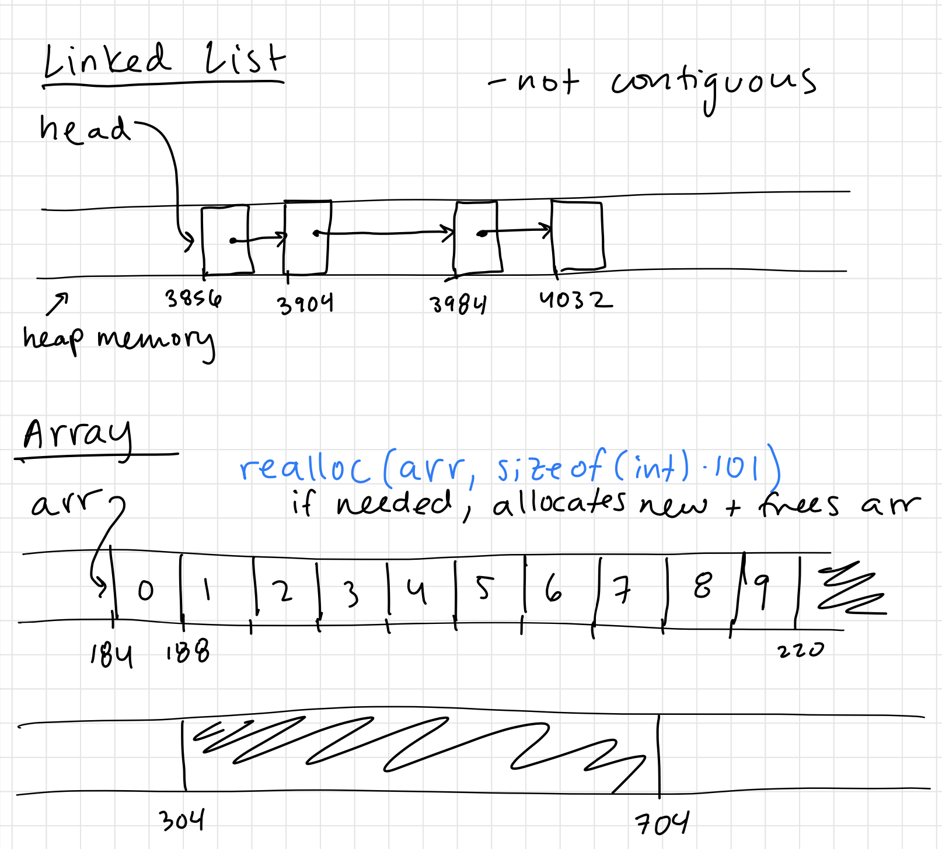

Slide 72
Valgrind
Runs your program, but tracks heap memory use

