Slide 1
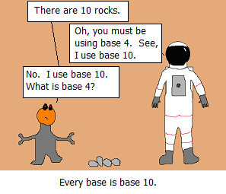

Slide 2
Binary
Computers represent everything as bits
Recall: a byte is 8 bits
Int: 4 bytes (32 bits)
What’s the largest int we can represent?
2^32 - 1
(unsigned)

Slide 3
Binary
Computers represent everything as bits
Recall: a byte is 8 bits
Int: 4 bytes (32 bits)
What’s the largest int we can represent?
2^32 - 1
(unsigned)

Slide 4
Binary
Computers represent everything as bits
Recall: a byte is 8 bits
Int: 4 bytes (32 bits)
What’s the largest int we can represent?
2^32 - 1
(unsigned)

Slide 5
Hexadecimal (base 16)
Binary takes up a lot of space
Hexadecimal takes few digits but can easily be converted to binary (and vice versa)
Hex uses digits 0-9 and a-f
1 hex digit = 4 bits
It would be helpful to use binary…but it would take up too much space
0000 0000 0000 0001 1101 0011 0101 1011
1d35b

Slide 6
In C
Format ints
%d for decimal
%b for binary
%x for hex
Assign ints
0b for binary (ex: 0b11011 is 27)
0x for hex (ex: 0x83fa9 is 540585)

Slide 7
Bitwise Operators
You know logical operators…&&,||,!
We will now learn &,|,~,^,<<,>>
These operate at the bit level

Slide 8
&
a | b | a & b
1 | 1 | 1
1 | 0 | 0
0 | 1 | 0
0 | 0 | 0

Slide 9
|
a | b | a | b
1 | 1 | 1
1 | 0 | 1
0 | 1 | 1
0 | 0 | 0

Slide 10
^
a | b | a ^ b
1 | 1 | 0
1 | 0 | 1
0 | 1 | 1
0 | 0 | 0

Slide 11
^
a | ~a
1 | 0
0 | 1

Slide 12
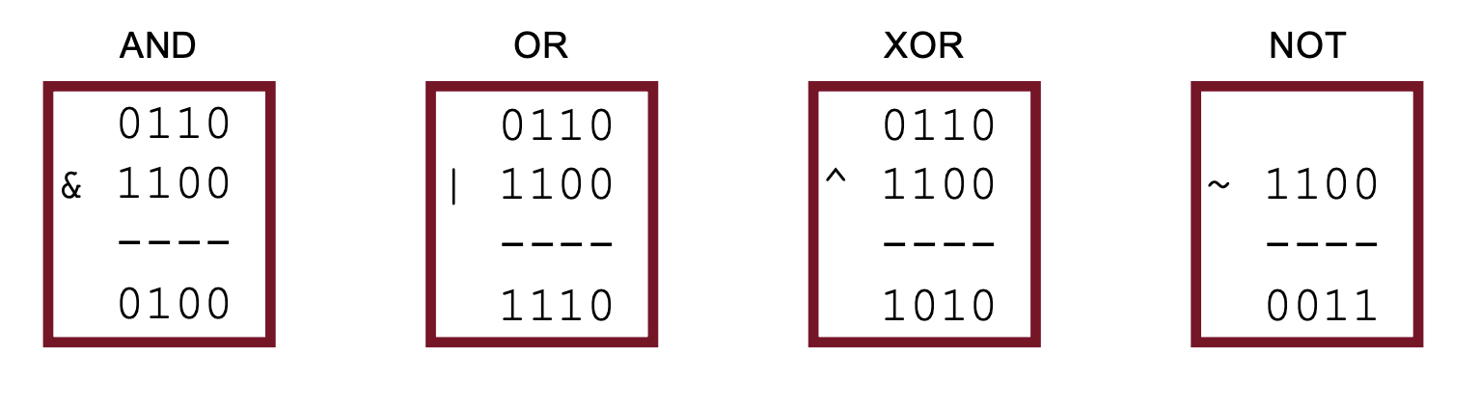
Operators on multiple bits

