Slide 1
Pointers and Modular Programming Chapter 6
Problem Solving & Program Design in C
Eighth Edition
Jeri R. Hanly & Elliot B. Koffman

Slide 2
Chapter Objectives
To learn about pointers and indirect addressing
To see how to access external data files in a program and to be able to read from input file and write to output files using file pointers
To learn how to return function results through a function’s arguments
To understand the differences between call-by-value and call-by-reference

Slide 3
Chapter Objectives
To understand the distinction between input, inout, and output parameters and when to use each kind

Slide 4
Pointers
pointer (pointer variable)
a memory cell that stores the address of a data item
8 bytes on on server but depends on machine
syntax: type *variable
int m = 25;
int *itemp; /* a pointer to an integer */

Slide 5
Pointers
pointer (pointer variable)
a memory cell that stores the address of a data item
8 bytes on on server but depends on machine
syntax: type *variable
int m = 25;
int *itemp; /* a pointer to an integer */
itemp = &m; /* itemp points to m */

Slide 6
& operator (address of)
Returns the address of a variable
the * never returns the address of a variable

Slide 7
* operator (indirection)
Follows a pointer to what it points to
(the thing at the address it stores)

Slide 8
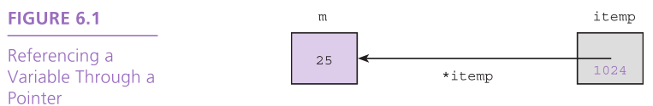
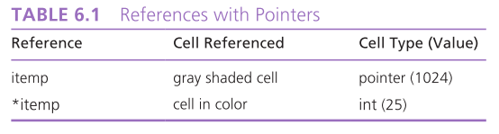
Indirection/indirect reference
accessing the contents of a memory cell through a pointer variable that stores it address

Slide 9
Pointers to Files
C allows a program to explicitly name a file for input or output.
Declare file pointers:
FILE *inp; /* pointer to input file */
FILE *outp; /* pointer to output file */
Prepare for input or output before permitting access:
inp = fopen(“infile.txt”, “r”);
outp = fopen(“outfile.txt”, “w”);

Slide 10
Pointers to Files
fscanf
file equivalent of scanf
fscanf(inp, “%lf”, &item);
fprintf
file equivalent of printf
fprintf(outp, “%.2f\n”, item);
closing a file when done
fclose(inp);
fclose(outp);

Slide 11
Segmentation fault
Runtime error
Means you tried to access memory that you weren’t allowed to access
Examples of causes:
trying to read from a file that wasn’t open
following a dangling pointer
accessing data beyond array bounds

Slide 12
Segmentation fault
Runtime error
Means you tried to access memory that you weren’t allowed to access
Examples of causes:
trying to read from a file that wasn’t open
following a dangling pointer
accessing data beyond array bounds
let’s introduce a segmentation fault in read.c

Slide 13
The NULL pointer
Uninitialized pointers point somewhere
NULL is a pointer that points nowhere
0 also works for the null pointer
int* ptr = NULL;
if (myptr == NULL) {
…
…

Slide 14
sizeof() function
Gives the number of bytes that a variable or value takes up
sizeof(m)
On our server:
Char: 1 bytes
Int: 4 bytes
Float: 4 bytes
Double: 8 bytes
Pointer: 8 bytes

Slide 15
Pointers
Create an integer pointer variable and set it
int main(void) {
int *b;
int n;
n = 5;
b = &n;
0x5100
0x5108
?
…
0x5200
0x5204
?
…

Slide 16
Pointers
Create an integer pointer variable and set it
int main(void) {
int *b;
int n;
n = 5;
b = &n;
b
0x5100
0x5108
?
…
0x5200
0x5204
?
…

Slide 17
Pointers
Create an integer pointer variable and set it
int main(void) {
int *b;
int n;
n = 5;
b = &n;
b
0x5100
0x5108
?
…
0x5200
0x5204
n
?
…

Slide 18
Pointers
Create an integer pointer variable and set it
int main(void) {
int *b;
int n;
n = 5;
b = &n;
b
0x5100
0x5108
?
…
0x5200
0x5204
n
5
…

Slide 19
Pointers
Create an integer pointer variable and set it
int main(void) {
int *b;
int n;
n = 5;
b = &n;
b
0x5100
0x5108
5200
…
0x5200
0x5204
n
5
…

Slide 20
Pointers
Create an integer pointer variable and set it
int main(void) {
int *b;
int n;
n = 5;
b = &n;
n = 6;
*b += 1;
*b = 2 * (*b);
b
0x5100
0x5108
5200
…
0x5200
0x5204
n
6
…

Slide 21
Pointers
Create an integer pointer variable and set it
int main(void) {
int *b;
int n;
n = 5;
b = &n;
n = 6;
*b += 1;
*b = 2 * (*b);
b
0x5100
0x5108
5200
…
0x5200
0x5204
n
7
…

Slide 22
Pointers
Create an integer pointer variable and set it
int main(void) {
int *b;
int n;
n = 5;
b = &n;
n = 6;
*b += 1;
*b = 2 * (*b);
b
0x5100
0x5108
5200
…
0x5200
0x5204
n
14
…

Slide 23
Pointers
Create an integer pointer variable and set it
int main(void) {
int *b;
int n;
n = 5;
b = &n;
n = 6;
*b += 1;
*b = 2 * (*b);
b = 2 * (*b);
b
0x5100
0x5108
5200
…
0x5200
0x5204
n
14
…

Slide 24
Pointers
Create an integer pointer variable and set it
int main(void) {
int *b;
int n;
n = 5;
b = &n;
n = 6;
*b += 1;
*b = 2 * (*b);
b = 2 * (*b);
b
0x5100
0x5108
28
…
0x5200
0x5204
n
14
…

Slide 25
Pointers
Create an integer pointer variable and set it
int main(void) {
int *b;
int n;
n = 5;
b = &n;
n = 6;
*b += 1;
*b = 2 * (*b);
b = 2 * (*b);
b
0x5100
0x5108
28
…
0x5200
0x5204
n
14
…
ptr0.c shows seg fault accessing *b

Slide 26
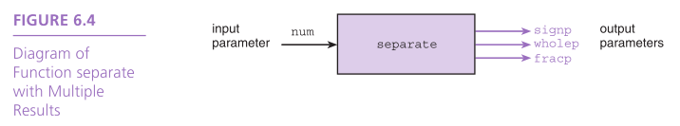
Functions with Output Parameters
We’ve used the return statement to send back one result value from a function.
We can also use output parameters to return multiple results from a function.

Slide 27
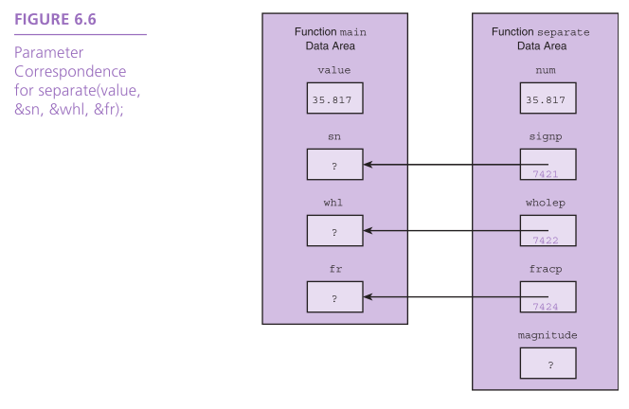

Slide 28
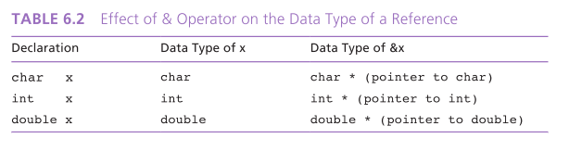

Slide 29
Meaning of Symbol *
binary operator for multiplication
“pointer to” when used when declaring a variable or a function parameters
unary indirection operator in a function body

Slide 30
Multiple Calls to a Function with Input/Output Parameters
An example of sorting data

Slide 31
