Slide 1
Arrays Chapter 7
Problem Solving & Program Design in C
Eighth Edition
Jeri R. Hanly & Elliot B. Koffman

Slide 2
Chapter Objectives
To learn how to declare and use arrays for storing collections of values of the same type
To understand how to use a subscript to reference the individual values in an array
To learn how to process the elements of an array in sequential order using loops

Slide 3
Chapter Objectives
To understand how to pass individual array elements and entire arrays through function arguments
To learn a method for searching an array
To learn a method for sorting an array
To learn how to use multidimensional arrays for storing tables of data
To understand the concept of parallel arrays
To learn how to declare and use your own data types

Slide 4
Basic Terminology
data structure
a composite of related data items stored under the same name
array
a collection of data items of the same type

Slide 5
Declaring and Referencing Arrays
array element
a data item that is part of an array
subscripted variable
a variable followed by a subscript in brackets, designating an array element
array subscript
a value or expression enclosed in brackets after the array name, specifying which array element to access

Slide 6
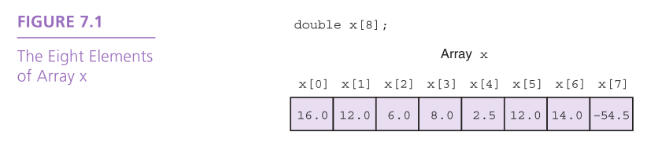

Slide 7
Array Initialization
int prime_lt_100[] = {2, 3, 5, 7, 11, 13, 17, 19,
23, 29, 31, 37, 41, 43, 47, 53, 59, 61, 67, 71, 73, 79, 83, 89, 97}
char vowels[] = {‘a’, ‘e’, ‘i’, ‘o’, ‘u’, ‘y’}

Slide 8
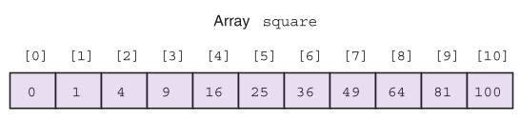
Using for Loops for Sequential Access
for (i = 0; i < SIZE; ++i)
square[i] = i * i;

Slide 9
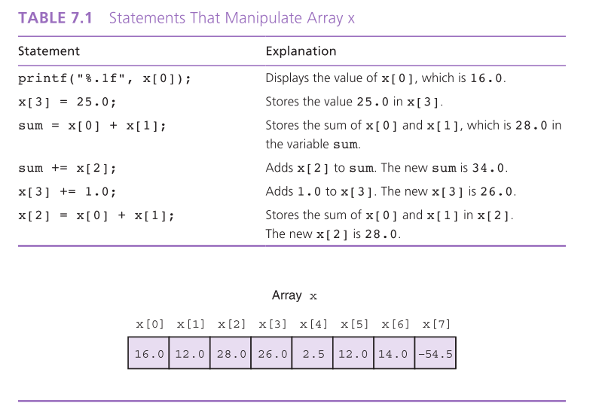

Slide 10
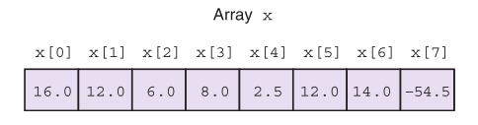
Array Subscripts
Syntax: aname [subscript]
Examples: x[3]
x[i + 1]

Slide 11
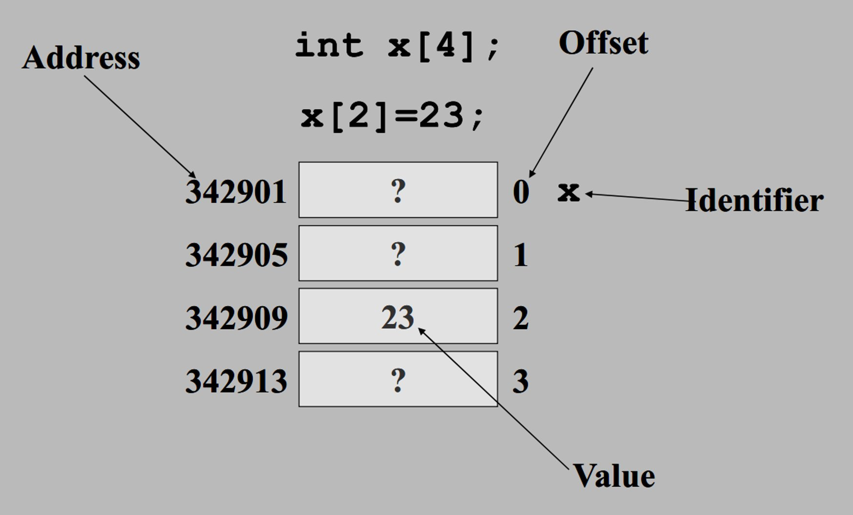

Slide 12
What’s at x[5]?

Slide 13
Partially Filled Arrays
A program may need to process many lists of similar data but the lists may not all be the same length.
In order to reuse an array for processing more than one data set, you can declare an array large enough to hold the largest data set anticipated.
Then your program should keep track of how many array elements are actually in use.

Slide 14
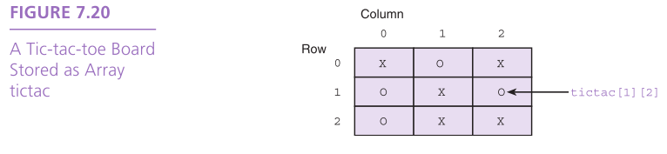
Multidimensional Arrays
multidimensional array
type arr_name[dim1val][dim2val]
tictac[3][3]

Slide 15
Using Array Elements as Function Arguments
scanf(“%lf”, &x[i]);

Slide 16
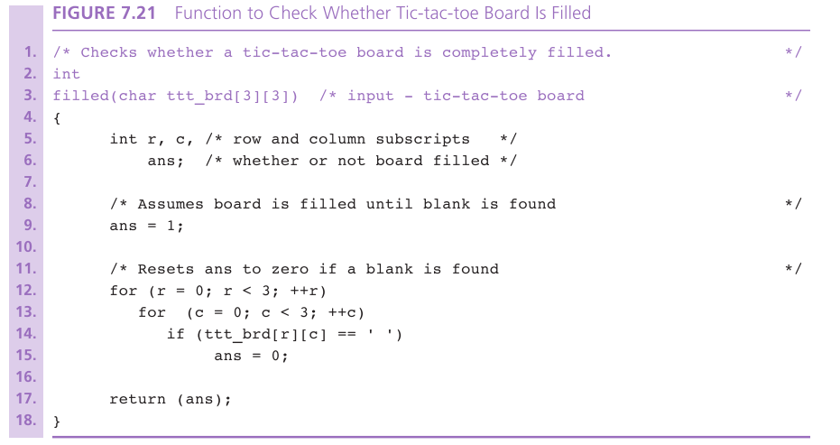

Slide 17
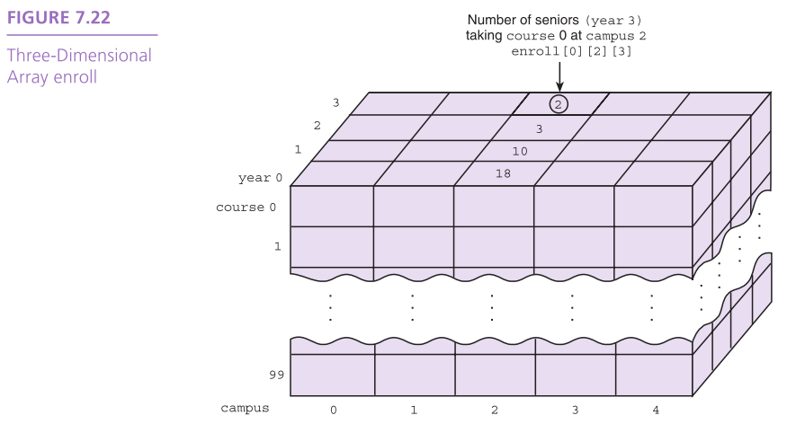

Slide 18
Array Arguments
We can write functions that have arrays as arguments.
Such functions can manipulate some, or all, of the elements corresponding to an actual array argument.

Slide 19
Variable scope
Part of a program where a variable is accessible
Lifetime of a variable

Slide 20
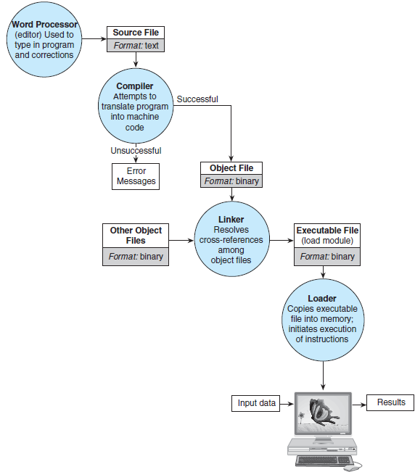

Slide 21
What happens when we run our executable file?
Memory
func2() {
printf(“%d\n”, x);
}
func1() {
int x = 1;
func2();
}
int main(void) {
char letter=’c’
func1();
}

Slide 22
What happens when we run our executable file?
Memory
func2() {
printf(“%d\n”, x);
}
func1() {
int x = 1;
func2();
}
int main(void) {
char letter=’c’
func1();
}
main

Slide 23
What happens when we run our executable file?
Memory
func2() {
printf(“%d\n”, x);
}
func1() {
int x = 1;
func2();
}
int main(void) {
char letter=’c’
func1();
}
main
letter: c

Slide 24
What happens when we run our executable file?
Memory
func2() {
printf(“%d\n”, x);
}
func1() {
int x = 1;
func2();
}
int main(void) {
char letter=’c’
func1();
}
main
letter: c

Slide 25
What happens when we run our executable file?
Memory
func2() {
printf(“%d\n”, x);
}
func1() {
int x = 1;
func2();
}
int main(void) {
char letter=’c’
func1();
}
main
letter: c
func1

Slide 26
What happens when we run our executable file?
Memory
func2() {
printf(“%d\n”, x);
}
func1() {
int x = 1;
func2();
}
int main(void) {
char letter=’c’
func1();
}
main
letter: c
func1
x: 1

Slide 27
What happens when we run our executable file?
Memory
func2() {
printf(“%d\n”, x);
}
func1() {
int x = 1;
func2();
}
int main(void) {
char letter=’c’
func1();
}
main
letter: c
func1
x: 1

Slide 28
What happens when we run our executable file?
Memory
func2() {
printf(“%d\n”, x);
}
func1() {
int x = 1;
func2();
}
int main(void) {
char letter=’c’
func1();
}
main
letter: c
func1
x: 1
func2

Slide 29
What happens when we run our executable file?
Memory
func2() {
printf(“%d\n”, x);
}
func1() {
int x = 1;
func2();
}
int main(void) {
char letter=’c’
func1();
}
main
letter: c
out of scope!
func1
x: 1
func2

Slide 30
What happens when we run our executable file?
void fill_array(
int list[],
int n,
int in_value) {
int i;
for (i = 0;
i < n; ++i) {
list[i] = in_value;
}
}
int main(void) {
int arr[10];
fill_array(arr, 5, 1);
}
Memory

Slide 31
What happens when we run our executable file?
void fill_array(
int list[],
int n,
int in_value) {
int i;
for (i = 0;
i < n; ++i) {
list[i] = in_value;
}
}
int main(void) {
int arr[10];
fill_array(arr, 5, 1);
}
Memory
main
arr:

Slide 32
What happens when we run our executable file?
void fill_array(
int list[],
int n,
int in_value) {
int i;
for (i = 0;
i < n; ++i) {
list[i] = in_value;
}
}
int main(void) {
int arr[10];
fill_array(arr, 5, 1);
}
Memory
main
arr:
fill_array
list:
n: 5
in_value: 1

Slide 33
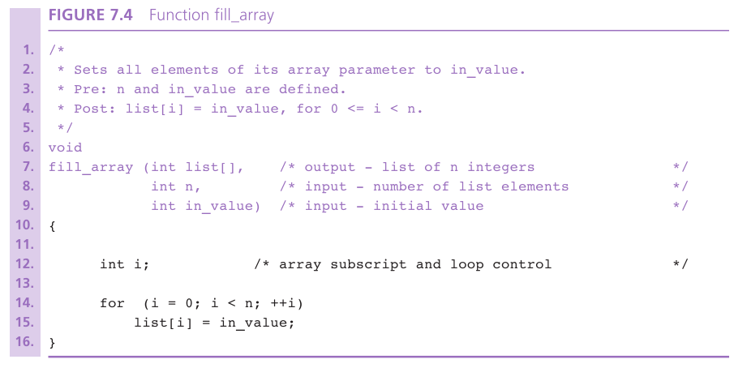

Slide 34
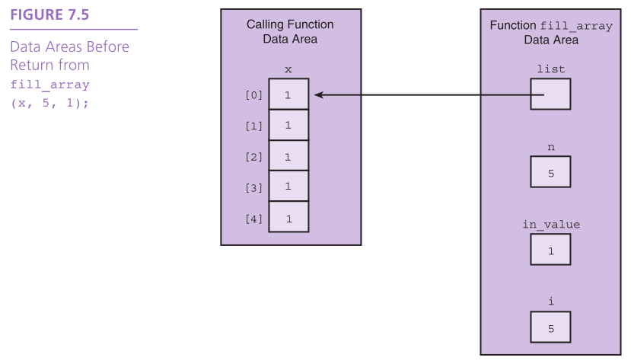

Slide 35
Arrays as Input Arguments
The qualifier const allows the compiler to mark as an error any attempt to change an array element within the function.

Slide 36
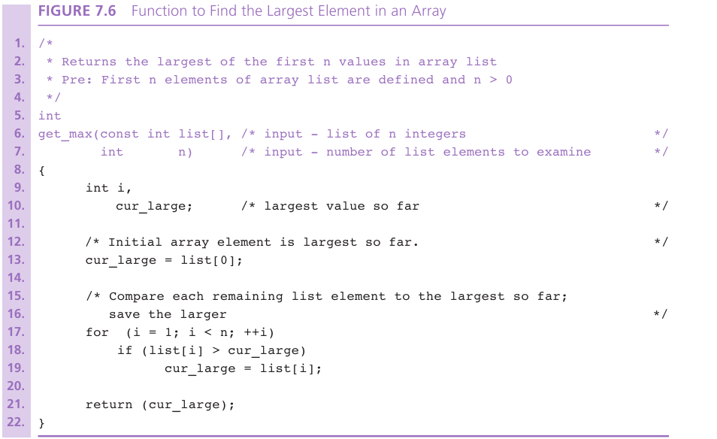

Slide 37
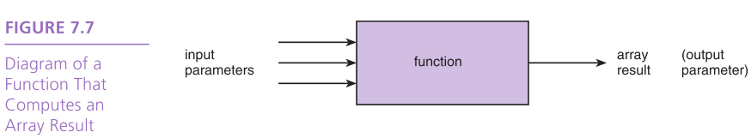
Returning an Array Result
In C, it is not legal for a function’s return type to be an array.
You need to use an output parameter to send your array back to the calling module.

Slide 38
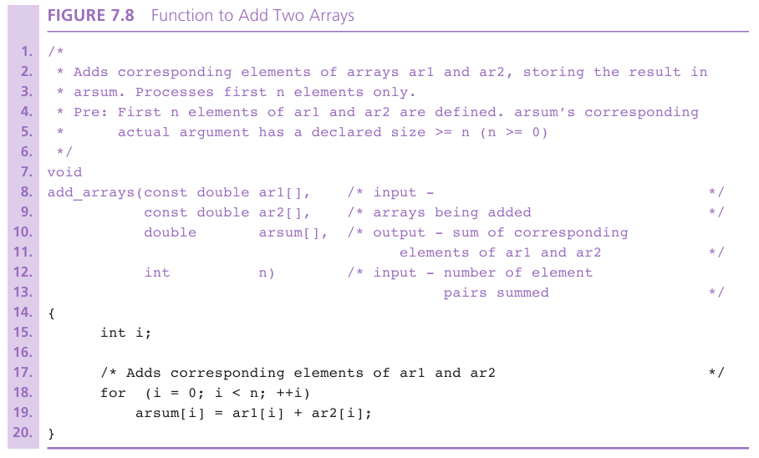

Slide 39
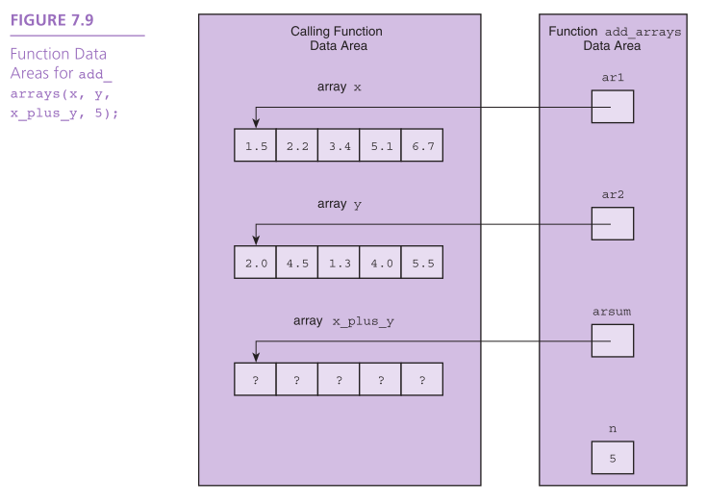

Slide 40
Array Search
Assume the target has not been found.
Start with the initial array element.
repeat while the target is not found and there are more array elements
if the current element matches the target
Set a flag to indicate that the target has been found
else
Advance to the next array element.
if the target was found
Return the target index as the search result
else
Return -1 as the search result.

Slide 41
Selection Sort
for each value of fill from 0 to n-2
Find index_of_min, the index of the smallest element in the unsorted subarray list[fill] through list[n-1]
if fill is not the position of the smallest element (index_of_min)
Exchange the smallest element with the one at position fill.

Slide 42
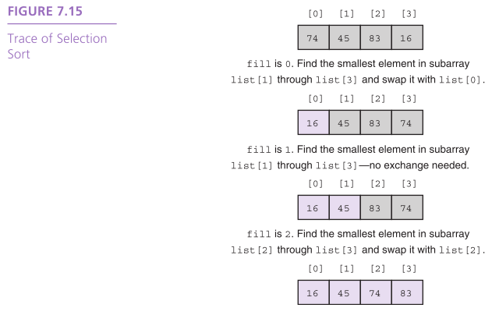

Slide 43
Wrap Up
A data structure is a grouping of related data items in memory.
An array is a data structure used to store a collection of data items of the same type.

