Slide 1
Repetition and Loop Statements Chapter 5
Problem Solving & Program Design in C
Eighth Edition
Jeri R. Hanly & Elliot B. Koffman

Slide 2
while Statement Syntax
while (loop repetition condition)
statement;
/* display N asterisks. */
count_star = 0;
while (count_star < N) {
printf(“*”);
count_star = count_star + 1;
}

Slide 3
Increment and Decrement Operators
counter = counter + 1 count += 1 counter++ ++counter
counter = counter - 1 count -= 1 counter--
--counter

Slide 4
while Statement Syntax
while (loop repetition condition)
statement;
/* display N asterisks. */
count_star = 0;
while (count_star < N) {
printf(“*”);
count_star = count_star + 1;
}

Slide 5
while Statement Syntax
while (loop repetition condition)
statement;
/* display N asterisks. */
count_star = 0;
while (count_star < N) {
printf(“*”);
count_star += 1;
}

Slide 6
Compound assignment
Operator | Definition
+ | addition
- | subtraction
* | multiplication
/ | division
% | remainder
Can do these too:
+=
-=
*=
/=
%=

Slide 7
Increment and Decrement Operators
side effect
a change in the value of a variable as a result of carrying out an operation

Slide 8
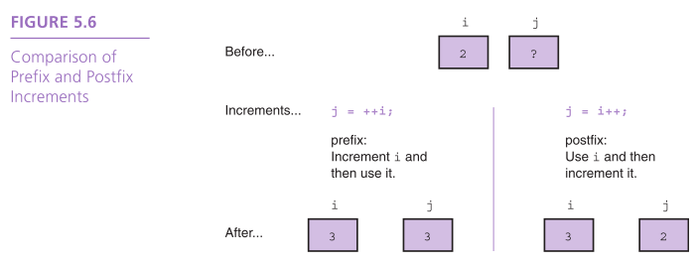

Slide 9
The for Statement Syntax
for (initialization expression;
loop repetition condition;
update expression)
statement;
/* Display N asterisks. */
for (count_star = 0;
count_star < N;
count_star += 1)
printf(“*”);

Slide 10
do-while Statement
For conditions where we know that a loop must execute at least one time
Get a data value
If data value isn’t in the acceptable range, go back to step 1.

Slide 11
do-while Syntax
We will talk more about the output of scanf next time
do
statement;
while (loop repetition condition);
/* Find first even number input */
do
status = scanf(“%d”, &num);
while (status > 0 && (num % 2) != 0);

Slide 12
Computing a Sum or Product in a Loop
accumulator
a variable used to store a value being computed in increments during the execution of a loop

Slide 13
Computing Factorial
loop body executes for decreasing value of i from n through 2
each value of i is incorporated in the accumulating product
loop exit occurs when i is 1

Slide 14
Nested Loops
Loops may be nested just like other control structures
Nested loops consist of an outer loop with one or more inner loops
Each time the outer loop is repeated, the inner loops are reentered, their loop control expressions are reevaluated, and all required iterations are performed

Slide 15
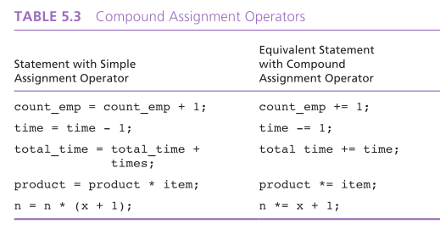

Slide 16
Loop Control Components
initialization of the loop control variable
test of the loop repetition condition
change (update) of the loop control variable
the for loop supplies a designated place for each of these three components

Slide 17
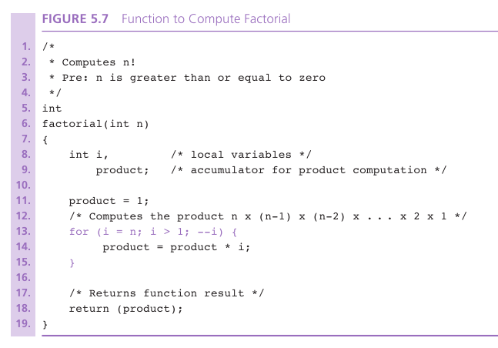

Slide 18
Endfile-Controlled Loop Design
Get the first data value and save input status
while input status does not indicate that end of file has been reached
Process data value
Get next data value and save input status

Slide 19
