Slide 1
Git/GitHub Basics
Vince Caristo
vincent.caristo@umconnect.umt.edu
Notes:
Who’s used git?
Hopefully make this usefu
Build Intuition around primary functions
Walk through demos of the most common workflows

Slide 2

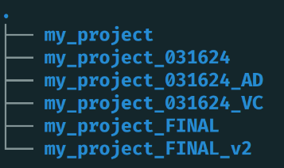
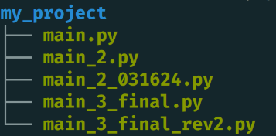
Why Git?
This doesn’t work well!
Instead, we want to:
Easily keep track of our work history
Collaborate with others
Try/test new things without breaking old work
Generate reproducible research
Credit: Eshin Jolly, 2019
Notes:
Hard to know what the differences between versions are
Hard to know who did what
Collaborate with other people
Exactly what Git is designed to do!

Slide 3
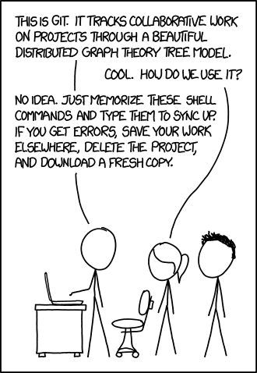
https://xkcd.com/1597/
Notes:
ME: Typing commands blindly
Powerful and makes our lives a lot easier..
UGLY interface and LEARNING CURVE to get started
That’s why we’re do this.
The majority can be done with just a handful of basic commands….and anything else you’ll just look up along the way

Slide 4

A series of snapshots of your file structure
my_project.py
my_project.py
my_project.py
Make some changes...
+ new feature
v1
v2
v3
git commit
git commit
git commit
"Snapshot"
"Snapshot"
"Snapshot"
Folder & file contents
Timestamp
Author
Message
Notes:
Continue developing our project + taking snapshots at important points along the way
Never having to deal with crazy file naming conventions
In fact…Say we want to undo our latest changes and go back to something that we knew worked well:
g conventions

Slide 5
A series of snapshots of your file structure
my_project.py
my_project.py
Make some changes...
git revert/reset
"Undo"
v1
v2
git commit
git commit
"Snapshot"
"Snapshot"
Folder & file contents
Timestamp
Author
Message
Notes:
our ability to do this while keeping track of everything makes it super flexible and easy
We can move back and forth in tie very easily, and git keeps track of everything for you

Slide 6

A collaboration tool
my_project.py
my_project.py
my_project.py
v1
v2
v3
git commit
git commit
merge + commit
"Snapshot"
"Snapshot"
Folder & file contents
Timestamp
Author
Message
fork
pull request
”make a personal copy"
“incorporate my changes, please!”
+ new feature
Collaborator
v1
v2
git commit
git commit
git commit
Notes:
and then send something called a pull request – ‘hey, I made these changes. Maybe you’d like to incorporate them into your project?”
incorporate with MERGE + COMMIT
INCLUDE WORK BOTH YOU AND COLLABORATOR have done
The beauty is that we can jump back and forth to any of these nodes here and have access to the entire process of development

Slide 7
Parallel development
New Release!
my_project.py
my_project.py
Official Release!
my_project.py
v1
v2
git commit
git commit
v3
"Snapshot"
"Snapshot"
merge + commit
git branch
”make a new independent timeline"
New feature idea
git commit
git commit
git commit
"Snapshot"
Notes:
Eventually, merge changes into main branch
The entire timeline of the project will be encapsulated in the git repository,
you can even generate a changelog to summarize the commit for your users

Slide 8
Git summary
Git is like a flexible time machine for files
Git is a local version control system (vcs)
- Git is a command line program (but there are GUI extensions!)
Enables flexible, organized, and collaborative workflows
We can move in any direction through time:
Backwards:
Retrieve old versions
Forwards:
Incorporate new changes
Sideways:
Parallel development
Credit: Eshin Jolly, 2019
Notes:
The metaphor of a time machine is useful because it allows us to understand that we can very flexibly between different versions of project:
- Backwards
- Forwards
- Sideways: different aspects in parallel
This makes it very easy to collaborate with people, and to make work that’s reproducible
Not worry about breaking code that are depending on,
Or, losing track of who did what on particular proejct

Slide 9
Git vs github
Github is a cloud storage site for git repositories
Github allows you to collaborate and share projects with others
Github keeps track of your entire git history
Enables (distributed) team collaboration
Resources for tracking issues, communication, and code releases
Credit: Eshin Jolly, 2019
Notes:
Git is a local version control system
Github is essentially a cloud service that allows you to share git repositiories
All the information about your project- the entire time machine – accessible in the cloud for others to use
So this makes it really easy to collaborate
Can use git and github for other kinds of files
- doesn’t track binary files very well
- but works well for any kind of flat file like code or csv data

Slide 10
Additional Resources
GUI tools
GitKraken: https://www.gitkraken.com
VSCode GitLens: https://www.gitkraken.com/gitlens
Books
ProGit Book: https://git-scm.com/book/en/v2
Beej’s Guide: https://beej.us/guide/bggit/
Tutorials
Oh My Git! https://ohmygit.org
Atlassian Tutorials - https://www.atlassian.com/git
Cheat Sheet
https://www.atlassian.com/git/tutorials/atlassian-git-cheatsheet
Notes:
All really good resources
Command line is place to start...
Git Kraken: available on all major platforms
GitLens is a particular implementation as a VSCode Extension
ProGit – maintainers of Git
? Know Beej – he’s a well-known educator in CS, popular book on networking from 1990s. Git tutorial is new
PRINT OUT THE HANDFUL OF COMMANDS
The majority can be done with just a handful of basic commands….and anything else you’ll just look up along the way

Slide 11
DEMO
Notes:
All really good resources
Command line is place to start...
Git Kraken: available on all major platforms
GitLens is a particular implementation as a VSCode Extension
ProGit - source of truth

Slide 12
Git’s Data Model
main
3 objects in git:
"Blob" (file)
Array<byte>
"Tree" (folder)
map<string, tree or blob>
"Commit"
struct{
parents: array<commit>
author: string
message: string
snapshot: tree
}
A branch is pointer to a commit (typically, the latest one)
HEAD is a special pointer that typically points to the state of the cwd
98ca9
6d3hb
h23kb
struct {
Parents
Author
Message
Snapshot
}
2f4hp
pr3ss
HEAD
new_feature
git checkout
“ move the HEAD pointer”
Credit: Missing Semester, https://missing.csail.mit.edu
Notes:
Branches
A branch in Git is just a named reference to a commit (i.e., a pointer to a commit object in Git's directed acyclic graph).
The branch pointer moves forward automatically when you create new commits on that branch
- typically, it points to the leaf node (latest commit)
HEAD
Special pointer that typically points the commit that reflects the state of the current working directory
Technically, HEAD points to a branch, which in turn points to a commit.
detached HEAD in Git occurs when HEAD is pointing to a specific commit instead of a branch.

Slide 13
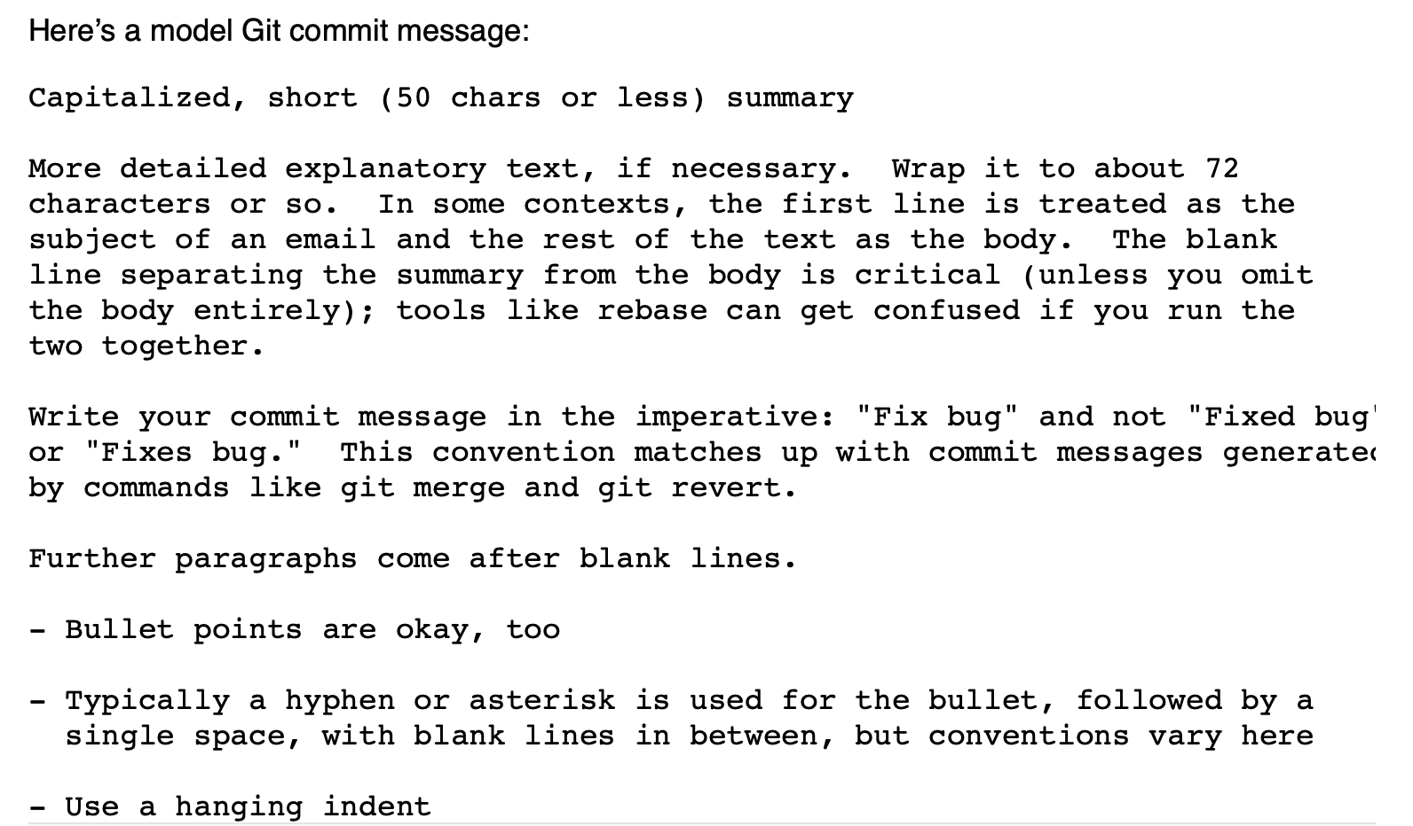
Writing good commit messages
Tweet-sized explanation of changes
Imperative, active voice is common
https://tbaggery.com/2008/04/19/a-note-about-git-commit-messages.html
Notes:
Branches
A branch in Git is just a named reference to a commit (i.e., a pointer to a commit object in Git's directed acyclic graph).
The branch pointer moves forward automatically when you create new commits on that branch.
HEAD
Special pointer that rep

