Slide 1
Single-cell foundation models
方法 | 物种 | 细胞数 | hidden size | layers | # of heads | total params
Geneformer | Human | 30M | 512 | 6 | 4 | ~30M
scGPT | Human | 10M | 512 | 12 | 8 | ~50M
scFoundation | Human | 50M | 768 | 12 | 12 | ~100M
Genecompass | Human,mouse | 126M | 768 | 12 | 12 | ~100M
UCE | 8 | 36M | 1280 | 33 |  | ~650M
CellFM | Human | 100M | 1536 | 40 | 48 | ~800M
CellPLM | Human | 11M | 1024 | 4 |  | ~80M
AIDO.Cell | Human | 50M | 640/1280 | 18/32 | 20 | 100M/650
GeneMamba | Human | 50M | 512 | 24 |  | ~66M
STATE | Human | 167M | 2048/1488 | 16/8 | 16/12 | ~600+244M
STACK | Human | 189+50M | 1600/3200 | 9 | 8/20 | 217/506/629M
TranscriptFormer | 12 | 112M | 2048 | 12 | 16 | 444M
Tahoe-X1 | Human | 250M | 2560 | 32 | 20 | ~3B
AlphaCell | Human | 220M | 2048 | 8*6 |  | ~1.2B
Lingshu-Cell | Human | <100M | 640 | 13 | 10
SpeciesLLM | 29 | 100M | 640 | 12 | 10 | ~100M
SpeciesLLM | 29 | 100M | 1280 | 24 | 20 | ~500M
SpeciesLLM |  | 100M | 1280 | 36 | 30 | ~1B

Slide 2
Single-cell foundation models
方法 | 物种 | 细胞数 | hidden size | Encode layers | # of heads | total params | Decode layers
Geneformer | Human | 30M | 256 | 6 | 4 | ~10.6M
scGPT | Human | 10M | 512 | 12 | 8 | ~50M
scFoundation | Human | 50M | 768 | 12 | 12 | ~100M
Genecompass | Human,mouse | 126M | 768 | 12 | 12 | ~100M
UCE | 8 | 36M | 1280 | 33 |  | ~650M
CellFM | Human | 100M | 1536 | 40 ERetNet blocks | 48 | ~800M
CellPLM | Human | 11M | 1024 | 4 |  | ~80M | 2
AIDO.Cell | Human | 50M | 640/1280 | 18/32 | 20 | 100M/650M
GeneMamba | Human | 50M | 512 | 24 |  | ~66M
STATE（SE/ST） | Human | 167M | 2048/1488 | 16/8 | 16/12 | ~600+244M
STACK | Human | 189+50M | 1600/3200 | 9 | 8/20 | 217/506/629M
TranscriptFormer | 12 | 112M | 2048 | 12 | 16 | 444M
Tahoe-X1 | Human | 250M | 2560 | 32 | 20 | ~3B
AlphaCell | Human | 220M | 128*32 | 8 |  | ~1.2B | 6
Lingshu-Cell | Human | <100M | 640 | 13 | 10
SpeciesLLM | 29 | 100M | 640 | 12 | 10 | ~100M
SpeciesLLM | 29 | 100M | 1280 | 24 | 20 | ~500M
SpeciesLLM |  | 100M | 1280 | 36 | 30 | ~1B

Slide 3
Single-cell foundation models
模型版本 | 物种 | 训练细胞数 / 数据版本 | hidden size / embedding dim | layers | num of attention heads | total params
Stack Base− | Human | 60.2M，scBaseCount subset | 800 = 100 tokens × 8 dim | 3 | 8 / 8 | 69.1M
Stack Base | Human | 73.7M / 60.2M / 148.8M 三种数据版本都训练过 | 800 = 100 tokens × 8 dim | 6 | 8 / 8 | 76.7M
Stack Base+ | Human | 60.2M，scBaseCount subset | 800 = 100 tokens × 8 dim | 9 | 8 / 8 | 84.4M
Stack Medium | Human | 60.2M，scBaseCount subset | 1600 = 100 tokens × 16 dim | 6 | 8 / 8 | 186M
Stack Large | Human | 60.2M / 148.8M 两种数据版本都训练过 | 1600 = 100 tokens × 16 dim | 9 | 8 / 8 | 217M
Stack XLarge | Human | 148.8M，full scBaseCount | 3200 = 100 tokens × 32 dim | 6 | gene-attn 8；cell-attn 20 | 506M
Stack Huge | Human | 148.8M，full scBaseCount | 3200 = 100 tokens × 32 dim | 9 | gene-attn 8；cell-attn 20 | 629M

Slide 4
Single-cell foundation models
方法 | lr (max)(min) | Warmups | Epochs | Schedular | dropout
Geneformer | 1e-3 | 10000 | 3 | Linear | 0.02
scGPT | 1e-4 |  | 6 | Linear | 0.1
scFoundation | 1e-4 | 10000 | 1?
Genecompass | 5e-5 | 10000 | 3 | linear | 0.02
UCE |  | 1 epoch | 8 | linear+exponentially decay | 0.05
CellFM | 1e-7(1e-6)(5e-7) |  | 2 |  | 0.1
AIDO.Cell | 3e-4 | 5% | 150000 step | linear | 0.0
GeneMamba |  |  | 5
CellPLM | 2e-4 |  |  |  | 0.2
STATE | 3e-6/1e-5 | 3% | 4 | linear+cosine annealing | 0.1
STACK | 1e-4/3e-5 | 10% | 10 | linear+cosine annealing | 0.0
TranscriptFormer (bs 4-16) | 1e-5/1.5e-4 | 10% | 15 | linear+cosine decay | 0.1
Tahoe-X1 | 3e-4/3e-5 | 5% | 5 | cosine annealing | 0.1
scMMGPT | 1e-5(1e-6) | 1000 steps | 5 | linear | 0.02
AlphaCell
Lingshu-Cell (bs 256 global) | 2e-5 | 100/1000 |  | linear wa cosine annealing
SpeciesLLM | 1e-4 (6e-5) | 2000 | 5 | Linear+cosine decay | 0.02-5

Slide 5
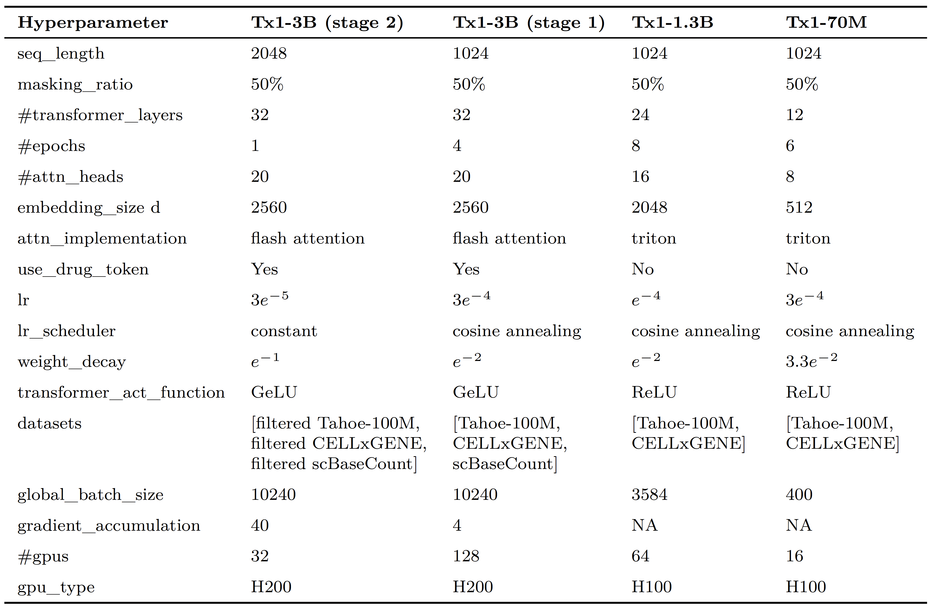
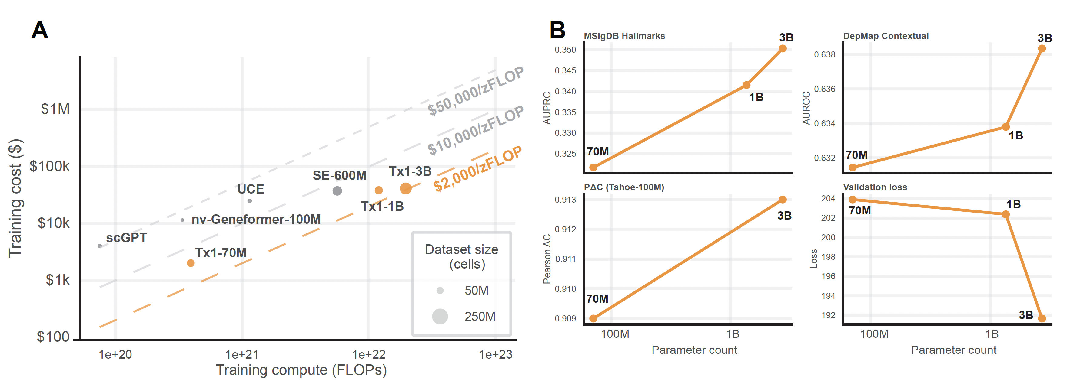
Scaling laws
Batch size 8
Batch size 20
Tahoe-X1
SpeciesLLM
September 18, 2025

Slide 6
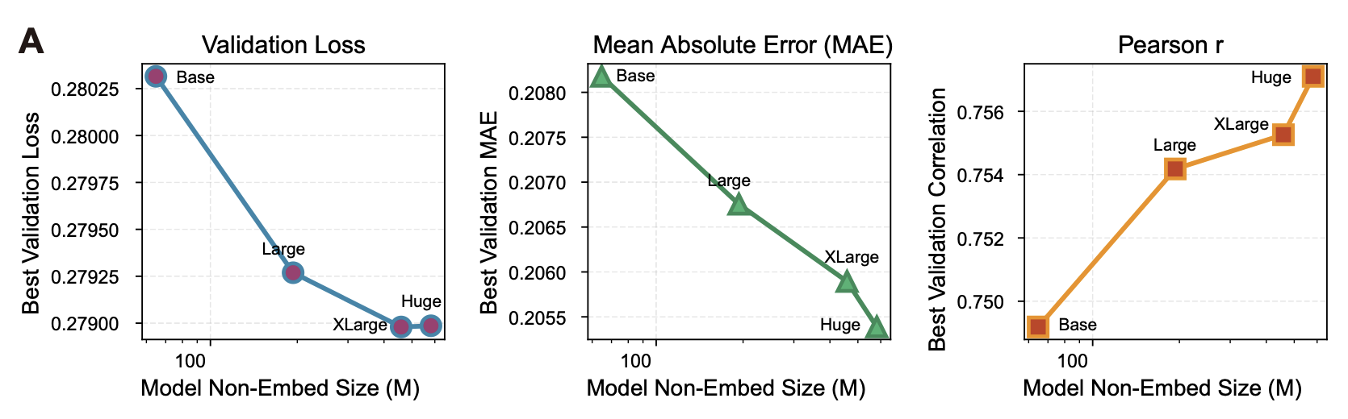
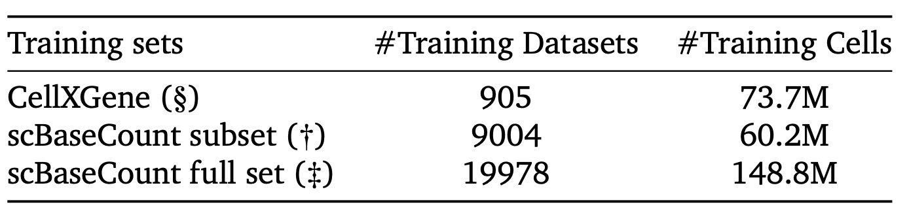
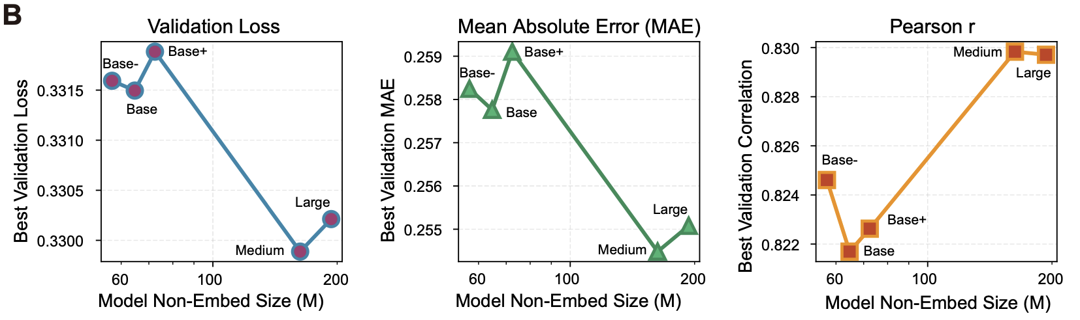
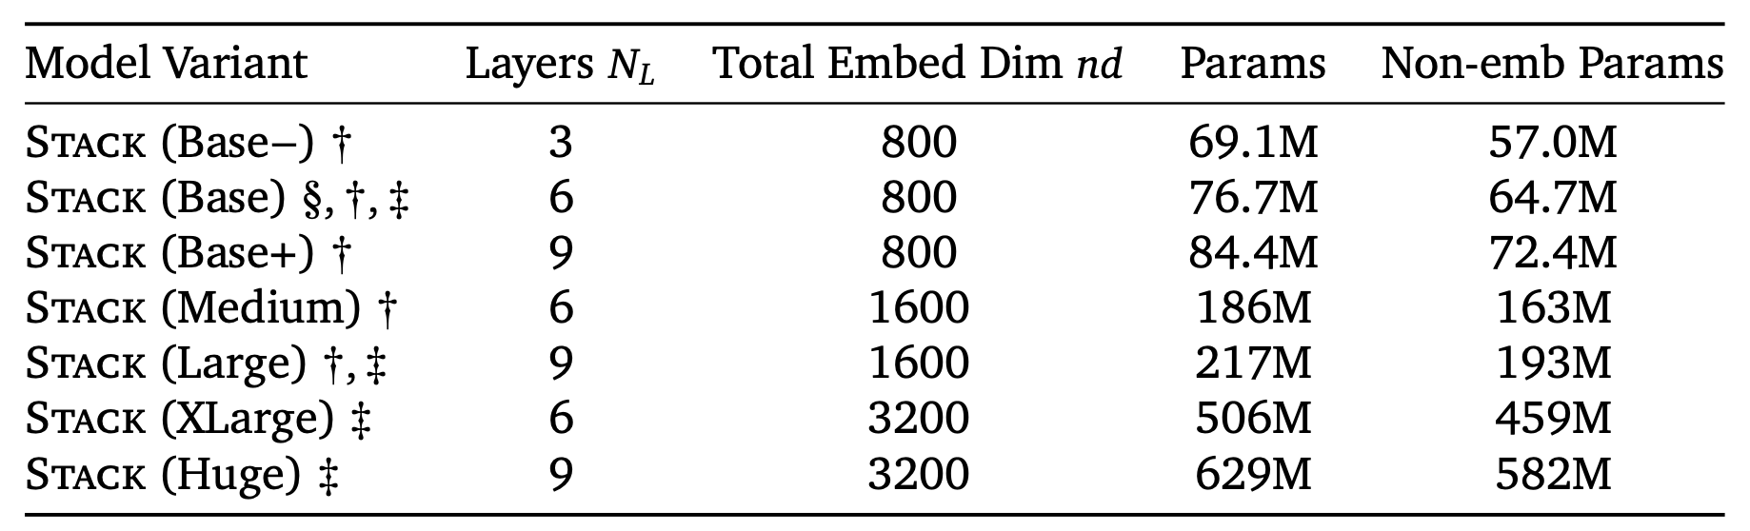
Scaling laws
Full set
Sub set
STACK
SpeciesLLM
September 18, 2025

Slide 7
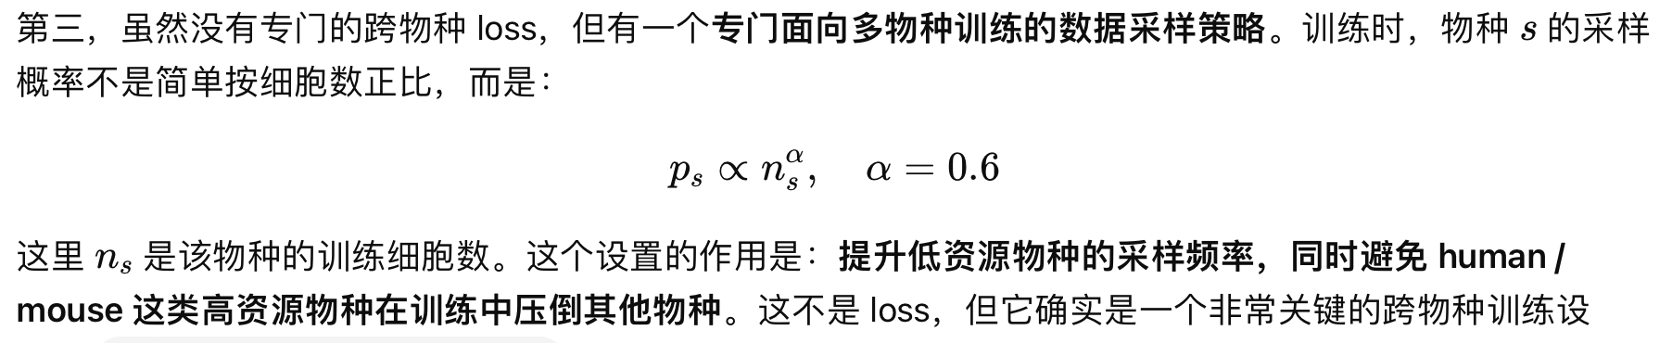
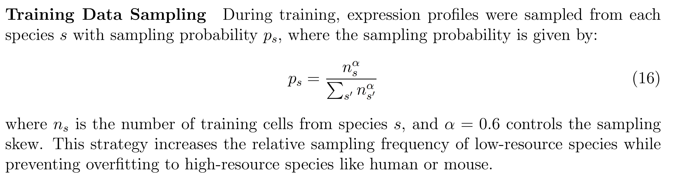
Data sampling
TranscriptFormer
数据采样策略，从（完全平均）和（完全不采样）中取平衡，缩小细胞数目的比例；
SpeciesLLM
September 18, 2025

Slide 8
Tahoe-X1
STACK
方法 | 物种 | 细胞数 | hidden size | layers | # of heads | total params
SpeciesLLM | 29 | 100M | 640 | 12 | 10 | ~100M
SpeciesLLM | 29 | 100M | 1280 | 24 | 20 | ~500M
SpeciesLLM |  | 100M | 1280 | 36 | 30 | ~1B
方法 | 物种 | 细胞数 | hidden size | layers | # of heads | total params
SpeciesLLM | 29 | 100M | 1400 | 20 | 20 | ~500M
SpeciesLLM |  | 100M | 1560 | 16 | 30 | ~500M

