Slide 1
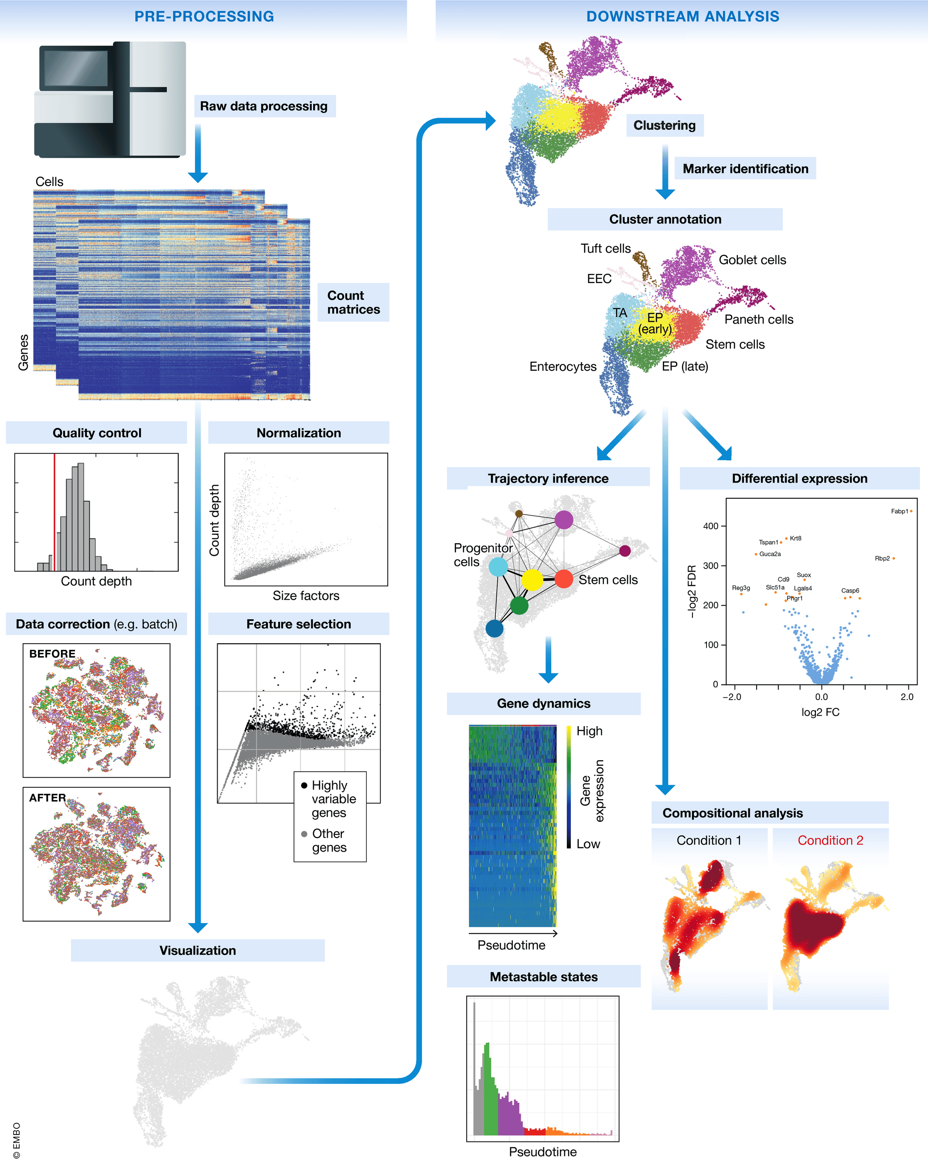
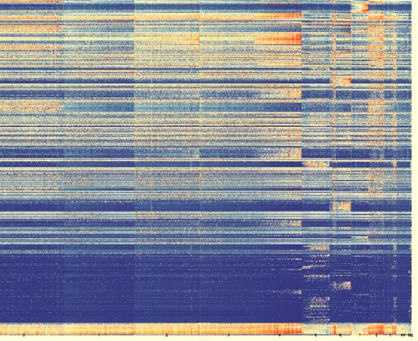
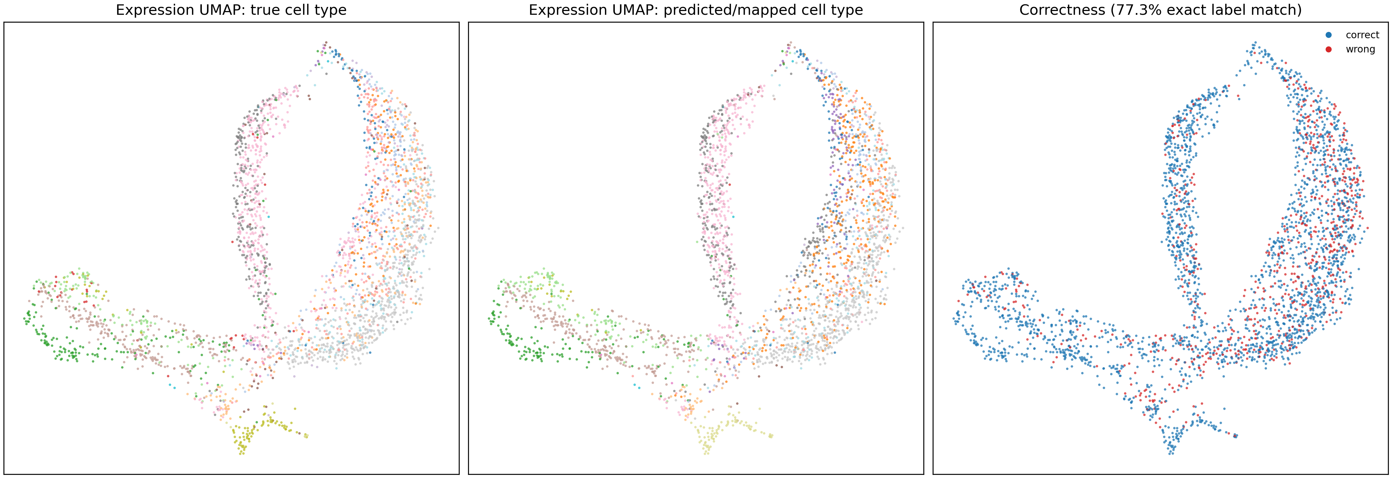
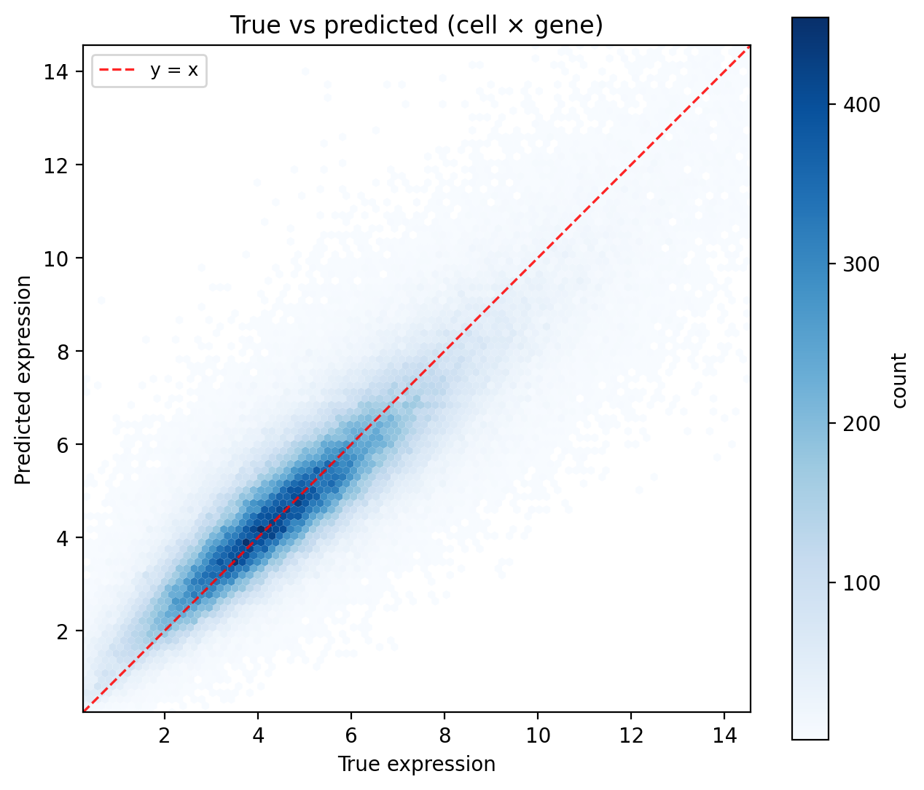
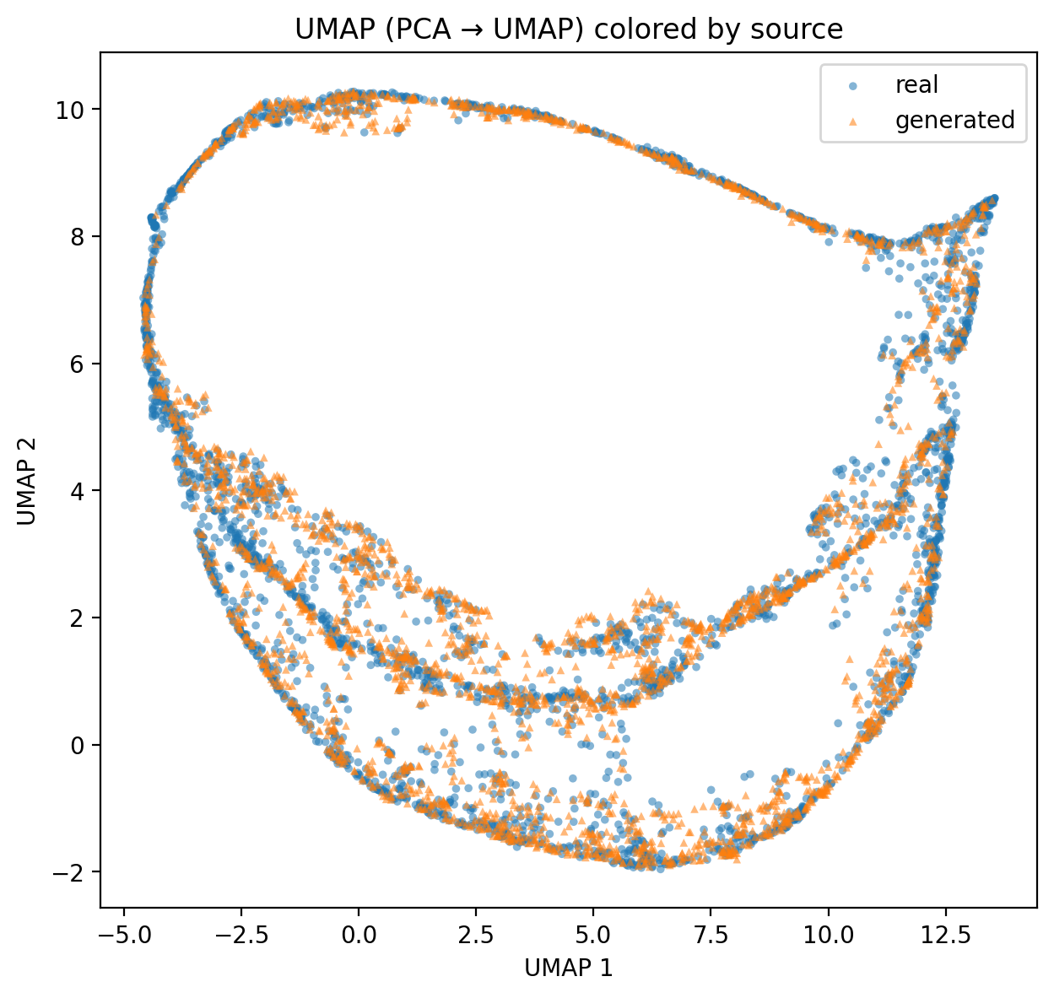
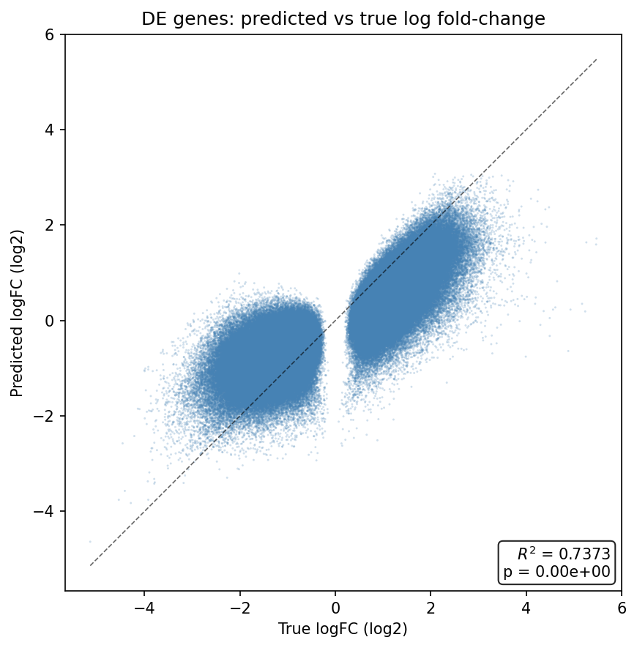
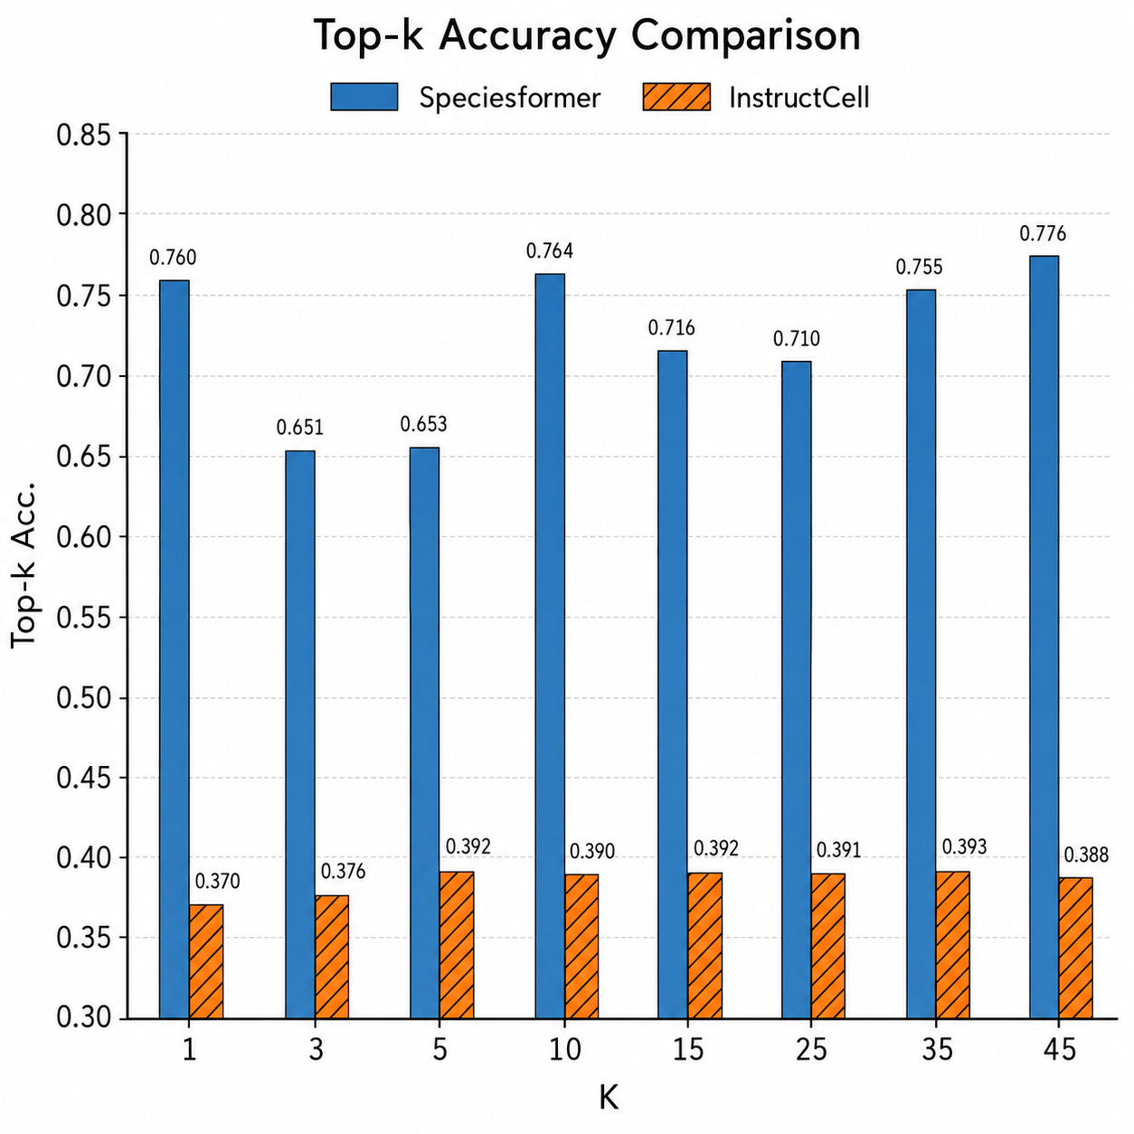
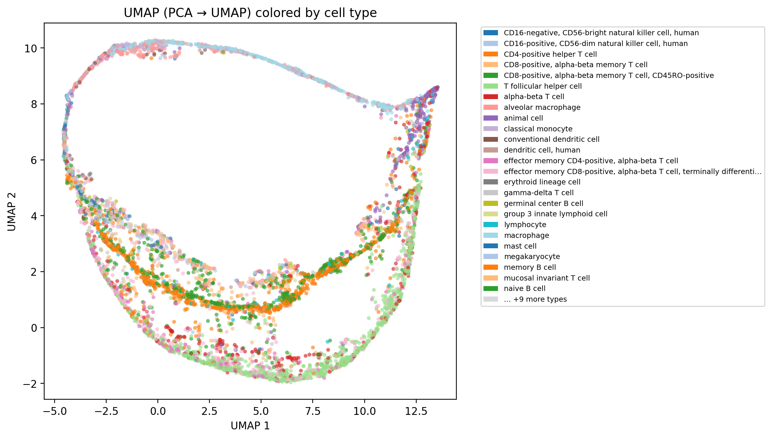
Cell Type description generation
Pseudo-Cell generation
Perturbed-Cell generation
Cell matrix
Cell state description
Cell state description
Cell state description
This cell is a B cell. B cells, also known as B lymphocytes, are a type of white blood cell of the lymphocyte subtype...
This cell is a B cell. B cells, also known as B lymphocytes, are a type of white blood cell of the lymphocyte subtype...
Cell {cell_name} (cell line {cell_line}) from {tissue} organ, in {phase} phase, was treated with {drug_info}, targeting {targets}.
Generated cell expression
Control cell expression
Generated cell expression
Log-transform
PCC=0.893
SPCC=0.927
DEG_AUPRC=0.916
DEG_Top20_acc=0.401
DEG_Top50_acc=0.466
DEG_Top100_acc=0.527
Stage1Continue-Log-transform
PCC=0.893
SPCC=0.927
Delta PCC=0.712
Delta MAE=0.342
DEG_AUPRC=0.915
DEG_Top20_overlap_acc=0.401
DEG_Top50_overlap_acc=0.465
DEG_Top100_overlap_acc=0.527
DEG_Jaccard_top100=0.36
LogFC_SPCC=0.645
SPCC_delta_effect= 0.633
PDS=0.699
Human Immune dataset
Zeroshot setting
Test samples: 2700
1. Integrating all (35) cell types exclude “unknown cell” to pretrain model.
2. Train-valid split: 8:1:1, test samples:
Tahoe-100M Plate1,3,9 subset (~4.9M cells)
Hold-out 5 cell lines for test
70% subsets for test, 30% subsets for train
SpeciesLLM
September 18, 2025
Notes:
For the first task, we also conducted modeling and analysis on the Chicken Atlas. We obtained the definitions of all cell ontology terms from the OLS database as cell type descriptions. We trained the model using all cell types in the Chicken Atlas, except for unknown cells. The training-validation ratio was 97:3, and the test set consisted of 600 samples.
We used the following metrics, commonly used in the NLP field, to evaluate the accuracy of the generated content:
As can be seen from the table, our generative model has very good performance in terms of these metrics.
BLEU primarily measures the n-gram overlap between the generated text and the reference text; ROUGE-N (n-gram overlap) and ROUGE-L (focused on longest common subsequence), commonly used in summary generation, focus on recall (the extent to which the generated text covers the reference text);
METEOR incorporates synonym matching and stemming, making it closer to human scores than BLEU; and LEVENSHTEIN primarily assesses the minimum number of edits required to transform a string into another, measuring the similarity between the generated text and the reference text.

Slide 2
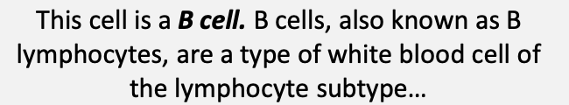
Pseudo-Cell generation
Evaluation
Cell state description
Human Immune dataset
Zeroshot setting
1. Test samples: 2700
Evaluation metrics
PCC SPCC MMD
KNN topk acc (k=1,3,5,7,10,15,25,35,45)
pKNN, delta sKNN
UMAP (generted vs. true; Cell-type)
Scatter plot
Generated cell expression
Top-k acc
K | 1 (↑) | 3 (↑) | 5 (↑) | 10 (↑) | 15 (↑) | 25 (↑) | 35 (↑) | 45(↑)
Macrogene-level | 0.747 | 0.614 | 0.615 | 0.672 | 0.668 | 0.691 | 0.678 | 0.693
Gene-level | 0.762 | 0.643 | 0.637 | 0.733 | 0.683 | 0.668 | 0.718 | 0.736
SpeciesLLM
September 18, 2025
Notes:
For the first task, we also conducted modeling and analysis on the Chicken Atlas. We obtained the definitions of all cell ontology terms from the OLS database as cell type descriptions. We trained the model using all cell types in the Chicken Atlas, except for unknown cells. The training-validation ratio was 97:3, and the test set consisted of 600 samples.
We used the following metrics, commonly used in the NLP field, to evaluate the accuracy of the generated content:
As can be seen from the table, our generative model has very good performance in terms of these metrics.
BLEU primarily measures the n-gram overlap between the generated text and the reference text; ROUGE-N (n-gram overlap) and ROUGE-L (focused on longest common subsequence), commonly used in summary generation, focus on recall (the extent to which the generated text covers the reference text);
METEOR incorporates synonym matching and stemming, making it closer to human scores than BLEU; and LEVENSHTEIN primarily assesses the minimum number of edits required to transform a string into another, measuring the similarity between the generated text and the reference text.

Slide 3
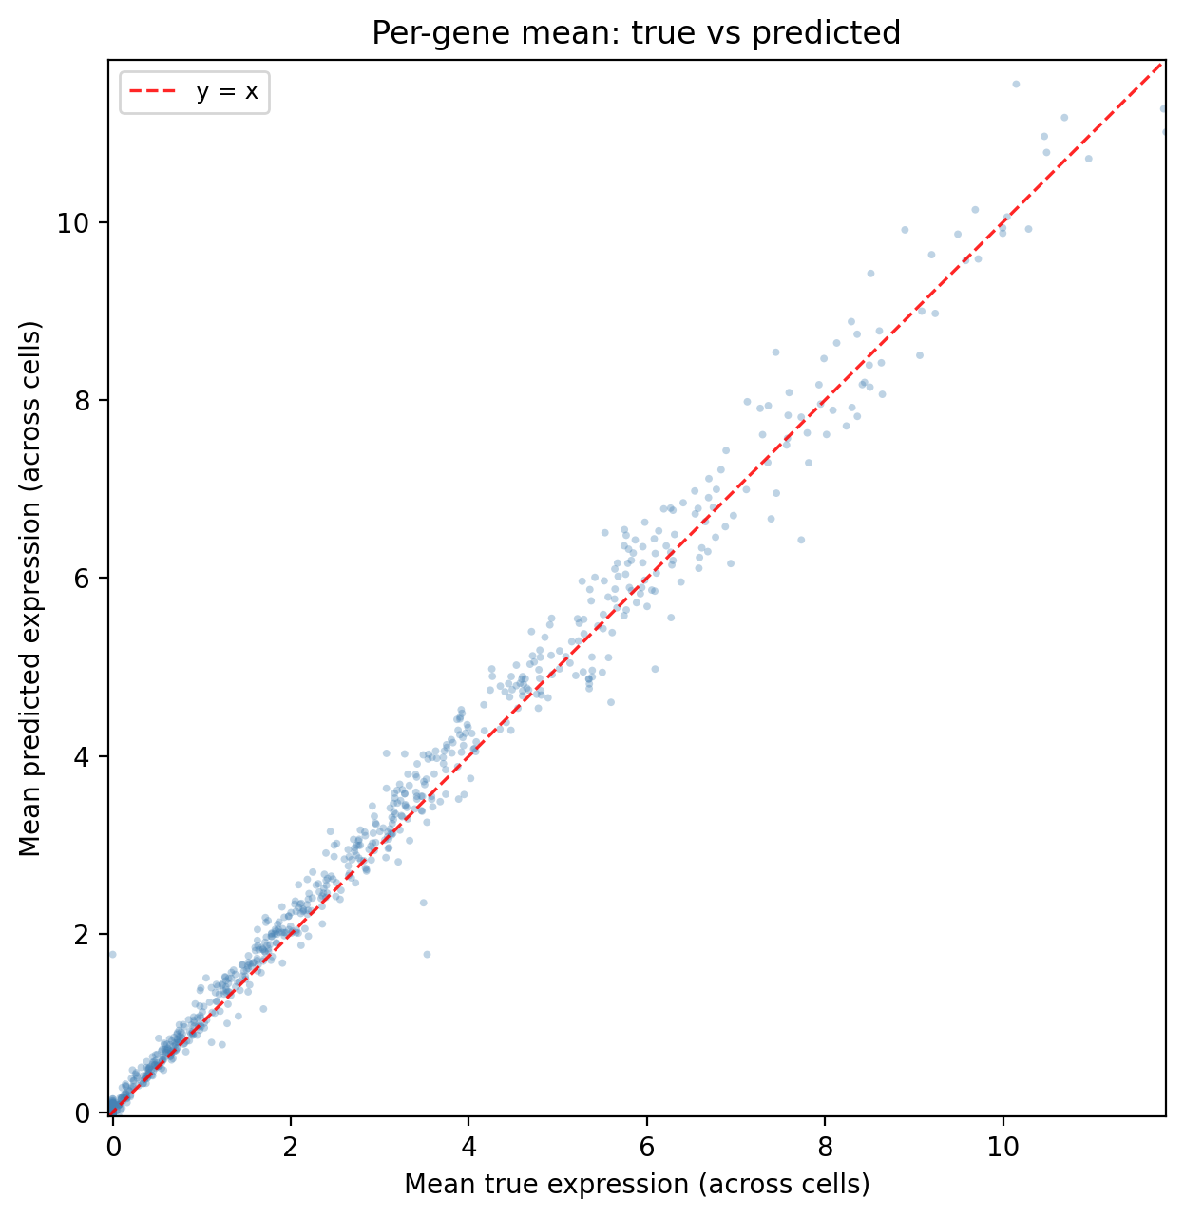
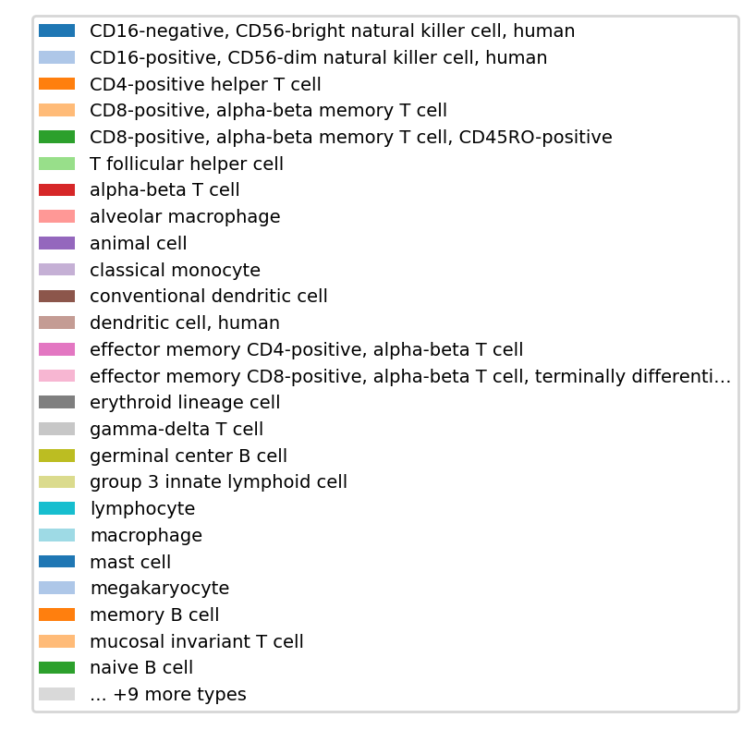
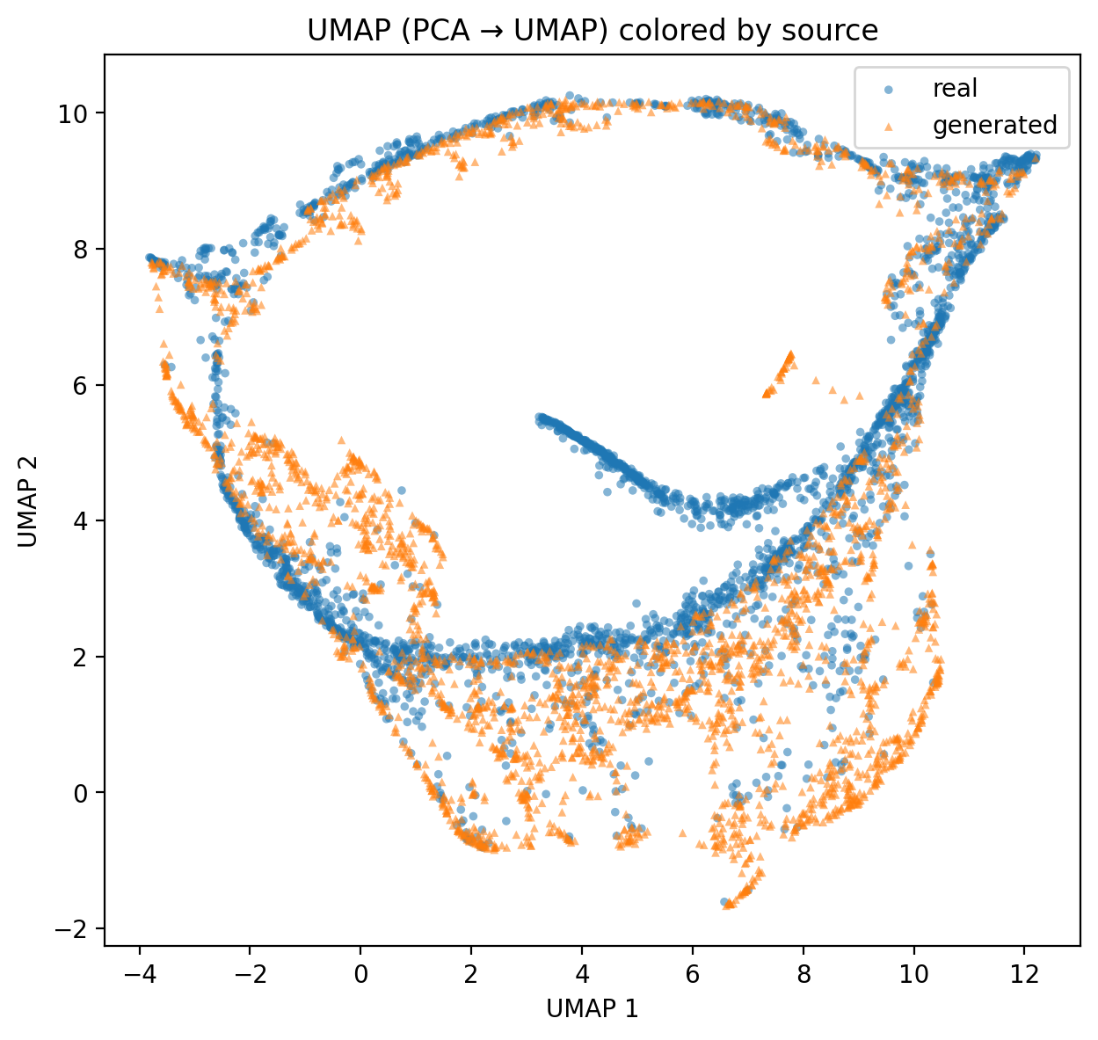
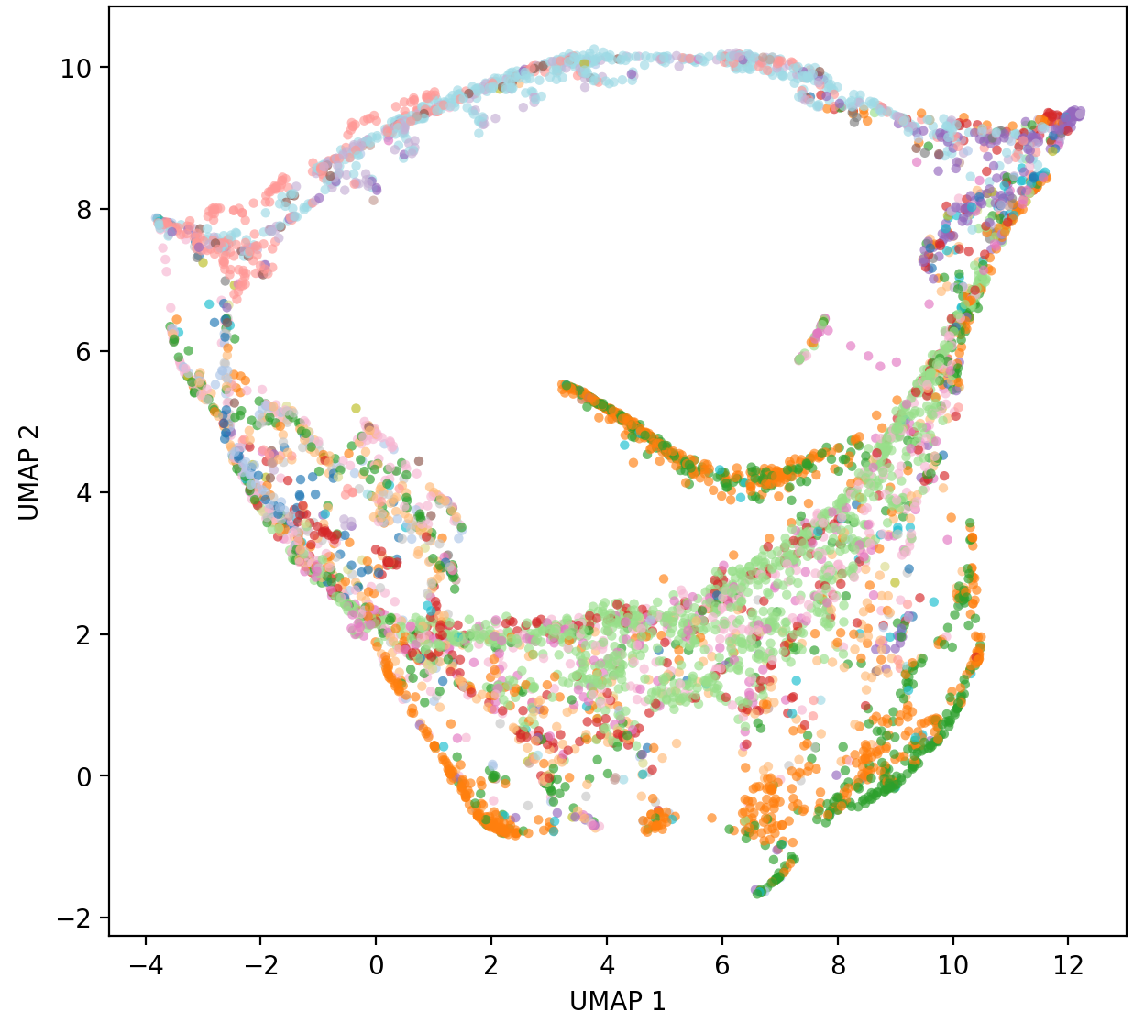
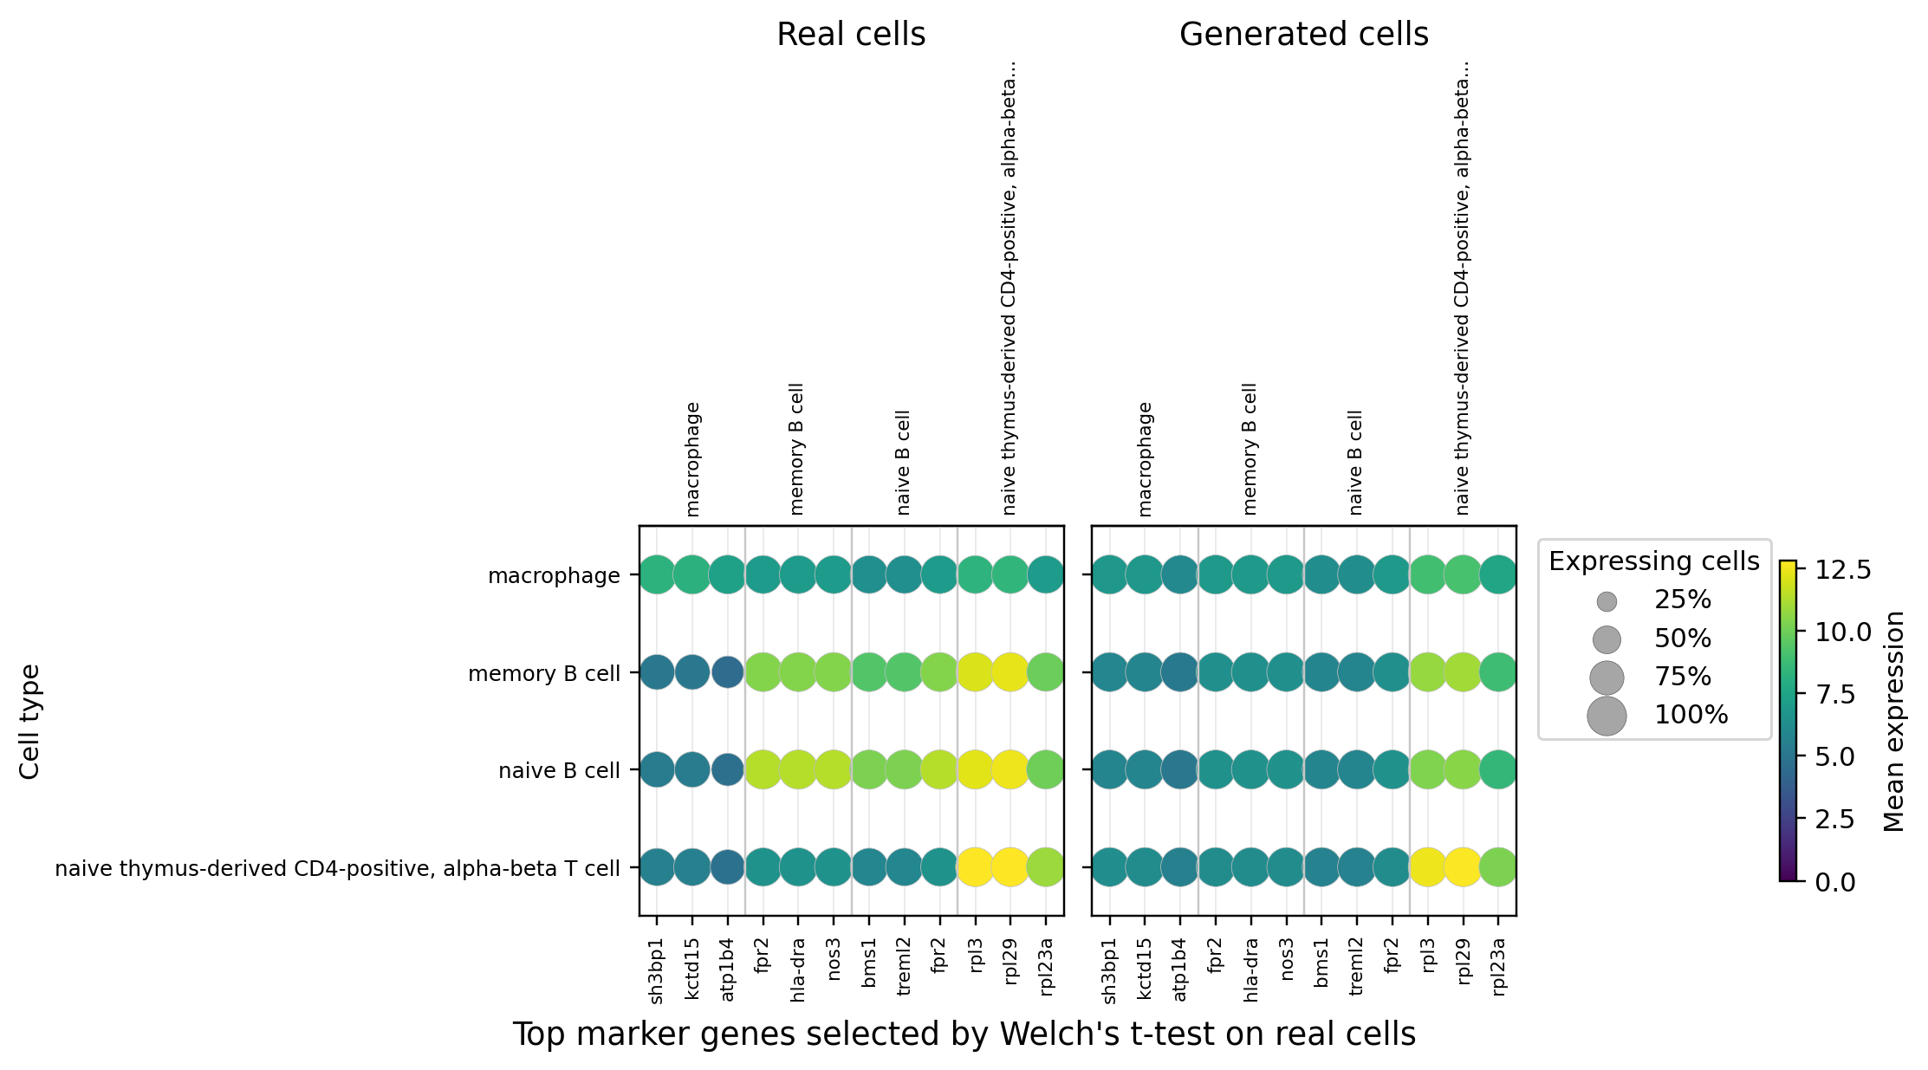
Pseudo-Cell generation
PCC=0.929
SPCC=0.944
MMD= 0.139
SpeciesLLM
September 18, 2025
Notes:
For the first task, we also conducted modeling and analysis on the Chicken Atlas. We obtained the definitions of all cell ontology terms from the OLS database as cell type descriptions. We trained the model using all cell types in the Chicken Atlas, except for unknown cells. The training-validation ratio was 97:3, and the test set consisted of 600 samples.
We used the following metrics, commonly used in the NLP field, to evaluate the accuracy of the generated content:
As can be seen from the table, our generative model has very good performance in terms of these metrics.
BLEU primarily measures the n-gram overlap between the generated text and the reference text; ROUGE-N (n-gram overlap) and ROUGE-L (focused on longest common subsequence), commonly used in summary generation, focus on recall (the extent to which the generated text covers the reference text);
METEOR incorporates synonym matching and stemming, making it closer to human scores than BLEU; and LEVENSHTEIN primarily assesses the minimum number of edits required to transform a string into another, measuring the similarity between the generated text and the reference text.

Slide 4
Pseudo-Cell generation
Evaluation
Cell state description
Human Immune dataset
Training setting
1. Integrating all (35) cell types exclude “unknown cell” to pretrain model.
2. Train-valid split: 8:1:1, test samples: 2700
Gene level
Evaluation metrics
PCC SPCC MMD
KNN topk acc (k=1,3,5,7,10,15,25,35,45)
pKNN, delta sKNN
UMAP (generted vs. true; Cell-type)
Scatter plot
Generated cell expression
Top-k acc
K | 1 (↑) | 3 (↑) | 5 (↑) | 10 (↑) | 15 (↑) | 25 (↑) | 35 (↑) | 45(↑)
Speciesformer | 0.76 | 0.651 | 0.653 | 0.764 | 0.716 | 0.71 | 0.755 | 0.776
InstructCell | 0.37 | 0.376 | 0.392 | 0.39 | 0.392 | 0.391 | 0.393 | 0.388
SpeciesLLM
September 18, 2025
Notes:
For the first task, we also conducted modeling and analysis on the Chicken Atlas. We obtained the definitions of all cell ontology terms from the OLS database as cell type descriptions. We trained the model using all cell types in the Chicken Atlas, except for unknown cells. The training-validation ratio was 97:3, and the test set consisted of 600 samples.
We used the following metrics, commonly used in the NLP field, to evaluate the accuracy of the generated content:
As can be seen from the table, our generative model has very good performance in terms of these metrics.
BLEU primarily measures the n-gram overlap between the generated text and the reference text; ROUGE-N (n-gram overlap) and ROUGE-L (focused on longest common subsequence), commonly used in summary generation, focus on recall (the extent to which the generated text covers the reference text);
METEOR incorporates synonym matching and stemming, making it closer to human scores than BLEU; and LEVENSHTEIN primarily assesses the minimum number of edits required to transform a string into another, measuring the similarity between the generated text and the reference text.

Slide 5
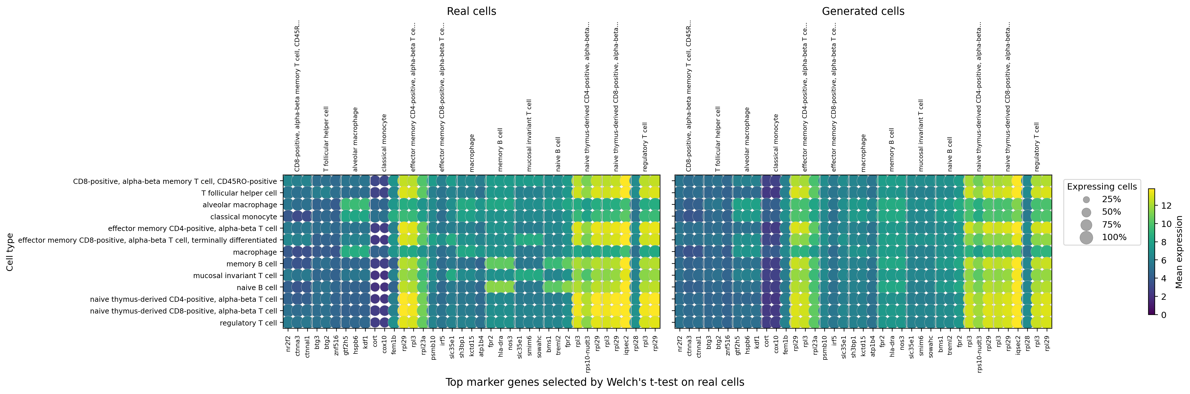
Pseudo-Cell generation
SpeciesLLM
September 18, 2025

Slide 6
Perturbed-Cell generation
Evaluation
Few-shot
Cell state description
Cell {cell_name} (cell line {cell_line}) from {tissue} organ, in {phase} phase, was treated with {drug_info}, targeting {targets}.
Tahoe-100M
Plate1,3,9 subset
(~4.9M cells)
Hold-out 5 cell lines for test
70% subsets for test, 30% subsets for train
Control cell expression
Generated cell expression
Log-transform
PCC=0.893
SPCC=0.927
Delta PCC=0.712
Delta MAE=0.342
DEG_AUPRC=0.916
DEG_Top20_overlap_acc=0.401
DEG_Top50_overlap_acc=0.466
DEG_Top100_overlap_acc=0.527
DEG_Jaccard_top100=0.361
LogFC_SPCC=0.647
SPCC_delta_effect= 0.634
PDS=0.701
Stage1Continue-Log-transform
PCC=0.893
SPCC=0.927
Delta PCC=0.712
Delta MAE=0.342
DEG_AUPRC=0.915
DEG_Top20_overlap_acc=0.401
DEG_Top50_overlap_acc=0.465
DEG_Top100_overlap_acc=0.527
DEG_Jaccard_top100=0.36
LogFC_SPCC=0.645
SPCC_delta_effect= 0.633
PDS=0.699
SpeciesLLM
September 18, 2025

Slide 7
Perturbed-Cell generation
Evaluation
Zero-shot
Cell state description
Cell {cell_name} (cell line {cell_line}) from {tissue} organ, in {phase} phase, was treated with {drug_info}, targeting {targets}.
SciPlex3
(~0.6M cells)
3 cell lines Cross-validation
Control cell expression
Generated cell expression
Tahoe-preprocessed-plate139-preprocessed-lr5e-5-epoch3
A549
PDS=0.507
PCC=0.833
SPCC=0.891
Delta MAE=1.25
DEG_AUPRC=0.961
DEG_Top20_overlap_acc=0.197
DEG_Top50_overlap_acc=0.272
DEG_Top100_overlap_acc=0.373
LogFC_SPCC=-0.035
Effect_size_SPCC=-0.045
K562
PDS=0.491
PCC=0.822
SPCC=0.883
Delta MAE=1.2
DEG_AUPRC=0.931
DEG_Top20_overlap_acc=0.147
DEG_Top50_overlap_acc=0.217
DEG_Top100_overlap_acc=0.317
LogFC_SPCC=-0.0
Effect_size_SPCC=-0.033
K562
PDS=0.491
PCC=0.883
SPCC=0.92
Delta MAE=1.31
DEG_AUPRC=0.962
DEG_Top20_overlap_acc=0.261
DEG_Top50_overlap_acc=0.319
DEG_Top100_overlap_acc=0.418
LogFC_SPCC=0.019
Effect_size_SPCC=0.024
SpeciesLLM
September 18, 2025

