Slide 1
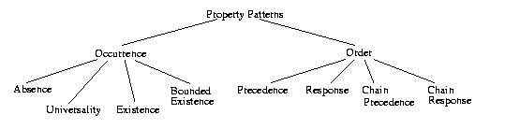
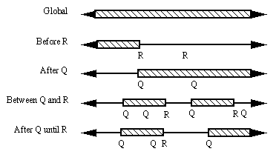
Background Information
Matt Dwyer and others developed a set of specification patterns that capture a great deal (>90%) of requirements as formal specifications.
  http://patterns.projects.cis.ksu.edu/
  Each pattern has two components: a scope, and a predicate.
  The scope defines on what part of execution a pattern should hold.

Slide 2
Background Information (cont)
  The predicate defines what should hold on the given scope.
    always a
    exists a
    a precedes b
    a reponds to b
  Globally :: Always a
    [aaaaaaaaaaaaaaaaaaaaaa…)
  Before R :: Always a
    [aaaaaaaaaaR--------------------)
  After Q :: Exists a
    [----a-------Q------------a----)
  Between Q and R :: A responds to B
    [----Q----b----a------R---)
    [----Q----b---a---Q----b---a---R---)
  After Q until R :: A precedes B
    [----Q-----a----b----R----)
    [----Q-----a---------R-----)
    [----Q-----ab---ab-----a-----------b----------a---)
    [----Q---a---b---b--)

Slide 3
Tips….
The first state of the scope must always satisfy the predicate.
  Between P and Q :: Always A
    [------------AAAAAAA----------)
    [------------P-----Q---------)
  Globally :: Always A
    [AAAAAAAAAAAAAAAAAA…)
If a scope has a definite ending, the end state of the scope does not have to satisfy the predicate. In that sense, the scopes are open on the closing event.
  Before P :: Always A
    [AAAAAAAAAAAAA----------------)
    [------------P----------------)
  After P until Q :: A responds to B
    [----B-----------A----)
    [---P------------Q----)

Slide 4
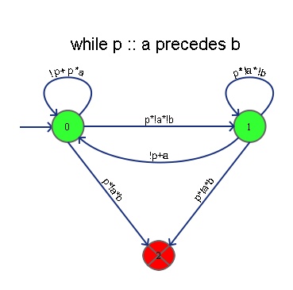
Translation to Lustre
Each machine is translated directly to Lustre, with each transition explicitly labelled.
The default case of each transition is set to -1. A property checks that the value of state is never set to -1, thus ensuring the transitions are completely specified.
The “holds” property is set to “state <> FAILED_STATE”
When appropriate, each machine was translated to SMV and verified to comply with the LTL found on the Specification Patterns website.
node while_p_a_precedes_b (p : bool; a : bool; b : bool) returns (holds : bool);
var
state,pre_state : subrange [-1,2] of int;
prop1 : bool;
let
pre_state = 0 -> pre state;
state =
if(pre_state = 0)
then
if(not p)
then 0
else if (p and a)
then 0
else if (p and not a and not b)
then 1
else if (p and not a and b)
then 2
else -1
else if (pre_state = 1)
then
if (not p)
then 0
else if a
then 0
else if(p and not a and not b)
then 1
else if(p and not a and b)
then 2
else -1
else if (pre_state = 2)
then 2
else -1;
holds = (state <> 2);
prop1 = (state <> -1);
--%PROPERTY prop1;
tel;

Slide 5
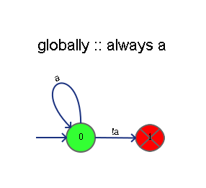
Globally :: Always A
  Only one trace satisfies it:
  [aaaaaaaaaaaaaaaaaaaaaaaaaaaaaaaaaaaaaa…)
  [aaaaaaaaaaaaaaaa-aaaaaaaaaaaaaaaaaaaaa…)

Slide 6
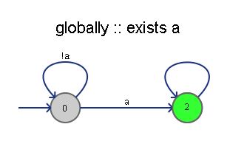
Globally :: Exists A
  Any trace containing a single a satisfies it:
  [----a---------------------…)
  [--------------------------…)

Slide 7
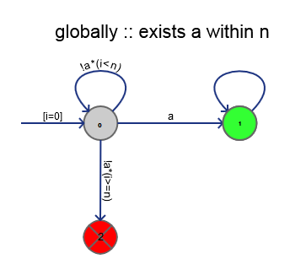
Globally :: Exists A within N
  Any trace in which an a occurs in the first N steps satisfies it
  [--a-----------------------…) (n=3)
  [---a----------------------…) (n=3)

Slide 8
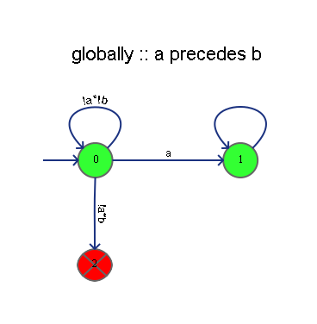
Globally :: A precedes B
  Any trace in which a B occurs at the same time as A or occurs after A satisfies it.
  [--”ab”-----------------------…)
  [--a-----b--------------------…)
  [-----------a-----------------…)
  [-----------------------------…)
  [---ba------------------------…)

Slide 9
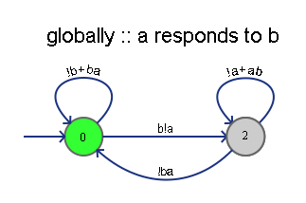
Globally :: A responds to B
  Any trace in which a B occurs at least once after every A satisfies it.
  [--b--a-----------------------…)
  [--”ba”-----------------------…)
  [---aba-----------------------…)
  [--b--a---b--a----------------…)
  [--b--b--a---b--a-------------…) (a must occur before b)
  [---b-------------------------…) (infinitely long trace)

Slide 10
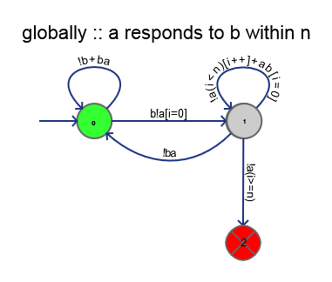
Globally :: A responds to B within N
  Any trace in which a B occurs an A occurs within N steps
  [--b--a-----------------------…) (n=3)
  [--”ba”-----------------------…) (n=3)
  [---aba-----------------------…) (n=3)
  [--b--a---b--a----------------…) (n=3)
  [---b---a--------------------…) (n=3)
  [---b------------------------…) (n=3)

Slide 11
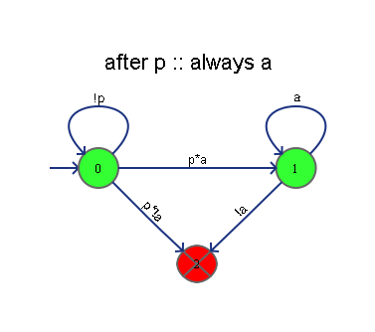
After P :: Always A
  Traces that satisfy this pattern:
  [-------’pa’aaaaaaaaaaaaaaaaaaaaaaaa…)
  [aaaaa----’pa’aaaaaaaaaaaaaaaaaaaaaa…)
  [a----a-----’pa’aaa----aaaaaaaaaaaaa…)
  [--a----a---------------------------…) (scope not defined)

Slide 12
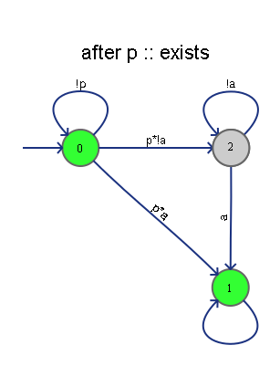
After P :: Exists A
  Any trace that contains a single A after a P occurs:
  [-------p------a---------…)
  [-------p------a--p--a---…)
  [----p---p---a-----------…) (two scopes, one not satisfied)
  [----p-a-p---a-----------…) (two scopes, both satisfied)

Slide 13
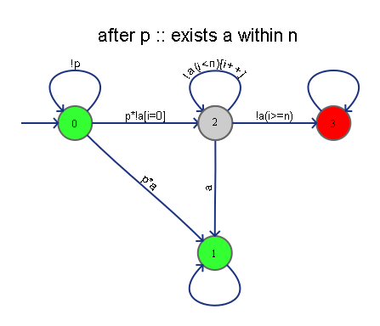
After P :: Exists A within N
  Any trace that contains a single A after a P occurs within N steps:
  [-------p------a---------…) (n=3)
  [-------p--a--p--a—------…) (n=3)
  [----p--ap---a-----------…) (two scopes, one not satisfied)
  [----p-a-p--a------------…) (two scopes, both satisfied)

Slide 14
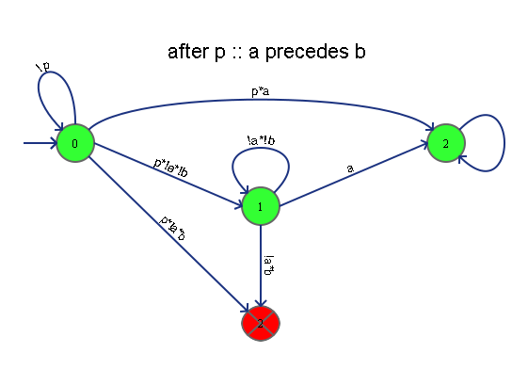
After P :: A precedes B
  Any trace that an A precedes every B after each occurrence of P satisfies
  [-------pb-----a---------…)
  [-------p--a--b--a—------…)
  [----p--ap---ab----------…) (two scopes, one not satisfied)
  [----p-abp--ab-----------…) (two scopes, both satisfied)

Slide 15
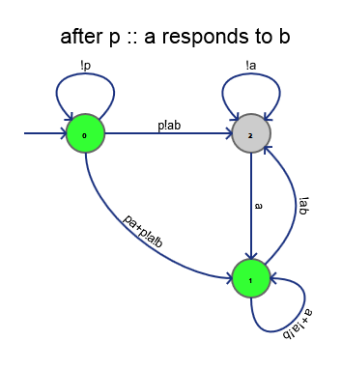
After P :: A responds to B
  Any trace that A appears after every B after each occurrence of P satisfies:
  [-------pb-----a---------…)
  [-------p--a--b--a—------…)
  [----p--ap---ab----------…) (two scopes, one not satisfied)
  [----p-bap----------ba---…) (two scopes, both satisfied)

Slide 16
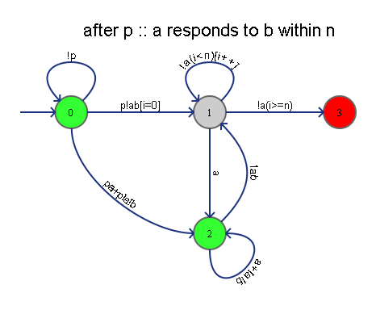
After P :: A responds to B within N
  Any trace that A appears after every B after each occurrence of P within N steps satisfies:
  [-------pb-----a---------…) (n=3)
  [-------p---b--a—--------…) (n=3)
  [----p--ap---b----a------…) (n=3)
  [----p-bap----------ba---…) (n=3)

Slide 17
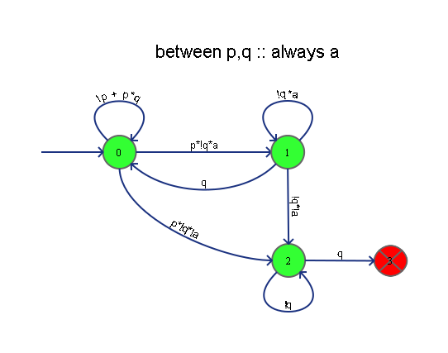
Between P,Q :: Always A
  Any trace in which A is always true after P (and simultaneously) until Q satisfies
  [-------”pa”aaaaaq-----------…)
  [-------”pa”aaaa”pa”aaaaq----…)
  [-------”pa”aaa-aq-----------…)
  [-pq-------------------------…) (trivial)
  [-------”pa””pa”aq-----------…) (two scopes)

Slide 18
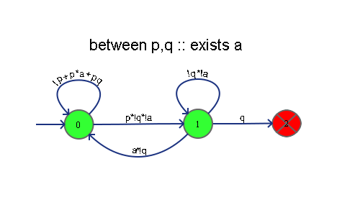
Between P,Q :: Exists A
  Traces that satisfy this pattern:
  [-------p----a---q------…)
  [-------pq--------pq----…) (trivial scopes)
  [-------p----a---p—a--q-…) (two scopes, both satisfied)
  [-------p----a---p—q----…) (two scopes, one not satisfied)
  [-------aq--------------…) (scope never started)
  [-------p—p—a—q---------…) (two scopes, both satisfied)

Slide 19
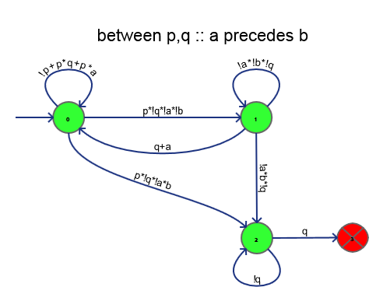
Between P,Q :: A precedes B
  Any trace in which each B is preceded by an A after an occurrence of P, until the occurrence of Q
  [-------p----a---q------…)
  [-------pq--------pq----…) (trivial scopes)
  [-------p----a---p—a--q-…) (two scopes, both satisfied)
  [-------p----a---p—q----…) (two scopes, one not satisfied)
  [-------aq--------------…) (scope never started)
  [-------p—p—a—q---------…) (two scopes, both satisfied)

Slide 20
Between P,Q :: A responds to B
  Any trace in which each B is followed by an A after an occurrence of P, until the occurrence of Q
  [-------p--b-a---q------…)
  [-------p--b---a---p----…) (scope not defined)
  [-------p--b-a---pba--q-…) (two scopes, both satisfied)
  [-------p-b---a---pbq---…) (two scopes, one not satisfied)
  [-------baq-------------…) (scope never started)
  [-------p—p—ba—q---------…) (two scopes, both satisfied)

Slide 21
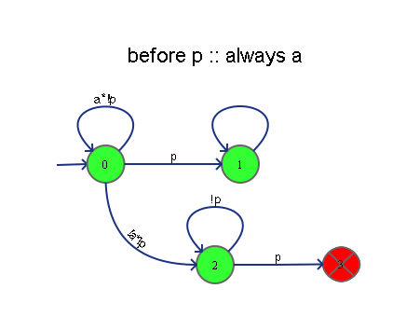
Before P :: Always A
  Any trace in which A is always true until the first occurrence of P (not including when P is first true)
  [aaaaaaaaaaap------a----…)
  [aaaaaa---aaaaa---------…) (scope not defined)
  [a--aaaaap--------------…) (not satisfied)
  [aaaaaap---p------------…) (only one scope)

Slide 22
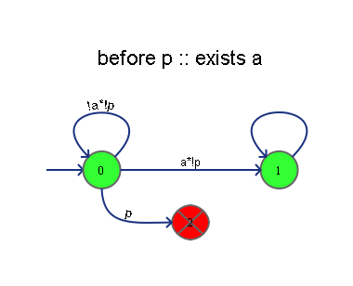
Before P :: Exists A
  Any trace in which A is true at least once until the first occurrence of P (not including when P is first true)
  [aa---------p------a----…)
  [-----------------------…) (scope not defined)
  [-------p----ap---------…) (only one scope, not satisfied)
  [aa----p-aaa---p--------…) (scopes do not overlap on before)

Slide 23
Before P :: A Precedes B
  Any trace in which every B is preceded by an A until the first occurrence of P (not including when P is first true)
  [ab---------p------a----…)
  [-----------------------…) (scope not defined)
  [----b--p----ap---------…) (only one scope, not satisfied)
  [------p----ap----------…) (only one scope, satisfied)
  [aa-b--p-aaa---p--------…) (scopes do not overlap on before)

Slide 24
Before P :: A Reponds to B
  Any trace in which every B is followed by an A until the first occurrence of P (not including when P is first true)
  [ab----a----p------a----…)
  [-----------------------…) (scope not defined)
  [----b--p----ap---------…) (only one scope, not satisfied)
  [------p----ap----------…) (only one scope, satisfied)
  [-----------ap----------…)

Slide 25
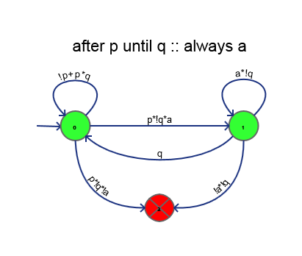
After P until Q :: Always A
  Any trace in which A is always true after P occurs (including the first state where P is true) until Q occurs (which may or may not ever happen)
  [---”pa”aaaaaaaaq-------…)
  [---”pa”aaaaaaaaaaaaaaaa…) (scope defined, but satisfied)
  [---”pa”aaaaaa-aq-------…)
  [---”pa”aaaaa”pa”aaaaaq-…) (two scopes, both satisfied)
  [---”pa”aaaaa”pa”aaa-aq-…) (two scopes, second unsatisfied)
  [---”pq”-----”pq”-------…) (trivial scopes)

Slide 26
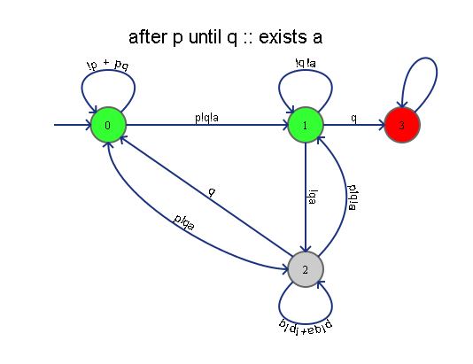
After P until Q :: Exists A
  Any trace in which A is true at least once after P occurs (including the first state where P is true) or until Q is true (not inclusive)
  [---p----a------q-------…)
  [---p--------a----------…) (scope defined, but satisfied)
  [---p-----------q-------…)
  [---p--a--p---a---q-----…) (two scopes, both satisfied)
  [---p-a-p---q-----------…) (two scopes, second unsatisfied)
  [---”pq”-----”pq”-------…) (trivial scopes)

Slide 27
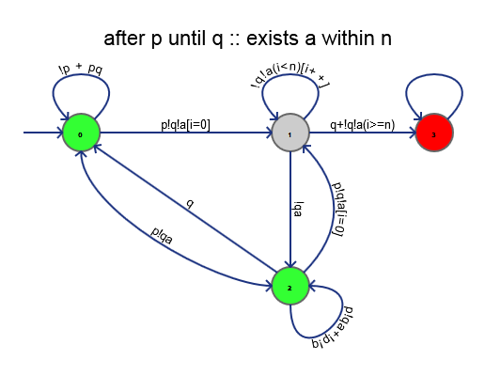
After P until Q :: Exists A within N
  Any trace in which A is true at least after P occurs within N steps (including the first state where P is true) or until Q is true.
  [---p--a------q------…) (n=3)
  [---p-q--------------…) (q before an a makes this unsatisfied)
  [---p--a-------------…) (n=3)
  [---p----a------q----…) (n=3)
  [---p--a--p—a----q---…) (two scopes, both satisfied) (n=3)
  [---p-a-p------aq----…) (two scopes, second unsatisfied) (n=3)
  [---”pq”-----”pq”----…) (trivial scopes)

Slide 28
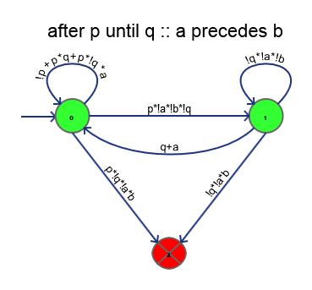
After P until Q :: A precedes B
  Any trace in which every occurrence of B is preceded by an occurrence of A after the each occurrence of P until the first occurrence of Q
  [---p--ab-----q------…)
  [---p-bq-------------…)
  [---p--a-------------…)
  [---p----b-----------…)
  [---p--a--p—a--b-q---…) (two scopes, both satisfied)
  [---p-a-p--b---aq----…) (two scopes, second unsatisfied)
  [---”pq”-----”pq”----…) (trivial scopes)

Slide 29
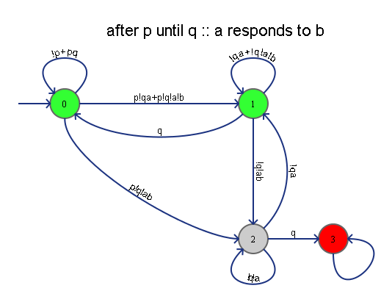
After P until Q :: A responds to B
  Any trace in which each occurrence of B is followed with an occurrence of A after each occurrence of P until the first occurrence of Q.
  [---p--b---aq--------…)
  [---p--a-------------…)
  [---p----a------q----…) (no B doesn’t mean A cannot happen)
  [---p-ba--p—b----aq--…) (two scopes, both satisfied)
  [---p-b-p---b--aq----…) (two scopes, first unsatisfied)
  [---”pq”-----”pq”----…) (trivial scopes)

Slide 30
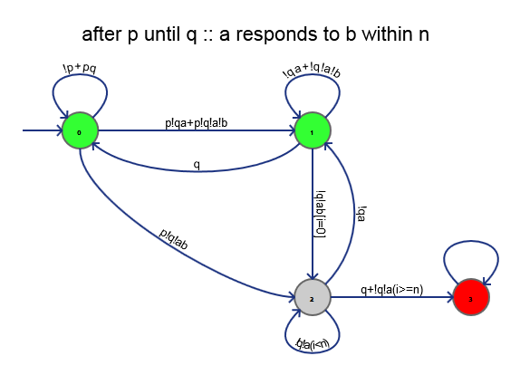
After P until Q :: A responds to B within N
  Any trace in which each occurrence of B is followed with an occurrence of A within N steps after each occurrence of P until the first occurrence of Q.
  [---p--b--aq---------…) (n=3)
  [---p--b---aq--------…) (n=3)
  [---p----a------q----…) (no B doesn’t mean A cannot happen)
  [---p-ba--p—b----aq--…) (two scopes, both satisfied)
  [---p-b---ap---b--aq-…) (two scopes, first unsatisfied)
  [---”pq”-----”pq”----…) (trivial scopes)

Slide 31
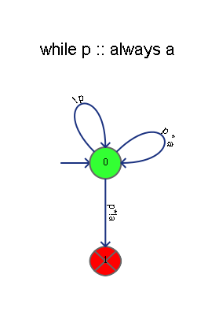
While P :: Always A
  Any trace in which whenever P is true, A is also true. (P implies A)
  [---aaa--aaaa----aa--…)
  [---ppp--pppp----pp--…)
  [---aa--aa---aa------…)
  [---ppp-pp---ppp-----…)

Slide 32
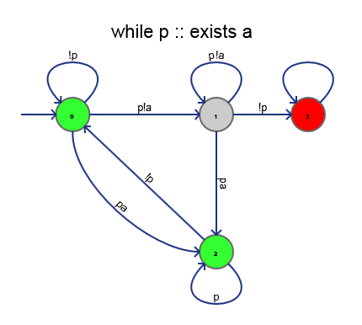
While P :: Exists A
  Once p becomes true, until p becomes false, A will occur at least once.
  [-----a---a-------a--…)
  [---ppp--pppp----pp--…)
  [---a----------a-----…)
  [---ppp-pp---ppp-----…)

Slide 33
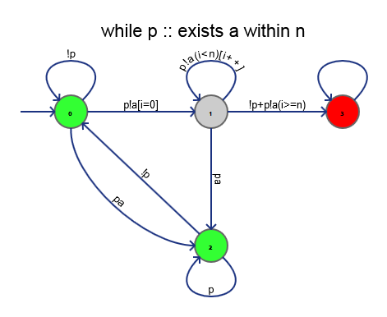
While P :: Exists A within N
  Once p becomes true, until p becomes false, A will occur at least once within N steps of the first occurrence of p.
  [-----a----a------a--…) (n=3)
  [---ppp--pppp----pp--…)
  [---a----------a-----…) (n=3) (2nd and 3rd scopes fail)
  [---ppp-pp--pppp-----…)

Slide 34
While P :: A precedes B
  Once p becomes true, until p becomes false, every occurrence of B will be preceded by an occurrence of A.
  [---a-b----ab-----a--…)
  [---ppp--pppp----pp--…)
  [---ab---b----ba-----…) (2nd and 3rd scopes fail)
  [---ppp-pp--pppp-----…)

Slide 35
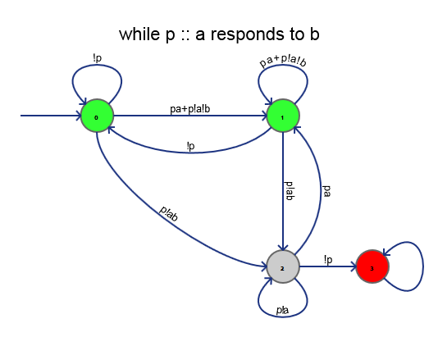
While P :: A responds to B
  Once p becomes true, until p becomes false, every occurrence of B will be followed by an occurrence of A.
  [---b-a---ba-----a---…)
  [---ppp--pppp----pp--…)
  [---ba---b----b------…) (2nd and 3rd scopes fail)
  [---ppp-pp--pppp-----…)

Slide 36
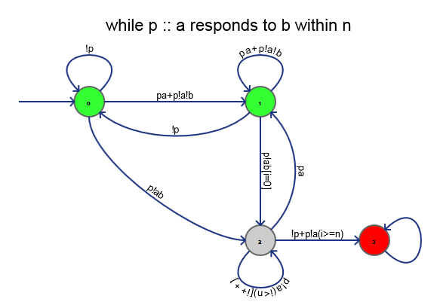
While P :: A responds to B within N
  Once p becomes true, until p becomes false, every occurrence of B will be followed by an occurrence of A within N steps.
  [---b-a--b-a-----a---…) (n=2)
  [---ppp--pppp----pp--…)
  [---ba---b--b--a-----…) (2nd and 3rd scopes fail) (n=2)
  [---ppp-pp--pppp-----…)

Slide 37
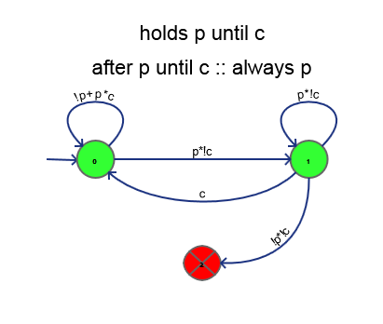
Hold at P until C
  Once P becomes true, it will remain true until C occurs.
  [--pppppppppppc---…)
  [--pppc-----------…)
  [--pc-------------…)
  [--p--c-p---------…)

Slide 38
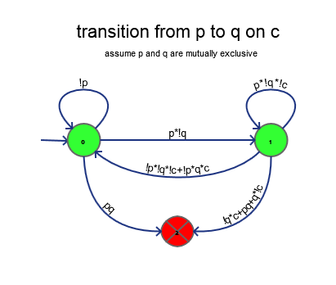
Transition From P to Q on C
  Once P becomes true, Q will only become true when C occurs simultaneously with it.
  [--ppppppppppp”qc”---…)
  [--pppc--------------…)
  [--ppppppp-----------…)
  [--p--c-p------------…)

