Slide 1
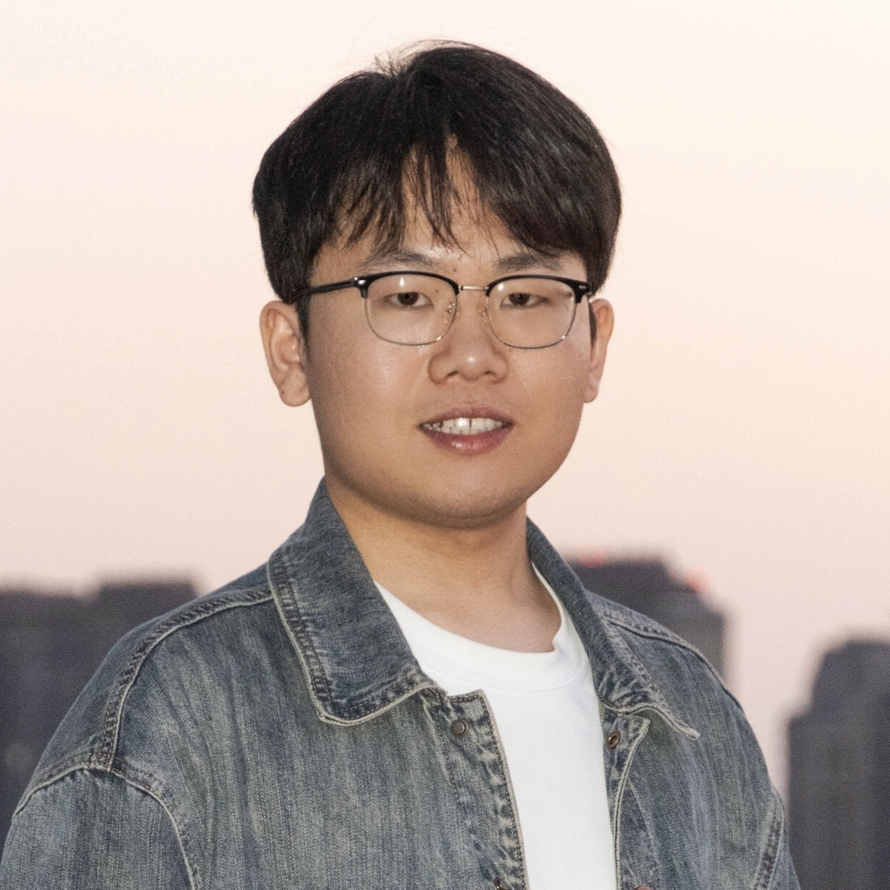
Universal Digital Agents That Learn, Remember, and Act
Guangyi Liu | Ph.D. Candidate, Zhejiang University
Research Internship / Talent Program Interview | Expected Jun 2028
Notes:
Open with the long-term research goal: agents that learn, remember, and act reliably in real digital environments.
[Sources]
- /Users/liuguangyi05/code/personal-info-guangyi/Guangyi-CV-latex/main.tex
- /Users/liuguangyi05/code/personal-info-guangyi/lgy0404.github.io/_pages/about.md

Slide 2
Candidate Snapshot | Research Focus and Impact
Research focus | Universal digital agents and GUI agents
Current role | Ph.D. candidate at ZJU APRIL Lab
Research output | 5 first-author works · ACM MM / ACL / TMLR
Academic impact | 415 citations · 122 first-author citations
Open-source impact | 632 first-author project GitHub stars
Notes:
Establish the overall profile in forty seconds: a focused research direction, a coherent body of work, and measurable academic and open-source impact. Metrics updated Aug 9, 2026.
[Sources]
- /Users/liuguangyi05/code/personal-info-guangyi/Guangyi-CV-latex/main.tex
- /Users/liuguangyi05/code/personal-info-guangyi/lgy0404.github.io/_pages/about.md

Slide 3
Education and Growth
2019–2023 | CUMT · B.Eng. in Automation | No. 1/203 · National Scholarship ×2
2023–2025 | Zhejiang University · M.S. | NeSC Group
2025–2028 | Zhejiang University · Ph.D. | APRIL Lab · Expected Jun 2028
Notes:
Highlight the continuous path from automation and control to universal digital agents, supported by the top undergraduate ranking and two National Scholarships.
[Sources]
- /Users/liuguangyi05/code/personal-info-guangyi/Guangyi-CV-latex/main.tex

Slide 4
Industry Research | From Prototypes to Real Systems
vivo AI Lab (Aug 2024–Aug 2025) | PhoneGPT, demonstration learning, online evaluation, and memory benchmarking
Kuaishou (Aug 2025–Jul 2026) | Agent post-training, long-horizon context management, and app defect detection
Research | Formulate questions and validate methods
Engineering | Build environments, data pipelines, and automated evaluation
Application | Connect agent research to real product workflows
Notes:
The two consecutive industry research experiences demonstrate a closed loop across research, engineering, and application rather than paper-only collaboration.
[Sources]
- /Users/liuguangyi05/code/personal-info-guangyi/Guangyi-CV-latex/main.tex
- /Users/liuguangyi05/code/personal-info-guangyi/lgy0404.github.io/_pages/about.md

Slide 5
Research Thesis | Continuous Improvement in Real Environments
Universal Digital Agents
Learn | Demonstrations, feedback, RL, and post-training
Remember | Context management, experience reuse, and continual adaptation
Evaluate | Online protocols, interpretable metrics, and failure diagnosis
Act | Cross-app tool use and long-horizon execution
Notes:
Mobile GUIs are the current proving ground because they combine dynamic interfaces, sparse feedback, hidden state, long-tail workflows, and deployment constraints.
[Sources]
- /Users/liuguangyi05/code/personal-info-guangyi/Guangyi-CV-latex/main.tex
- /Users/liuguangyi05/code/personal-info-guangyi/research-summary-guangyi/interview-slides/slidev/slides.md

Slide 6
End-to-End Ownership | From Question to System
Environment and data | Exploration, demonstrations, rollouts, feedback, and memory traces
Policy | Prompting, SFT, RL, and context-management actions
Evaluation | Online success, pass@k, progressive scrutiny, and failure diagnosis
System | A reproducible pipeline from exploration to deployment
Find the bottleneck → make it measurable → close the loop
Notes:
Emphasize ownership of the full research loop: not only algorithms, but also environments, data, evaluation, and reproducible systems.
[Sources]
- /Users/liuguangyi05/code/personal-info-guangyi/research-summary-guangyi/interview-slides/slidev/slides.md

Slide 7
Five First-Author Works, One Coherent Research Arc
Survey → LearnAct → MemGUI-Bench → MobileForge → MemGUI-Agent
From field mapping to demonstration learning, memory evaluation, self-improvement, and long-horizon agents
Notes:
Use this slide as the transition from the candidate overview to the paper-by-paper discussion that follows the same research arc.
[Sources]
- /Users/liuguangyi05/code/personal-info-guangyi/Guangyi-CV-latex/main.tex
- /Users/liuguangyi05/code/personal-info-guangyi/lgy0404.github.io/_pages/about.md

