Slide 1
SEOUL Public Bicycle
Hayeong Lee
Haneul KIM
JooHwan HAN

Slide 2

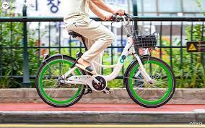
01
02
03
04
05
Public bicycle Datasets
Data of station
History of broken
History of usage
User information
Usage
IST-4-DBM1 | 2022
IST-4-DBM1 | 2022

Slide 3
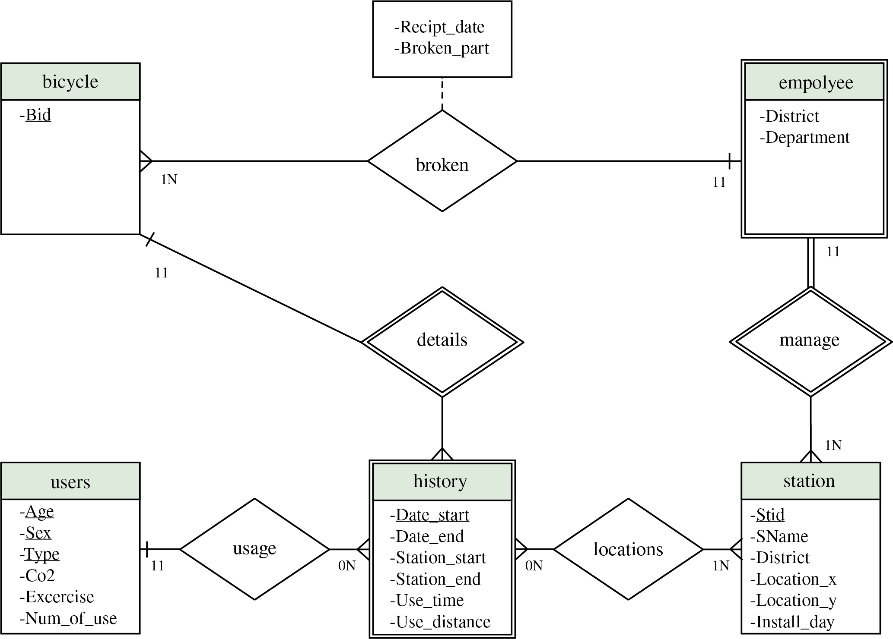
01
02
03
04
05
ER Diagram
IST-4-DBM1 | 2022
IST-4-DBM1 | 2022

Slide 4
01
02
03
04
05
Queries
Basic query 1 : Which bicycle has more than 60 minutes of uses and has 4 uses?
Basic query 2 : What is the total Co2 reduction and exercise for women in their 30s with season ticket?.
Query 1 : Which departure and arrival station had the most number of usage in a month?
Query 2 : What is the biggest number of usage of bicycles, and what is the total time?
Query 3 : A station with the most bicycles
Query 4 : Which department is in charge of the station the most?
Query 5 : Which distirct has the most station?
Query 6 : What was the travel distance and usage time of the broken bicycle?
Query 7 : What was the fastest bicycle and its speed?
IST-4-DBM1 | 2022
IST-4-DBM1 | 2022

Slide 5
01
02
03
04
05
Queries
Basic query 1 : Which bicycle has more than 60 minutes of uses and has 4 uses?
Basic query 2 : What is the total Co2 reduction and exercise for women in their 30s with season ticket?.
Query 1 : Which departure and arrival station had the most number of usage in a month?
Query 2 : What is the biggest number of usage of bicycles, and what is the total time?
Query 3 : A station with the most bicycles
Query 4 : Which department is in charge of the station the most?
Query 5 : Which distirct has the most station?
Query 6 : What was the travel distance and usage time of the broken bicycle?
Query 7 : What was the fastest bicycle and its speed?
IST-4-DBM1 | 2022
IST-4-DBM1 | 2022

Slide 6

01
02
03
04
05
Queries
What is the biggest number of usage of bicycles, and what is the total time and distance?
Locations
Max
F_bid | F_sid | T_time | T_distance | Num_of_used
… | … | … | … | …
SPB-30009 | 184 | 16 | 1975 | 1
SPB-46117 | 108 | 287 | 29070 | 5
… | … | … | … | …
Max_num_of_used
5
IST-4-DBM1 | 2022
IST-4-DBM1 | 2022

Slide 7
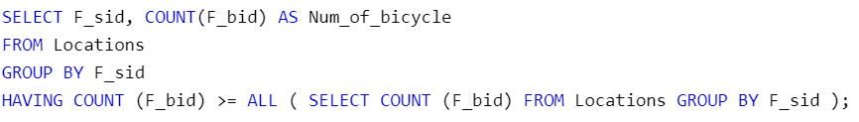
01
02
03
04
05
Queries
A station with the most bicycles
Locations
New_Locations
F_sid | Count(F_bid)
207 | 126
354 | 4
497 | 15
… | …
F_sid | Count(F_bid)
537 | 11
354 | 4
497 | 15
… | …
>=
IST-4-DBM1 | 2022
IST-4-DBM1 | 2022

Slide 8


01
02
03
04
05
Queries
What was the travel distance and usage time of the broken bicycle ?
Locations
Broken
F_bid | F_sid | T_time | T_distance | Num_of_used
SPB-30001 | 726 | 10 | 853.65 | 1
SPB-30009 | 184 | 16 | 1975 | 1
SPB-32092 | 109 | 72 | 1401,51 | 1
Bid | Receipt_date | Broken_part
SPB-36049 | 2022-01-01 0:45 | etc
SPB-34190 | 2022-01-01 1:01 | etc
SPB-32092 | 2022-01-01 1:55 | etc
IST-4-DBM1 | 2022
IST-4-DBM1 | 2022

Slide 9
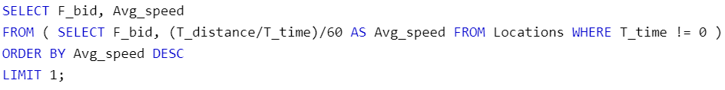

01
02
03
04
05
Queries
What was the fastest bicycle and its speed?
Locations
New_Locations
F_bid | F_sid | T_time | T_distance | Num_of_used
SPB-38134 | 538 | 0 | 0,2 | 1
SPB-30009 | 184 | 16 | 1975 | 1
… | … | … | … | …
F_bid | Avg_speed
SPB-30001 | 1,42275
SPB-30009 | 2,0572916666
… | …
IST-4-DBM1 | 2022
IST-4-DBM1 | 2022

Slide 10
01
02
03
04
05
Relational Algebra
Find the Bicycle id where used time is over 60 and the number of used is 4
Locations
F_bid | F_sid | T_time | T_distance | Num_of_used
SPB-30001 | 726 | 10 | 853.65 | 1
SPB-30009 | 184 | 16 | 1975 | 1
… | … | … | … | …
$$Π_{F_bid}\left(σ_{T_time> 60 ∧ Num_of_used =4}\left(Locations\right)\right)$$
2. Find $CO_{2}$ and Exercise values of thirties female who has season ticket.
Users
Age | Sex | Types | Co2 | Exercise | Num_of_use
Teenager |  | Group | 185.9 | 21171.17 | 289
Teenager |  | Daily(membership) | 2272.5 | 246956.42 | 3917
… | … | … | … | … | …
$$Π_{Co2, Exercise}\left(σ_{Age=^{′}30대^{′}∧ Sex=^{′}F^{′}∧ Types=^{′}정기^{′}}\left(Users\right)\right)$$
IST-4-DBM1 | 2022
IST-4-DBM1 | 2022

Slide 11

01
02
03
04
05
Conclusions & Limitations
Conclusions
By implementing ER diagram and database,
1. understand what we learned in theory
2. able to handle data from point of view of users and companies
Limitations
1. Data loss occurred in the process of randomly extracted data
2. User information is not specific
IST-4-DBM1 | 2022
IST-4-DBM1 | 2022

Slide 12
THANK YOU
Hayeong Lee
Haneul KIM
JooHwan HAN

