Slide 1
Performance improvements of commonly used optimizers in Machine Learning using CUDA or OpenCL

Slide 2
Agenda
Motivation
Quick intro to CUDA and OpenCL
Implementation of Benchmarks

Slide 3
Motivation

Slide 4
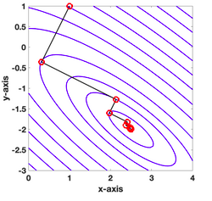
The role of optimization in machine learning
Optimizers are the engines of machine learning, they provide the direction in which the model learns.
https://en.wikipedia.org/wiki/Gradient_descent
1

Slide 5
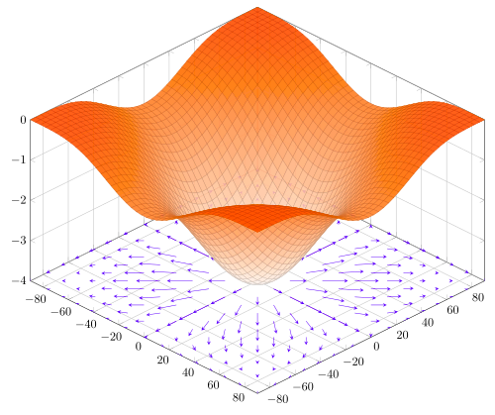
The role of optimization in machine learning
Initally we are optimizing the learnable weights towards a minimum of a loss function,
Start
Minimum
https://en.wikipedia.org/wiki/Gradient
2

Slide 6
The role of optimization in machine learning
this is often leads to linear algebra operations, most inputs like images or text are represented as matrices...
1 2 3 4
... … … …
... ... … ...
..
.
1 2 3 4
... … … …
... ... … ...
..
.
1 2 3 4
... … … …
... ... … ...
..
.
X
=
https://en.wikipedia.org/wiki/Gradient
3

Slide 7
The role of hardware in machine learning
Matrix operations are computional expensive, since we still need to compute every index...
1 2 3 4
... … … …
... ... … ...
..
.
1 2 3 4
... … … …
... ... … ...
..
.
1 2 3 4
... … … …
... ... … ...
..
.
X
=
https://en.wikipedia.org/wiki/Gradient
4

Slide 8
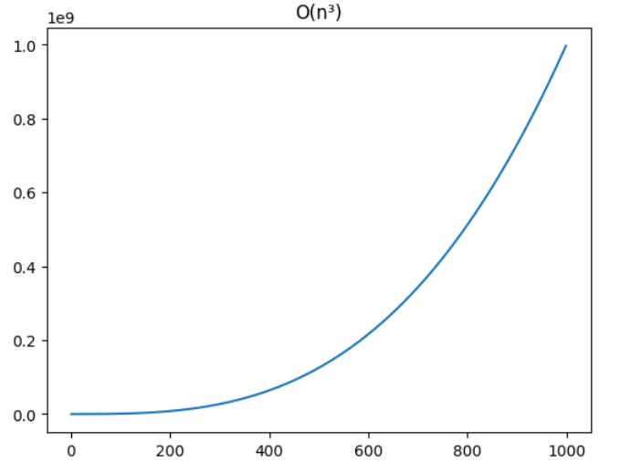
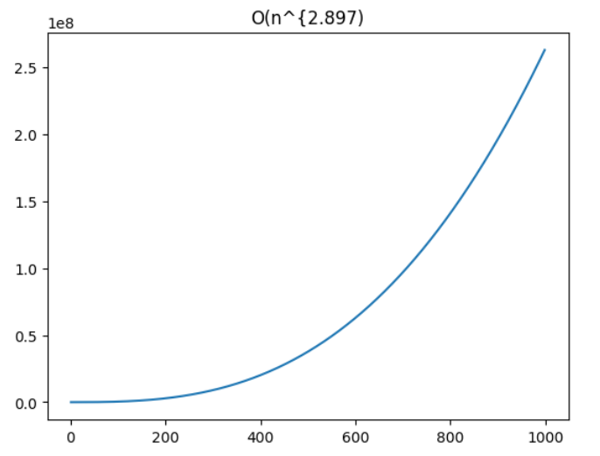

The role of hardware in machine learning
Lets have a look at various complexities…
Classic Stassen Winograd
https://www.sciencedirect.com/topics/computer-science/matrix-multiplication
6

Slide 9
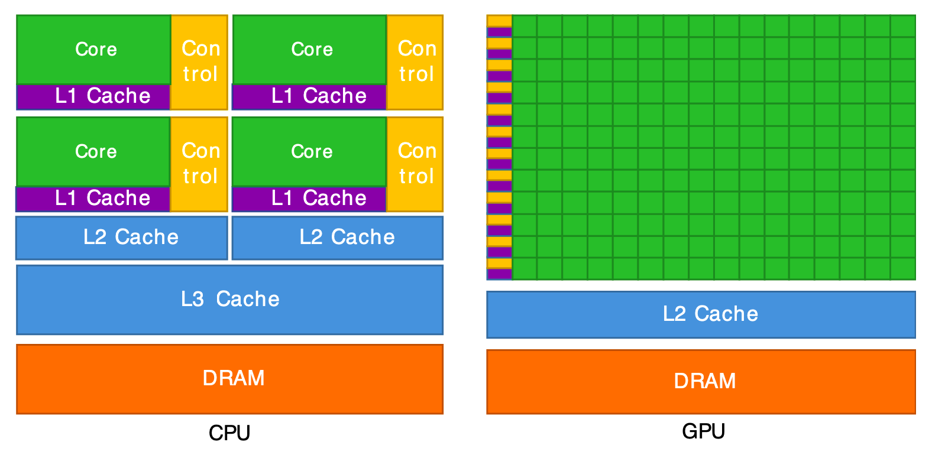
The role of hardware in machine learning
What about hardware exploitation...
https://cvw.cac.cornell.edu/gpu-architecture/gpu-characteristics/design
7

Slide 10
The role of hardware in machine learning
Core counts make a difference...
4 to 8 cores
100 to ~1000
cores
https://jasonwhatson.com/posts/gpu-vs-cpu-performance-for-matrix-multiplication
8

Slide 11
The role of hardware in machine learning
Core counts (architecture) make a difference...
4 to 8 cores
100 to ~1000
cores
https://jasonwhatson.com/posts/gpu-vs-cpu-performance-for-matrix-multiplication/
9

Slide 12
Quick intro to CUDA and OpenCL
10

Slide 13
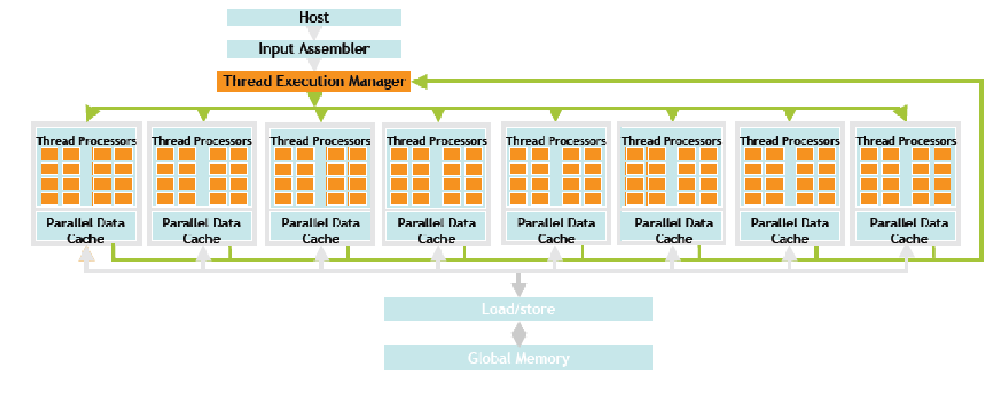
CUDA or OpenCL?
So the better choice are GPUs but how to exploit them? There are various frameworks...
CUDA
https://developer.nvidia.com/blog/cuda-refresher-cuda-programming-model/
11

Slide 14
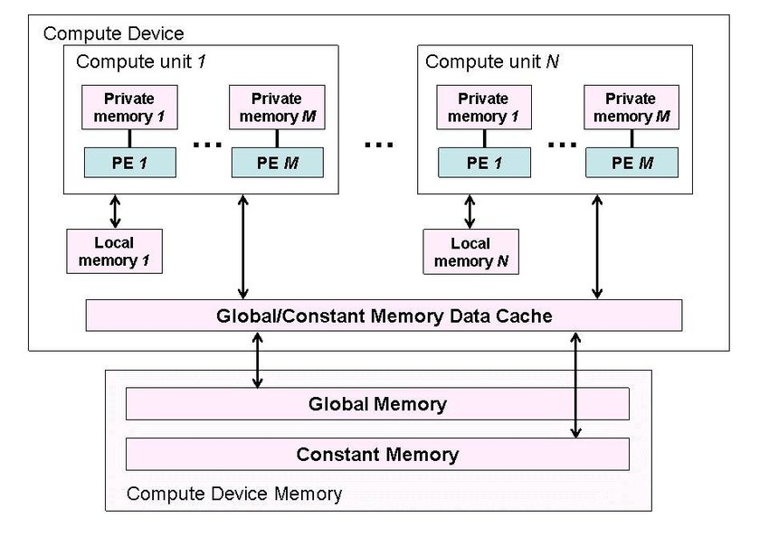
CUDA or OpenCL?
So the better choice are GPUs but how to exploit them? There are various frameworks...
OpenCL
https://www.researchgate.net/figure/Conceptual-OpenCL-device-architecture-After-Munshi-ed-2010_fig3_265592744
12

Slide 15
CUDA or OpenCL
OpenCL
10

Slide 16
Implementation of the Benchmark
13

Slide 17
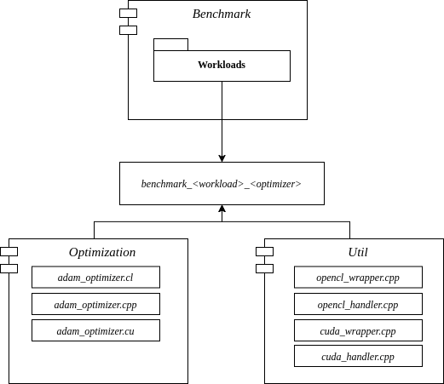
Implementation of the Benchmark
For both frameworks, measuring..
  Data transfer time from CPU-Cache to GPU-Cache…
  Computing time…
  Using Google Benchmark Libary...
14

Slide 18
Sources

