Slide 1
Performance improvements of commonly used optimizers in machine learning using CUDA and OpenCL
Lennart Hahner

Slide 2
Motivation
I. Motivation
II. Expectations
III. CUDA vs. OpenCL
IV. Implementation
V. Results
1

Slide 3
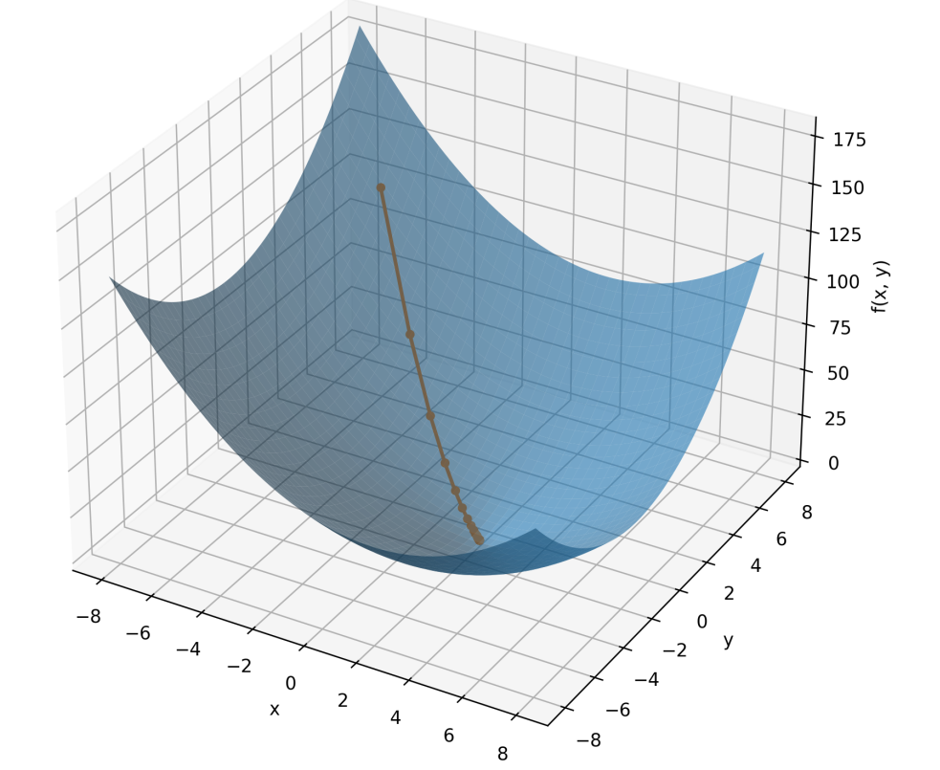
The role of optimization in machine learning
I. Motivation
II. Expectations
III. CUDA vs. OpenCL
IV. Implementation
V. Results
Optimizers are the engines of machine learning models.
2

Slide 4
The role of optimization in machine learning
I. Motivation
II. Expectations
III. CUDA vs. OpenCL
IV. Implementation
V. Results
Train learnable weights towards a minimum of a loss function.
Start
Minima
3

Slide 5
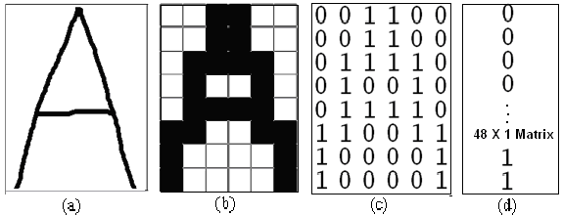
The role of optimization in machine learning
I. Motivation
II. Expectations
III. CUDA vs. OpenCL
IV. Implementation
V. Results
Most inputs e.g. images or text are represented as matrices...
[1] Figure 2 from Improving the Character Recognition Efficiency of Feed Forward BP Neural Network
4

Slide 6
The role of hardware in machine learning
I. Motivation
II. Expectations
III. CUDA vs. OpenCL
IV. Implementation
V. Results
Thus, we often deal with matrix or tensor operations during optimizations...
1 0 2
4
5
3
0
..
3 0 …
…
X
=
5

Slide 7
The role of hardware in machine learning
I. Motivation
II. Expectations
III. CUDA vs. OpenCL
IV. Implementation
V. Results
Thus, we often deal with matrix or tensor operations during optimizations...
X
=
6

Slide 8
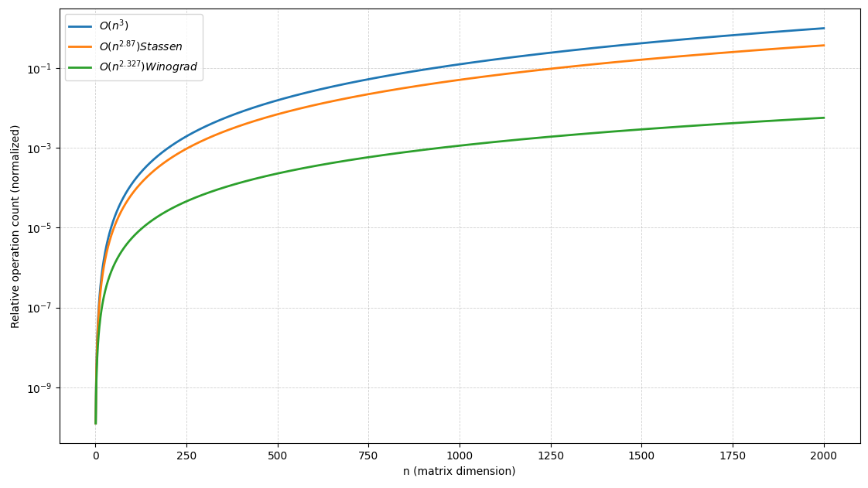
The role of hardware in machine learning
I. Motivation
II. Expectations
III. CUDA vs. OpenCL
IV. Implementation
V. Results
Matrix and Tensor operations are computationally expensive...
7

Slide 9
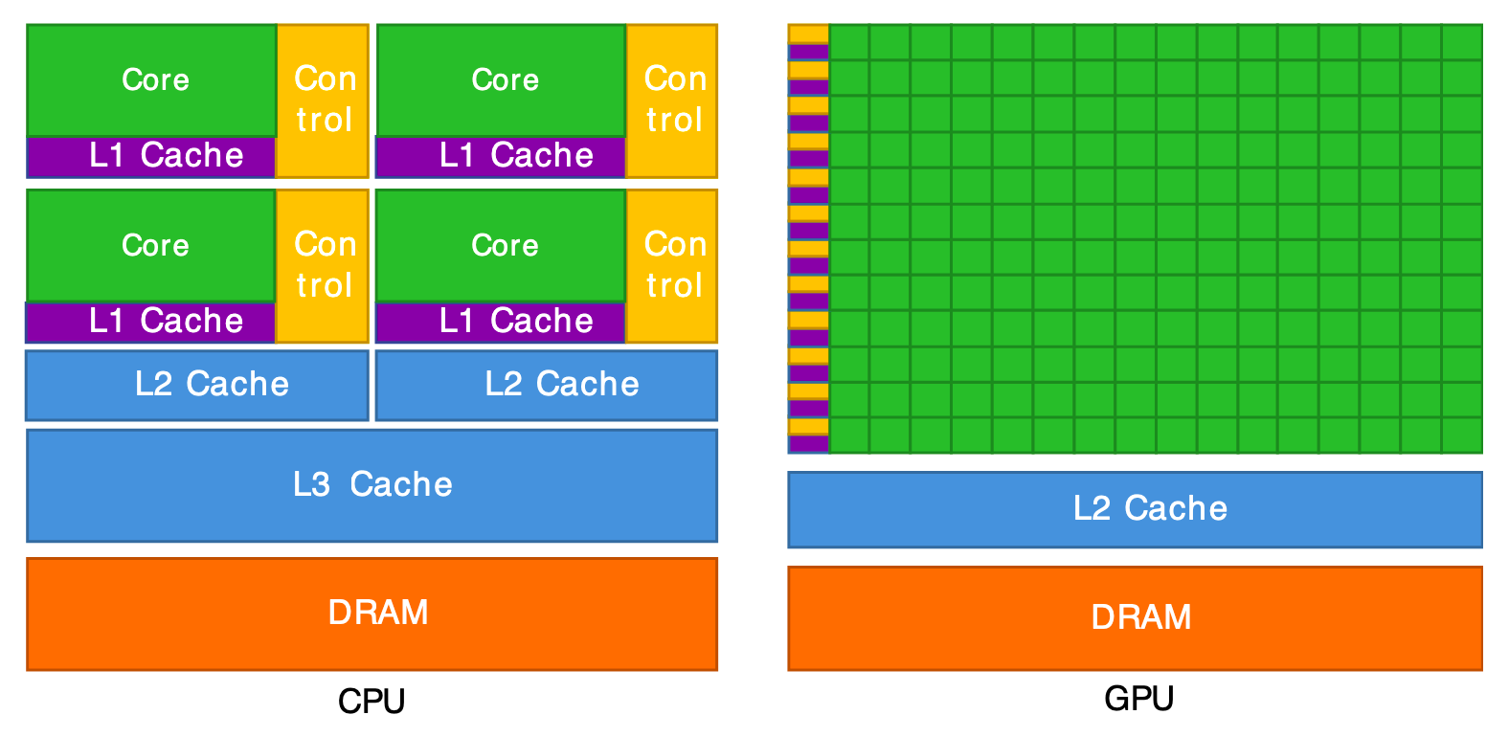
The role of hardware in machine learning
I. Motivation
II. Expectations
III. CUDA vs. OpenCL
IV. Implementation
V. Results
...exploiting hardware for parallelization
[2] Figure 2 - Review of GPU-based Monte Carlo simulation platforms for transmission and emission tomography in medicine.
8

Slide 10
The role of hardware in machine learning
I. Motivation
II. Expectations
III. CUDA vs. OpenCL
IV. Implementation
V. Results
...exploiting hardware for parallelization
Specification | Intel Core i9 14900KF [3] | Nvidia GeForce RTX 5080 [4]
Cores | 24 | 16384+
Max. Boost Clock (Ghz) | 6 | 2.62
Architecture | x86 | Blackwell
Core Paradigma | MIMD | SPMD
[3] Intel
[4] NVIDIA
9

Slide 11


The role of hardware in machine learning
I. Motivation
II. Expectations
III. CUDA vs. OpenCL
IV. Implementation
V. Results
...how to exploit GPUs?
10

Slide 12
Table of Contents
Motivation
Related work & expectations
Conceptual differences of OpenCL and CUDA
The implementation
Results
11

Slide 13
Expectations
I. Motivation
II. Expectations
III. CUDA vs. OpenCL
IV. Implementation
V. Results
12

Slide 14
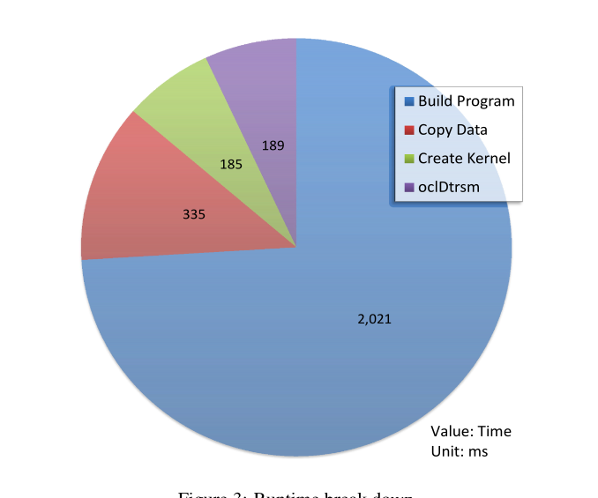
Results of „From CUDA to OpenCL“ [5]
I. Motivation
II. Expectations
III. CUDA vs. OpenCL
IV. Implementation
V. Results
OpenCL enables code portability, but not performance
OpenCL GEMM
program
13
[5] „From CUDA to OpenCL: Towards a Performance-portable Solution for Multi-platform GPU Programming“ Peng D.

Slide 15
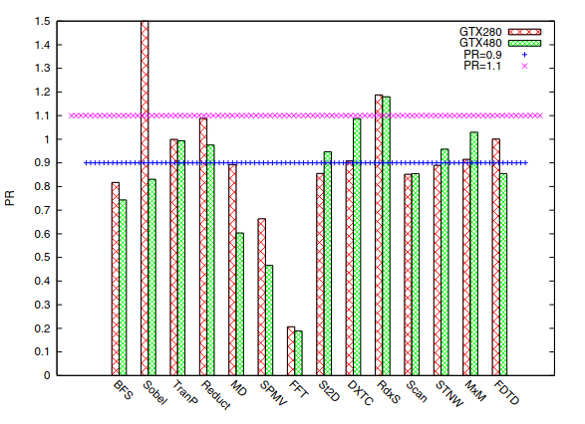
Results of „A comprehensive Performance comparison of CUDA and OpenCL“ [6]
I. Motivation
II. Expectations
III. CUDA vs. OpenCL
IV. Implementation
V. Results
CUDA is at most ~30% faster than OpenCL for most applications
Workloads
14
[6] J. Fang, A. L. Varbanescu and H. Sips, "A Comprehensive Performance Comparison of CUDA and OpenCL,"

Slide 16
Literature review
I. Motivation
II. Expectations
III. CUDA vs. OpenCL
IV. Implementation
V. Results
Most of the comparison results are more than 10 years old…
[5],[6]
[7]
[8]
[9]
15

Slide 17
So, what to expect from the comparison?
I. Motivation
II. Expectations
III. CUDA vs. OpenCL
IV. Implementation
V. Results
...CUDA might perform better, due to the longer compile/build time of OpenCL, but it’s worth revisiting...
16

Slide 18
Conceptual comparison of
CUDA and OpenCL
I. Motivation
II. Expectations
III. CUDA vs. OpenCL
IV. Implementation
V. Results
17

Slide 19
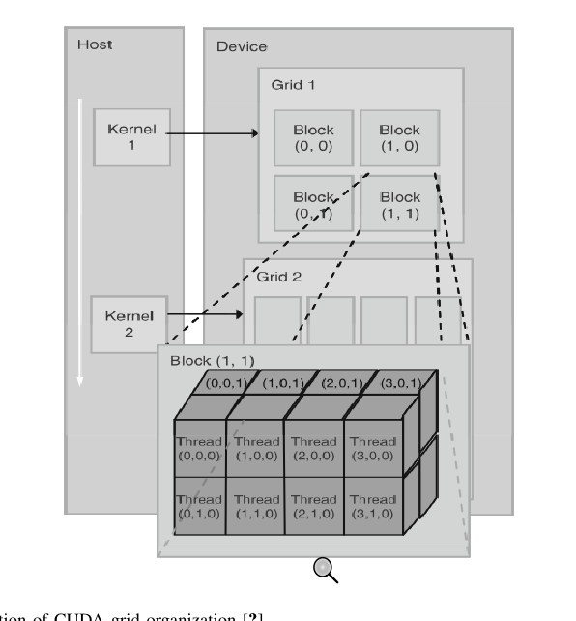
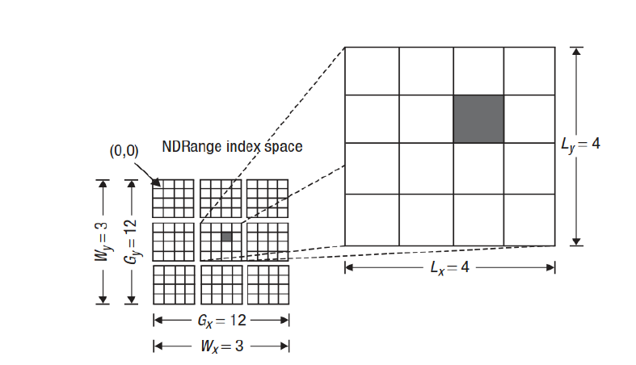
Abstraction differences
I. Motivation
II. Expectations
III. CUDA vs. OpenCL
IV. Implementation
V. Results
n Wrap
32 Wrap
[10] Figure 1.7 in Aftab M. et al. “OpenCL Programming Guide”
[11] Figure 3.13 in Kirk D. et al. “Programming Massively Parallel Processors””
18

Slide 20
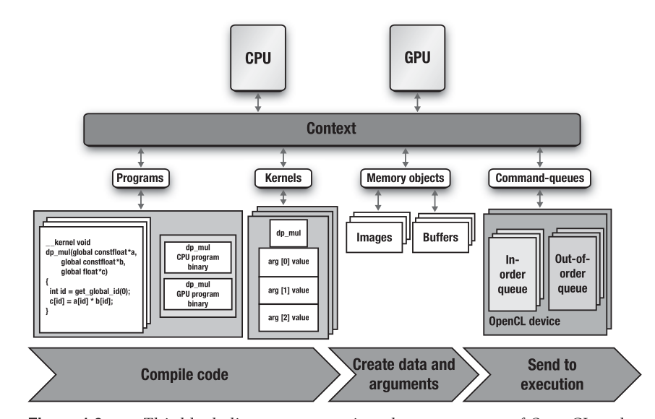
Architecture differences
I. Motivation
II. Expectations
III. CUDA vs. OpenCL
IV. Implementation
V. Results
CPU
GPU
CUDA C Program
Runtime API
cudaMalloc(…)
Execution Context
cudaMemcpy(…)
Load Module
__global void mykernel(…) {
NVCC
Scheduler
CUDA Driver
Memory Management
Compiles code
Create data
Execute
[10] Figure 1.7 in Aftab M. et al. “OpenCL Programming Guide”
[12] Based on CUDA Programming Guide
19

Slide 21
Architecture differences
I. Motivation
II. Expectations
III. CUDA vs. OpenCL
IV. Implementation
V. Results
Unlike CUDA, OpenCL requires
an environmental setup...
Get cl_device_id
Create cl_context
Create cl_command_queue
Create cl_program
Define cl_kernel
Allocate cl_mem
20
[11] Figure 1.9 in Aftab M. et al. “OpenCL Programming Guide”

Slide 22
Architecture differences
I. Motivation
II. Expectations
III. CUDA vs. OpenCL
IV. Implementation
V. Results
NVCC enables easy integration of
kernel functions...
Allocate device memory
cudaMalloc(...)
Copy to device cudaMemcpy(...)
Launch kernel
kernel«blocks, threads»(...)
Copy from device cudaMemcpy(...)
Free cudaFree(...)
CPU
GPU
CUDA C Program
Runtime API
cudaMalloc(…)
Execution Context
cudaMemcpy(…)
Load Module
__global void mykernel(…) {
NVCC
Scheduler
CUDA Driver
Memory Management
Compiles code
Create data
Execute
21
[12] Based on CUDA Programming guide

Slide 23
Kernels in different languages
I. Motivation
II. Expectations
III. CUDA vs. OpenCL
IV. Implementation
V. Results
E.g.: the update step of the Adam optimizer
__kernel void adam_update(
__global float* param,
__global const float* grad,
__global float* m,
__global float* v,
const float lr,
const float beta1,
const float beta2,
const float eps,
const float bc1,
const float bc2,
const int n
){
...
}
__global__ void adam_update_kernel_impl(
float *__restrict__ param,
const float *__restrict__ grad,
float *__restrict__ m,
float *__restrict__ v,
size_t n,
float lr, float beta1,
float beta2,
float bc1, float bc2, float eps)
{
...
}
22

Slide 24
Summary
I. Motivation
II. Expectations
III. CUDA vs. OpenCL
IV. Implementation
V. Results
Important differences summarized…
Abstraction does not expose hardware concepts.
Architecture that’s build for explicit control.
OpenCL C is separated from host code
Abstraction exposes hierarchical execution structure.
Architecture simplifies interaction with runtime API.
CUDA C is integrated within host code
23

Slide 25
The implementation
I. Motivation
II. Expectations
III. CUDA vs. OpenCL
IV. Implementation
V. Results
24

Slide 26
Architecture overview
I. Motivation
II. Expectations
III. CUDA vs. OpenCL
IV. Implementation
V. Results
User Interaction Layer
Compile and execute the binary
Util Layer
Logging, DTOs
and wrapper
Benchmark Layer
Workload A
Workload B
…
Workload N
Optimization Layer
Optimizer (CPU)
Optimizer in CUDA
Optimizer in OpenCL
Data Layer
Dataset creation
25

Slide 27
Architecture overview
I. Motivation
II. Expectations
III. CUDA vs. OpenCL
IV. Implementation
V. Results
User Interaction Layer
Compile and execute the binary
Util Layer
Logging, DTOs
and wrapper
Benchmark Layer
Workload A
Workload B
…
Workload N
Optimization Layer
Optimizer (CPU)
Optimizer in CUDA
Optimizer in OpenCL
Data Layer
Dataset creation
26

Slide 28
Benchmark layer
I. Motivation
II. Expectations
III. CUDA vs. OpenCL
IV. Implementation
V. Results
Definition and initialization of workloads...
Benchmark Module
Define the workload and run with optimizer
Workload Modules
<<Interface>>
Workload
forward(…) and compute_loss(…)
GEMM
…
27

Slide 29
Architecture overview
I. Motivation
II. Expectations
III. CUDA vs. OpenCL
IV. Implementation
V. Results
User Interaction Layer
Compile and execute the binary
Util Layer
Logging, DTOs
and wrapper
Benchmark Layer
Workload A
Workload B
…
Workload N
Optimization Layer
Optimizer (CPU)
Optimizer in CUDA
Optimizer in OpenCL
Data Layer
Dataset creation
28

Slide 30
Optimization layer
I. Motivation
II. Expectations
III. CUDA vs. OpenCL
IV. Implementation
V. Results
Optimizer implementations on different platforms
Optimizer Module
<<Interface>>
Optimizer
step(…)
Adam
step(…)
…
AdamCUDA
step(…)
launch_kernel(…)
AdamOpenCL
step(…)
configure(…)
29

Slide 31
Architecture overview
I. Motivation
II. Expectations
III. CUDA vs. OpenCL
IV. Implementation
V. Results
User Interaction Layer
Compile and execute the binary
Util Layer
Logging, DTOs
and wrapper
Benchmark Layer
Workload A
Workload B
…
Workload N
Optimization Layer
Optimizer (CPU)
Optimizer in CUDA
Optimizer in OpenCL
Data Layer
Dataset creation
30

Slide 32
Util layer
I. Motivation
II. Expectations
III. CUDA vs. OpenCL
IV. Implementation
V. Results
Implementation of cross-Cutting concerns
Util Module
Device Abstractions
Data View
DevicePlatformWrapperCl
HostParamView
DevicePlatformWrapperCu
DeviceParamView
Logging
DeviceParamView
31

Slide 33
Results
I. Motivation
II. Expectations
III. CUDA vs. OpenCL
IV. Implementation
V. Results
32

Slide 34
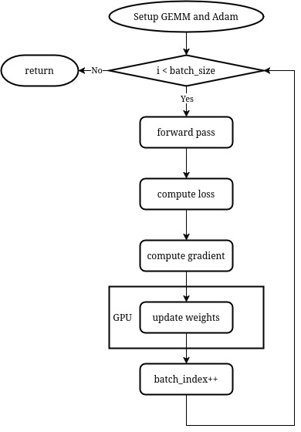
Benchmark environment
I. Motivation
II. Expectations
III. CUDA vs. OpenCL
IV. Implementation
V. Results
__global__ void adam_update_kernel_impl(
float *__restrict__ param,
const float *__restrict__ grad,
float *__restrict__ m,
float *__restrict__ v,
size_t n,
float lr, float beta1,
float beta2,
float bc1, float bc2, float eps)
{
...
}
33

Slide 35
Measured aspects in consideration
I. Motivation
II. Expectations
III. CUDA vs. OpenCL
IV. Implementation
V. Results
Metric | Measurement
Computation-Time | Isolate computer efficiency of the programming model.
Data-Transfer-time | Workloads can be memory-bound instead of compute-bound.
Quality-of-solution | Provide numerical stability and correctness
Build-time | Insights into compilation latency.
34

Slide 36
Benchmark environment
I. Motivation
II. Expectations
III. CUDA vs. OpenCL
IV. Implementation
V. Results
Running on…
A NVIDIA GeForce GTX 970
with an Intel i3-9100F and 16 GB RAM
35

Slide 37
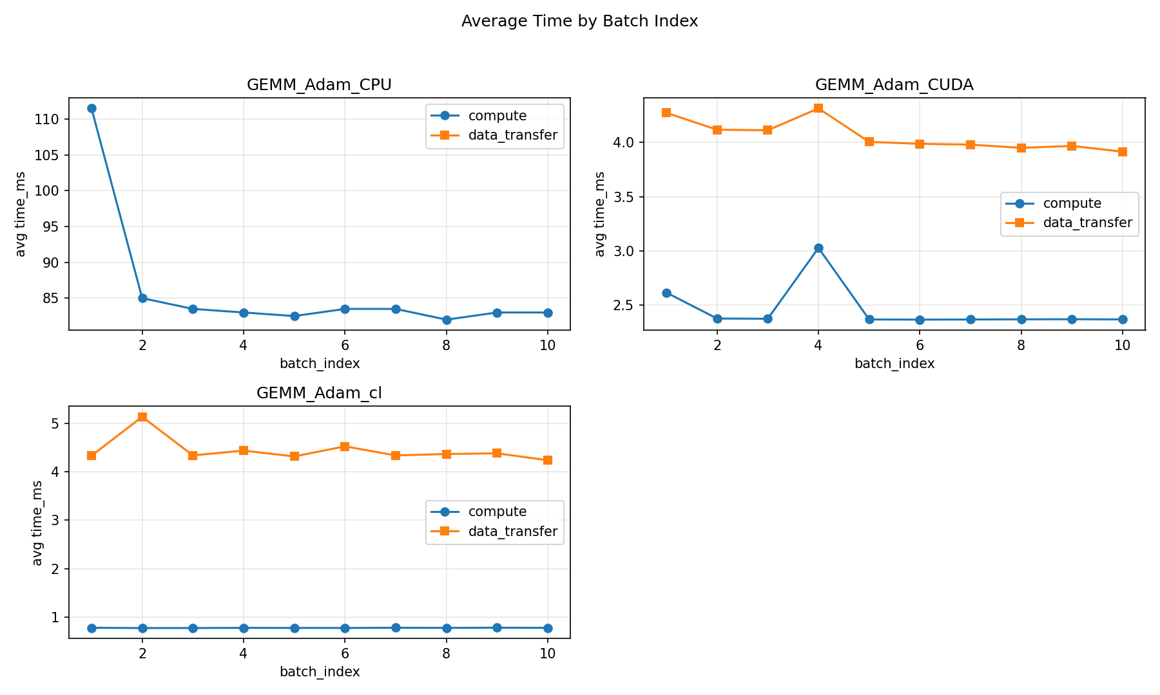
Visuals of currently obtained measurements
I. Motivation
II. Expectations
III. CUDA vs. OpenCL
IV. Implementation
V. Results
Averaged computation time and
data transfer time on batch-index….
36

Slide 38
Conclusion so far
I. Motivation
II. Expectations
III. CUDA vs. OpenCL
IV. Implementation
V. Results
OpenCL and CUDA perform on average pretty similar…
...but some Remarks:
    Currently only tested on GTX 970 → old platform
    The number of results are sparse
    Some metrics are missing, e.g. build-time
37

Slide 39
Outlook
I. Motivation
II. Expectations
III. CUDA vs. OpenCL
IV. Implementation
V. Results
Some TODOs until end of march...
Platform independence
AdamW
More measurements
38

Slide 40
Sources
[1] Rishi, Rahul. (2011). Improving the Character Recognition Efficiency of Feed Forward BP Neural Network. International Journal of Computer Science & Information Technology. 3. 10.5121/ijcsit.2011.3107.
[2] Chi, Yujie & Schubert, Keith & Badal, Andreu & Roncali, Emilie. (2025). Review of GPU-based Monte Carlo simulation platforms for transmission and emission tomography in medicine. Physics in Medicine & Biology. 70. 10.1088/1361-6560/adfda7.
[3] Intel, “Intel Core i9 Prozessor 14900KF”, accessed on 05 Feb 2026 from “https://www.intel.de/content/www/de/de/products/sku/236787/intel-core-i9-processor-14900kf-36m-cache-up-to-6-00-ghz/specifications.html”
[4] Nvidia, “Compare GeForce Graphics Cards” accessd on 05 Feb 2026 from https://www.nvidia.com/en-us/geforce/graphics-cards/compare/#50-series
[5] „From CUDA to OpenCL: Towards a Performance-portable Solution for Multi-platform GPU Programming“ Peng D., Luszczek P., Tomov S., Peterson G., Dongarra J. Parallel Computing, Volume 38, Issue 8, Pages 391-407, 2012
[6] J. Fang, A. L. Varbanescu and H. Sips, "A Comprehensive Performance Comparison of CUDA and OpenCL," 2011 International Conference on Parallel Processing, Taipei, Taiwan, 2012, pp. 216-225, doi: 10.1109/ICPP.2011.45.
[7] Karimi, Kamran. “A Performance Comparison of CUDA and OpenCL.” Arxiv Preprint ArXiv:1005.2581, arxiv.org, 2010.
[8] Holm, Havard Heitlo & Brodtkorb, André & Sætra, Martin. (2020). Performance and Energy Efficiency of CUDA and OpenCL for GPU Computing Using Python. 10.3233/APC200089.
[9] Puya Memarzia, Farshad Khunjush „An In-depth Study on the Performance Impact of CUDA, OpenCL, and PTX Code“ Journal of Information and Computing Science Vol. 10, No. 2, 2015, pp.124-136
[10] Aftab M. et al. “OpenCL Programming Guide”2012 Pearson Education, Inc. ISBN-13: 978-0-321-74964-2
[11] Kirk D. et al. “Programming Massively Parallel Processors” 2010 David B. Kirk/NVIDIA Corporation and Wen-mei Hwu. Published by Elsevier Inc. ISBN: 978-0-12-381472-2
[12] NVIDIA “CUDA Programming Guide” 2026 accessed on 11.02.2026 from https://docs.nvidia.com/cuda/cuda-programming-guide/index.html
39

