Slide 1
Price Prediction Project (PPP)
Machine Learning
Intermediate presentation

Slide 2
Agenda
Data Preprocessing Plan
Data Cleaning
Normalization
Different models to train
Linear or Polynomial Regression
Random forest
Transformers
CNN
Current Status
Burn-down chart

Slide 3
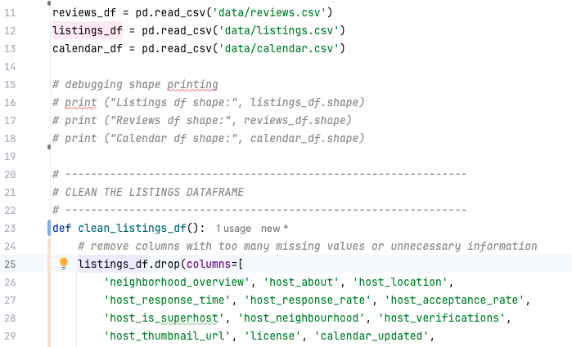
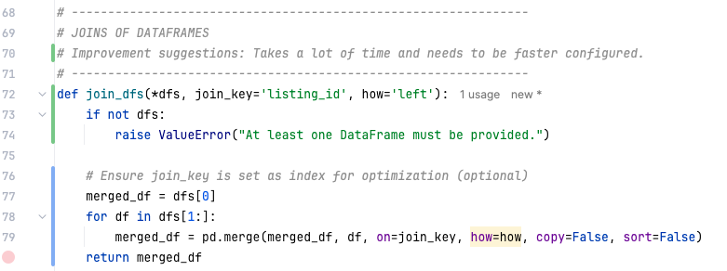
Data Cleaning
Cleaning the different .csv in different DataFrames.
Replacing and erasing NA and empty rows or fields
At the end merge the cleaned data.

Slide 4
Data Cleaning – Current View
This is the data after running our data cleaning on it.

Slide 5
Data Cleaning – Enhanced Dataset
This is the data after running our data cleaning on it.
Extract number information like “rooms”, “bathrooms” etc. from this column

Slide 6
Normalization – Normalization strategy
For example: Z-Score Standardization
Our features vary in Scale
Are not necessarily bounded within a fixed range.
May include outliers, e.g.: a listing with a maximum_nights_y of 1125
Z-score standardization might be well-suited here because it centers data around mean = 0 and standard deviation = 1, which helps models treat all features equally, even if they come from different scales.

Slide 7
Normalization – Normalization strategy
For example: Z-Score Standardization
Using scikit-learn’s StandardScaler
scaled_data = scaler.fit_transform(df[['minimum_nights_y', 'maximum_nights_y’]])
Or with pandas:
df['min_nights_z'] = (df['minimum_nights_y'] - df['minimum_nights_y'].mean()) / df['minimum_nights_y'].std()

Slide 8
Normalization – Normalization strategy
Using other Normalization strategies:
Strategy | Reason Not Chosen
Min-Max Scaling | Sensitive to outliers, distorts distribution; not ideal if ranges are wide like max_nights = 1125.
Log Transform | Only appropriate for skewed distributions. We applied it to the target (price_y), but not to features unless we see strong skew.
Robust Scaling | Could be useful with extreme outliers, but Z-score is more common and effective here unless extreme anomalies dominate.
No Normalization | Models like linear regression, KNN, or neural networks would perform poorly due to unscaled inputs.

Slide 9
Different Models – Team split
Linear or Polynomial Regression (Thies)
Random forest or gradient-boosted trees (Fabian)
Transformers (Lennart)
CNN (Defne)

Slide 10

Different Models – Linear or Polynomial Regression
Using scikit-learn https://scikit-learn.org/stable/modules/generated/sklearn.linear_model.LinearRegression.html

Slide 11
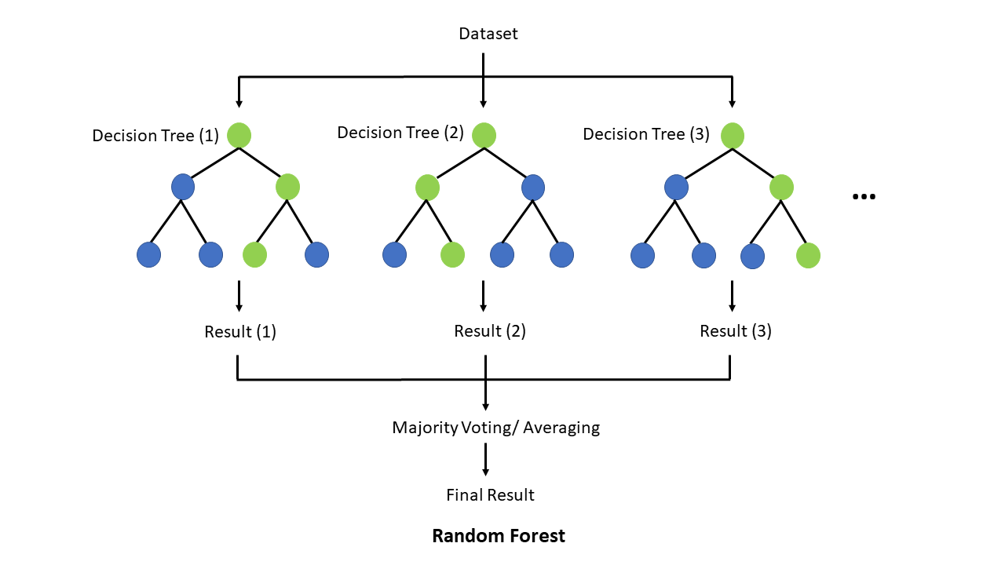
Different Models – Random forest
Random Forest & Gradient Boosting
https://scikit-learn.org/stable/modules/generated/sklearn.ensemble.RandomForestClassifier.html

Slide 12
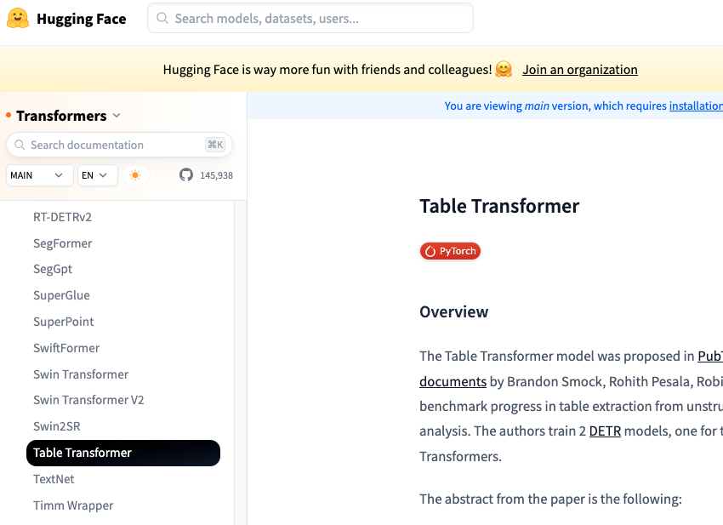
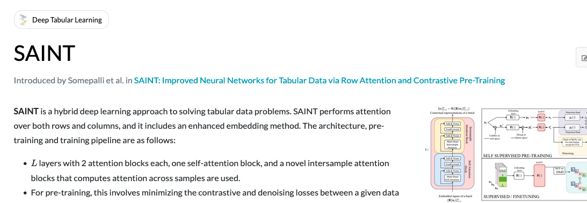
Different Models – Transformers
Using HuggingFace Table Transformer https://huggingface.co/docs/transformers/main/model_doc/table-transformer
Using SAINT https://github.com/somepago/saint

Slide 13
Different Models – CNN
TODO

Slide 14
Current Status – Burn-down Chart
1. Preprocessing
2. Feature Engineering
3. Build a Predictive Model
4. Evaluation & Fine Tuning
Jul 16-18

