Slide 1
Price Prediction Project (PPP)
Machine Learning
Intermediate presentation

Slide 2
Agenda
Data Preprocessing Plan
Data Cleaning
Normalization
Different models to train
Linear or Polynomial Regression
Random forest
Transformers
CNN
Current Status
Burn-down chart

Slide 3
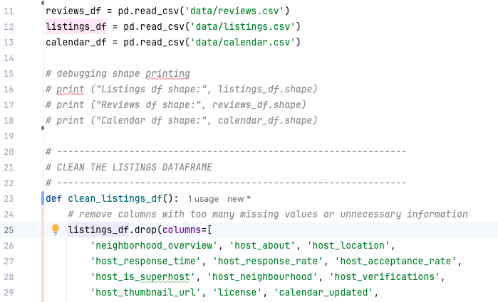
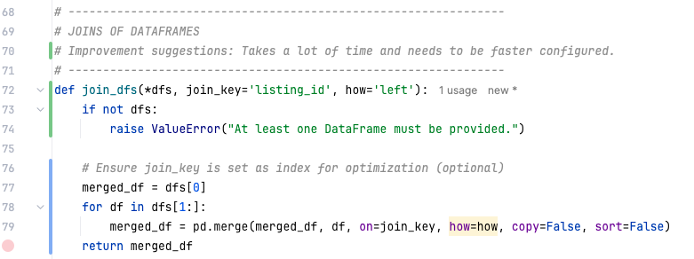
Data Cleaning
Cleaning the different .csv in different DataFrames.
Replacing and erasing NA and empty rows or fields
At the end merge the cleaned data.

Slide 4
Data Cleaning – Current View
This is the data after running our data cleaning on it.

Slide 5
Data Cleaning – Enhanced Dataset
This is the data after running our data cleaning on it.
Extract number information like “rooms”, “bathrooms” etc. from this column

Slide 6
Normalization – Normalization strategy
For example: Z-Score Standardization
Our features vary in Scale
Are not necessarily bounded within a fixed range.
May include outliers, e.g.: a listing with a maximum_nights_y of 1125
Z-score standardization might be well-suited here because it centers data around mean = 0 and standard deviation = 1, which helps models treat all features equally, even if they come from different scales.

Slide 7
Normalization – Normalization strategy
For example: Z-Score Standardization
Using scikit-learn’s StandardScaler
scaled_data = scaler.fit_transform(df[['minimum_nights_y', 'maximum_nights_y’]])
Or with pandas:
df['min_nights_z'] = (df['minimum_nights_y'] - df['minimum_nights_y'].mean()) / df['minimum_nights_y'].std()

Slide 8
Normalization – Normalization strategy
Using other Normalization strategies:
Strategy | Reason Not Chosen
Min-Max Scaling | Sensitive to outliers, distorts distribution; not ideal if ranges are wide like max_nights = 1125.
Log Transform | Only appropriate for skewed distributions. We applied it to the target (price_y), but not to features unless we see strong skew.
Robust Scaling | Could be useful with extreme outliers, but Z-score is more common and effective here unless extreme anomalies dominate.
No Normalization | Models like linear regression, KNN, or neural networks would perform poorly due to unscaled inputs.

Slide 9
Different Models – Team split
Linear or Polynomial Regression (Thies)
Random forest or gradient-boosted trees (Fabian)
Transformers (Lennart)
CNN (Defne)

Slide 10

Different Models – Linear or Polynomial Regression
Using scikit-learn https://scikit-learn.org/stable/modules/generated/sklearn.linear_model.LinearRegression.html

Slide 11
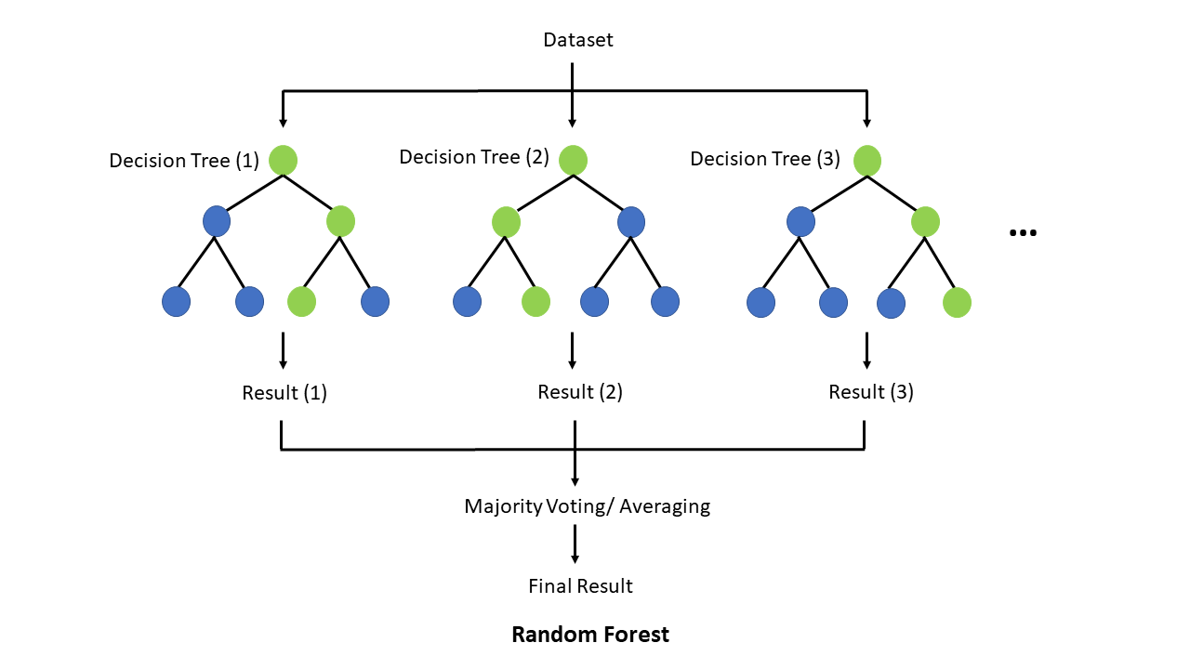
Different Models – Random forest
Random Forest & Gradient Boosting
https://scikit-learn.org/stable/modules/generated/sklearn.ensemble.RandomForestClassifier.html

Slide 12
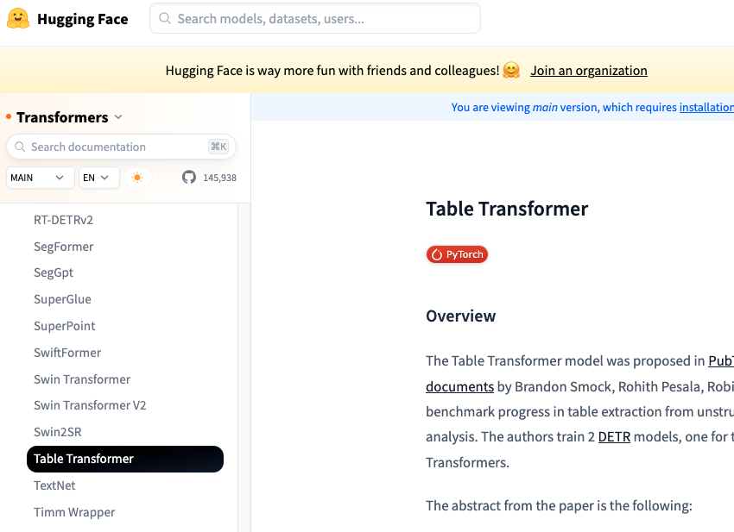
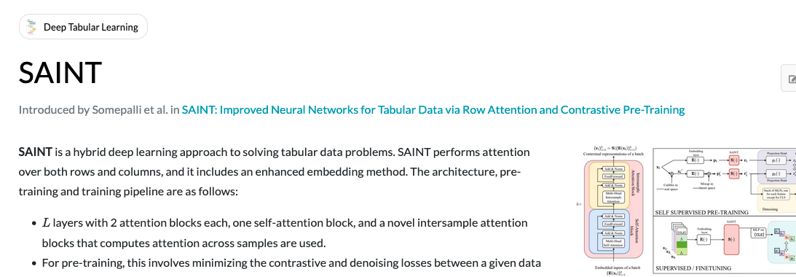
Different Models – Transformers
Using HuggingFace Table Transformer https://huggingface.co/docs/transformers/main/model_doc/table-transformer
Using SAINT https://github.com/somepago/saint

Slide 13
Different Models – CNN
After data has been acquisitied and preprocessed for creating the dataset and loading the data:
Create the dataset from preprocessed images and prepare it to be fed into the CNN, using Keras or PyTorch tools.- possibly PyTorch better since we learned in class?
PyTorch: Use a custom Dataset class to feed images and labels.
TensorFlow: Use tf.data.Dataset for batching and prefetching
train_ds = torchvision.datasets.ImageFolder("path_to_data", transform=...)train_loader = torch.utils.data.DataLoader(train_ds, batch_size=32, shuffle=True)

Slide 14
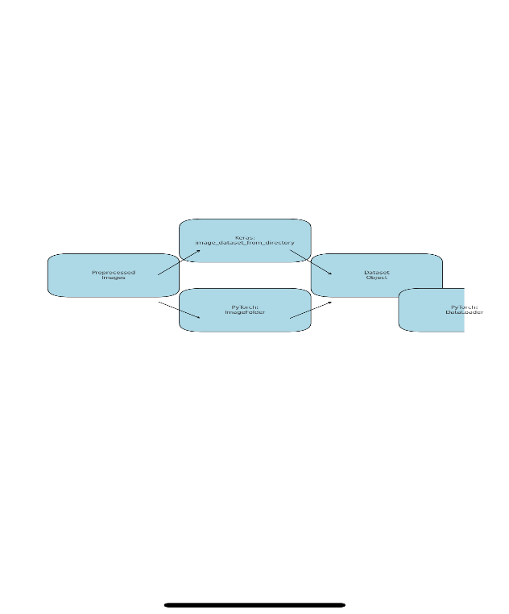
Different Models – CNN
Add Metadata (Optional Feature Enhancement)
Neighbourhood, latitude, longitude, location, etc
Concatenate metadata features with CNN features before final classification layer.
split the model: CNN part + metadata MLP.
class CNN(nn.Module):
This creates a custom neural network class called CNN, which inherits from torch.nn.Module.
2. Inside the Constructor __init__
Layers Defined:
• self.conv1 = nn.Conv2d(...) → First convolutional layer. Etc…
3. The forward() Method
This defines how data flows through the network during training or prediction.
def forward(self, x):

Slide 15
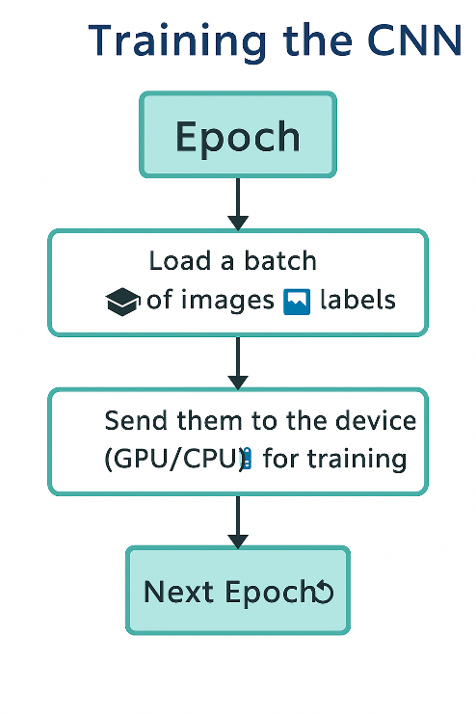
CNN
Training the CNN – Epoch Loop
num_epochs = 10for epoch in range(num_epochs): print(f"Epoch [{epoch + 1}/{num_epochs}]")
for batch_index, (data, targets) in enumerate(train_loader): data = data.to(device) targets = targets.to(device)
Load a batch of images and labels
🔹 Send them to the device (GPU/CPU) for training

Slide 16
Cnn- continue
scores = model(data)loss = criterion(scores, targets)optimizer.zero_grad()loss.backward()optimizer.step()
Model makes predictions (scores)
Loss is calculated (how wrong the prediction is)
Gradients are computed and applied

Slide 17
Cnn-Continue
4. Add Attention Layers or Other Architecture Components
If enhancing model capacity:
• Use Dropout, BatchNorm, Residual Blocks, or Attention modules.
• the preprocessed images could be turned into more complex CNN architectures.

Slide 18
Example Sources for Image Processing with CNN
python - How to feed images into a CNN - Stack Overflow
Image Processing Using CNN: A Beginners Guide

Slide 19
Current Status – Burn-down Chart
1. Preprocessing
2. Feature Engineering
3. Build a Predictive Model
4. Evaluation & Fine Tuning
Jul 16-18

Slide 20
Questions
Are we allowed to use LLMs for text to numerical values ?
What would be a good feature count ?
Join, save - takes long time any suggestions
Avg of pricing ?

