Slide 1
Final Presentation Price Prediction Project
Names here

Slide 2
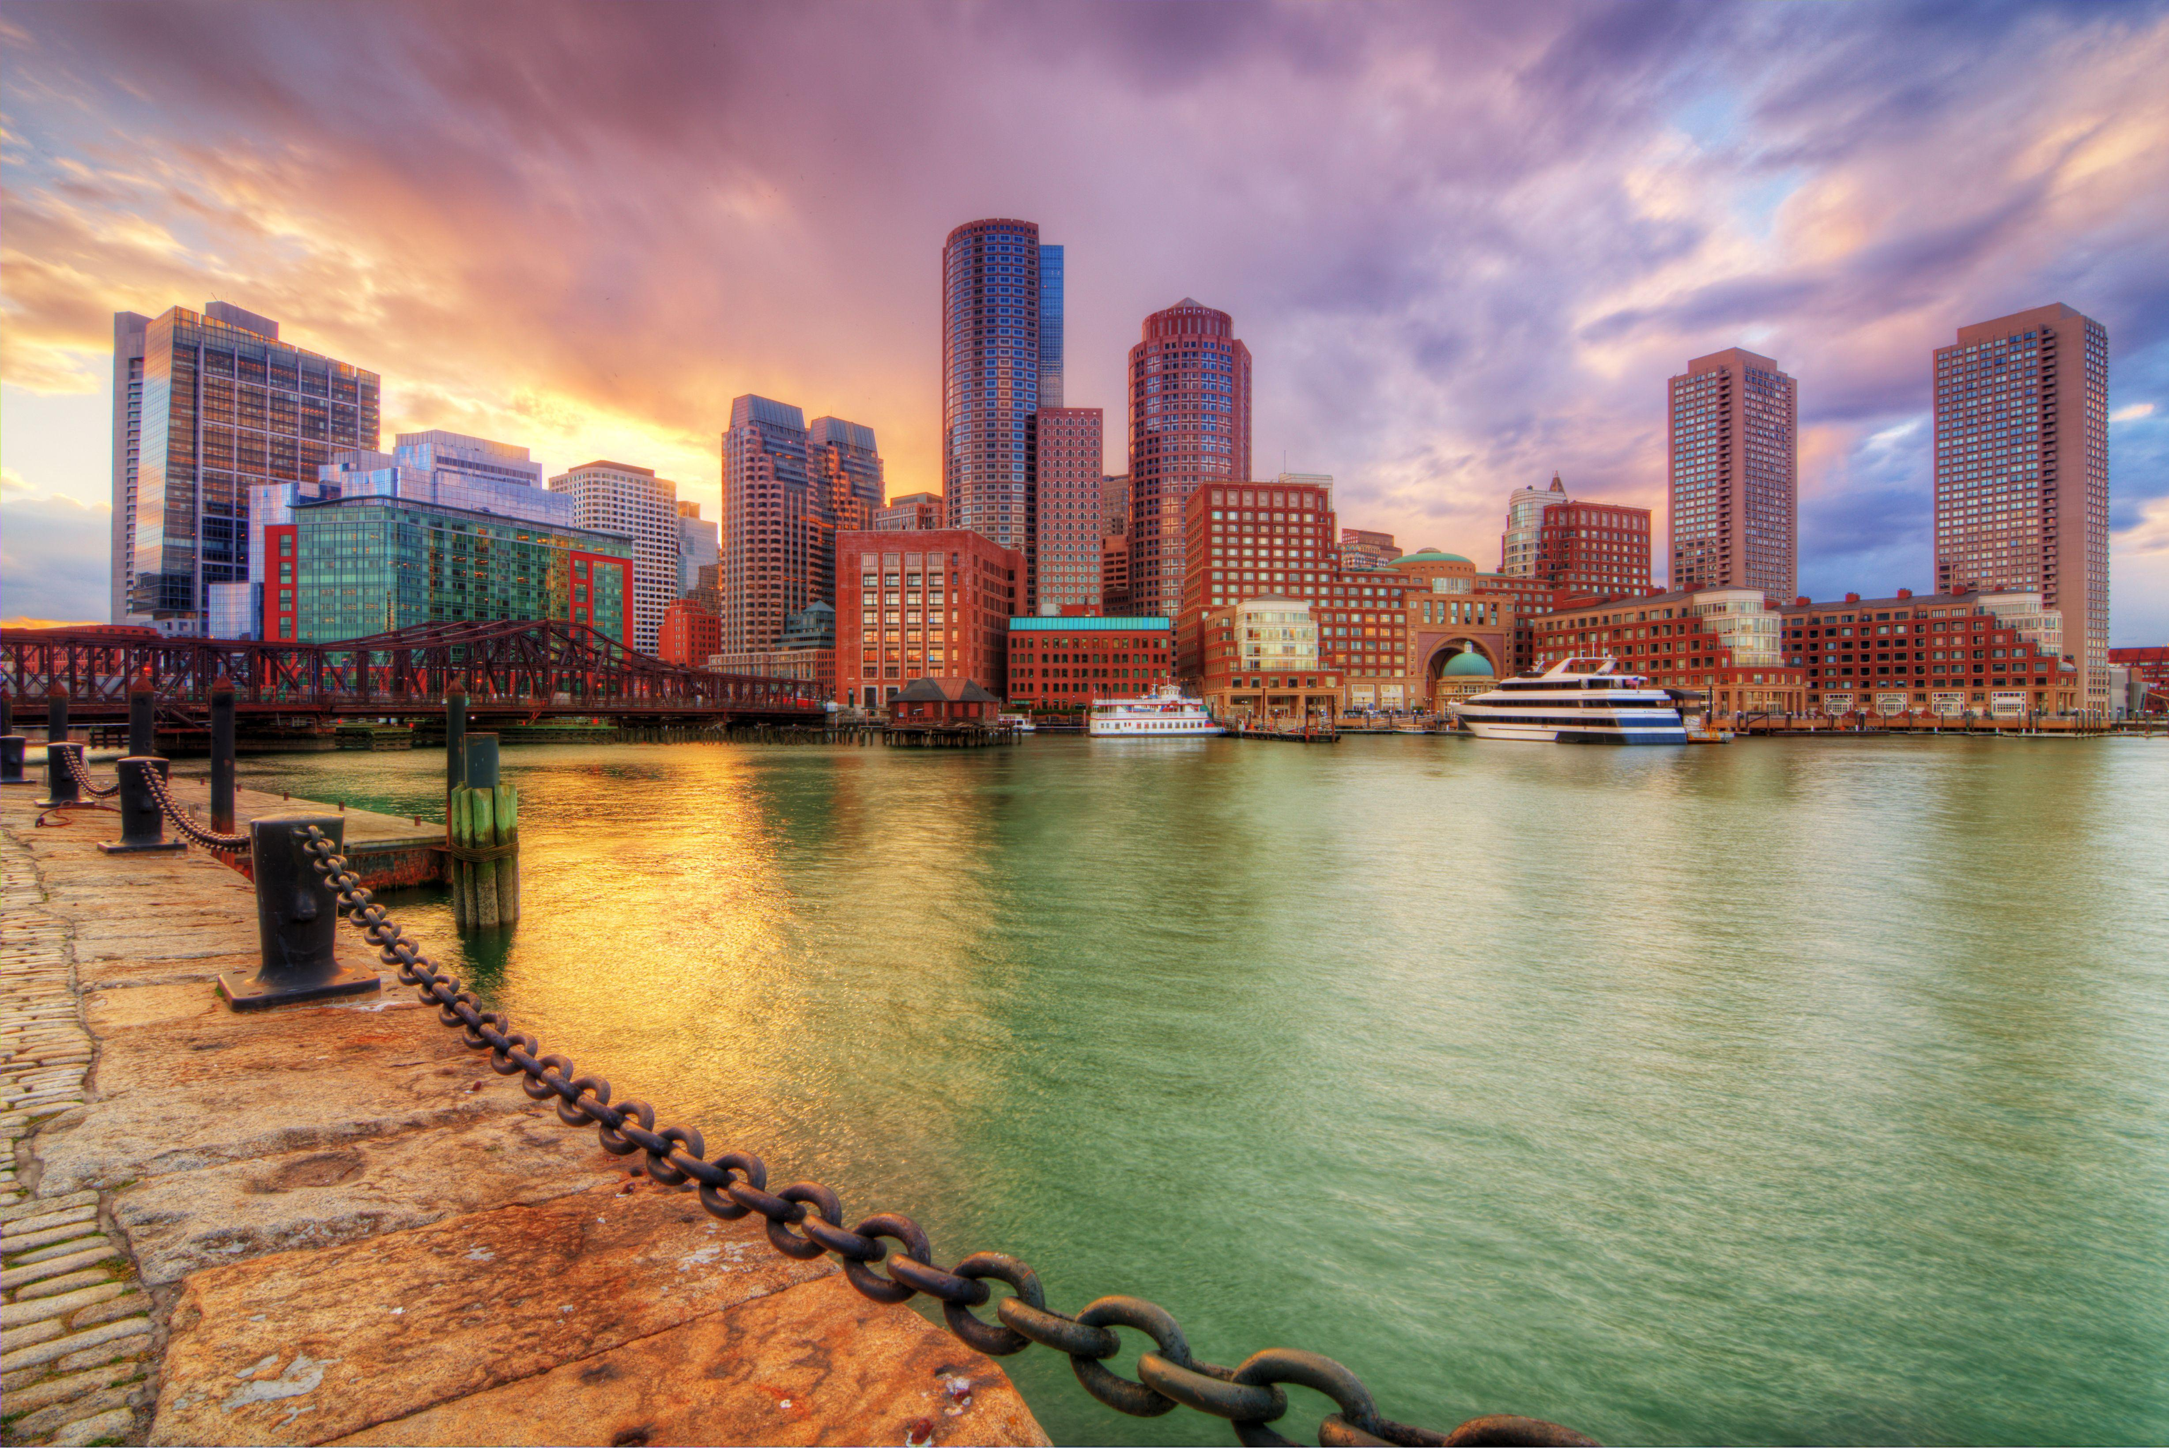
Selecting a City
From the Inside Airbnb Dataset
We chose Boston
Decently sized population
English Speaking
Texts
Reviews
Tourism Hotspot

Slide 3
Cleaning the Data
Conversion to Dataframes
Cleaning the individual Dataframes
Dropping unnecessary columns
Dropping rows with important missing values (e.g. price)
Inserting mean value into missing values (e.g. cleanliness score, etc.)
Normalizing Data
Z-Score normalization
Using the sklearn StandardScaler

Slide 4
Cleaning the Data
Joining of Dataframes
Resulting cleaned dataframes joined into combined dataframe
Left join on listing_id
Exporting of Dataframes
Saved results to csv files for easier future access
Seperate version of listings.csv saved without object columns
For Linear Regression and Random Forests

Slide 5
Feature Engineering

Slide 6
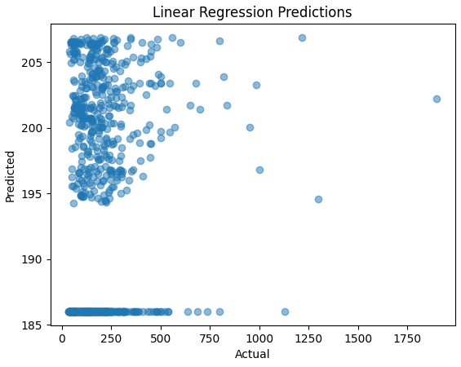
Linear Regression
Implemented using scikit-learn
Dataset split into train and test values for target attribute and data
MSE of 10923 😱
// this is all just placeholder

Slide 7
Random Forest

Slide 8
CNN

Slide 9
Transformers

Slide 10
Analysis
„Hey this model is better than this one and this is probably why...“

Slide 11
Future Improvements
What would we do better in the future

