Slide 1
EXCEPTION HANDLING
by Liubov Koliasa

Slide 2
Agenda
Errors vs Exceptions
Exception inheritance tree
List of standart exception
Handling exceptions
Handling many exceptions
Raising Exceptions
Logging

Slide 3
Errors vs Exceptions
There are (at least) two distinguishable kinds of errors:
syntax errors and logical errors (exceptions).
The first type is syntax error. They result from a violation of the programming language syntax when writing source code. If there are such errors, the program cannot be compiled. When working in any development environment, for example, in PyCharm, the IDE itself can track syntax errors and allocate them in some way.
The second type of errors are runtime errors. They appear in the already compiled program during its execution. Such errors are also called exceptions. When that error occurs, Python generate an exception that can be handled, which avoids your program to crash.

Slide 4
Errors vs Exceptions
Syntax errors occur when the parser detects an incorrect statement.
>>> print( 0 / 0 ))
File “<stdin>”, line 1
print( 0 / 0 ))
^
SyntaxError: invalid syntax
An exception is an error that happens during execution of a program. When that error occurs, a Python script raises exception (it creates an Exception object) that can be handled, which avoids your program to crash.
>>> print( 0 / 0)
Traceback (most recent call last):
File “<stdin>”, line 1, in <module>
ZeroDivisionError: integer division or modulo by zero

Slide 5
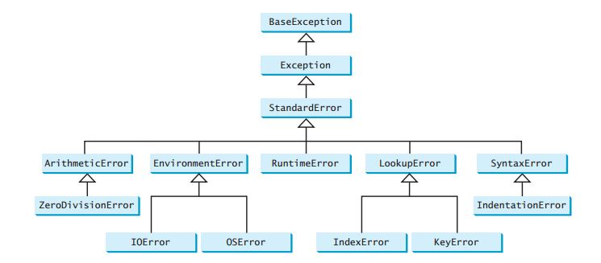
Exception inheritance tree

Slide 6
List of Standard Exceptions
BaseException The base class for all built-in exceptions. It is not meant to be directly inherited by user-defined classes.
Exception All built-in, non-system-exiting exceptions are derived from this class. All user-defined exceptions should also be derived from this class.
ArithmeticError The base class for those built-in exceptions that are raised for various arithmetic errors.
ZeroDivisionError Raised when division or modulo by zero takes place for all numeric types.
IOError Raised when an input/ output operation fails, such as the print statement or the open() function when trying to open a file that does not exist.
IndexError Raised when an index is not found in a sequence.
KeyError Raised when the specified key is not found in the dictionary.
NameError Raised when an identifier is not found in the local or global namespace.
TypeError Raised when an operation or function is attempted that is invalid for he specified data type.

Slide 7
List of Standard Exceptions
EOFError Raised when one of the built-in functions (input() or raw_input()) hits an end-of-file condition (EOF) without reading any data.
ValueError Raised when the built-in function for a data type has the valid type of arguments, but the arguments have invalid values specified.
AttributeError Raised in case of failure of attribute reference or assignment.
IdentationError Raised when identation is not correct.
StopIteration Raised when the next() method of an iterator does not point to any object.
SystemExit Raised by the sys.exit() function.
KeyboardInterrupt Raised when the user interrupts program execution, usually by pressing Ctrl+c.
SyntaxError Raised when a syntax error is encountered by the parser.
ImportError Raised when python cannot find the module.

Slide 8
List of Standard Exceptions
>>> 8 * (17/0)
Traceback (most recent call last):
File, line 1, in <module>
ZeroDivisionError: division by zero
>>> 6 + value*2
Traceback (most recent call last):
File, line 1, in <module>
NameError: name 'value' is not defined
>>> '5' + 5
Traceback (most recent call last):
File, line 1, in <module>
TypeError: Can't convert 'int' object tompl
Ic
itly
>>> abc = { 'a':1, 'b':2 }
>>> abc['c']
Traceback (most recent call last):
File, line 1, in <module>
KeyError: 'c'

Slide 9
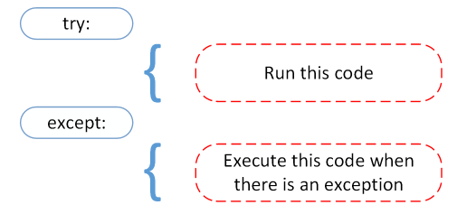
Handling Exceptions
Exceptions should be class objects. The exceptions are defined in the module “exceptions”. This module never needs to be imported explicitly: the exceptions are provided in the built-in namespace as well as the exceptions module.
One can catch exception with the help of "try...except", which have the following syntax:
a = [5, 6, 7,8]
try:
print("Second element = {}".format(a[1]))
# Throws error since there are only 4 elements in array
print("Fifth element = {}".format(a[4]))
except IndexError as e:
print(e)

Slide 10

TIME TO PRACTICE
1. Write a program that prompts the user to enter an integer and determines whether the number is even or odd, taking into account the case of entering incorrect data.
Notes:
1. Напишіть програму, яка пропонує користувачу ввести ціле число і визначає чи це число парне чи непарне, врахувати випадок введення некоректних даеих.

Slide 11
Handling Many Exceptions
# Program to handle multiple errors with one except statement
try:
a = int(input("Enter your number: "))
if a < 4:
b = a/(a-3) # throws ZeroDivisionError for a = 3
if a >= 4:
print("Value of b = ", b) # throws NameError
# note that braces () are necessary here for multiple exceptions
except(ZeroDivisionError, NameError, ValueError):
print("Error Occurred and Handled"))

Slide 12
Handling Many Exceptions
# Program to handle multiple errors with one except statement
try:
a = int(input("Enter your number: "))
if a < 4:
b = a/(a-3) # throws ZeroDivisionError for a = 3
if a >= 4:
print("Value of b = ", b) # throws NameError
# note that braces () are necessary here for multiple exceptions
except ValueError:
print("Value Error!")
except NameError:
print("NameError!))
except ZeroDivisionError:
print("ZeroDivisionError!")
except:
print("Error!")
)

Slide 13
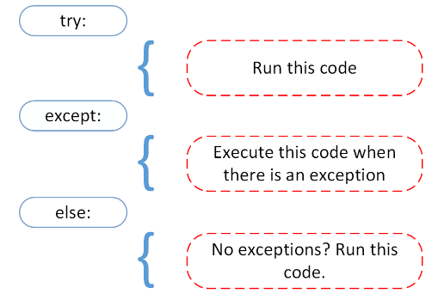
Handling Exceptions
We can use the else keyword to define a block of code to be executed if no errors were raised:
try:
f = open("newfile.txt") f.write("Second element: ")
except:
print("Something went wrong when writing to the file")
else:
print("Nothing went wrong")

Slide 14
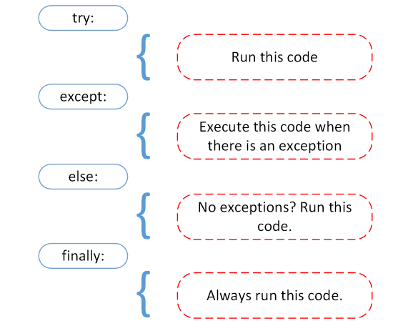
Handling Exceptions
The finally block, if specified, will be executed regardless if the try block raises an error or not:
try:
f = open("newfile.txt") f.write("Second element: ")
except:
print("Something went wrong when writing to the file")
else:
print("Nothing went wrong")
finaly:
f.close()
print("The 'try except' is finished")

Slide 15
TIME TO PRACTICE
3. Write a program to calculate the divide of two numbers entered by the user sequentially through a comma, to predict the case of division by zero, cases of syntactic errors and cases of other exceptional situations. Use the else and finally blocks.
Notes:
Напишіть програму для обчислення частки двох чисел, які вводяться користувачем послідовно через кому, передбачити випадок ділення на нуль, випадки синтаксичних помилок та випадки інших виняткових ситуацій. Використати блоки else та finally.

Slide 16
Raising Exceptions
In Python programming, exceptions are raised when corresponding errors occur at run time, but we can forcefully raise it using the keyword raise.
The raise statement allows the programmer to force a specific exception to occur. The sole argument in raise indicates the exception to be raised. This must be either an exception instance or an exception class (a class that derives from Exception).
try:
value = int(input("Enter a positive integer: "))
if value <= 0:
raise ValueError("That is not a positive number!")
except ValueError as e:
print(e)

Slide 17

TIME TO PRACTICE
2. Write a program that prompts the user to enter their age, and then displays a message stating whether the age is even or odd. The program must provide the ability to enter a negative number, and in this case generate an exception. The master code should call a function that processes the information entered.
Notes:
2. Напишіть програму, яка пропонує користувачу ввести свій вік, після чого виводить повідомлення про те чи вік є парним чи непарним числом. В програмі необхідно передбачити можливість введення від’ємного числа, і в цьому випадку згенерувати виняткову ситуацію. Головний код має викликати функцію, яка обробляє введену інформацію.

Slide 18
Custom exception class
class CustomError(Exception):
def __init__(self, data):
self.data = data
def __str__(self):
return repr(self.data)
total_score = int(input("Enter expert score: "))
try:
num_of_group = int(input("Enter number of your group: "))
if num_of_group < 1:
raise CustomError("Number of your group can't be less than 1")
except CustomError as e:
print("We obtain error:", e.data)

Slide 19
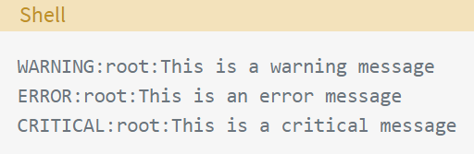
Logging
Adding logging to your Python program is as easy as this:
With the logging module imported, you can use something called a “logger” to log messages that you want to see. By default, there are 5 standard levels indicating the severity of events. Each has a corresponding method that can be used to log events at that level of severity. The defined levels, in order of increasing severity, are the following: DEBUG, INFO, WARNING, ERROR, CRITICAL
import logging
import logging
logging.debug('This is a debug message')
logging.info('This is an info message')
logging.warning('This is a warning message')
logging.error('This is an error message')
logging.critical('This is a critical message')

Slide 20
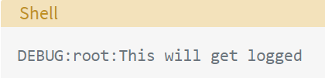

Basic Configurations
You can use the basicConfig (**kwargs) method to configure the logging.
Some of the commonly used parameters for basicConfig () are the following:
level: The root logger will be set to the specified severity level.
filename: This specifies the file.
filemode: If filename is given, the file is opened in this mode. The default is a, which means append.
format: This is the format of the log message.
import logging
logging.basicConfig(level=logging.DEBUG)
logging.debug('This will get logged')
import logging
logging.basicConfig(filename='app.log',filemode='w',
format='%(name)s - %(levelname)s - %(message)s')
logging.warning('This will get logged to a file')

Slide 21

Formatting the Output
While you can pass any variable that can be represented as a string from your program as a message to your logs, there are some basic elements that are already a part of the LogRecord and can be easily added to the output format. If you want to log the process ID along with the level, the date, time info and message, you can do something like this:
import logging
logging.basicConfig(format='%(process)d-%(levelname)s-%(asctime)s-%(message)s', level=logging.INFO)
logging.info('Admin logged in') logging.warning('This is a Warning')

Slide 22

Logging Variable Data
In most cases, you would want to include dynamic information from your application in the logs. You have seen that the logging methods take a string as an argument. The arguments passed to the method would be included as variable data in the message.
import logging
item = 'Process'
logging.warning(f'{item} raised an error')

Slide 23
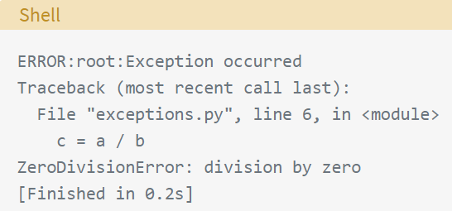
Capturing Stack Traces
The logging module also allows you to capture the full stack traces in an application. Exception information can be captured if the exc_info parameter is passed as True
import logging
a = 5; b = 0
try:
c = a / b
except Exception as e:
logging.error("Exception occurred", exc_info=True)
import logging
a = 5; b = 0
try:
c = a / b
except Exception as e:
logging.exception("Exception occurred")

Slide 24
Classes and Functions
So far, we have seen the default logger named root, which is used by the logging module whenever its functions are called directly like this: logging.debug(). You can (and should) define your own logger by creating an object of the Logger class, especially if your application has multiple modules.
The most commonly used classes defined in the logging module are the following:
Logger: This is the class whose objects will be used in the application code directly to call the functions.
LogRecord: Loggers automatically create LogRecord objects that have all the information related to the event being logged, like the name of the logger, the function, the line number, the message, and more.
Handler: Handlers send the LogRecord to the required output destination, like the console or a file. Handler is a base for subclasses like StreamHandler, FileHandler, SMTPHandler, HTTPHandler, and more. These subclasses send the logging outputs to corresponding destinations, like sys.stdout or a disk file.
Formatter: This is where you specify the format of the output by specifying a string format that lists out the attributes that the output should contain.

Slide 25

Classes and Functions
Out of these, we mostly deal with the objects of the Logger class, which are instantiated using the module-level function logging.getLogger(name). Multiple calls to getLogger() with the same name will return a reference to the same Logger object, which saves us from passing the logger objects to every part where it’s needed.
Unlike the root logger, a custom logger can’t be configured using basicConfig(). You have to configure it using Handlers and Formatters
import logging
logger=logging.getLogger('Example_logger')
logger.warning('This is a warning')

Slide 26
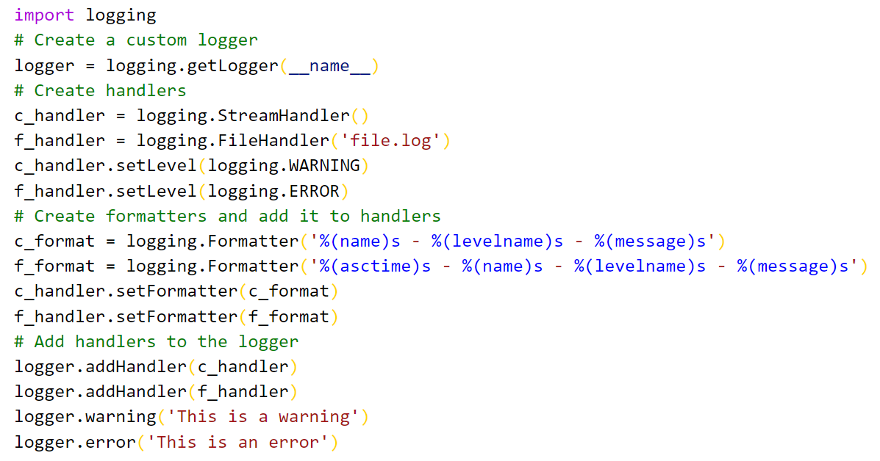
Using Handlers

Slide 27
TIME TO PRACTICE
Write a program that analyzes the entered number and, depending on the number, gives the day of the week that corresponds to this number (1 is Monday, 2 is Tuesday, etc.). Take into account cases of entering numbers from 8 and more, as well as cases of entering non-numerical data.
Notes:
4. Написати програму, яка аналізує введене число та в залежності від числа видає день тижня, який відповідає цьому числу (1 це Понеділок, 2 це Вівторок і т.д.) . Врахувати випадки введення чисел від 8 і більше, а також випадки введення не числових даних.

Slide 28



