Slide 1
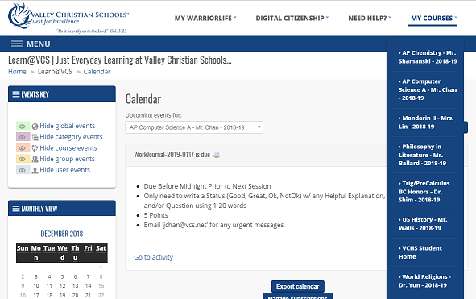
NOTE: This doc moved to Tom’s Gdocs @
https://drive.google.com/drive/u/0/folders/1HL6VSMSldBhIBpAMPGwQkbs7r1q60ktv
Valley Christian HS
Student Portal Homework Crawler

Slide 2
What are the Issues ?
Biggest challenge: Using the learn.vcs student Powerschool portal to keep track of all homework and when it’s due.
Not having a good dashboard, where all pending homework is viewable on a single online page (a calendar would be great)
No single page showing every homework item for every class with the due date attached
No single page showing homework progress
What are the Impacts?
Student’s grades suffer due to missing deadlines
Takes time wandering through the student portal
Homework due dates are opaque to parents

Slide 3
The Solution
Automated software application that crawls the student’s Moodle portal and places each homework item in a Google spreadsheet.
Spreadsheet has worksheets corresponding to the day the crawler was run.
Worksheet has columns for Class name, assignment date, description of homework item, its due date, completion status, yes/no status and lastly for comments.
Each worksheet row associated with one homework item
For each worksheet, Homework crawler looks back a few days and forward into tomorrow
Secure method of storing Moodle info and Google Docs credentials

Slide 4
Flow Chart
Connect to learn.vcs.net portal
Crawl all recent class assignments
Relay assignment info to Spreadsheet Filler
Populate Google spreadsheet

Slide 5
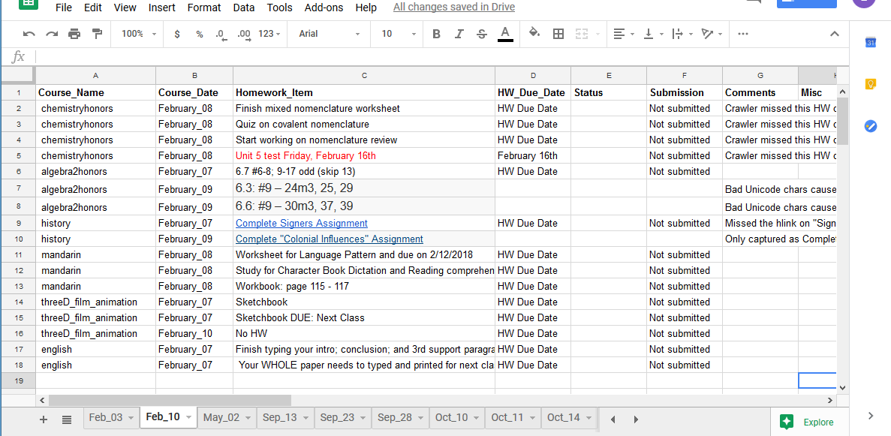
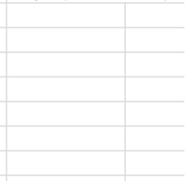
Crawler Spreadsheet Example

Slide 6
Design Criteria and Constraints
Using limited number of actual student’s portal accounts
Operate crawler locally on a PC (instead of website)
Google limitations on number of rows inserted into worksheet
Student credentials in the clear (instead of encrypted)
Moodle lacks consistent date and assignment formats (teachers can free-form anything)

Slide 7
Top level component diagram
1
3
CredentialEncrypter.py
PowerSchool class links
classes
lesson plans
VCHS Username,password
cred.txt
class links
crawls
Config.properties
reads
Homework Crawler
location
4
5
Browser driver
invokes
invokes
2
Client_secret.json
fill_spreadsheet.py
Google spreadsheet
reads
populates
Use CredentialEncrypter to encrypt your VCHS PowerSchool credentials,
Follow the SpreadsheetUpdater README to get your Google credentials
Follow the above instructions to capture your class IDs -> config.properties
Download and install the Chrome Selenium driver, location -> config.properties
After installing Java 7/8, run the homework crawler per the README instructions

Slide 8
Detailed what to-do information and links (Windows-only
To download the CredentialEncrypter program, go to https://github.com/tthale/Python-Encrypter.git and put it in a “Credential Encrypter” subdirectory on our system. This program is used to obfuscate your Google gmail credentials from prying eyes. You will also need to install the PyCrypto encryption library by running ‘pip install pycrypto’. If you run into problems when installing this library, you may need to download, build and install PyCrypto @ https://pypi.org/project/pycrypto/. If you STILL are running into problems (on Windows systems), then go to http://www.voidspace.org.uk/python/modules.shtml#pycrypto and match your OS version and your Python version with a matching PyCrypto version found here.
To download the Google Spreadsheet Updater, go to https://github.com/tthale/Google_Spreadsheet_Updater and put it in a Google_Spreadsheet_Updater subdirectory on your system.
Download the Windows Chrome Selenium driver @ http://chromedriver.chromium.org/downloads. Be sure to match your version of your Chrome browser to this driver. Install this driver in a location you’ll remember (since the location needs to be configured with the Homework Crawler)

Slide 9
Detailed what to-do information and links (con’t)
There's several components that need to be installed to get the Java-based Homework Crawler to interact correctly with the Python-based components of the Google Spreadsheet Filler application. In between, there are more shell and Python adapters performing the necessary argument processing for the two major halves.
a) Install JVM - minimum version 8, @ https://www.java.com/en/download/ (check if already installed by executing java --version)
b) Optionally, check out the HomeworkCrawler project @ https://github.com/lhale/VCHS_HomeworkCrawler.git (that will cover the executable HomeworkCrawler.jar file and the runSpreadsheetUpdater.sh adapter program .
c) Install Git bash @ https://git-scm.com/downloads
d) Install Python - minimum version 2.7.14 @ https://python.org (check if already installed by executing python --version)
e) Install pip via instructions @ https://www.makeuseof.com/tag/install-pip-for-python/ and verify it's installed in the Scripts subdirectory of where your Python is installed (which means this subdirectory should be in your system's PATH).

Slide 10
Detailed what to-do information and links (con’t)
f) Install pygsheets via 'pip install’ https://github.com/nithinmurali/pygsheets/archive/master.zip'. Unfortunately, there is no 'pip install pygsheets'
g) Depending upon a previous install of Python, you may have to add these additional libs:
pip install urllib3
pip install --upgrade pyOpenSSL ndg-httpsclient pyasn1
pip install python-dev libffi-dev libssl-dev
pip install requests==2.5.3
h) Install pycrypto via ‘pip install pycrypto’. You might need to build this if issues arise - see previous details in this presentation for on how to do that.

Slide 11
Detailed what to-do information and links (con’t)
4) You will need to get a special “key” from your gmail account and configure it for the fill_spreadsheet program. This is the most complicated part of the Homework Crawler setup. It is detailed @ the README.md in the Google_Spreadsheet_Updater Git project @ https://github.com/lhale/Google_Spreadsheet_Updater.git (you should have checked out this project into a suitable area on your PC) and add this location to the HomeworkCrawler project’s config file found @ ./resources/config.properties.
5) It seems to be we may need an installer for the crawler/filler, in order to get this mainstream. Might need to create a Selenium crawler just to orchestrate the installs (hopefully a script can do most of grabbng the git project pieces and installing in a common area.
6) The ultimate would be a Saas-style web application available to all VCHS students.

Slide 12
APPENDIX A
Argument passing from Homework Crawler to fill_spreadsheet
Due to Java runtime limitations in passing arguments to other executables and access to other directories, a couple of adapters are required to condition the arguments to be correctly consumed. On Windows, Java is only allowed to open & execute a CMD window.
Arguments passed:
Homework Crawler
bash <rsu> python <getopts_loc> <sprd_sht_nm> <wrk_sht_nm> <date> “<class_nm>,<hw_date>,<hw item>,<due_date>,<status>,<submission>,<comment>”
runSpreadsheetUpdater.sh
(Intermediary between Java, the OS and Python)
python <getopts_loc> “sprd_sht_nm” “wrk_sht_nm” “date” “class_nm” “hw_date” “hw item” “due_date” “status” “submission” “comment”
getopts.py
(future)
“sprd_sht_nm” “wrk_sht_nm” “date” “class_nm” “hw_date” “hw item” “due_date” “status” “submission” “comment”
fill_spreadsheet.py
Where: rsu=runSpreadsheetUpdater.sh, getopts_loc=full pathname to getopts.py, sprd_sht_nm=user’s Google spreadsheet name, wrk_sht_nm=current month_day worksheet name

Slide 13
APPENDIX B
Videos?
We’ve recorded a video to show how it all works on a Windows PC. You can view it @ https://youtu.be/7b8UXfV089w

