Slide 1
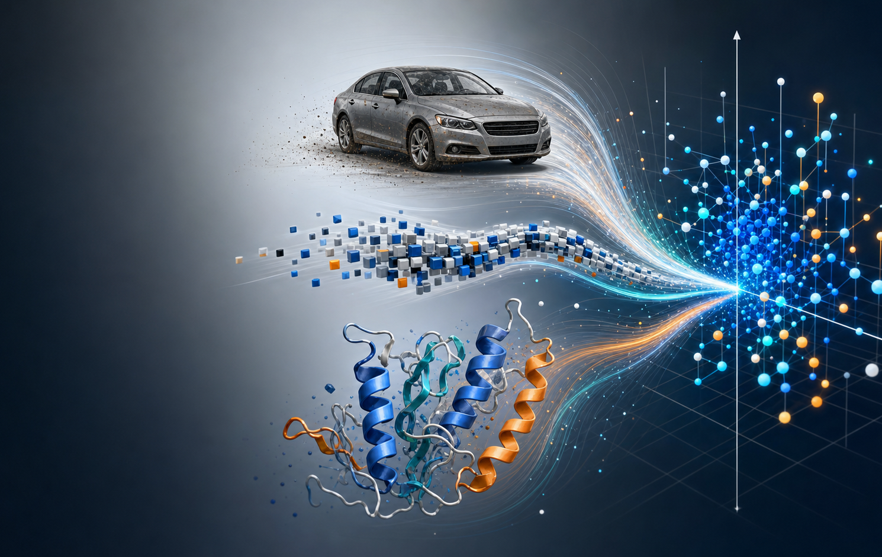
Representation Learning
Useful coordinates for cars, words, proteins, and anything else we want math to understand.
High school math summer camp

Slide 2

What Numbers Should We Give the World?
A representation is a choice of coordinates for an object.
car
sentence
protein
person
year, mileage, model
tokens and context
amino acid sequence
taste and behavior
Good coordinates make useful relationships visible.

Slide 3
An approximate syllabus
What we will talk about:
1 Vectors and similarity
2 Learning useful coordinates
3 Car prices and categorical embeddings
4 Words, ModernBERT, and transformers
5 Proteins and the live demo

Slide 4
Vectors
Collection of numbers with a location and a direction.
protein
wagon
Nearby points often behave similarly. Directions can describe changes.
enzyme
sedan
phrase
word

Slide 5
Dot product
Vector multiplication that gives a similarity score.
same direction
different directions
large positive score
small or negative score
Attention asks this question many times.

Slide 6
Learning Moves the Points
Training changes coordinates so the error gets smaller.
The model is learning a coordinate system that makes the task easier.

Slide 7
Not Every Number Means Something
Some numerical encodings create fake structure.
red = 1
blue = 2
green = 3
This accidentally says:
blue is twice red
green is greater than blue
Feature choice matters too: most cars have 4 wheels, so wheel count carries little signal.

Slide 8
Token embedding
In its simplest form, token embedding is a learned lookup table.
word token
token ID
embedding row
vector
The table starts random. Training changes the rows until useful relationships become easier.

Slide 9
The Car Example
Used car prices give a familiar place to test representation choices.
25,000
70 / 15 / 15
5 seeds
12
used listings
train / val / test
repeated runs
categorical features
Question: what happens when categories become fake numbers, one-hot rows, or learned coordinates?

Slide 10
Bad Representations Can Break a Model
The strongest lesson is the gap between fake order and useful coordinates.
28.5x
Embeddings had 4.7% lower full-test RMSE than one-hot in this run, but MAE was mixed.
Metric: test RMSE relative to learned embeddings, mean over 5 PyTorch runs.
1.05x
1.00x
Integer IDs
One-hot
Embeddings

Slide 11
A Learned Map Is the Payoff
The embedding table becomes geometry the model can use.
cadillac
acura
lexus
mazda
Nearest examples in the projection:
lexus -> acura, ford
tesla -> bmw, volvo
toyota -> mazda, tesla
ford
toyota
volvo
tesla
honda
bmw
A 2D projection is a teaching view; the real embedding vectors have more dimensions.
jeep
subaru

Slide 12
The Same Idea Shows Up Everywhere
Representation learning is a general way to make comparison possible.
object -> vector -> useful action
recommend
retrieve
translate
annotate
people and items
images and text
words and context
protein sequences

Slide 13
Recommendations
A recommender learns vectors for people and items.
robotics
student
biology
coding
music
random
Learning puts tastes and items into the same space. Similar directions become recommendations.

Slide 14

Images and Text Can Share a Space
A search phrase and a picture can be represented by nearby vectors.
red hiking
backpack
shared vector
space
Search becomes geometry when pictures and phrases use compatible coordinates.

Slide 15
Training LLMs
ModernBERT learns representations by filling in blanks.
The [MASK] wore a crown.
king
Prediction forces grammar, facts, and meaning into vectors.
The scientist mixed chemicals in the [MASK].
lab
The protein sequence folds into a [MASK].
helix

Slide 16
Token Embedding
A token starts as an ID. The model looks up a row in a learned matrix.
embedding
matrix
one-hot ID
input
vector
This is the raw input-embedding table used for the arithmetic demo.

Slide 17
Vector Arithmetic as Top-k Lookup
Do the arithmetic, then ask which vocabulary vectors are closest.
query = king + woman - man
top-k nearest words
prince
king
queen
princess
lady
woman
In this run, queen is rank 6 for king + woman - man.

Slide 18
ModernBERT Analogy Returns
Best method only: raw, unit, and centered-unit were tried internally.
39 analogies median rank 1 hit@10 87% hit@25 95%
expression
expected
rank
top result
berlin + france - germany
paris
1
paris
paris + germany - france
berlin
1
berlin
bigger + small - big
smaller
1
smaller
faster + slow - fast
slower
1
slower
slower + fast - slow
faster
1
faster
smaller + big - small
bigger
1
bigger
taller + short - tall
shorter
1
shorter
boy + woman - man
girl
1
girl
brother + woman - man
sister
1
sister

Slide 19
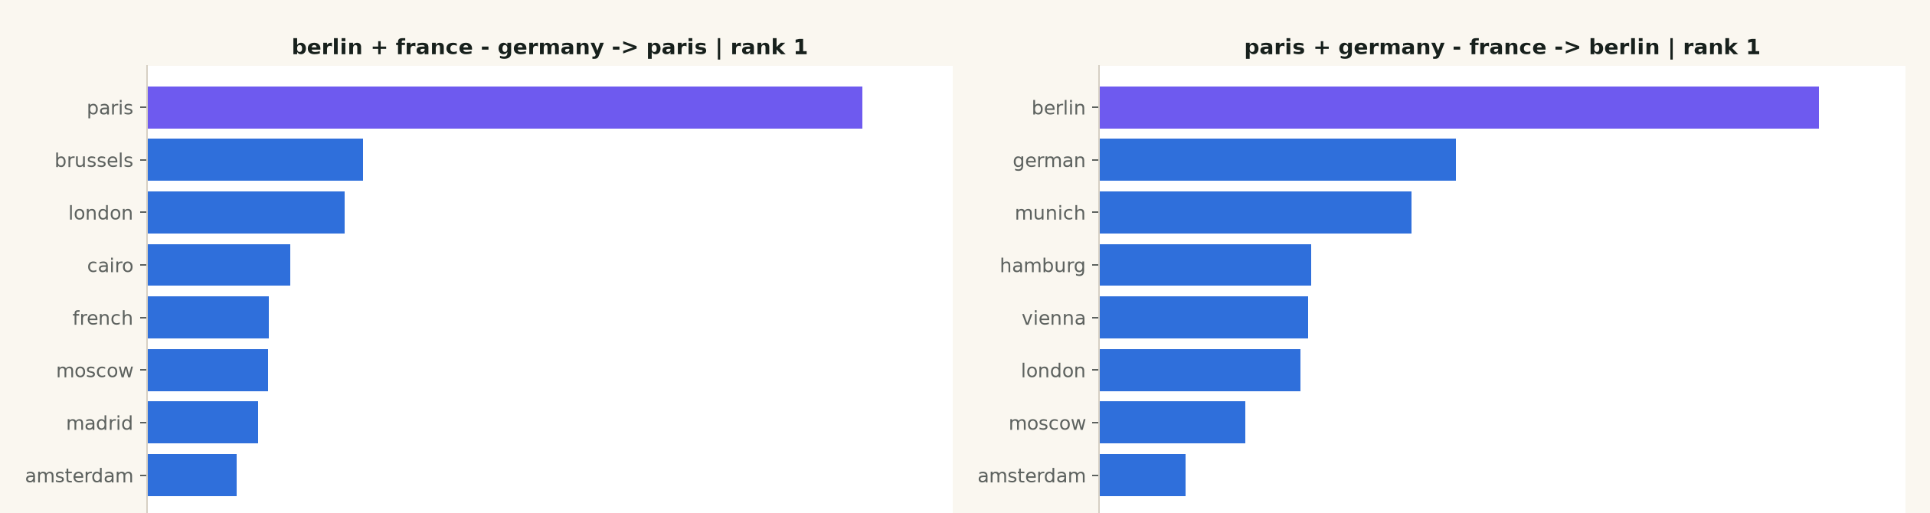
ModernBERT Top-k: Capitals
The nearest-token list often makes the relationship visible.

Slide 20
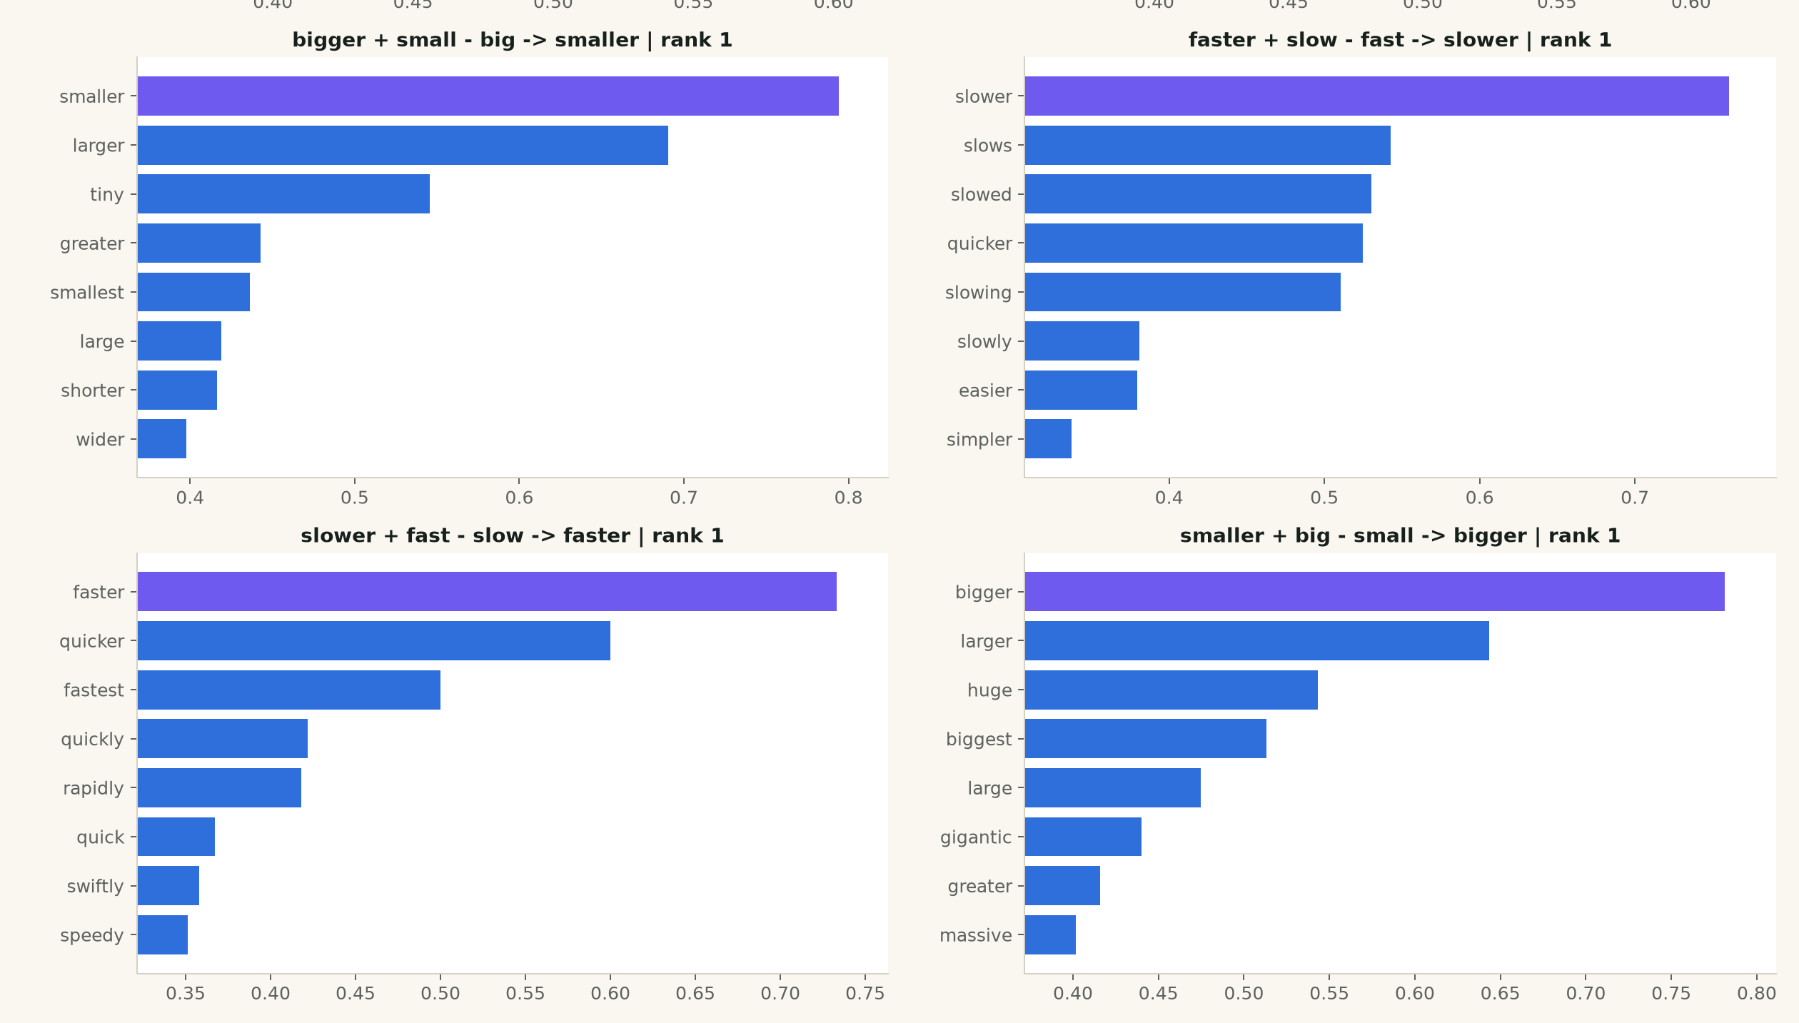
ModernBERT Top-k: Comparatives
The expected word is highlighted when it appears in the top-k list.

Slide 21
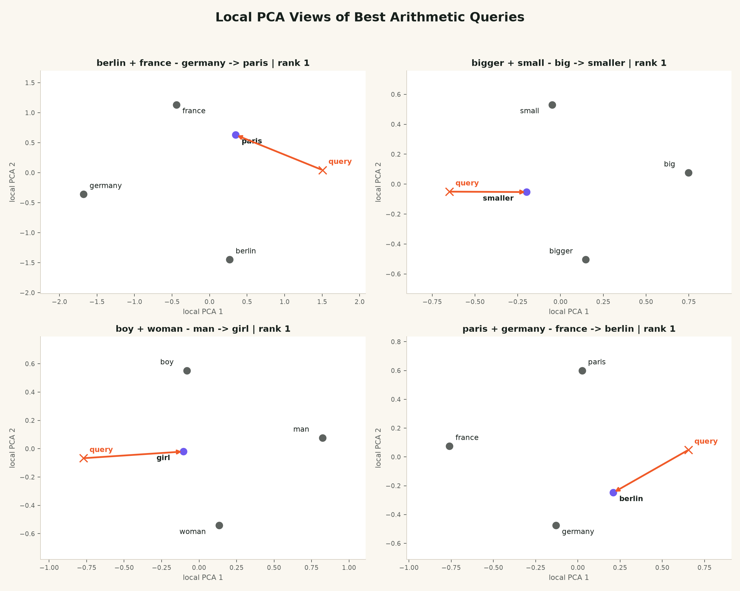
ModernBERT Local PCA

Slide 22
ModernBERT Is Not Classic word2vec
Input embeddings show useful geometry, but ModernBERT is contextual.
king - royalty -> man
king + woman - man -> queen
queen - royalty -> woman
rank 827
rank 6
rank 16
not in top 50
in top 50
in top 50
The teaching point is honest: vector arithmetic can work, but model architecture and tokenization matter.

Slide 23
Meaning Depends on Context
The same word can get a different vector in a different sentence.
river bank
water, shore, fishing
same token
new context
new vector
bank account
money, teller, savings

Slide 24
Transformers Build Contextual Representations
Each layer updates token vectors by comparing them with other tokens.
repeated
layers
tokens
vectors
contextual
vectors
Stack enough layers and the vector for a word can carry sentence-level meaning.

Slide 25
Attention Is Similarity at Scale
Tokens ask dot-product questions about other tokens.
the
protein
folds
helix
the
A whole sentence becomes a table of comparisons.
protein
folds
1. compare token vectors
2. turn scores into weights
3. mix information into a new vector
helix

Slide 26

Proteins Are Sequences Too
Protein language models apply the same representation idea to amino acid strings.
MKTAYIAKQRQISFVKSHFSRQ
Amino acids are symbols. A protein language model turns a sequence into vectors for residues, domains, or the whole protein.

Slide 27
Protein Models Learn from Sequence
Prediction over millions of sequences can reveal functional patterns.
protein
language model
annotation
search
design
sequence
embedding
The model is not given a hand-written biology dictionary. It learns useful coordinates from sequence patterns.

Slide 28
Live Demo
Sequence to neighbors, function, and design ideas.
input
sequence
embedding
vector
nearest
proteins
labels and
design ideas
Live question: which proteins are nearby, what function is likely, and what design idea follows?

Slide 29
What Representation Learning Can Do in the Lab
Vectors become tools for deciding what to test next.
annotate
suggest a function for an unknown sequence
search
find related proteins across huge databases
triage
prioritize experiments before spending bench time
design
propose sequence changes worth testing

Slide 30
Learn the Coordinates, Then Do the Math
compare
predict
search
design
Questions?

