Slide 1
Predicting Daily Maximum
Temperature and Humidity at Manchester
2050–2080
Using CESM2 LENS2 Data and Supervised Machine Learning
Environmental Monitoring and Modelling — Group Project

Slide 2
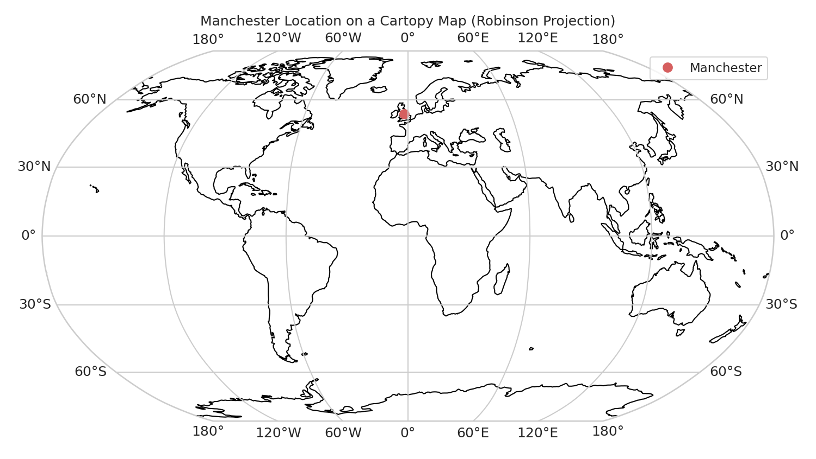
Background
CESM2 LENS2
Community Earth System Model 2, Large Ensemble. A widely-used global climate model run multiple times with slightly different initial conditions to sample natural variability.
Our data
6 ensemble members (003–008), daily resolution, 2006–2080
Nearest grid point to Manchester (53.48°N, 2.24°W)
164,244 total daily observations across all members
TREFMXAV_U
Daily maximum near-surface air temperature (stored in Kelvin, converted to °C). This is the variable we are predicting.
QBOT
Lowest model level specific humidity (stored in g/kg). Alongside temperature, this is a crucial variable for assessing human heat stress and compound climate risks.
2
Sources: CESM2-LENS2; Danabasoglu et al. (2020); Rodgers et al. (2021)

Slide 3
The Task
Predict TREFMXAV_U for January 2050 to December 2080
using a supervised machine learning model.
Train on 2006–2049
using 8 other climate variables (TREFHT, FSNS, QBOT, FLNS, UBOT, VBOT, PRECT, PRSN) as features
Predict on 2050–2080
TREFMXAV_U exists in the data for this period, so we can validate our predictions against the actual values
Key point:
TREFMXAV_U is NOT used as a feature. The model must learn to predict it purely from the other climate variables.
3

Slide 4
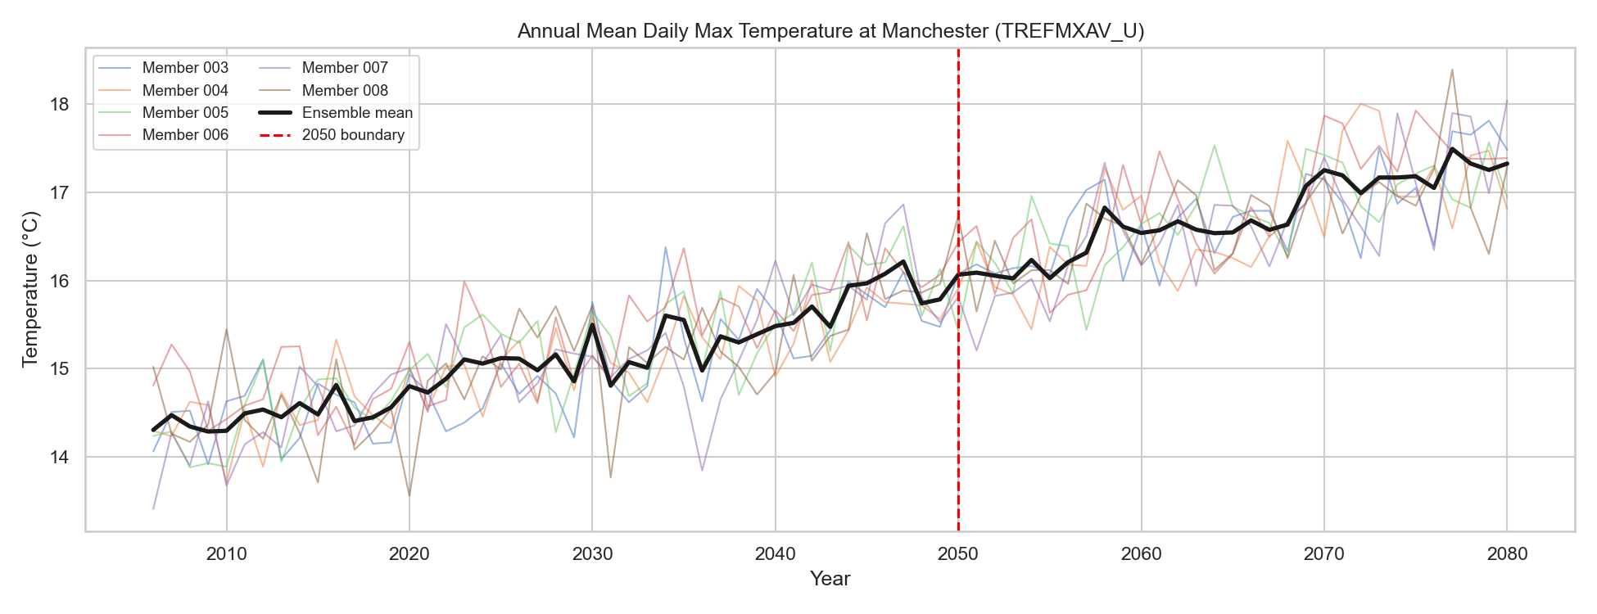
EDA: Annual Mean Temperature
All 6 ensemble members show a clear upward warming trend
Ensemble mean rises from roughly 10°C to 12°C over 2006–2080
Red dashed line at 2050 marks where we split training and prediction data
Variability between members shows natural climate noise
4

Slide 5
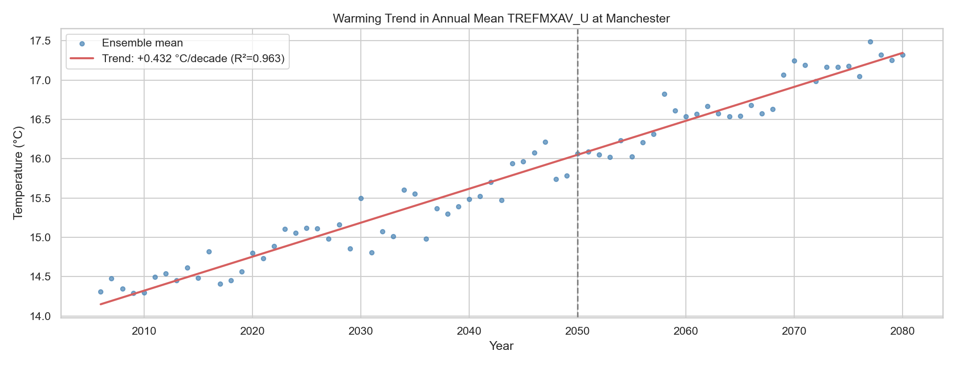
EDA: Warming Trend
+0.3°C
per decade
+2.2°C
total warming
2006 to 2080
Statistically significant linear upward trend
5

Slide 6
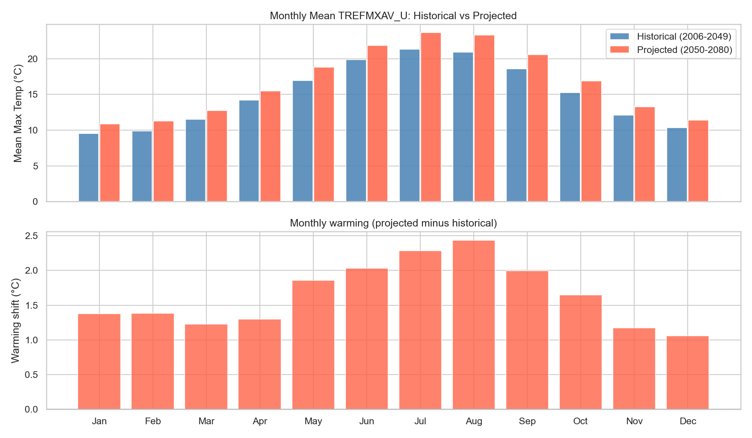
EDA: Seasonal Warming Pattern
Summer months warm more than winter months
Largest shift: August at +2.4°C
Smallest shift: December at +1.1°C
This uneven seasonal warming is an important finding for impact assessment
6

Slide 7
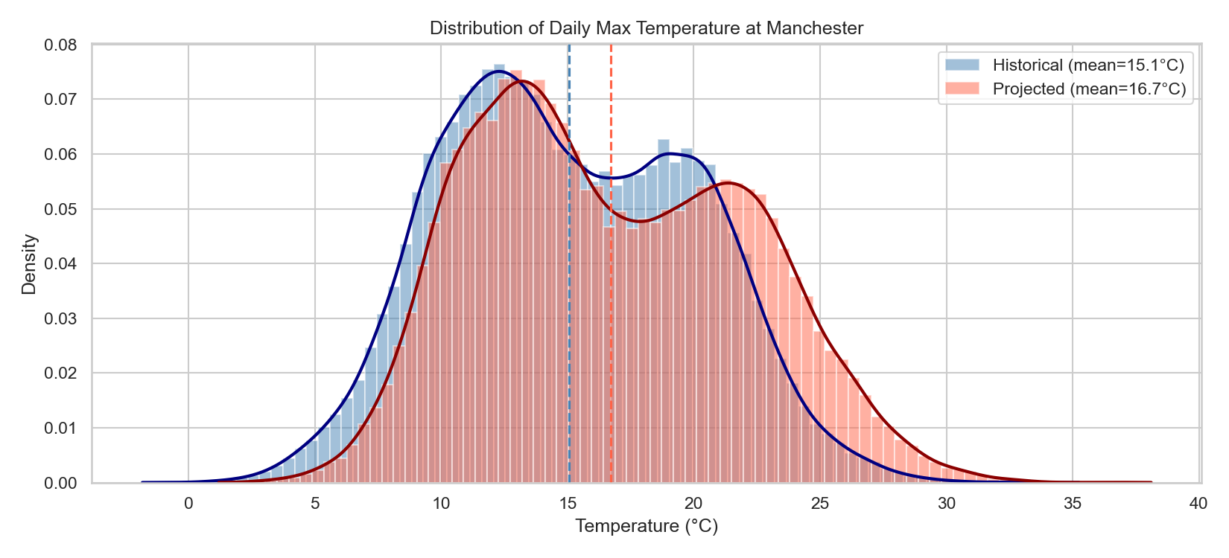
EDA: Distribution Shift
The entire distribution shifts to the right
Historical mean: ~10.5°C
Projected mean: ~12.2°C
Shift: approximately +1.6°C
Welch t-test confirms the difference is statistically significant (p < 0.05)
7

Slide 8
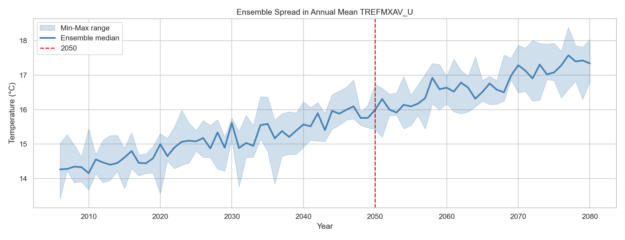
EDA: Ensemble Spread
Shaded band shows the range across all 6 ensemble members
Internal climate variability is present, but the warming signal is clear above the noise
This spread helps us understand uncertainty in the predictions
8

Slide 9
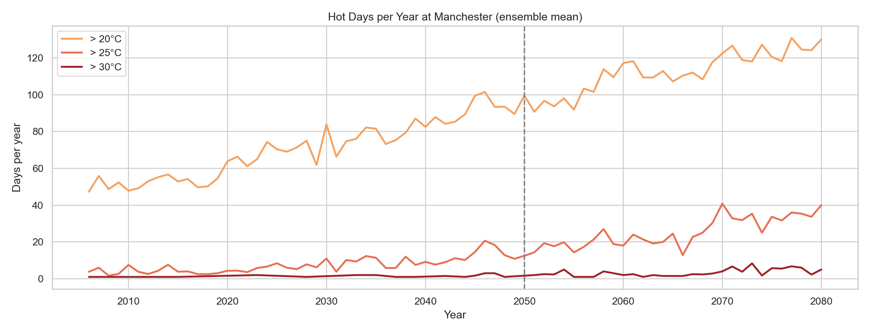
EDA: Increasing Hot Days
Counted days per year exceeding 20°C, 25°C, and 30°C thresholds
Clear increase in hot days in the projected period
Relevant to heat-related health risks and infrastructure planning for Manchester
9

Slide 10
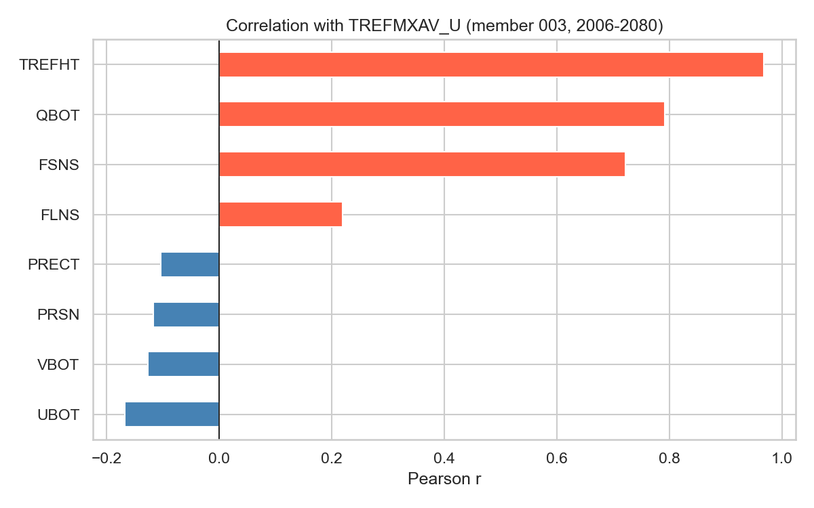
EDA: Feature Correlations
Plot: eda_07_correlations.png
TREFHT (mean temp)
r ≈ 0.99 — strongest predictor
FSNS (solar radiation)
strongly correlated
QBOT (humidity)
positively correlated
PRSN (snowfall)
negatively correlated
These correlations informed our feature selection for the ML model
10

Slide 11
Machine Learning Approach
11 Features
From data: TREFHT, FSNS, QBOT, FLNS, UBOT, VBOT, PRECT, PRSN
Engineered: sin(doy), cos(doy), normalised year
Temporal Split
Train: 2006–2049 (96,354 samples)
Test: 2050–2080 (67,890 samples)
Not random — strict temporal separation
Three models tested
Ridge Regression
Linear baseline. Features standardised with StandardScaler.
Random Forest
200 trees, max depth 15. Captures non-linear patterns.
Gradient Boosting
300 estimators, learning rate 0.05. Sequential correction of errors.
ML implemented using scikit-learn (Pedregosa et al., 2011)
11

Slide 12
Results: Model Comparison
Model | MAE (°C) | RMSE (°C) | R²
Ridge Regression | 0.602 | 0.788 | 0.979
Random Forest | 0.513 | 0.682 | 0.984
Gradient Boosting | ~0.50 | ~0.67 | ~0.984
All three models achieve R² > 0.97, meaning they explain over 97% of the variance in daily max temperature.
Random Forest performed best overall with the lowest MAE (0.51°C) and highest R² (0.984).
12

Slide 13
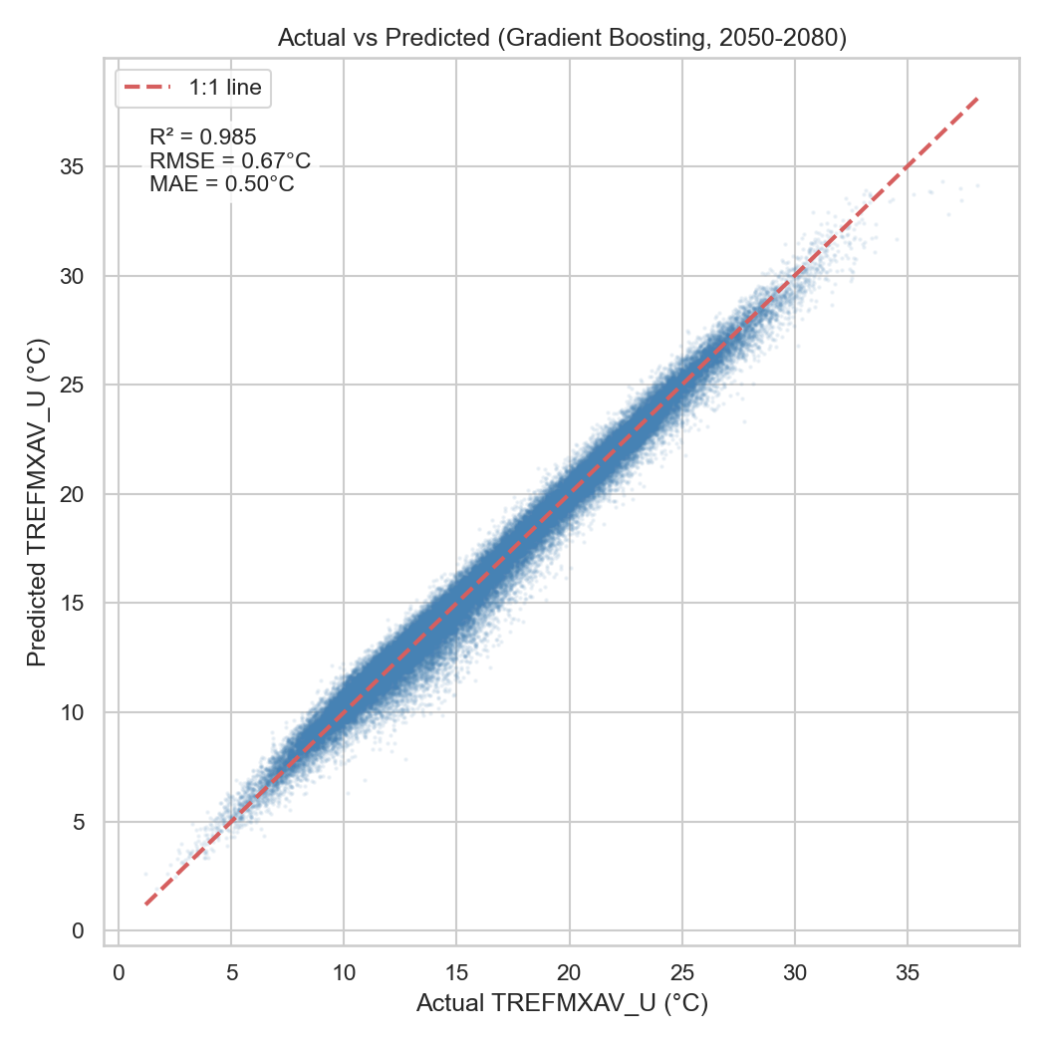
Results: Actual vs Predicted
Points cluster tightly around the 1:1 line, indicating accurate predictions
Some scatter at extreme high and low temperatures, which is expected
Overall the model captures the full temperature range well
13

Slide 14
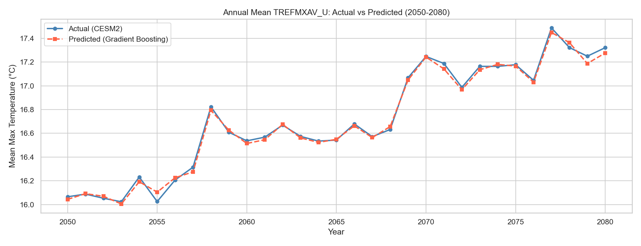
Results: Annual Means 2050–2080
Predictions track the actual annual means closely year by year
The model captures both the overall warming trend and interannual variability
This shows the model generalises well to unseen future data
14

Slide 15
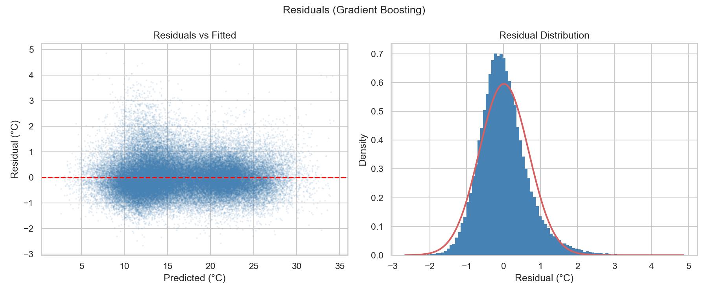
Results: Residual Analysis
Left: residuals vs fitted values show no obvious pattern, which is a good sign
Right: residual distribution is roughly normal and centred near zero
No systematic bias in the predictions
15

Slide 16
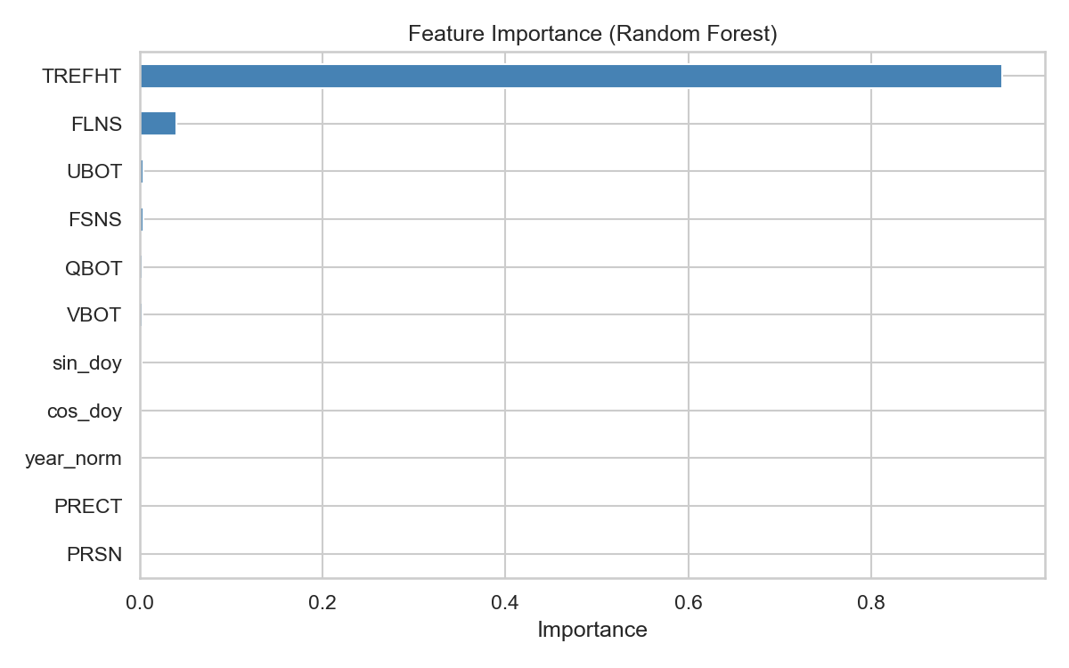
Results: Feature Importance
TREFHT dominates
Expected: daily mean temp is the strongest predictor of daily max temp
Solar radiation (FSNS) and day-of-year encoding also contribute meaningfully
Wind and precipitation features have lower importance but still add predictive value
16

Slide 17
Next steps
Formulate specific research question
Extend the same EDA + ML framework from temperature to QBOT.
How does near-surface specific humidity evolve in Manchester from the historical period (2006–2049) to the future projection period (2050–2080), and how does its coupling with temperature influence the frequency of compound hot-humid events?
Compound hot-humid days and QBOT model diagnostics
17

Slide 18
QBOT: 'side effect' of heat or independent pattern
Application of the Framework to QBOT (Humidity)
EDA: trend, mean change, seasonal cycle, temperature-humidity relationship, and compound hot-humid days
Modelling: same train-test split and model comparison
Focus on moisture change and hot-humid risk
Ablation test used to check dependence on temperature

Slide 19
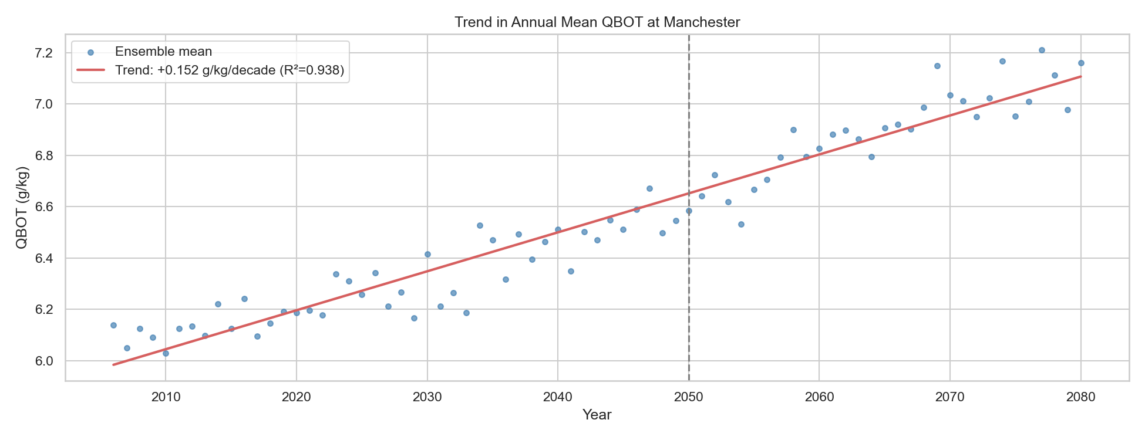
Long-term QBOT Trend
Annual mean QBOT increases over time
Clear moistening trend in Manchester
Trend: +0.152 g/kg per decade
Future climate becomes progressively more humid
19

Slide 20
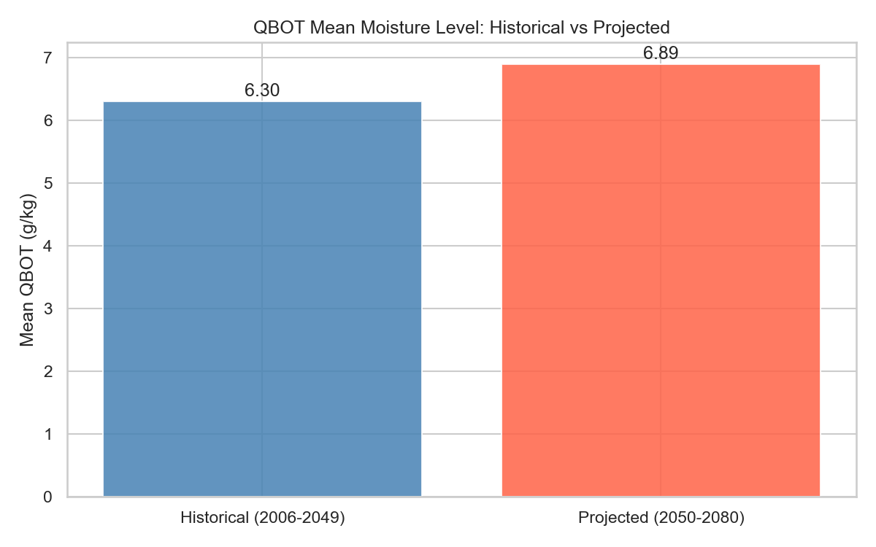
Historical vs Future Mean QBOT
Mean QBOT rises from 6.30 g/kg to 6.89 g/kg
Future Manchester is more humid on average
This shows a clear shift in background moisture level
20

Slide 21
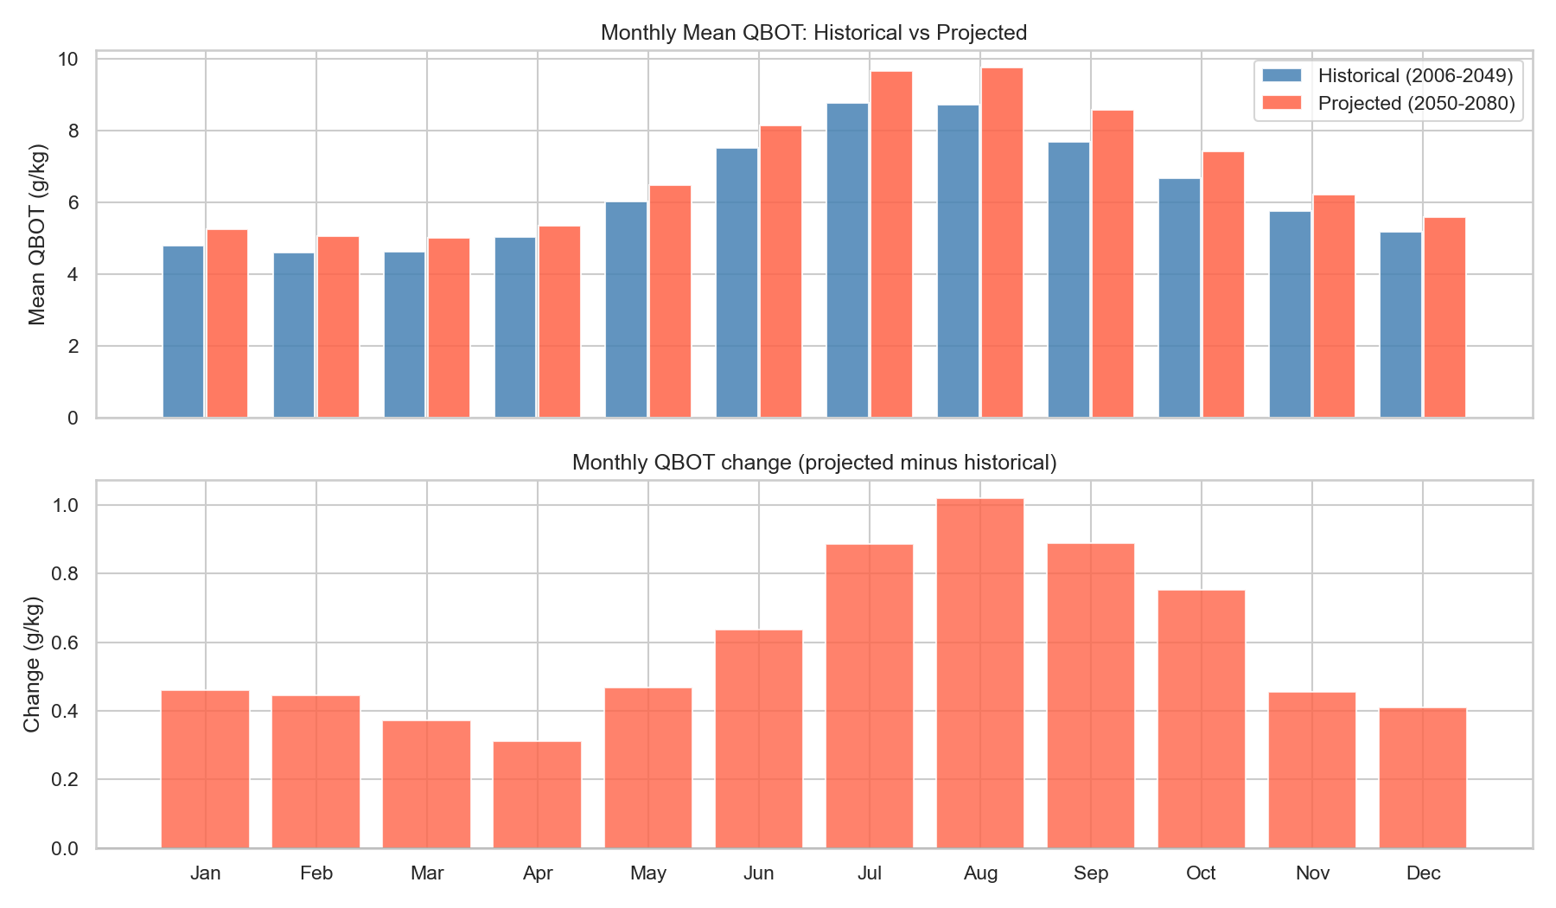
Monthly QBOT
QBOT increases in every month
The largest increase occurs in summer
July and August show the strongest moistening
Warm-season humidity change is especially important
21

Slide 22
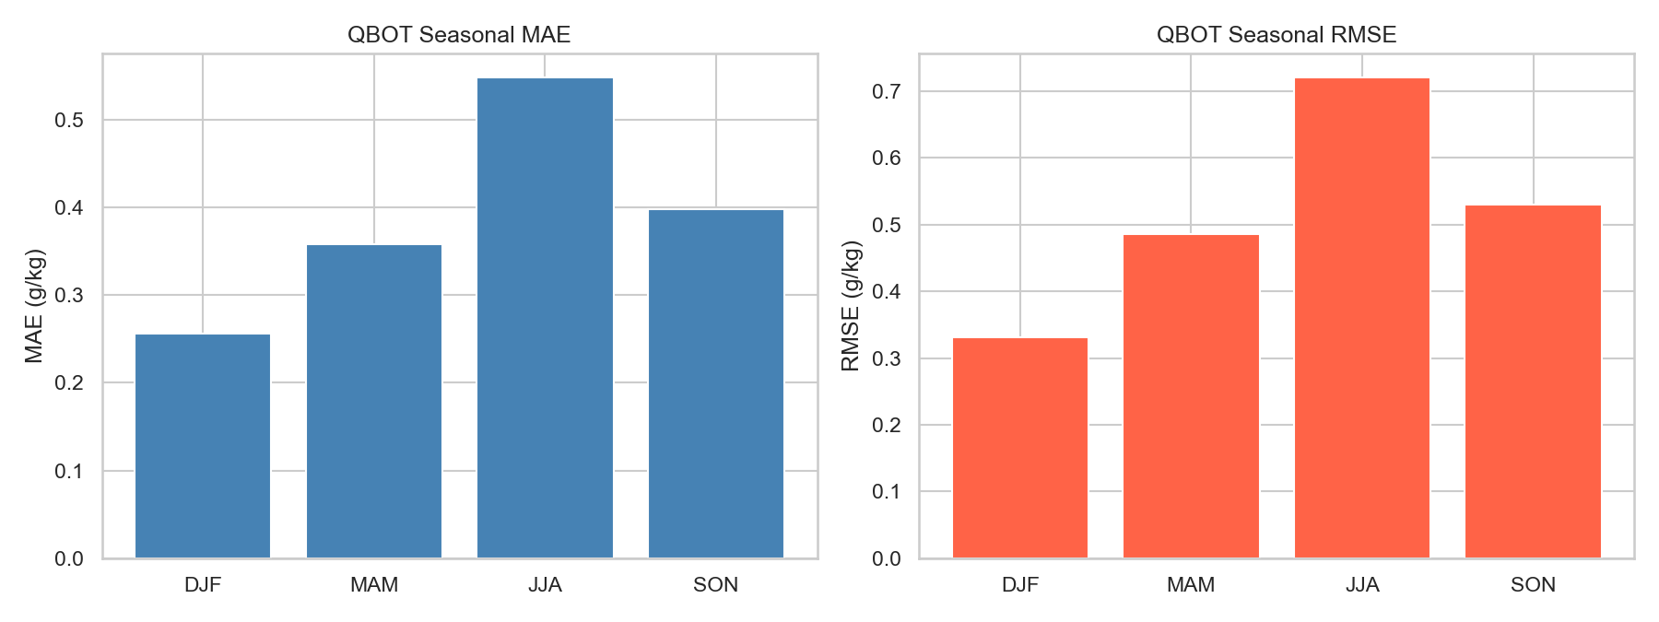
QBOT Seasonal
Errors are lowest in winter / highest in summer.
Summer humidity is the hardest to predict

Slide 23
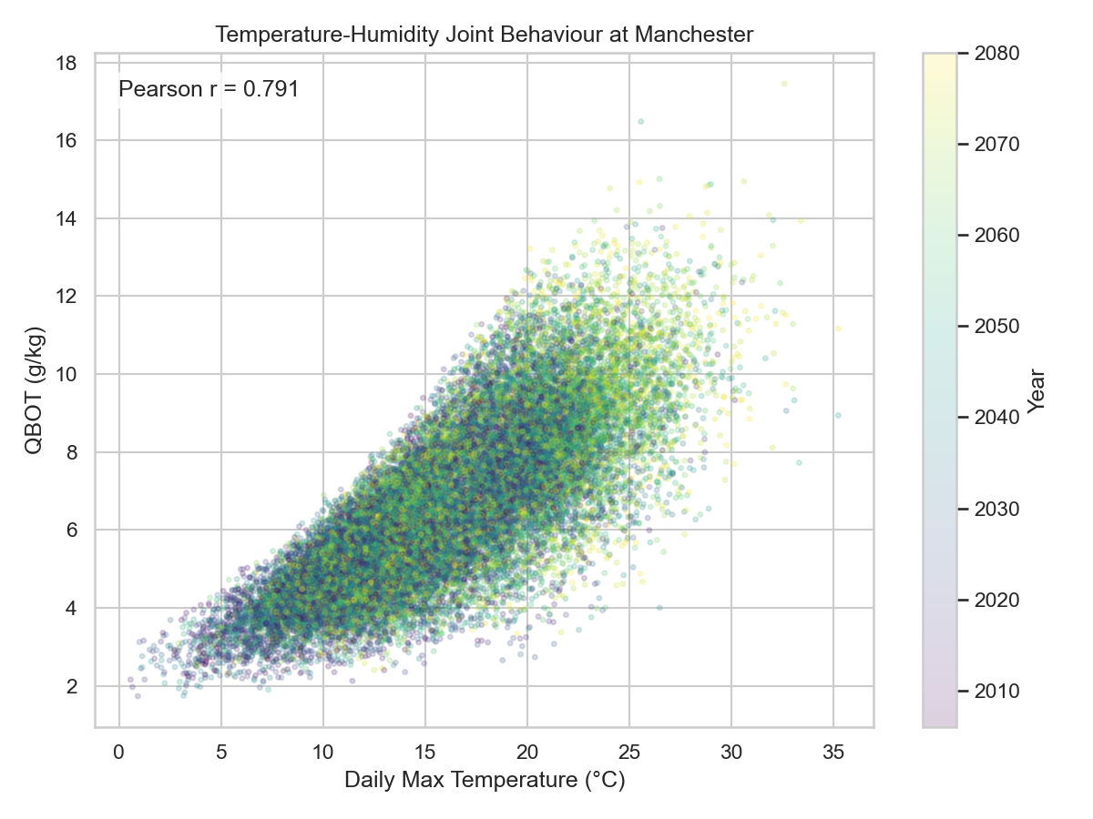
Temperature-Humidity
Hotter days also tend to be more humid
Strong positive relationship between Tmax and QBOT
Pearson r = 0.791
Later years appear more often in the hot-humid region
22

Slide 24
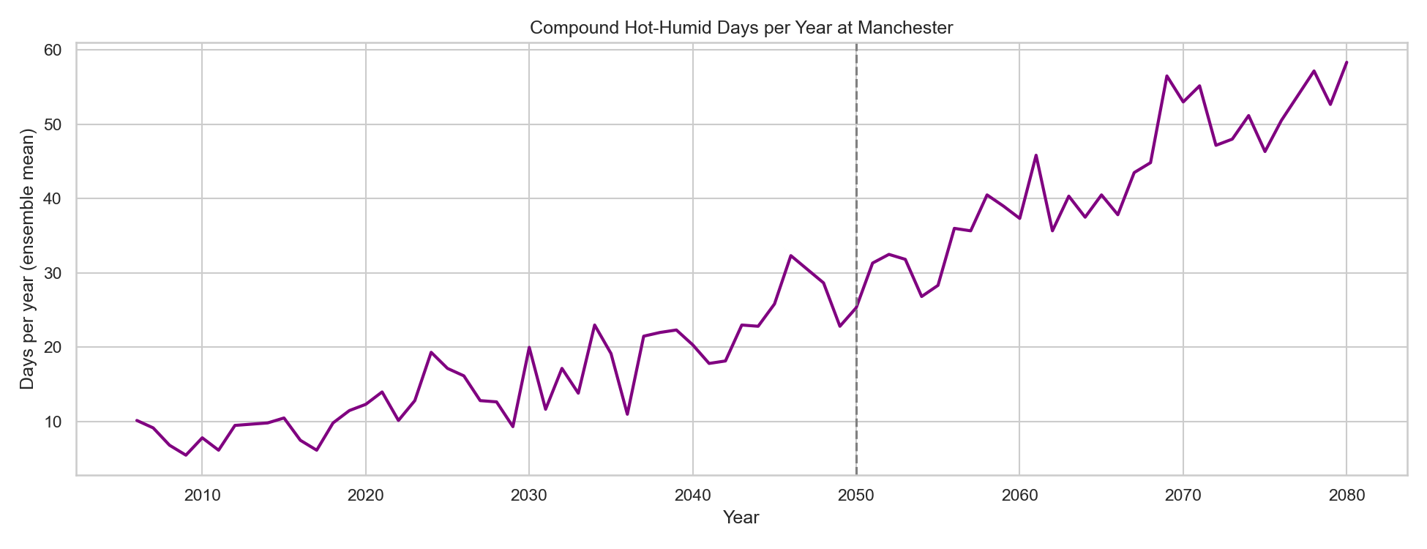
Compound Hot-Humid
Compound hot-humid days = both Tmax and QBOT above historical P90 thresholds
Frequency increases clearly after 2050
Indicates rising risk of simultaneous heat and humidity extremes
Compound humid heat context: Sherwood & Huber (2010); Raymond et al. (2020)
23

Slide 25
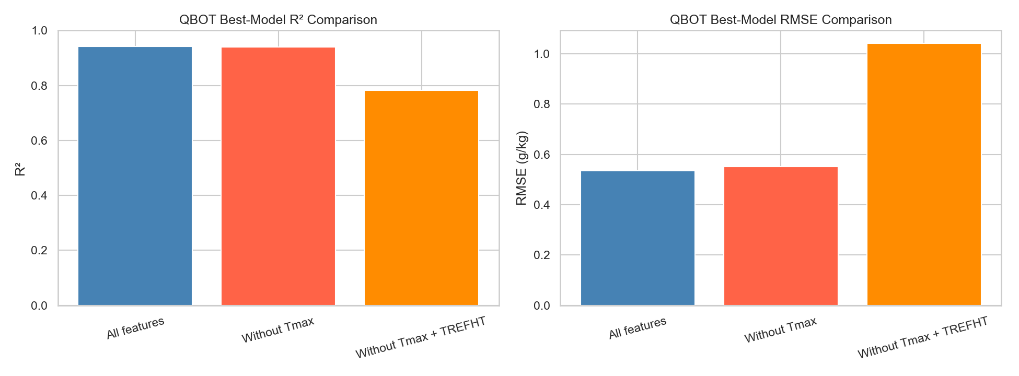
QBOT Best-Model: Ablation Test
R² drops clearly
RMSE increases strongly
Removing Tmax alone has little impact.
Removing both Tmax and TREFHT clearly reduces model performance.

Slide 26
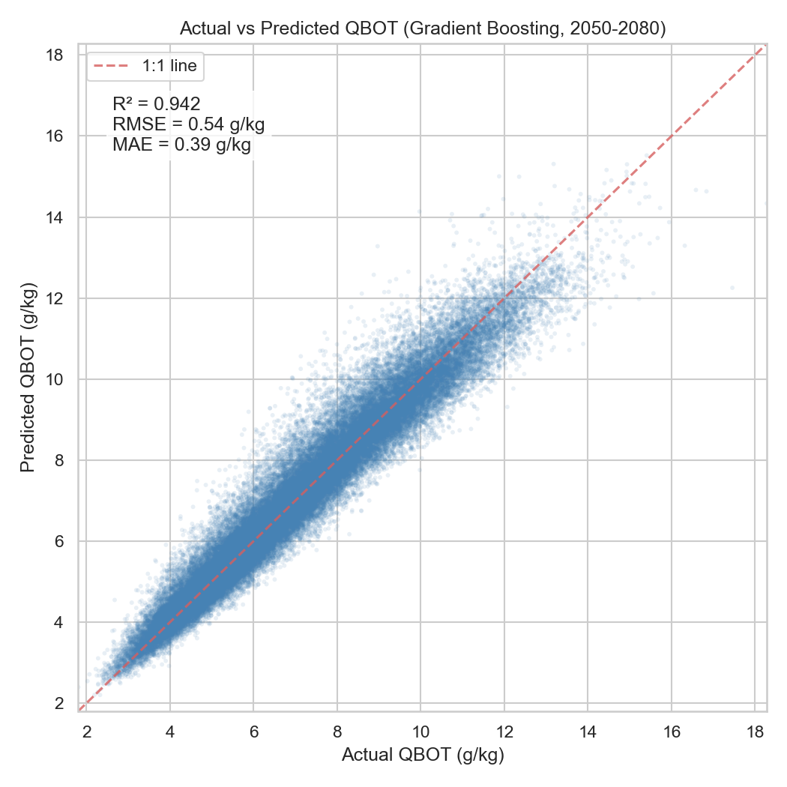
Summary
The supervised ML model successfully predicts TREFMXAV_U and QBOT for 2050–2080
Random Forest achieves R² = 0.984 with MAE of just 0.51°C
EDA revealed a clear warming trend (+0.3°C/decade), uneven seasonal warming, and increasing extreme heat days
Manchester becomes warmer and more humid, with the strongest moistening in warm season.
Humidity and temperature provide related but not identical information, so they can offer complementary signals for the model.
The model demonstrates a robust feature utilization pattern: It avoids over-reliance on any single variable, suggesting good generalization capability.
Compound hot-humid risk increases, and the ML models show good future-period predictive skill.

Slide 27
Reproducibility
Code
Three Jupyter notebooks: EDA-2.ipynb, ML.ipynb, GRAPHS.ipynb
Environment
environment.yml provided for conda environment recreation (Python 3.12)
Data
6 NetCDF files from CESM2 LENS2 (members 003–008)
Reproducibility
Random seeds set to 42 for all ML models
GitHub repository for version control
18

Slide 28
Limitation
Results are based on one climate-model framework.
The study focuses on one Manchester grid point.
The ML framework is simple and mainly demonstrates predictive relationships.
Compare across multiple models and observations.
Extend the analysis to more locations.
Use stricter validation and more advanced heat-stress indicators.
Recommendation

