Slide 1
This is a presentation
A great one
Petros / Monday, 1 February 2021

Slide 2
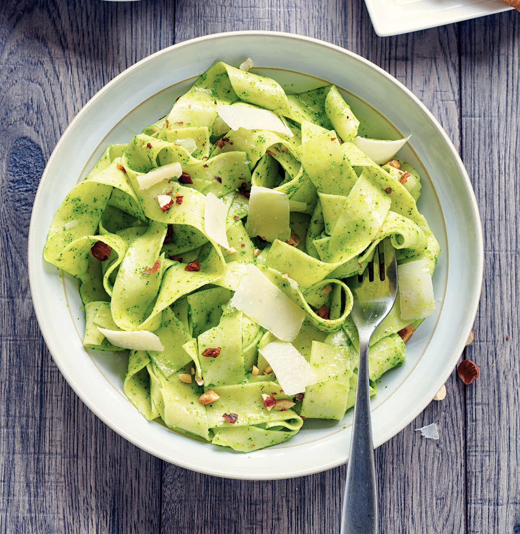
I like this food
Great food
Not sure what it is

