Slide 1
Liver disease prediction
Using Machine Learning
Project Guide: Team members:
J Swami Naik, Associate professor L Harshitha 179X1A0576
G Chandrakala 179X1A0585
P Sravani 179X1A05F4

Slide 2
Content
Abstract
Introduction
Software Requirement
Steps
Methods
Conclusion

Slide 3
1 Abstract
Liver disease had became one of the most prominent disease in our country. It has became a challenge to predict the disease of liver in early stage if not diagnosed early stages it become very hard to cure later on. Machine Learning has helped us a lot in the field of medical. The classification techniques are performed in the training dataset. The main aim of the project is to apply various machine learning algorithms on the datasets and thus identify whether the patient has liver disease or not.

Slide 4
2. Introduction
The liver plays an important role in many body functions.
Machine learning model has been using to predict liver disease.
We apply various machine learning algorithms like random forest, SVM (support vector machine), Logistic regression on the dataset and thus it helps to identify whether the patient has liver disease or not.

Slide 5
3 System Requirement:
Latest Version of Python should be present the System.
Jupyter Notebook should be installed in the System.
64-bit Processor
4GB or more than 4GB RAM is required
DATASET
Liver disease data set should be downloaded from Kaggle datasets.

Slide 6
4.Steps
There are seven stages involved in liver disease prediction. They are
Data gathering
Data pre-processing
Choose model
Train model
Test model
Tune model
Prediction

Slide 7
4.1 Data gathering
Data gathering is the process of collecting required information for the best possible outcome.
For best outcome you need to feed good and valid input to the machine.
Data set used in liver disease prediction model is.
Age of the patient | Gender of the patient | Total Bilirubin | Direct Bilirubin | Alkphos Alkaline Phosphotase | Sgpt Alamine Aminotransferase | Sgot Aspartate Aminotransferase | Total Protiens | ALB Albumin | A/G Ratio Albumin and Globulin Ratio | Result
65 | Female | 0.7 | 0.1 | 187 | 16 | 18 | 6.8 | 3.3 | 0.9 | 1
62 | Male | 10.9 | 5.5 | 699 | 64 | 100 | 7.5 | 3.2 | 0.74 | 1
62 | Male | 7.3 | 4.1 | 490 | 60 | 68 | 7 | 3.3 | 0.89 | 1
58 | Male | 1 | 0.4 | 182 | 14 | 20 | 6.8 | 3.4 | 1 | 1
72 | Male | 3.9 | 2 | 195 | 27 | 59 | 7.3 | 2.4 | 0.4 | 1

Slide 8
4.2 DATA PRE-PROCESSING
Data preprocessing is required tasks for cleaning the data and making it suitable for a machine learning model
Data pre-processing is performed on data which is collected through data gathering.
Age of the patient | Gender of the patient | Total Bilirubin | Direct Bilirubin | Alkphos Alkaline Phosphotase | Sgpt Alamine Aminotransferase | Sgot Aspartate Aminotransferase | Total Protiens | ALB Albumin | A/G Ratio Albumin and Globulin Ratio | Result
65 | Female | 0.7 | 0.1 | 187 | 16 | NaN | 6.8 | 3.3 | 0.9 | 1
62 | Male | NaN | 5.5 | 699 | 64 | 100 | 7.5 | 3.2 | 0.74 | 1
62 | Male | 7.3 | 4.1 | 490 | 60 | 68 | 7 | 3.3 | 0.89 | NaN
58 | Male | 1 | 0.4 | NaN | 14 | 20 | NaN | 3.4 | 1 | 1
72 | Male | 3.9 | NaN | 195 | 27 | 59 | 7.3 | 2.4 | 0.4 | 1

Slide 9
4.3 CHOOSE MODEL
Models used are:
1. Logistic Regression
2. Decision Tree
3. Random Forest

Slide 10
4.4 TRAIN MODEL
We divide the gathered data into train data and test data.
We use the divided train data to train the model to identify hidden patterns present in the data.
from sklearn.model_selection import train_test_split
X_train, X_test, Y_train, Y_test = train_test_split(x, y, random_state=0)
classifier.fit(X_train, Y_train)

Slide 11
4.5 TEST MODEL
After completion of training the model we test the model with the test data.
predicted_y = classifier.predict(X_test)

Slide 12
4.6 TUNE MODEL
Tuning is the process of maximizing a model’s performance without overfitting or creating too high of a variance.
In machine learning, this is accomplished by selecting appropriate “hyperparameters.”
4.7 PREDICTION
Prediction, or inference, is the step where we get to answer some questions.
This is the point of all this work, where the value of machine learning is realized.
We can finally use our model to predict whether a patient contain a liver disease or not.

Slide 13
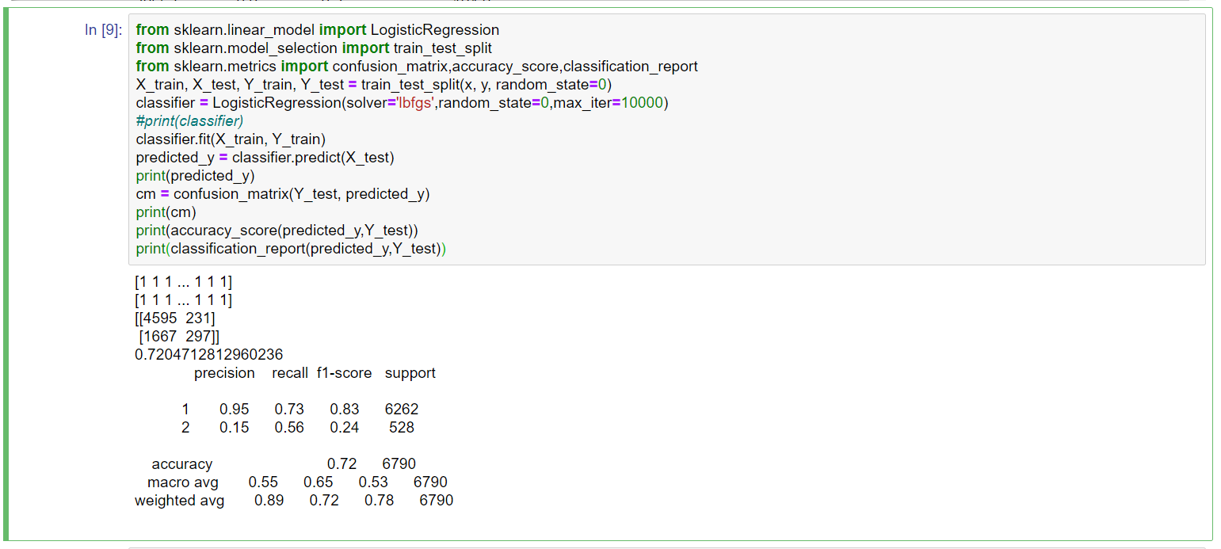
5 Methods:
5.1 Logistic Regression:
It is a technique to analyses a data-set which has a dependent variable and one or more independent variables to predict the outcome in a binary variable, meaning it will have only two outcomes.

Slide 14
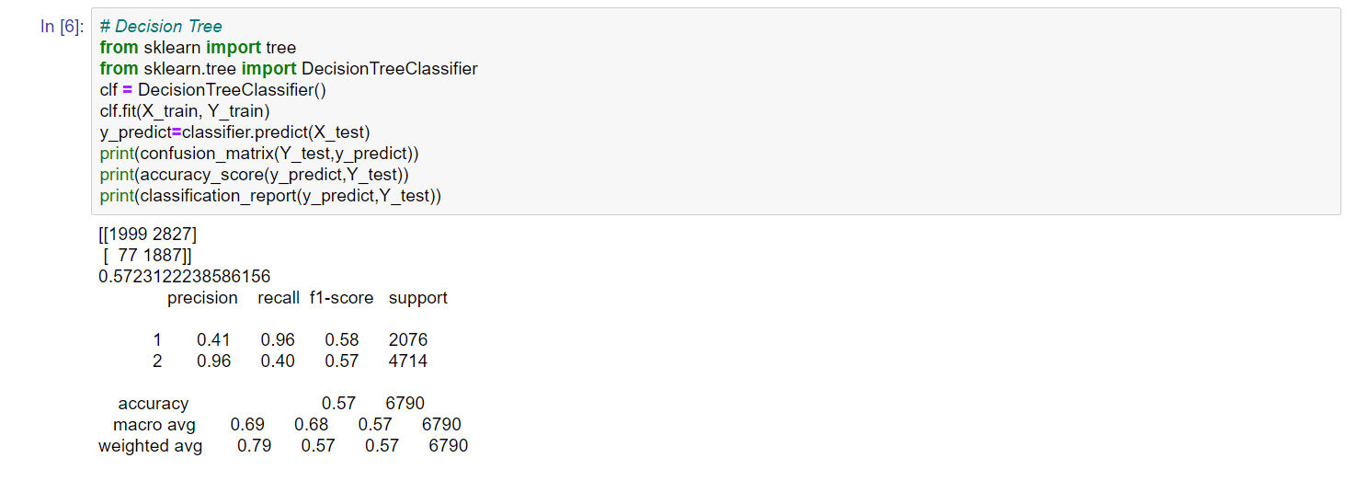
5.2 Decision Tree :
Decision-tree algorithm falls under the category of supervised learning algorithms. It works for both continuous as well as categorical output variables.

Slide 15
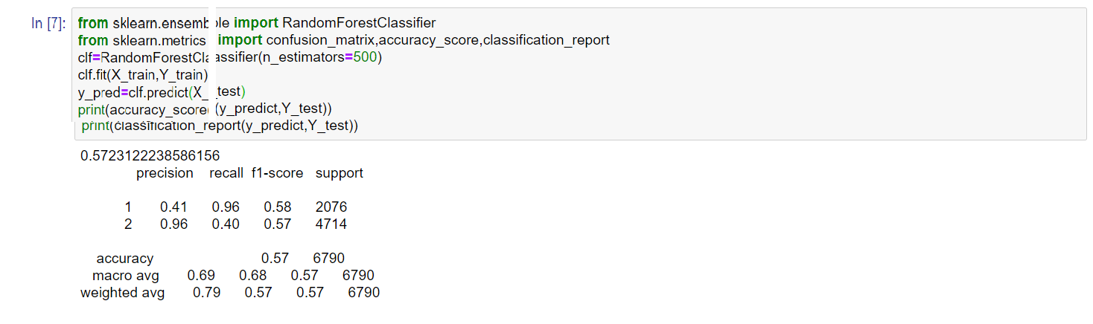
5.3 Random Forest :
Random Decision Forest is a supervised Machine learning algorithm used for classification, regression, and other tasks using decision trees.
It is basically a set of decision trees (DT) from a randomly selected subset of the training set and then It collects the votes from different decision trees to decide the final prediction.

Slide 16
6 Conclusion:
Liver disease prediction helps to identify whether the patient has liver disease or not.
However the method requires further improvement mostly regarding feature selection of liver into multiple components.
This method can be employed for heart disease detection with heart disease data set.

Slide 17
Thank You

