Slide 1
FPGA design of a simple text editor
ECE260: Digital Electronics II
Final Presentation
Louis Coyle II

Slide 2
Use Model
User loads the program onto FPGA.
Connects PS/2 keyboard for input.
Proceeds to use program as a simple text editor, like notepad.
Escape to clear screen, enter for new line, arrow keys for editing.

Slide 3
Motivation
LCD as engine to fuel learning
Previous experience with protocols either simple (UART) or abstracted (serial over USB)
PS/2 as stepping stone to other protocols
PS/2 is a protocol with specific use
More focused learning to then be applied to wider range of uses with more advanced protocols

Slide 4
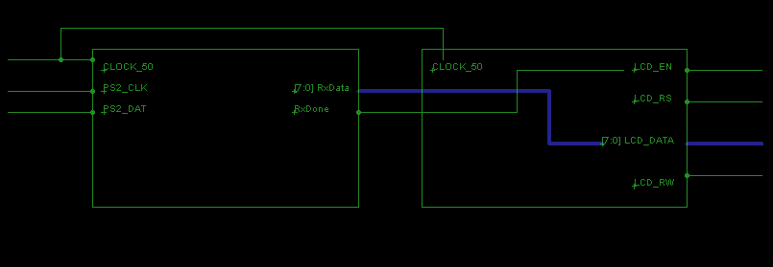
Block Diagram
*PS2_DAT sends serial make/break codes, LCD_DATA receives parallel ASCII or command.

Slide 5
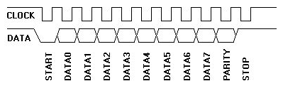
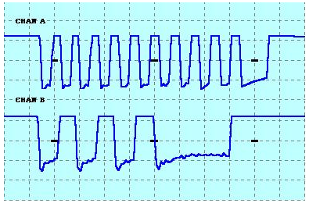
PS/2 Device-to-Host Communication
Data line changes state when clock is high, data is valid when clock is low.
Scan code for the ‘Q’ key (2’h15) being sent from keyboard to computer.
A – Clock, B – Data

Slide 6
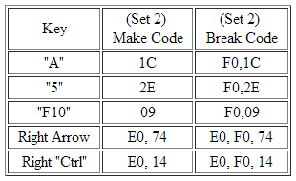
Make/Break, Typematic
Most Break codes are two bytes long.
First byte is 2’hF0, second is the make code.
Extended keys usually have three byte ones.
Pressing and holding makes key typematic.
Keyboard will keep sending the make code until released or another key pressed.
So, in order to send an uppercase ‘A’ to a word processor:
  press Shift key (make code: 2’h12)
  press ‘A’ key (make code: 2’h1C)
  release ‘A’ key (break code: 2’hF0, 2’h1C)
  release Shift key (break code: 2’hF0, 2’h12)
The sequence of data sent to computer then would be:
  2’h12, 2’h1C, 2’hF0, 2’h1C, 2’hF0, 2’h12

Slide 7
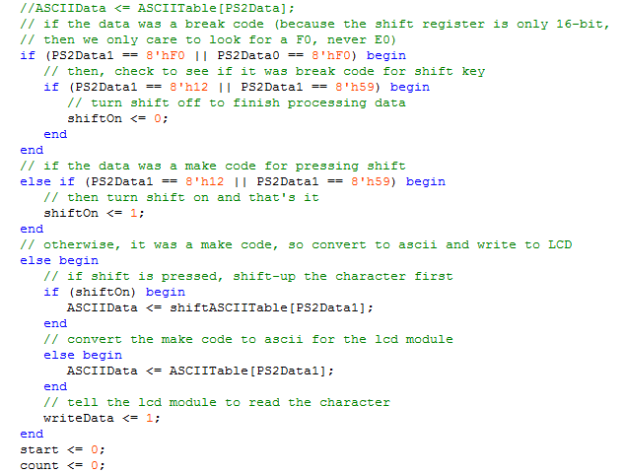
Handling the Shift Key
Looked for break code first.
Only if the shift code is a make code, turn shift on.
When there is a shift break code, turn shift off.

Slide 8

Make/Break to ASCII

Slide 9
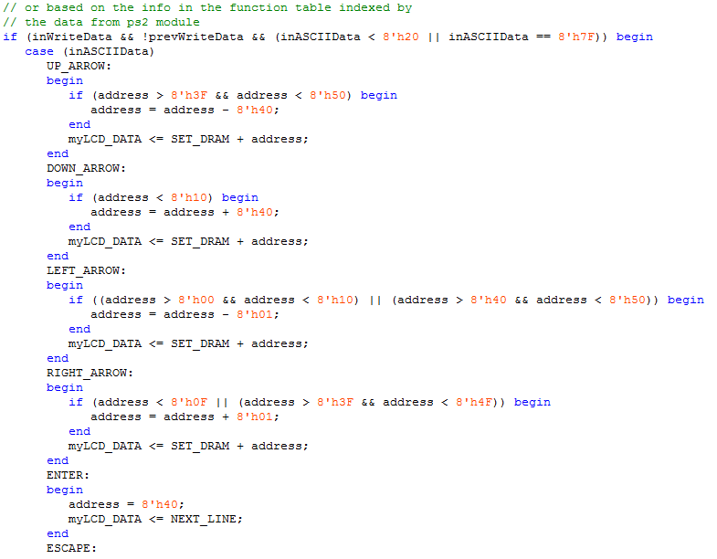
Non-Character ASCII Codes
By non-character I mean that they aren’t printed as a character on the LCD.
Need to have a special command executed on the LCD to function.
On the right is some of my code for this.

Slide 10
Demonstration
Notes:
Delay – time before first character appears
Rate – at which characters will appear after delay

Slide 11
Thank You for Listening
Questions?

Slide 12
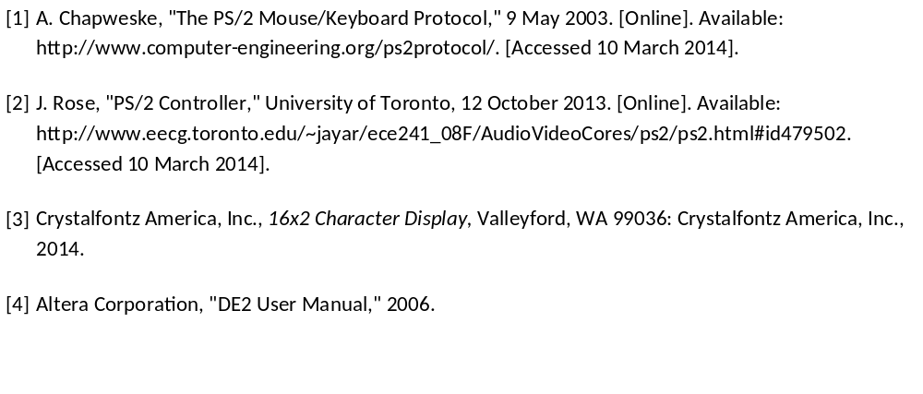
References

