Slide 1
PS/2 to LCD Driver
ECE260: Digital Electronics II
Project Proposal
Louis Coyle II

Slide 2
PS/2 to LCD Driver
PS/2 driver connected to LCD
Display pressed characters on LCD
Shows functionality of both drivers
Use of arrows and backspace to edit the displayed characters

Slide 3
Motivation
LCD as engine to fuel learning
Previous experience with protocols either simple (UART) or abstracted (serial over USB)
PS/2 as stepping stone to USB, other protocols
PS/2 is a protocol with specific use
More focused learning to then be applied to wider range of uses with more advanced protocols

Slide 4
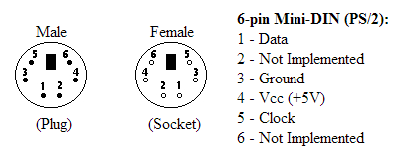
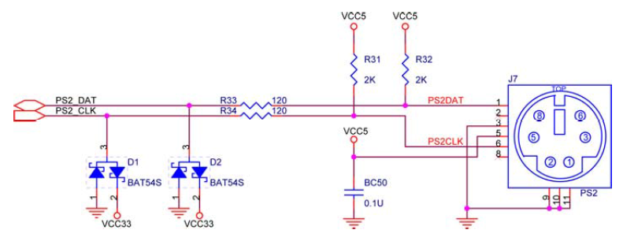
PS/2 Interface
Data and clock lines are open-collector with pull-up resistors to VCC5.
This means the idle state of the bus is high.
Clock always supplied by the device.

Slide 5
Bus States
Data | Clock | State
1 | 1 | Idle
1 | 0 | Comm. Inhibited
0 | 1 | Host Request-to-Send
0 | 0 | Comm. Inhibited*
Only allowed to transmit data after idle state.
If host wants to send data, it must pull the clock low, stopping the device from sending data.
Then the host must pull data low and release clock.
This is RTS, and tells device to start generating clock.
*In Host-to-Device, after ‘ack’, host can pull the clock low while it processes data.

Slide 6
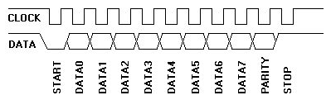
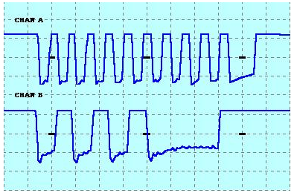
PS/2 Device-to-Host Communication
Data line changes state when clock is high, data is valid when clock is low.
Scan code for the ‘Q’ key (2’h15) being sent from keyboard to computer.
A – Clock, B – Data

Slide 7
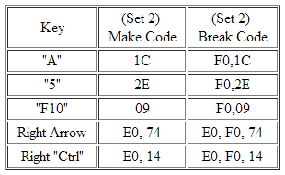
Make/Break, Typematic
Most Break codes are two bytes long.
First byte is 2’hF0, second is the make code.
Extended keys usually have three byte ones.
Pressing and holding makes key typematic.
Keyboard will keep sending the make code until released or another key pressed.
So, in order to send an uppercase ‘A’ to a word processor:
  press Shift key (make code: 2’h12)
  press ‘A’ key (make code: 2’h1C)
  release ‘A’ key (break code: 2’hF0, 2’h1C)
  release Shift key (break code: 2’hF0, 2’h12)
The sequence of data sent to computer then would be:
  2’h12, 2’h1C, 2’hF0, 2’h1C, 2’hF0, 2’h12

Slide 8
BAT (Basic Assurance Test)
On power-on or software reset
Enables three LEDs (Num, Scroll, Caps lock)
Performs diagnostic self-test
Typematic delay: 500ms
Typematic rate: 10.9cps
Scan code set: 2
Typematic/Make/Break: Set for all keys.
Turns off LEDs and sends 2’hAA(Success) or 2’hFC(Error) to host.
Notes:
Delay – time before first character appears
Rate – at which characters will appear after delay

Slide 9
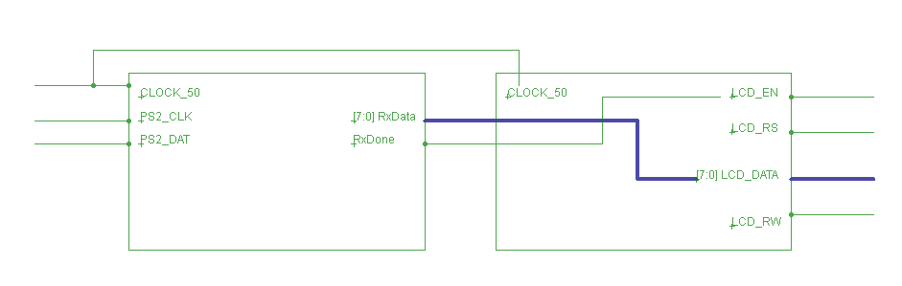
Block Diagram

Slide 10
Thank You for Listening
Questions?

Slide 11
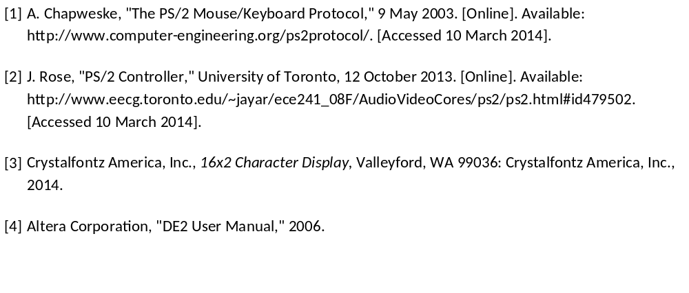
References

