Slide 1
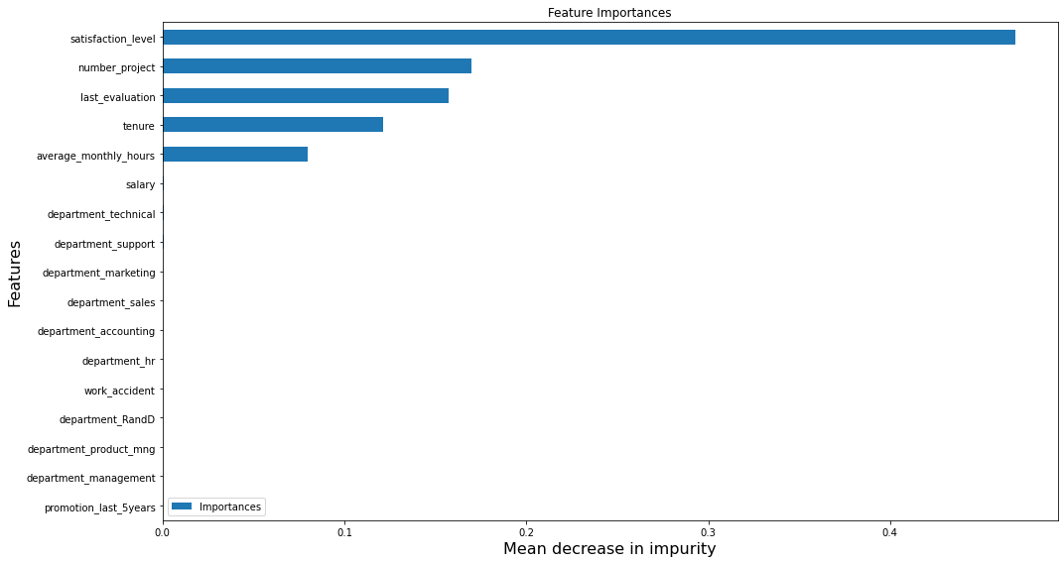
Build a Classification Model on HR turnover data
Prepared for Salifort Motors
Salifort Motors has a high turnover of employees and wants a model that will predict whether an employee will leave the company.
Due to the high turnover rate, the company needs a classification model to predict if an employee will leave the company. It will help the company increase retention and job satisfaction for current employees, and save money and time in training new employees
Build a statistical model, e.g. logistic regression and a machine learning model e.g. random forest to predict if an employee will leave.
The analysis shows employees are overworked.
Employees working on too many projects – 7.leave the company.
Employees that are overworked and dissatisfied leave the company. ‘employees that are not overworked a nd dissatisfied might have been fired. Employees that aare overworked and satisfied might have been recruited by other companies.
The random forest model gave an excellent performance with an f1 score = 95.6%, precision = 98.5% and recall = 93.0%
Logistic regression model f1 score = 34%
Important features for the random forest model
The important features for the random forest model are satisfaction_level, number_project,last_evaluation, tenure, average_monthly_hours
Establish a policy where employees work reasonable hours to prevent them from becoming overworked burnout. Ensure employees work 3-4 projects. Create an overtime with pay policy, so employees are compensated for their time. Instead of predicting who is likely to leave, predict satisfaction level of employees.

