Slide 1
MEPtoolkit
Future dev considerations

Slide 2
Installing the toolkit
Installing the toolkit and its dependencies may require to install a recent version of RTools:
https://cran.r-project.org/bin/windows/Rtools/
Then, the devtools package is necessary to install from Github:
install.packages("devtools")
library(devtools)
install_github("Medical-Evidence-Project/MEPtoolkit", build_vignettes = TRUE)
library(MEPtoolkit)
Don't forget the "build_vignettes" argument to have access to the entry-point vignette!

Slide 3
Entry-point vignette
Once the toolkit is installed and loaded, you can access a vignette which explains the main philosophy of the package, and presents all functions. This should serve as an entry point to anyone:
vignette("MEPtoolkit")

Slide 4
Design philosophy
An important point to keep in mind for usage and future development is the assumption that numbers reported in articles (except sample sizes) have been rounded. Therefore, all functions in the package work on ranges rather than exact numbers.

Slide 5
Design philosophy
For instance, if a user inputs a mean of 3.50 in a function, the function has to assume that the underlying mean ranges between [3.495; 3.505]. A consequence of this is that all numbers that could be rounded have to be passed as a character vector instead of a number (because R automatically removes trailing zeroes, and the precision would be lost in the process).
All future functions should respect this design, and is made easy through the use of the validate_* functions (see rounding_validation.R)

Slide 6
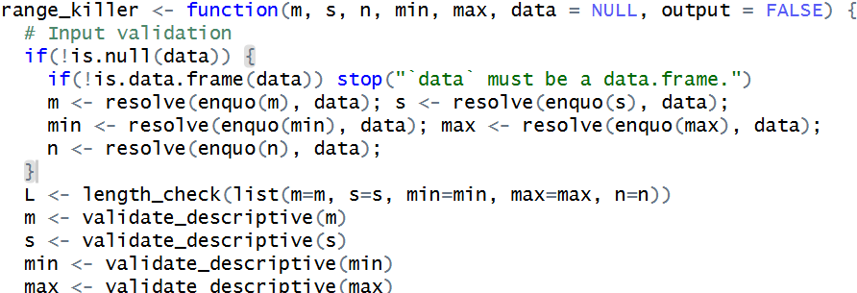
Input types
When functions take numbers as input that could be batched (e.g. many means & SDs from the same article for the t_slicer function), they are designed to work either with individual vectors or dataframes/tibbles. The way this is handled is similar in all functions, but the inner workings of R makes it impossible to outsource this input validation in a specific function. Therefore, all functions that could accept either vectors or a dataframe should start in a similar fashion (here is an example: )

Slide 7
Test coverage
At the moment, most functions only have extremely basic test coverage (just making sure that normal usage is functional), but those tests should be expanded in the long run

Slide 8
zzz.R (font & colors)
In the future, graph outputs from the MEP package should use a specific font and a specific color scheme. This is not implemented yet, but early code for the font and colors are already present in the zzz.R file.

