Slide 1
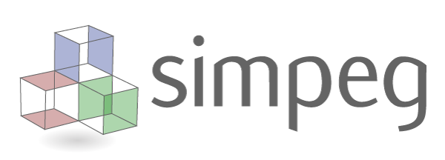

3D hybrid-parametric inversion of AEM data accelerated by tiling
Lindsey J. Heagy¹, Joseph Capriotti², Seogi Kang³, Dominique Fournier⁴, John Weis¹, Johnathan Kuttai¹, Devin Cowan¹, Santiago R. Soler¹
¹ University of British Columbia - Geophysical Inversion Facility
² Colorado School of Mines
³ University of Manitoba
⁴ Mira Geoscience

Slide 2
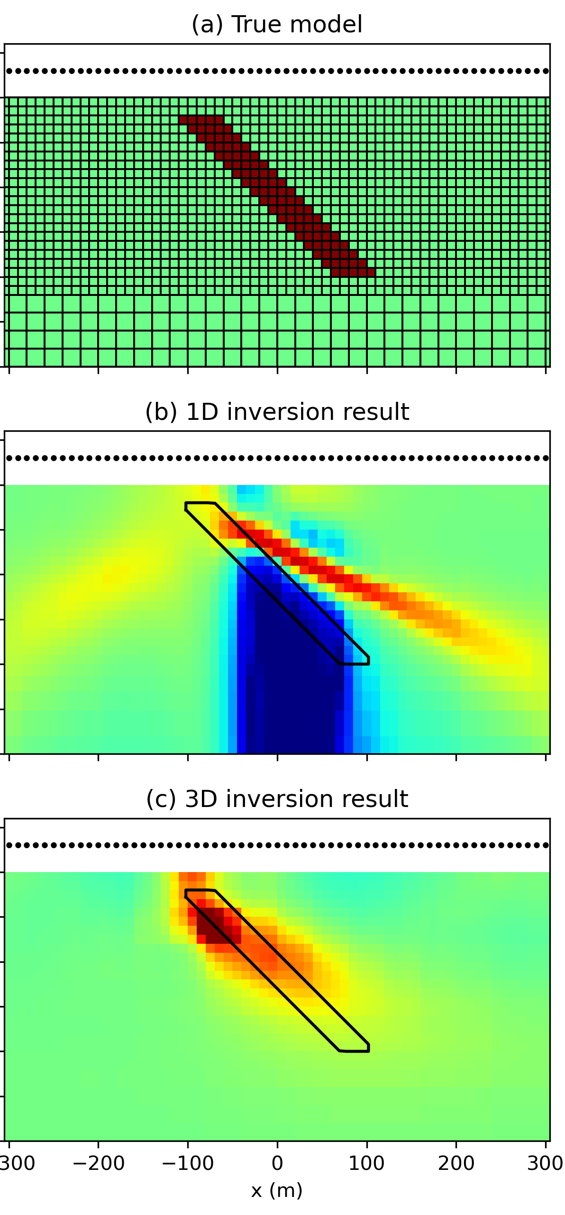
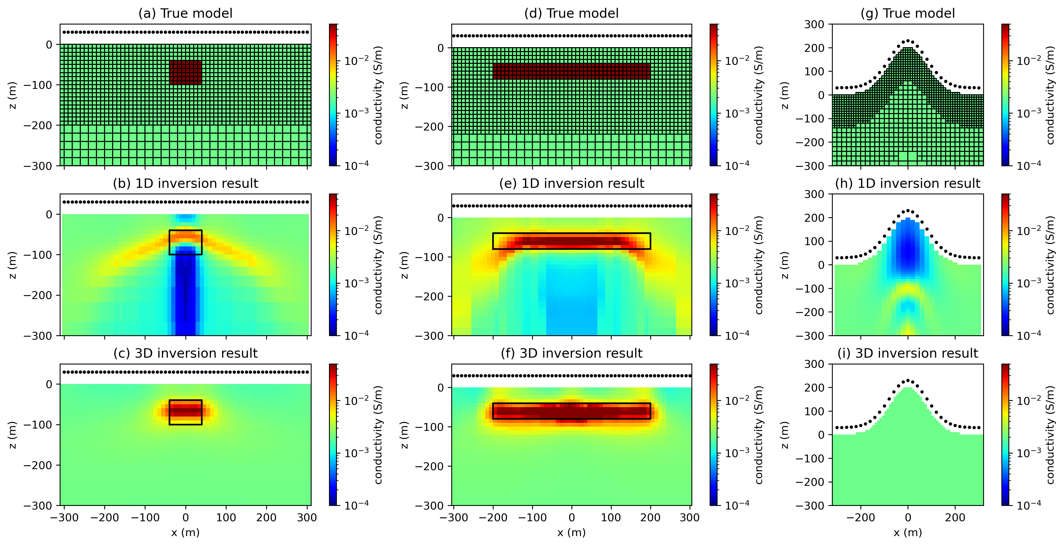
why 3D?
Heagy, L.J., Oldenburg, D.W., Kang, S., Yang, D., 2025. Why every electromagnetic inversion needs a 3D forward simulation. The Leading Edge 44, 847–854.

Slide 3
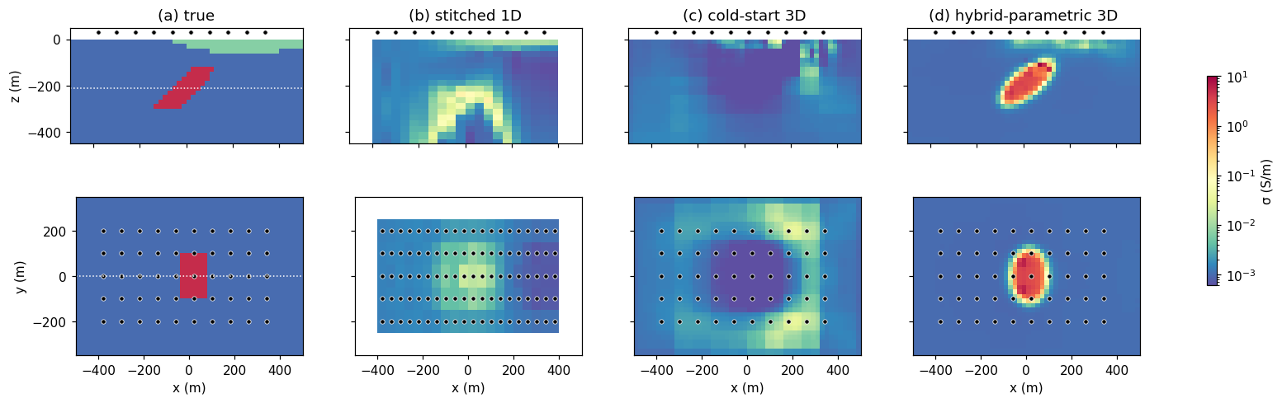
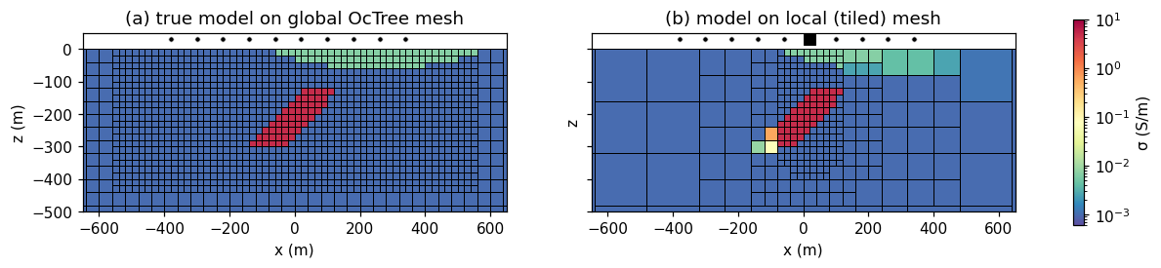
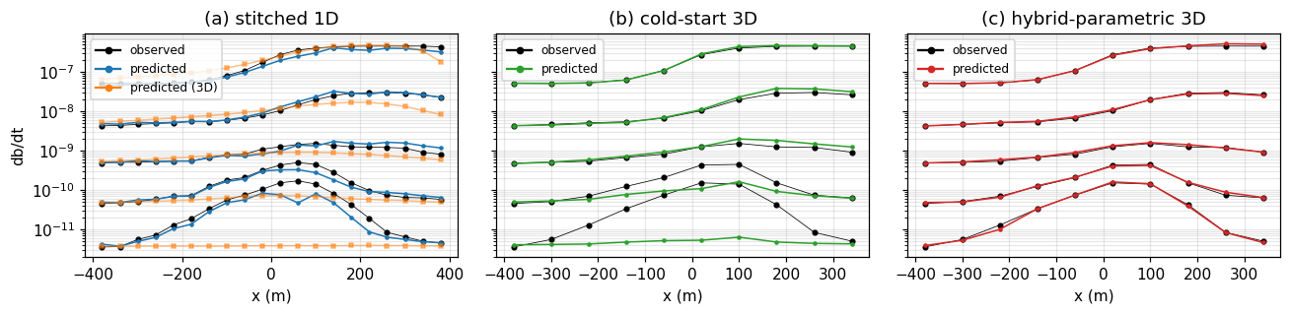
why 3D?
Stitched 1D: dip, extent ambiguous
example: conductive target, conductive overburden (partial)
3D forward (orange) shows where 1D inversion doesn’t fit the data

Slide 4
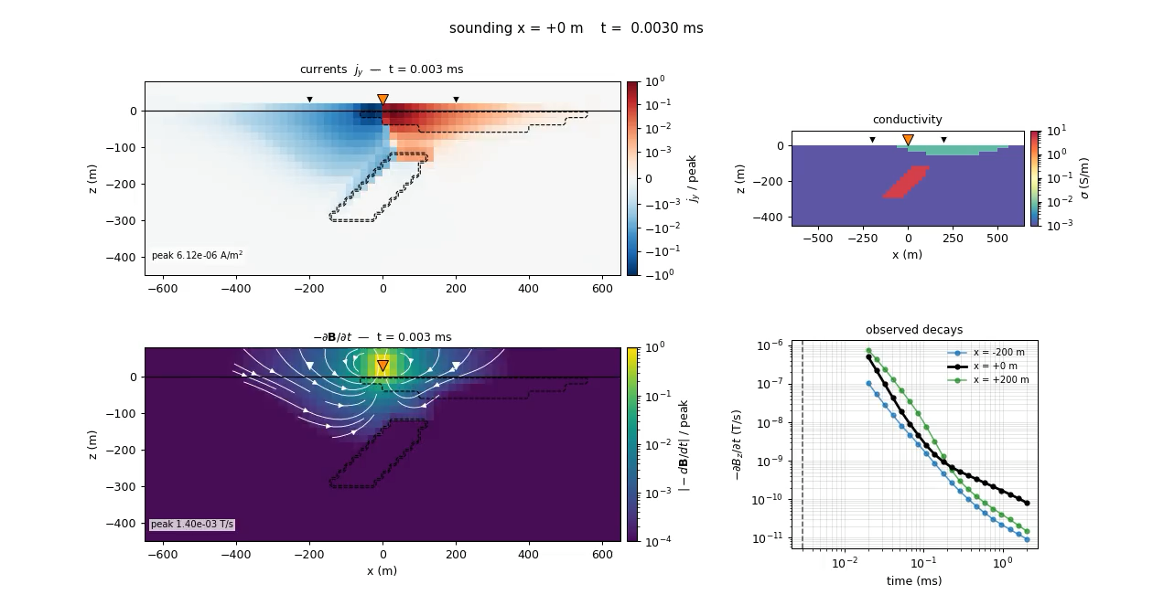
why 3D?

Slide 5
challenges with 3D
Computational cost
Non-uniqueness

Slide 6
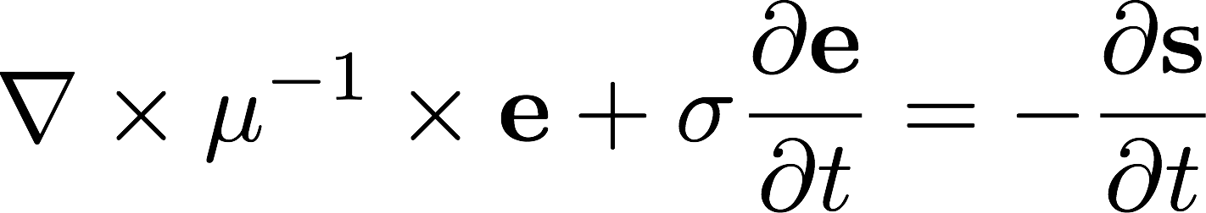
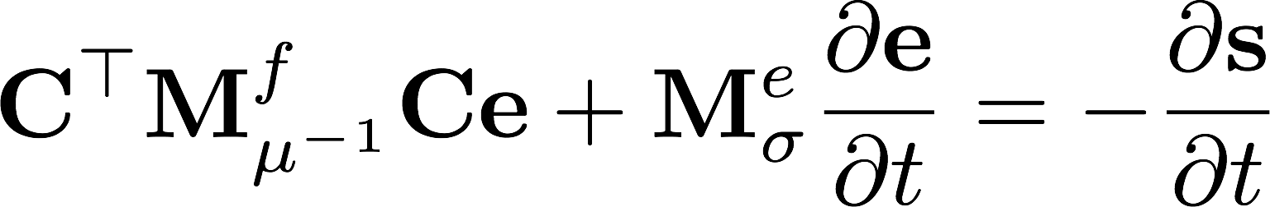
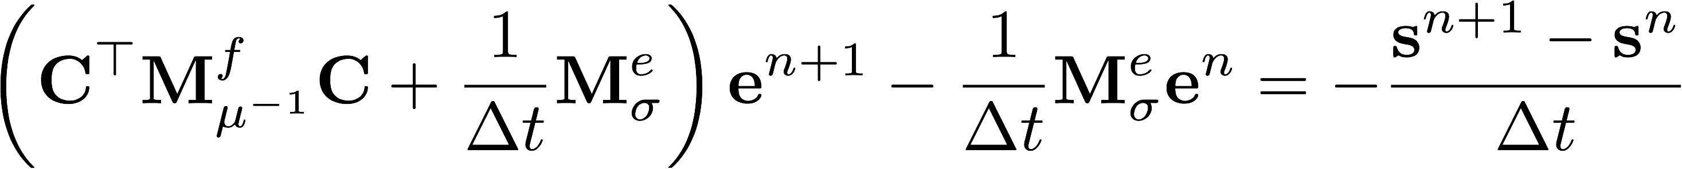
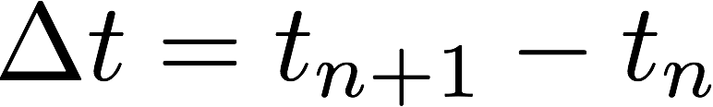
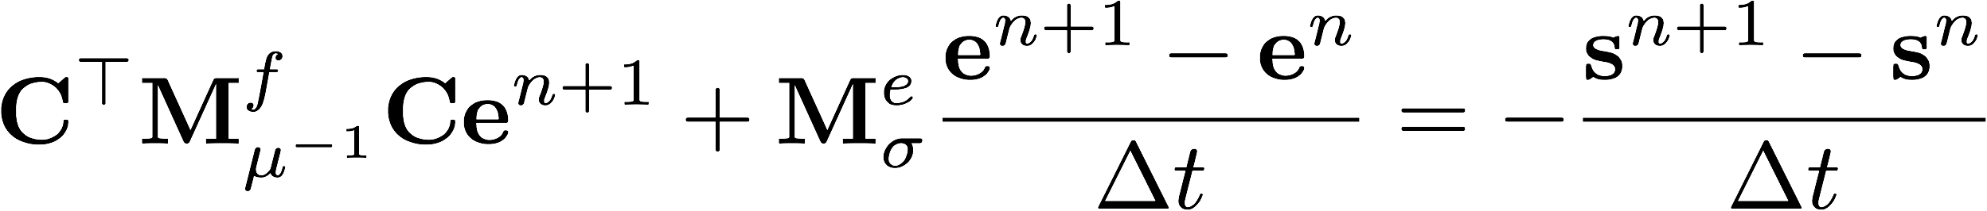
challenges with 3D
Computational cost.
  Solving full 3D Maxwell
  Discretize in space
  Then in time (backward Euler; depends on )
  Time step

Slide 7
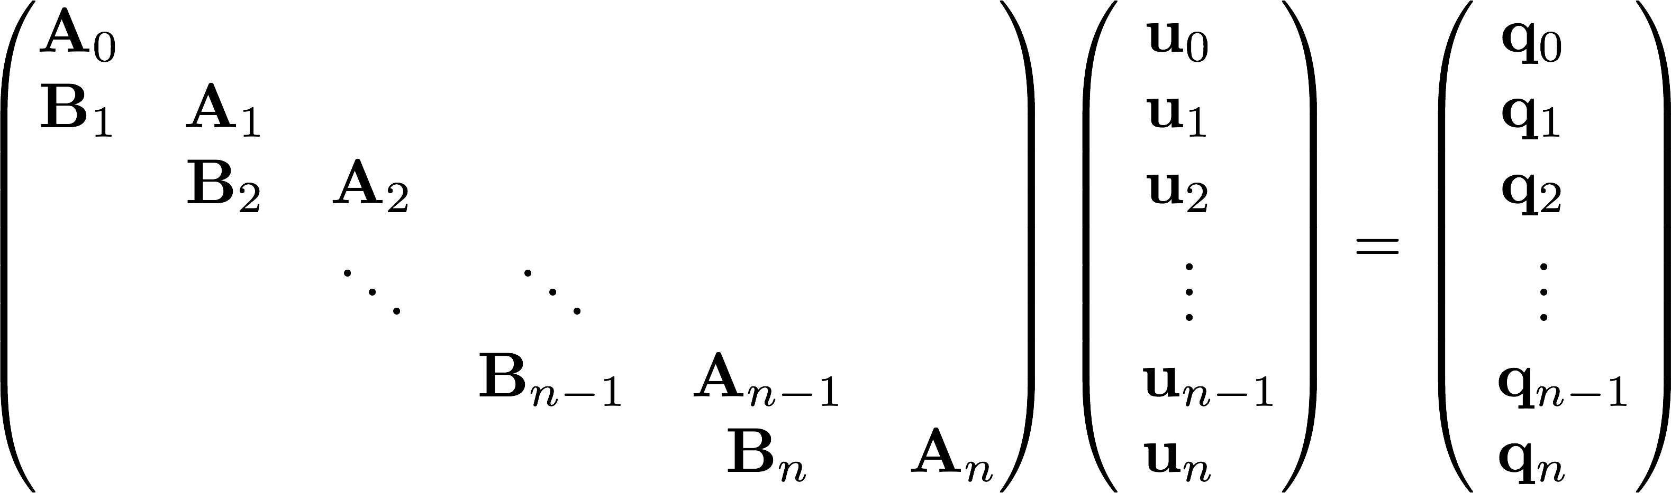
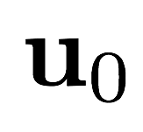
challenges with 3D
Computational cost.
  Time stepping problem
  Arrange in a big matrix
  Solve with forward elimination
  Initial conditions provide
  To propagate forward, solve

Slide 8
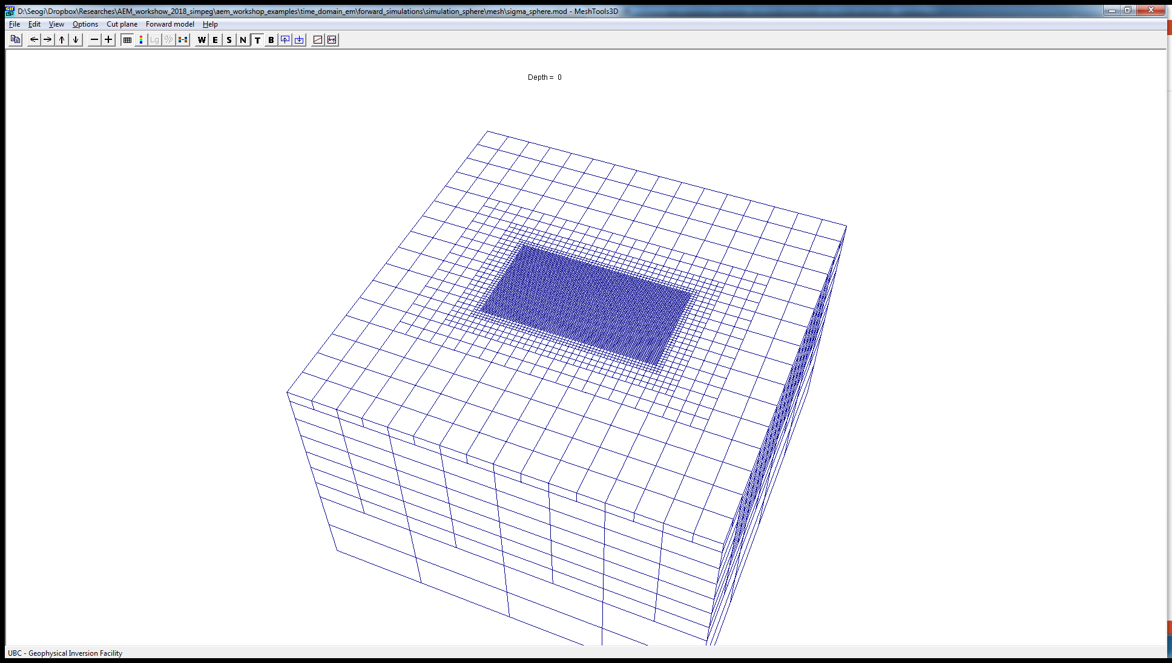
challenges with 3D
Computational cost.
50,000 cells (not a huge mesh…)
80 time-steps, 4 unique step sizes
For a single sounding:
4 factorizations: each ~18 s
80 back-substitutions: each ~0.15 s
total: 90s
Inversion: each iteration may take ~10-20 solves
10 inversion iterations → ~5 hours

Slide 9
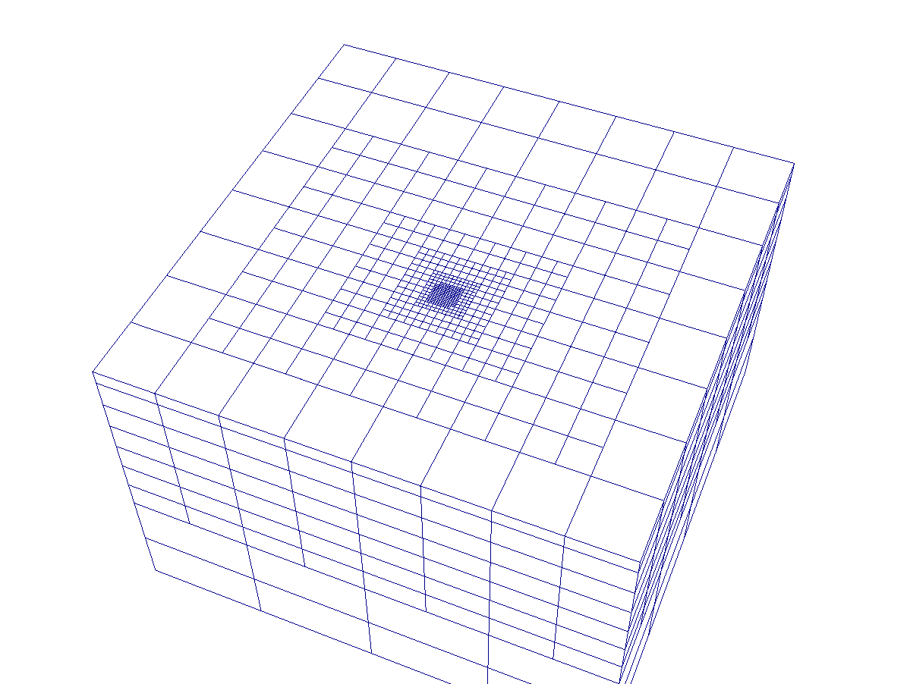
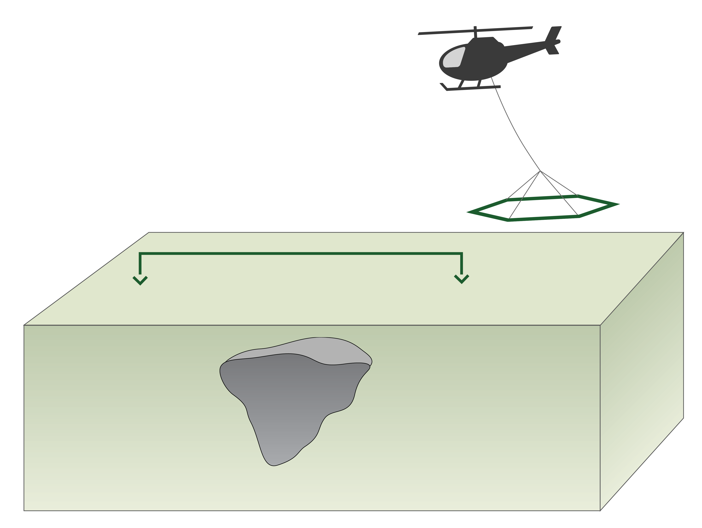
challenges with 3D
Computational cost.
Solution: tiling (after Yang et al; Cox et al)
Global mesh
Local mesh
Yang, D., Oldenburg, D.W., Haber, E., 2014. 3-D inversion of airborne electromagnetic data parallelized and accelerated by local mesh and adaptive soundings. Geophysical Journal International

Slide 10
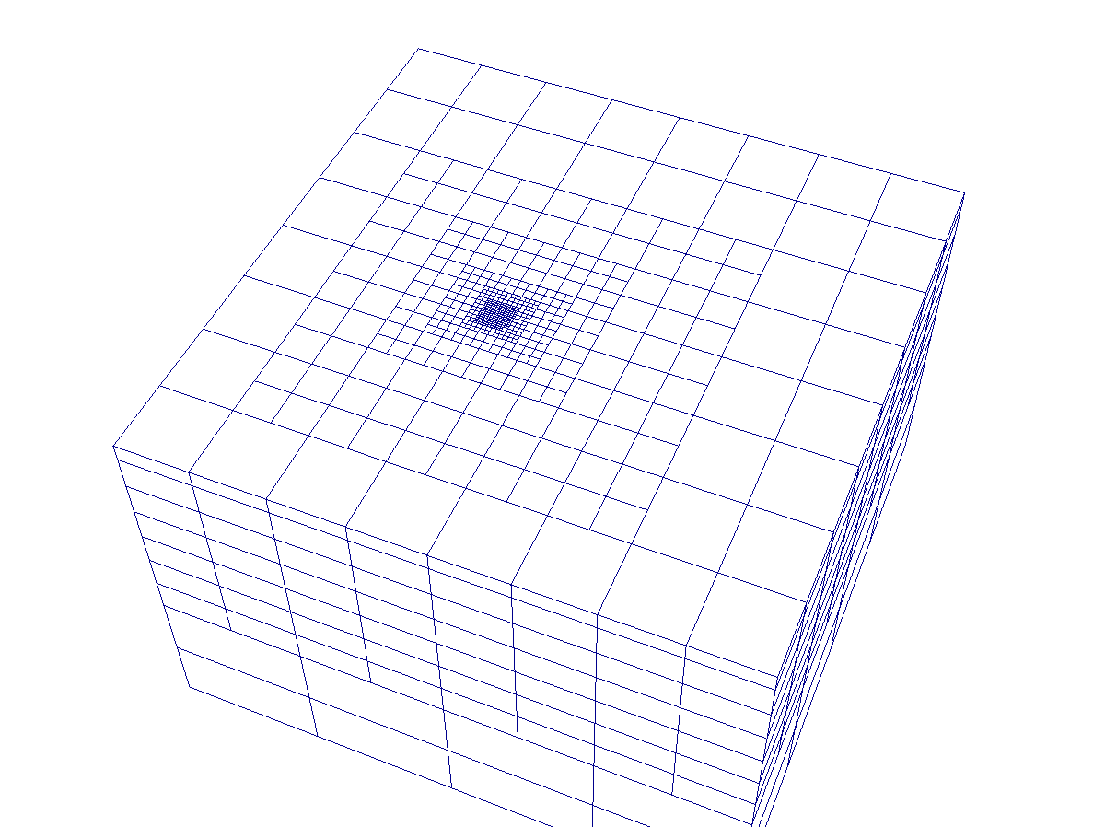
challenges with 3D
Computational cost.
Solution: tiling (after Yang et al; Cox et al)
Global mesh
Local mesh
Yang, D., Oldenburg, D.W., Haber, E., 2014. 3-D inversion of airborne electromagnetic data parallelized and accelerated by local mesh and adaptive soundings. Geophysical Journal International

Slide 11
challenges with 3D
Nonuniqueness
Higher dimensional space
Prone to sensitivity artifacts (see McMillan)
e.g. Cold-started inversion, no sensitivity weighting

Slide 12
challenges with 3D
Nonuniqueness
One solution: parametric / hybrid parametric approaches (after McMillan et al)
2 step inversion: invert late times only for best fitting ellipsoid
Use this as a starting and reference model for a full 3D voxel inversion

Slide 13
challenges with 3D

Slide 14
implementation
tiling + hybrid parametric inversions in SimPEG
two key components:
mappings: transformations of model vector, with derivatives
meta-simulation: for tiling & parallelized simulations

Slide 15
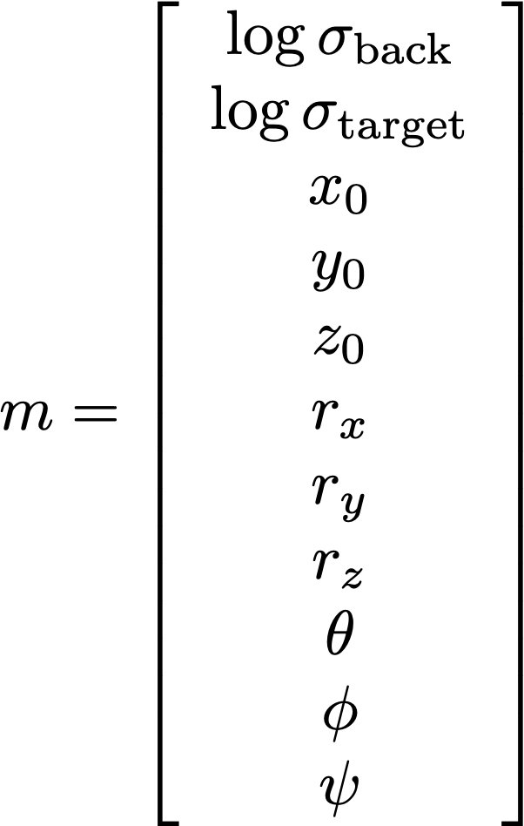

mappings
Ellipsoid parameters
Mappings translate inversion parameters to the forward simulation mesh

Slide 16
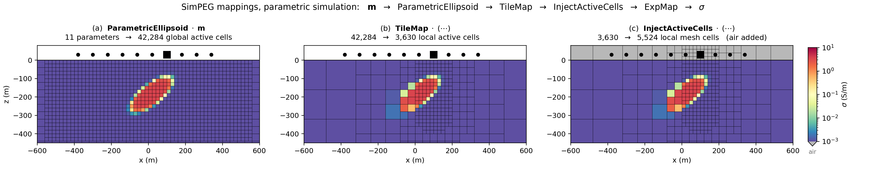
mappings
Ellipsoid parameters
Parametric ellipsoid on global mesh (in active cells)
Parametric ellipsoid
Level set approach (differentiable)
Use Pytorch (autodiff!)
maps.ParametricEllipsoid(
global_mesh,
active_cells,
boundary_sharpness=10.0)

Slide 17
mappings
Ellipsoid parameters
Parametric ellipsoid on global mesh (in active cells)
Volume-averaged model on local, tile mesh
maps.ParametricEllipsoid(
global_mesh,
active_cells,
boundary_sharpness=10.0)
maps.TileMap(global_mesh,
active_cells, local_mesh)

Slide 18
mappings
Ellipsoid parameters
Parametric ellipsoid on global mesh (in active cells)
Volume-averaged model on local, tile mesh
Include air cells, take exponential
maps.ParametricEllipsoid(
global_mesh,
active_cells,
boundary_sharpness=10.0)
maps.TileMap(global_mesh,
active_cells, local_mesh)
maps.InjectActiveCells(
local_mesh, active_cells)
maps.ExpMap(local_mesh)

Slide 19
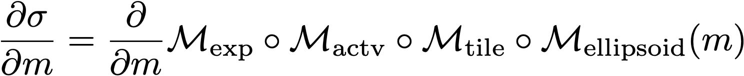
mappings
Also need sensitivities!
Chain rule.
Ellipsoid parameters
Parametric ellipsoid on global mesh (in active cells)
Volume-averaged model on local, tile mesh
Include air cells, take exponential
maps.ParametricEllipsoid(
global_mesh,
active_cells,
boundary_sharpness=10.0)
maps.TileMap(global_mesh,
active_cells, local_mesh)
maps.InjectActiveCells(
local_mesh, active_cells)
maps.ExpMap(local_mesh)

Slide 20

meta-simulations
book-keeping and parallelization for full forward simulation
two approaches (currently)
Multiprocessing: python’s built in multi-threading (single node)
Dask: can parallelize across nodes

Slide 21
# source-dependent meshes (tiles by transmitter)
simulations, mappings = [], []
for src in survey.source_list:

Slide 22
# source-dependent meshes (tiles by transmitter)
simulations, mappings = [], []
for src in survey.source_list:
local_mesh = build_local_mesh(src, refine_depth=300)

Slide 23
# source-dependent meshes (tiles by transmitter)
simulations, mappings = [], []
for src in survey.source_list:
local_mesh = build_local_mesh(src, refine_depth=300)
# the mapping carries (and volume-averages) the model
tile = TileMap(global_mesh, active_cells, local_mesh)
mappings.append(tile)

Slide 24
# source-dependent meshes (tiles by transmitter)
simulations, mappings = [], []
for src in survey.source_list:
local_mesh = build_local_mesh(src, refine_depth=300)
# the mapping carries (and volume-averages) the model
tile = TileMap(global_mesh, active_cells, local_mesh)
mappings.append(tile)
# a standard SimPEG TDEM simulation
simulations.append(Simulation3DElectricField(
local_mesh,
survey=Survey([src]),
time_steps=[(3e-6, 20), (1e-5, 20), (3e-5, 20), (1e-4, 20)],
sigmaMap=expmap * active_cells * ellipsoid_mapping,
)

Slide 25
# source-dependent meshes (tiles by transmitter)
simulations, mappings = [], []
for src in survey.source_list:
local_mesh = build_local_mesh(src, refine_depth=300)
# the mapping carries (and volume-averages) the model
tile = TileMap(global_mesh, active_cells, local_mesh)
mappings.append(tile)
# a standard SimPEG TDEM simulation
simulations.append(Simulation3DElectricField(
local_mesh,
survey=Survey([src]),
time_steps=[(3e-6, 20), (1e-5, 20), (3e-5, 20), (1e-4, 20)],
sigmaMap=expmap * active_cells * ellipsoid_mapping,
)
# compose: behaves like ONE simulation
sim = MultiprocessingMetaSimulation(simulations, mappings)
dpred = sim.dpred(model) # Jvec / Jtvec too

Slide 26
computational savings
Global mesh
50,000 cells; 90s per simulation
~ 5 hours for 10 inversion iterations
Tiled approach
5,500 cells per tile; 3s per simulation
~ 10 min for 10 iterations in an inversion

Slide 27
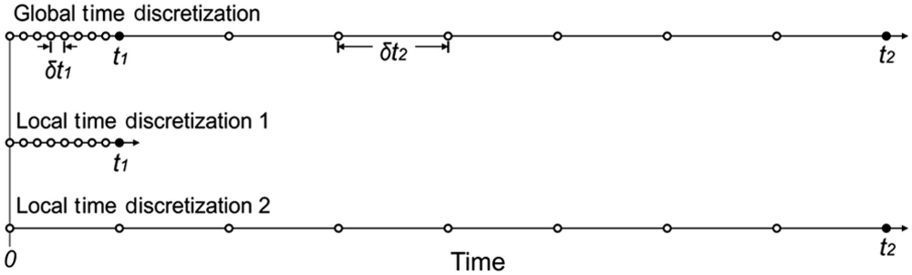
meta-simulations more broadly
Works with any SimPEG simulation type
In natural-source / FDEM methods: parallelize over frequency + tiling
Flexible & extensible
Could be used with different time stepping strategies (Yang & Oldenburg, 2016)
Yang, D., Oldenburg, D.W., 2016. Survey decomposition : A scalable framework for 3D controlled-source electromagnetic inversion. Geophysics 81, E69–E87.

Slide 28


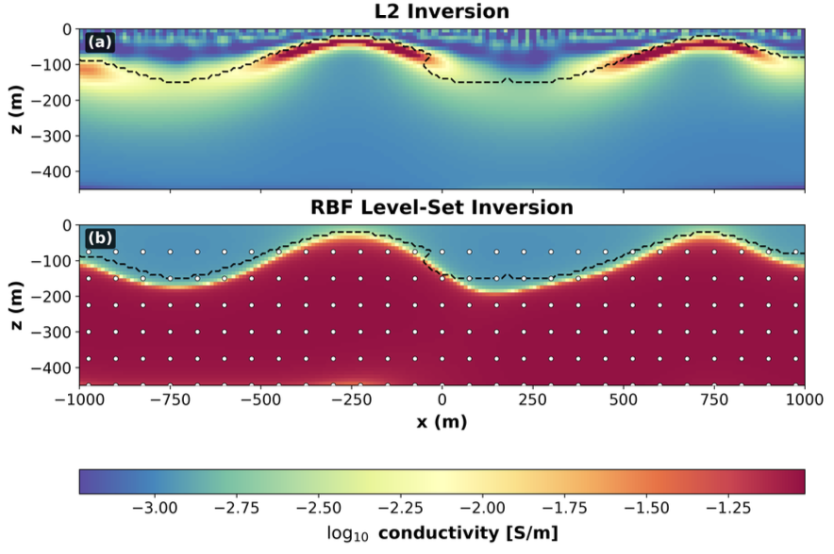


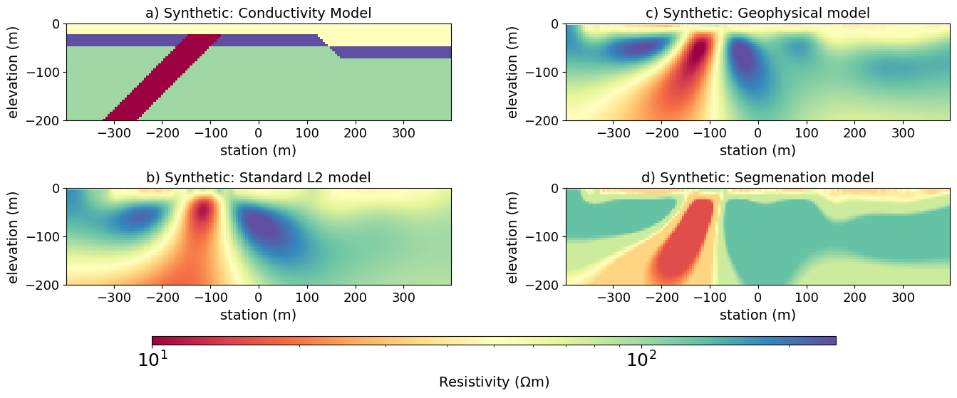
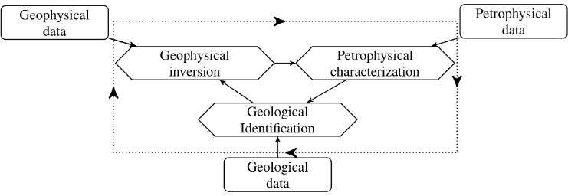
modular. can be combined with other advanced inversions
Lp norms (Fournier et al)
Parametric inversions with RBFs (Pokar et al)
Petrophysically and geolocially guided inversion (Astic et al)
Segmentation-guided inversion (Kuttai et al)

Slide 29
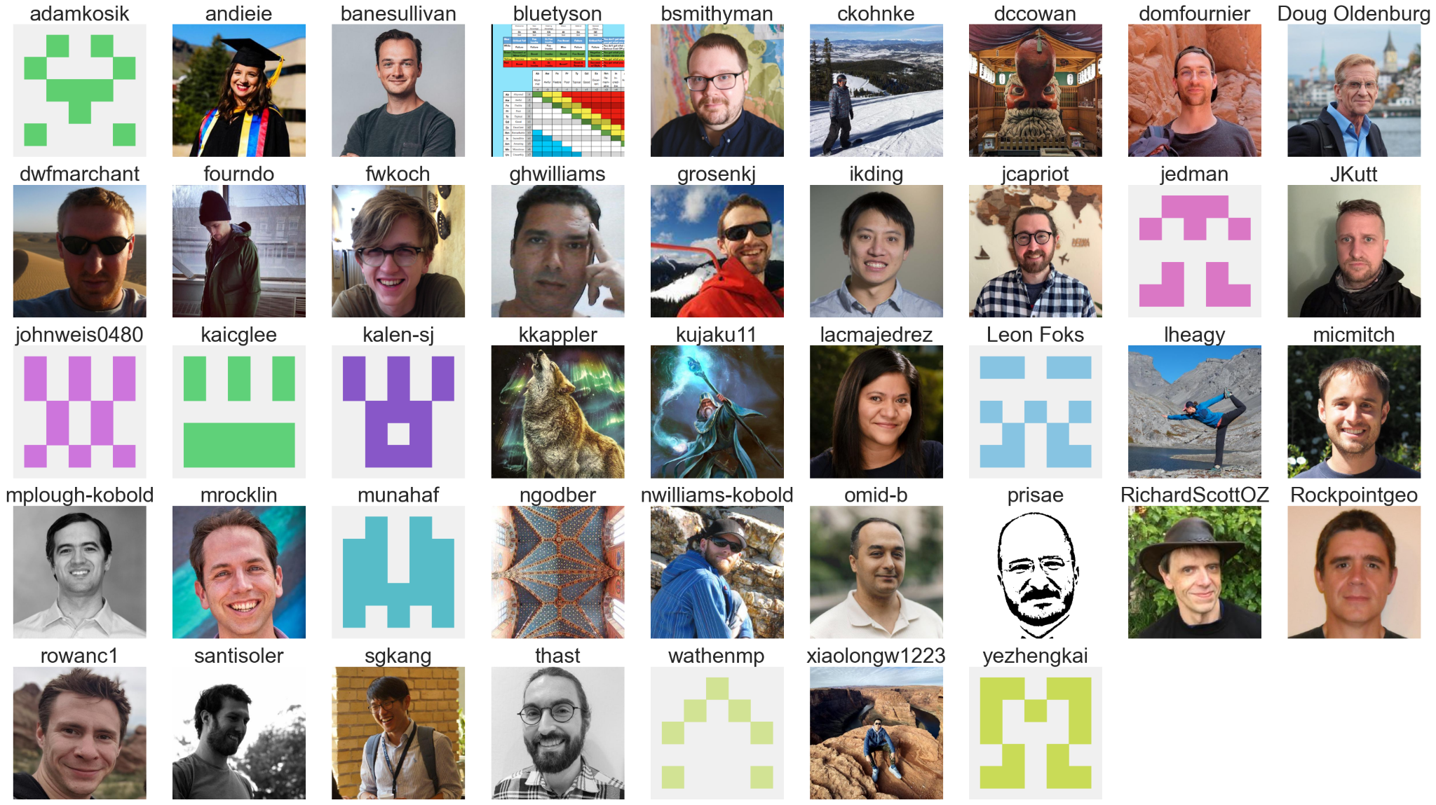
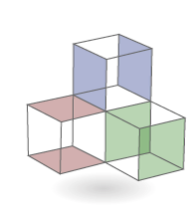

thank you!
simpeg.xyz
lheagy@eoas.ubc.ca

Slide 30
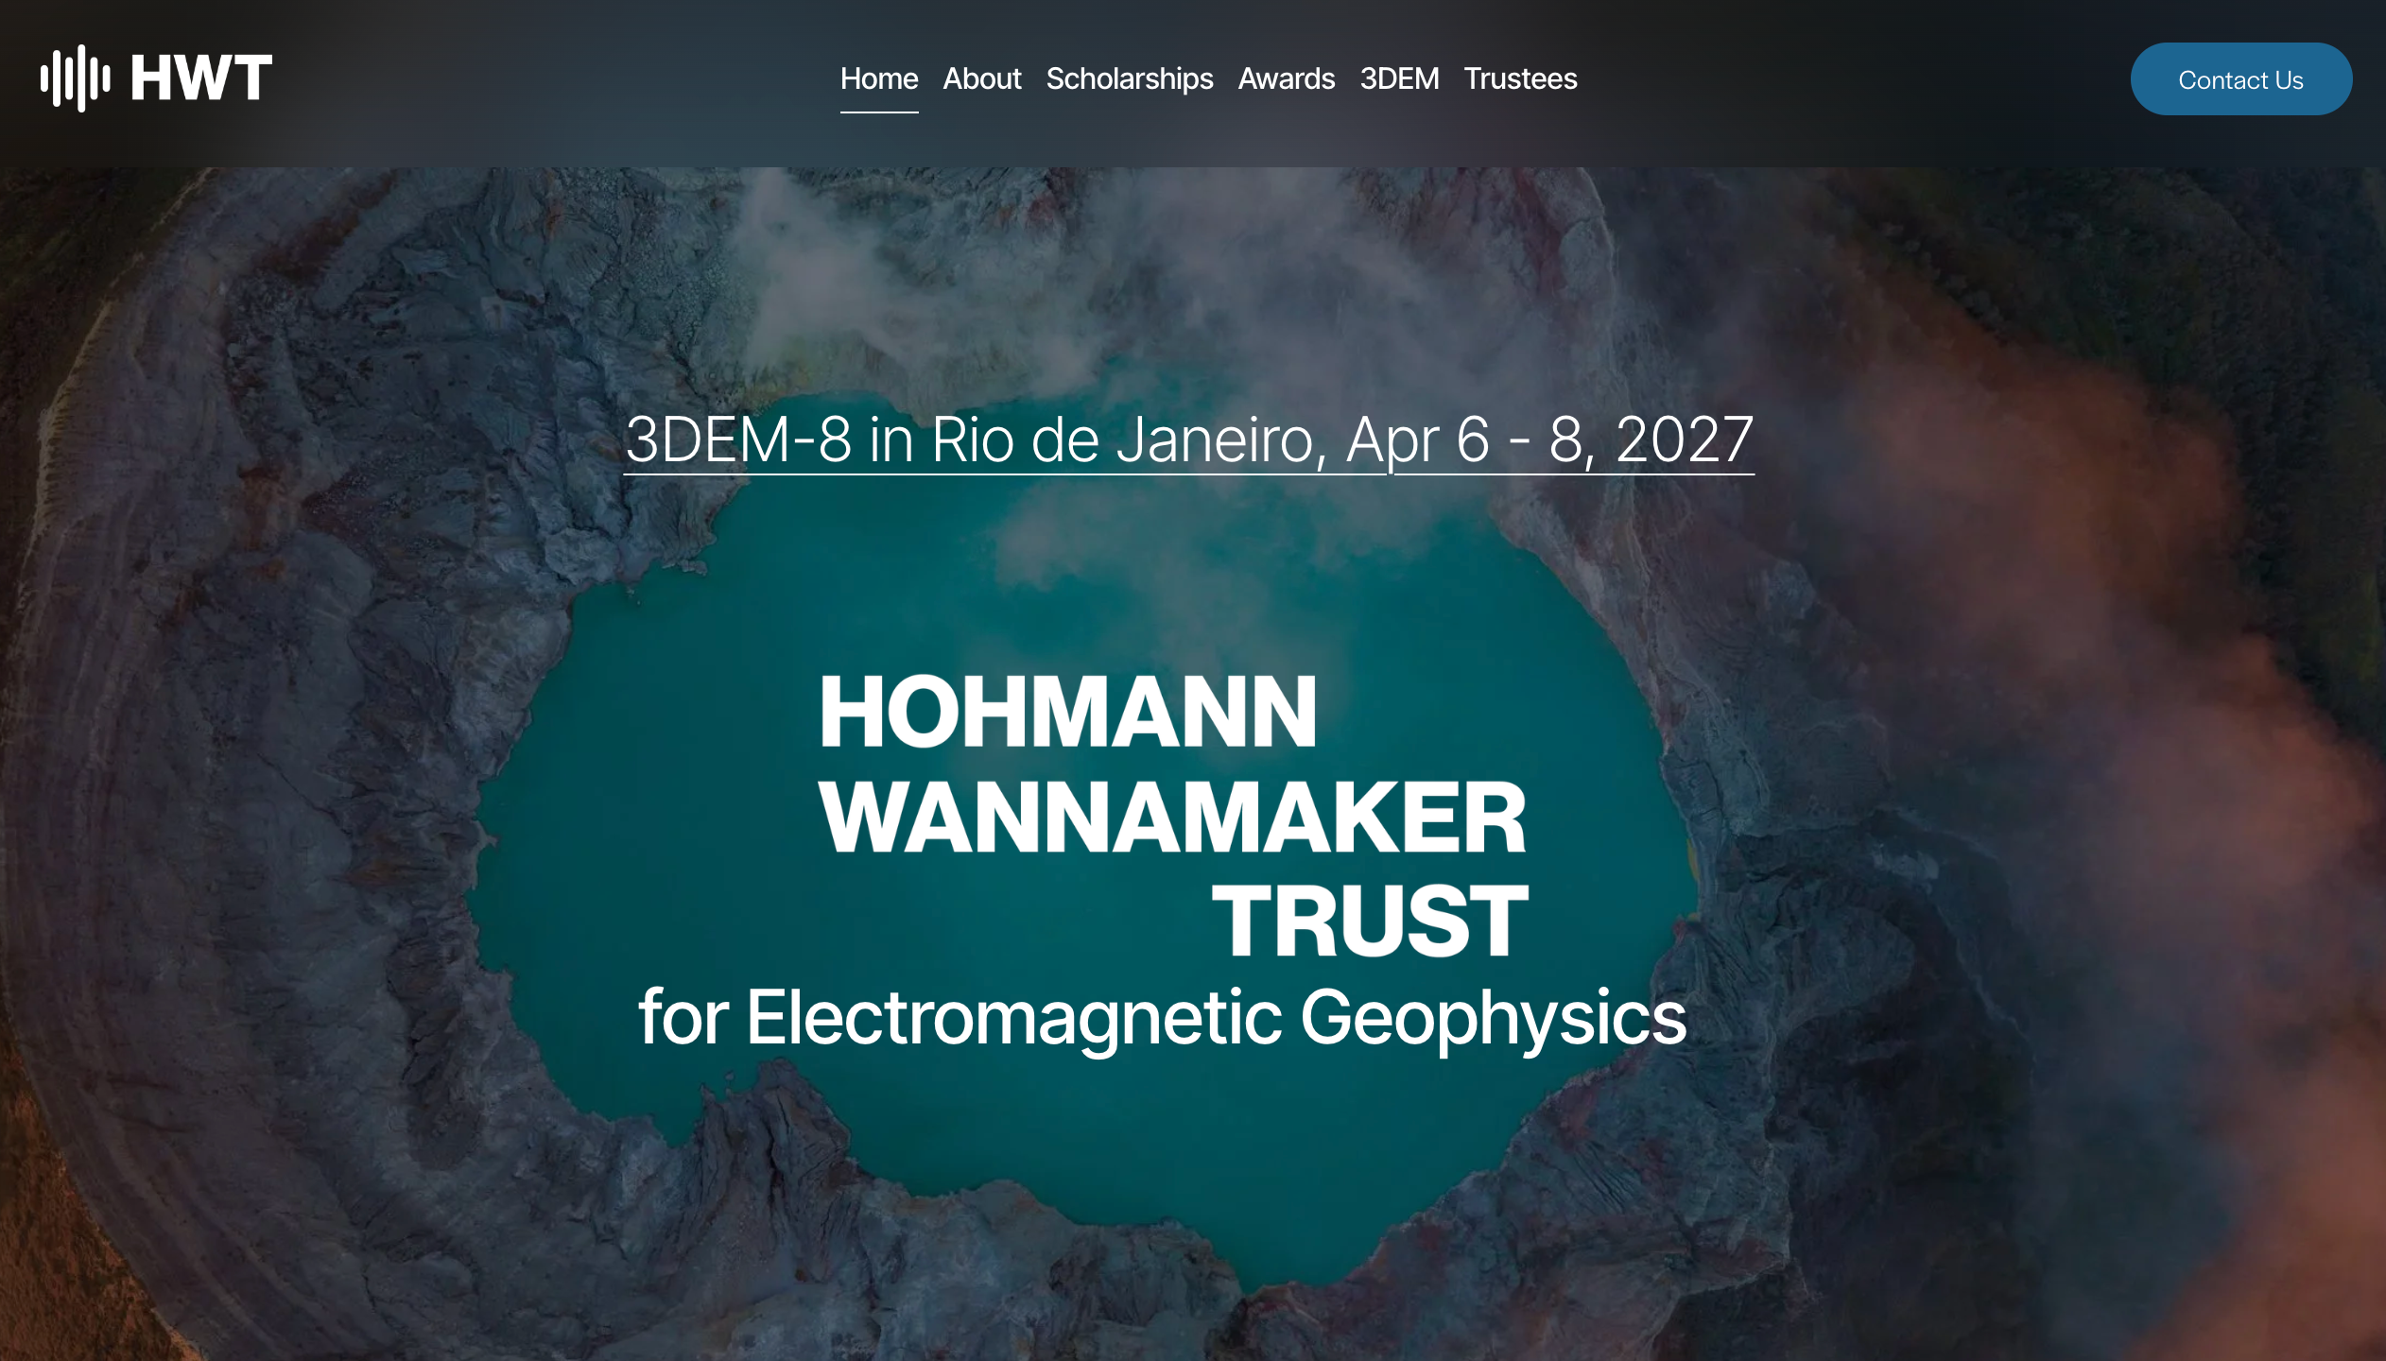
https://www.hohmannwannamakertrust.org

Slide 31
on a related note…. refactor of inversion framework
A main goal of SimPEG is modularity and interoperability
… but some friction when
  interfacing to other codes,
  developing unconventional inversions
Solution: working on a refactor to simplify user interface, enable interoperability & extension.
Join the development and share your ideas!
https://github.com/simpeg/inversion-design-ideas

