Slide 1

ITK-Overview
Insight Software Consortium

Slide 2
What is ITK
Image Processing
Segmentation
Registration
No Graphical User Interface (GUI)
No Visualization

Slide 3









ITK Sponsors
The National
Institute for Dental and Craniofacial Research
The National
Science
Foundation
The National Institute of Neurological Disorders and Stroke

Slide 4














ITK Developers

Slide 5

ITK Developers
* indicates a subcontractor.

Slide 6
ITK by the Numbers
March 2000
  First code check-in
1300
  # of nightly builds
1062
  tests run nightly
41
  # of platforms ( software + hardware )
700
  # of classes
1600
  # of files with code

Slide 7
ITK by the Numbers
400K
  # of lines of code
100K
  # of lines of test code
35K
  # of lines of examples
150K
  # of lines of Applications
240
  weekly t-cons
50
  unique developers

Slide 8
ITK by the Numbers
1032
  # of users subscribed to the mailing-list
400
  # of emails posted monthly to the users-list
819
  # of pages in the Software Guide PDF document
1800
  # of monthly hits to the URL of the Software Guide PDF
1900
  # of monthly hits to the URL of the Tutorial PDF
2400
  # of monthly hits to the source code files (.zip + .tar.gz)

Slide 9
How to Integrate ITK in you application
C++ Glue Code
GUI
{MFC,Qt,
wxWin
FLTK}
ITK
Image
Processing
Visualization
{OpenGL, VTK}

Slide 10
What do I need ?
C++ Compiler
gcc 2.95 – 4.0
Visual C++ 6.0
Visual C++ 7.0
Visual C++ 7.1
Visual C++ 8.0
Intel 7.1
Intel 8.0
IRIX CC
Borland 5.5
Mac - gcc
CMake
www.cmake.org

Slide 11
Step 1. Download ITK
Stability
Release tar
files
Live on the
Edge
CVS
http://www.itk.org
Insight.tgz
CVS anonymous

Slide 12

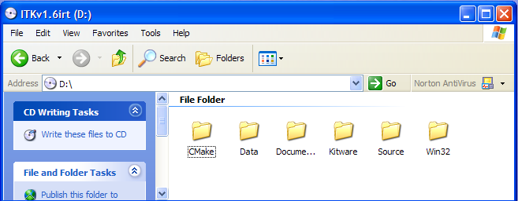
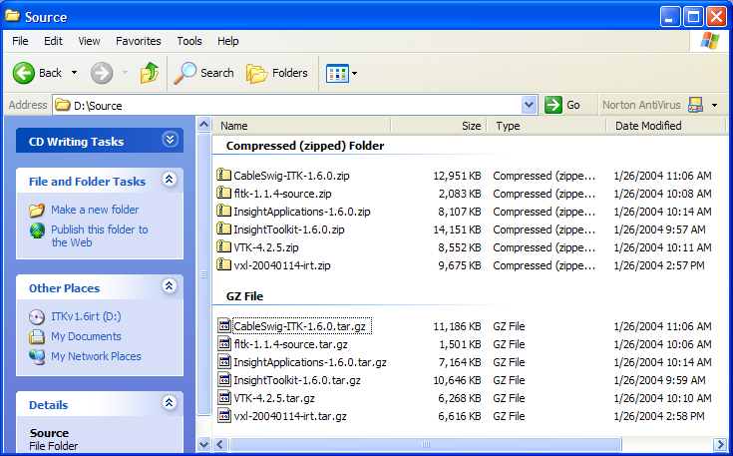
Copying ITK from the CD
/Source/
InsightToolkit-2.4.1.zip
InsightToolkit-2.4.1.tar.gz

Slide 13
Step 2. Download CMake
Latest
CMake
Release
ITK
Requires
http://www.cmake.org
Install
Binaries
Get the
Binaries
2.2.3

Slide 14
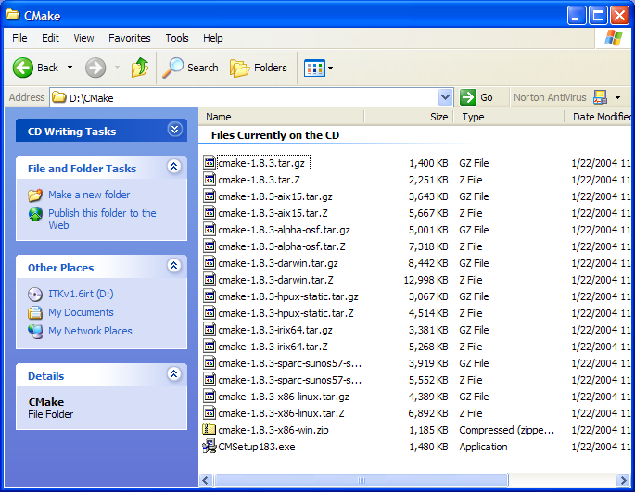
Installing CMake from the CD
/CMake/
cmake-2.2.3.tar.gz
cmake-2.2.3-x86-win.zip
cmake-2.2.3-x86-linux.tar.gz
CMakeSetup223.exe

Slide 15


Step 3. Configure ITK
Source Tree
Binary Tree
Out
Source Build
ITK
ITKb
Recommended !
Common
Common
Algorithms
Algorithms
BasicFilter
BasicFilter
Numerics
In
Source
Build
Numerics
IO
IO

Slide 16
Configuring ITK – MS-Windows
Run CMake
Select the SOURCE directory
Select the BINARY directory
Select your Compiler

Slide 17
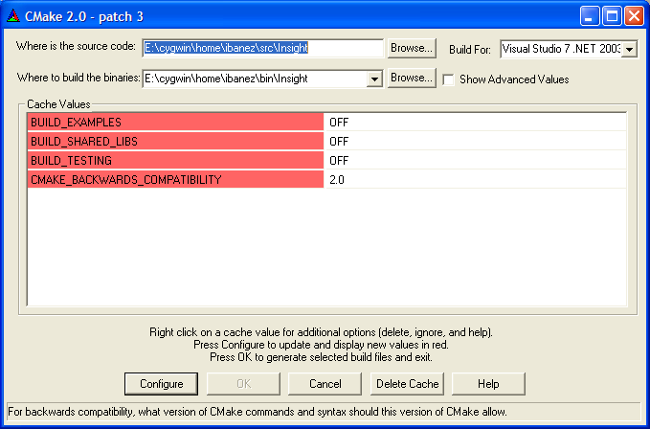
Configuring ITK – MS-Windows

Slide 18
Configuring ITK – MS-Windows
Disable BUILD_EXAMPLES
Disable BUILD_SHARED_LIBS
Disable BUILD_TESTING
Click “Configure” to configure
Click “OK” to generate project files

Slide 19
Configuring ITK – Unix
Create the BINARY directory (mkdir)
Change directory to the BINARY directory (cd)
Set the environment variables CC and CXX
setenv CC /usr/bin/gcc; setenv CXX /usr/bin/g++ OR
export CC=/usr/bin/gcc; export CXX=/usr/bin/g++
Type ccmake with argument the SOURCE directory

Slide 20
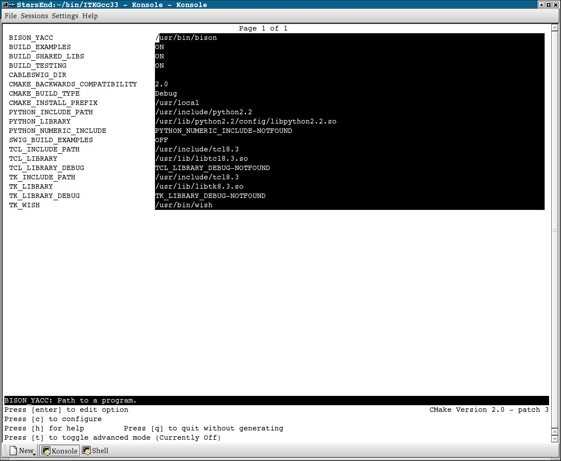
Configuring ITK – Unix

Slide 21
Configuring ITK – Unix
Disable BUILD_EXAMPLES
Disable BUILD_SHARED_LIBS
Disable BUILD_TESTING
Type “c” to configure
Type “g” to generate the Makefiles
Type “make” to start building

Slide 22
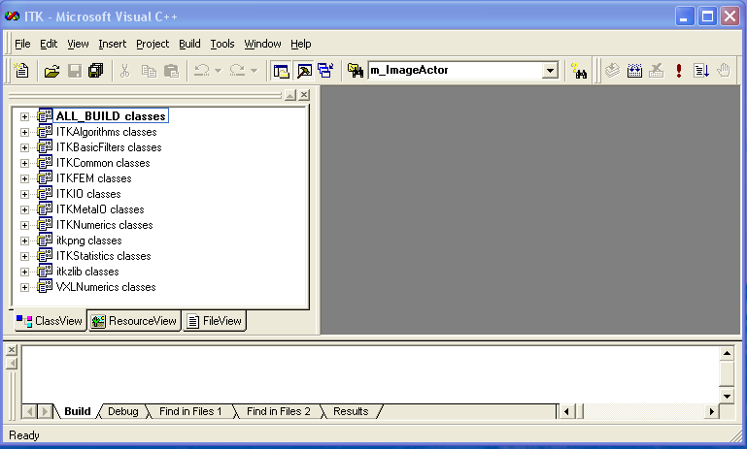
Building ITK

Slide 23
Building ITK
Open ITK.dsw in the Binary Directory
Select ALL_BUILD project
Build it
…It will take about 15 minutes …

Slide 24
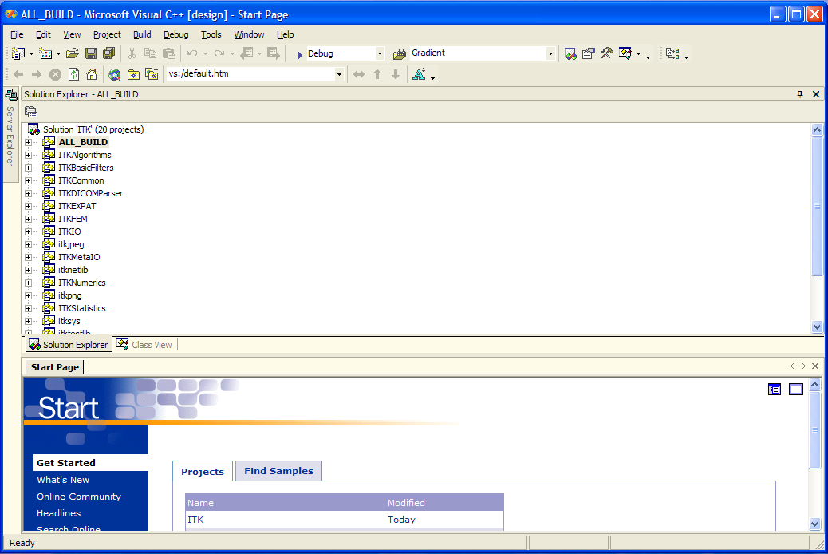
Building ITK

Slide 25
Building ITK
Open ITK.sln in the Binary Directory
Select ALL_BUILD project
Build it
…It will take about 15 minutes …

Slide 26
Building ITK
Most of ITK classes are C++ Templates
Basic libraries are small
they only contain non-templated classes
Basic libraries are built in about 15 min

Slide 27
Step 5. Verify the Built
Libraries will be found in
ITK_BINARY / bin / { Debug, Release }

Slide 28
Step 5. Verify the Build
The following libraries should be there
ITKCommon
ITKBasicFilters
ITKAlgorithms
ITKNumerics
ITKFEM
ITKIO
ITKStatistics
ITKMetaIO
itkpng
itkzlib

Slide 29
Step 6. Use ITK from an external Project
Copy
“HelloWorld.cxx”
“CMakeLists.txt”
from the
Examples/Installation
Directory
into another
directory
Run
CMake
Select Source Dir
Select Binary Dir

Slide 30
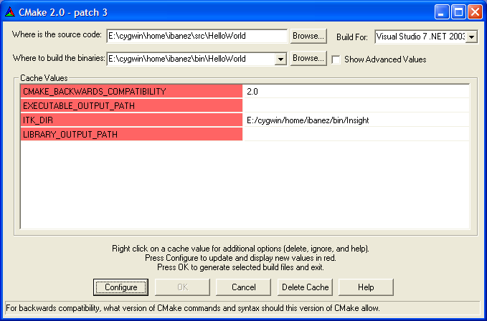
Using ITK – Hello World

Slide 31
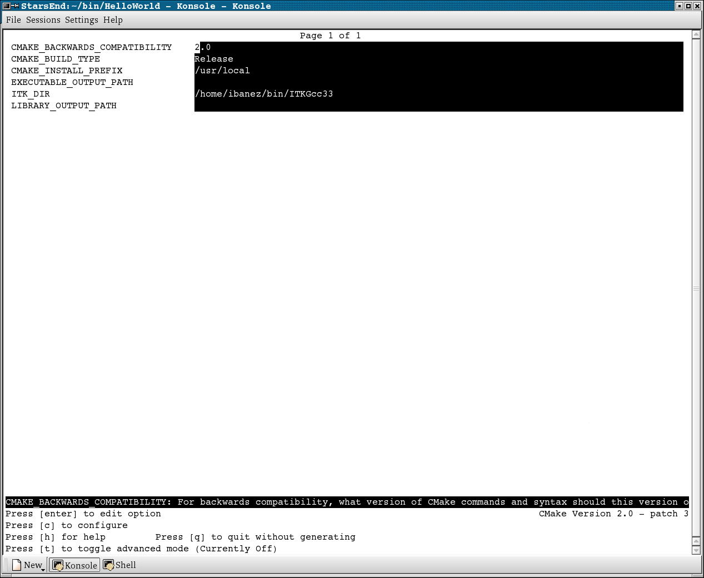
Using ITK – Hello World

Slide 32
Step 6. Use ITK from an external Project
accept the default in CMAKE_BACKBARD_COMPATIBILITY
leave empty EXECUTABLE_OUTPUT_PATH
leave empty LIBRARY_OUTPUT_PATH
Set ITK_DIR to the binary directory
where ITK was built

Slide 33
Step 7. Build Sample Project
Open HelloWorld.dsw (or .sln)
generated by CMake
Select ALL_BUILD project
Build it
…It will take about 3 seconds …

Slide 34
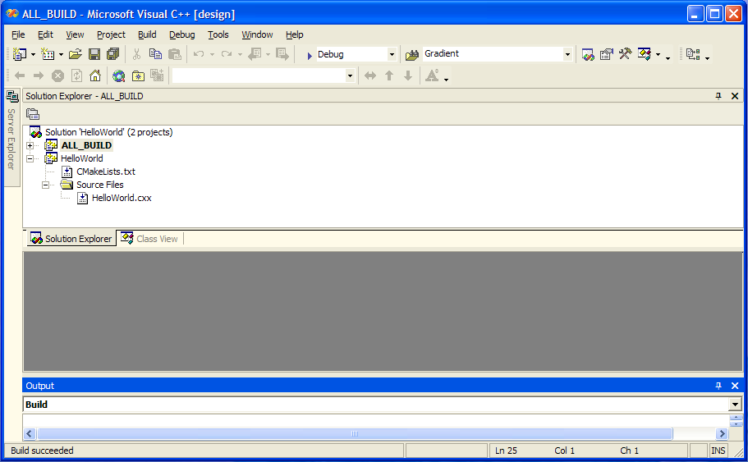
Step 7. Build Sample Project

Slide 35
Step 8. Run the example
Locate the file HelloWorld.exe
Run it…
It should produce the message:
ITK Hello World !

Slide 36
Starting your own project
Create a clean new directory
Write a CMakeLists.txt file
Write a simple .cxx file
Configure with CMake
Build
Run

Slide 37
Step 9. Writing CMakeLists.txt
PROJECT( myProject )
FIND_PACKAGE ( ITK )
IF ( ITK_FOUND )
INCLUDE( ${ITK_USE_FILE} )
ENDIF( ITK_FOUND )
ADD_EXECUTABLE( myProject myProject.cxx )
TARGET_LINK_LIBRARIES ( myProject ITKCommon ITKIO)

Slide 38
Step 10. Writing myProject.cxx
#include "itkImage.h"
#include "itkImageFileReader.h"
#include "itkGradientMagnitudeImageFilter.h"
int main( int argc, char **argv ) {
typedef itk::Image<unsigned short,2> ImageType;
typedef itk::ImageFileReader<ImageType> ReaderType;
typedef itk::GradientMagnitudeImageFilter<
ImageType,ImageType> FilterType;
ReaderType::Pointer reader = ReaderType::New();
FilterType::Pointer filter = FilterType::New();
reader->SetFileName( argv[1] );
filter->SetInput( reader->GetOutput() );
filter->Update();
return 0;
}

Slide 39
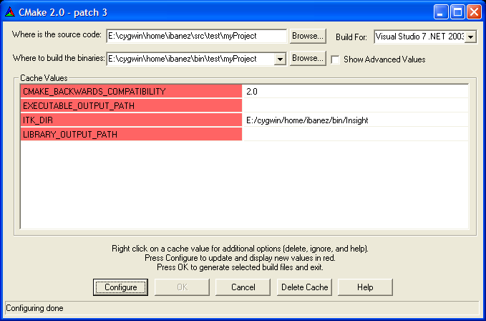
Step 11. Run CMake

Slide 40
Step 12. How to find what you need
http://www.itk.org/ItkSoftwareGuide.pdf
http://www.itk.org/Doxygen/html/index.html
Follow the link Alphabetical List
Follow the link Groups
Post to the insight-users mailing list

Slide 41
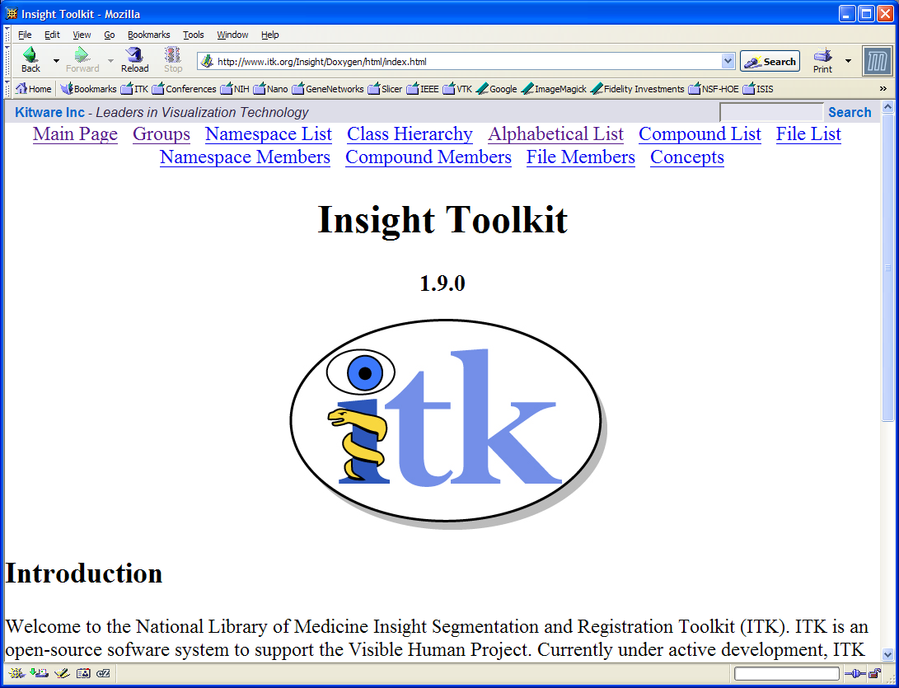

Slide 42
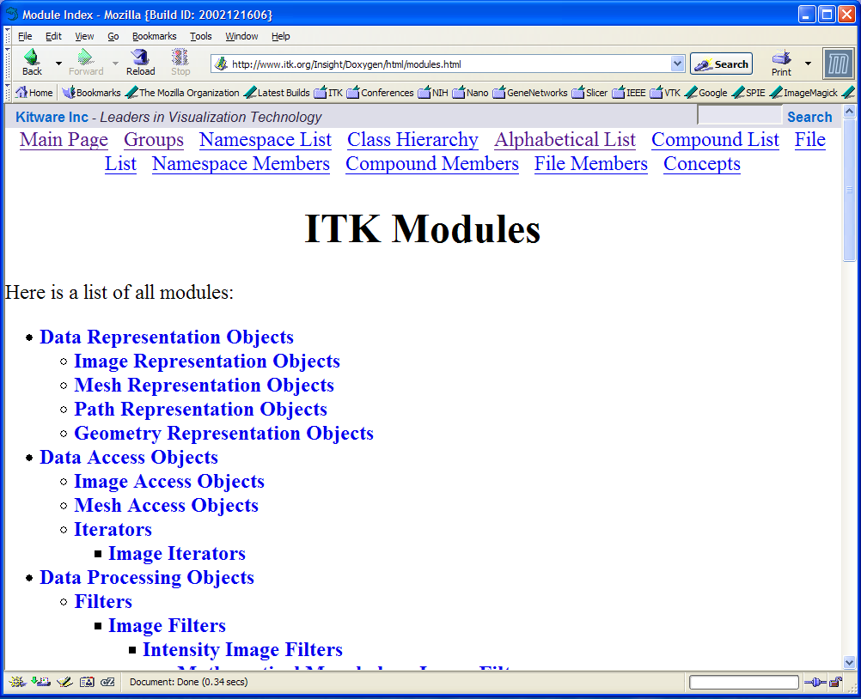

Slide 43
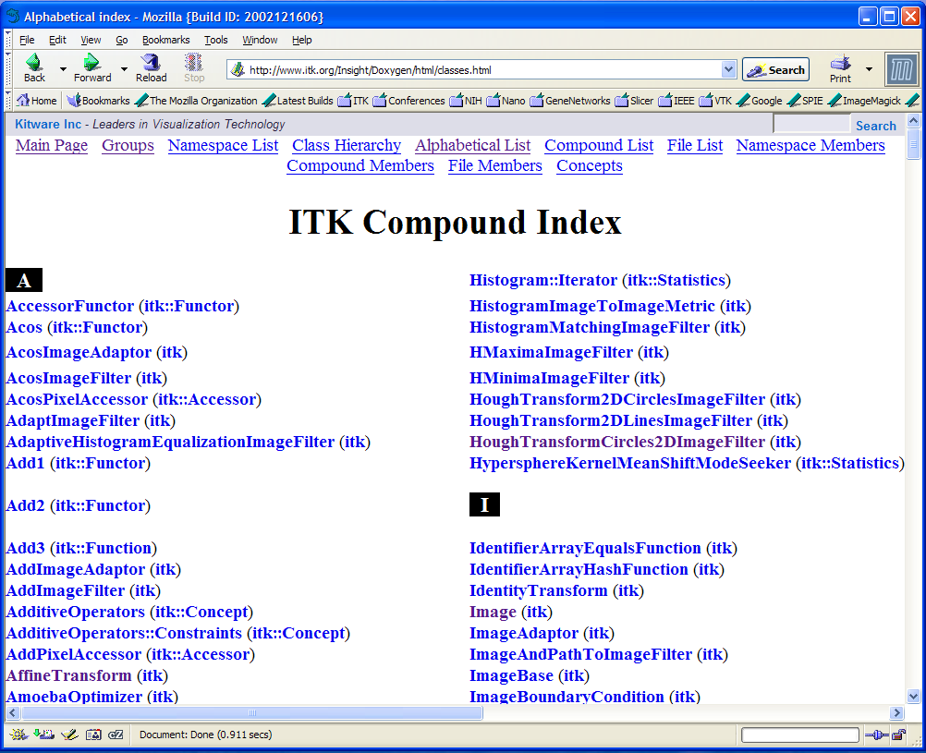

Slide 44

The ITK Software Guide is freely available as a PDF document at
www.itk.org/
ItkSoftwareGuide.pdf
Its paper version can be ordered from Amazon.com and from Kitware’s e-store.

Slide 45
Enjoy ITK !

