Slide 1

Building Open Science
The Insight Journal
Luis Ibáñez
Kitware, Inc.
Insight Software Consortium

Slide 2
Developing Software for Research
is an intrinsically
Ungrateful
business

Slide 3
Data
Driving
Problem
Software
Research
Mean
Goal
?
Algorithms
Papers

Slide 4
You don’t get research
credits for:
Implementing algorithms published by others
Writing Software Documentation
Fixing Bugs
Improving Performance
Preparing Tutorials
Porting to new platforms
Supporting Users
Making software releases

Slide 5
If you are a student
Software will not give
you a degree…
If you are a professor
Software will not give
you a promotion…

Slide 6
Software development is seen as not worthy of a researcher time

Slide 7
Raise your hand those who can do
Medical Image Processing
without
Software

Slide 8
You do get research
credits for:
Publishing papers
Publishing books
Getting Patents
Getting Funding (Grants, Contracts)
Licensing your Patents

Slide 9
Why is that ?

Slide 10
Time to face the
Truth

Slide 11


Slide 12
Publications do not cure Cancer !

Slide 13
Doctors do not prescribe “reading papers” as a treatment.

Slide 14
Medical treatment is done with
Medical Devices
Drugs
Surgical Procedures

Slide 15
Publications that don’t lead to one of those treatments
are sterile publications

Slide 16
Really good research results are not published…
They get Patented

Slide 17
With the hope of being used for
Medical Devices
Drugs
Surgical Procedures

Slide 18
Why do we care so much about publishing ?

Slide 19
Publications are a measure of scientific productivity
They disseminate knowledge
They allow others to reproduce our results
They are validated by the peer-review process

Slide 20
Papers disseminate knowledge

Slide 21
Information in the 21st Century
Is disseminated on the Internet

Slide 22
How long it takes to post a PDF file on the Web ?
At most 1 day
Typically 1 hour

Slide 23
How long it takes to publish a paper on a Journal ?
At least 1 year
Typically 2 years

Slide 24
How much do you have to pay for publishing a paper in a Journal ?
About $500 / paper

Slide 25
How much do you have to pay for reading the same paper ?
About $30 / paper
or subscribe for $300 / year

Slide 26
How much it costs to post a PDF on the Web ?
Certainly less than
$500 + N x $30

Slide 27
Papers allow others to reproduce the results

Slide 28
Reproducing the Results…
Do you get source code with the paper ?
How long it will take you to rewrite this code ?
Do you get the author’s data ?
How can you get their data ?
Do you get all the parameters they used ?
How can you reproduce results if you don’t have code, data and parameters ?

Slide 29
And anyways, why do you want to invest time in reproducing somebody else’s results…
If you don’t get
any credit for doing it ?

Slide 30
Have you ever seen a paper in a Medical Image Journal whose only content is the reproduction of results from another paper ?

Slide 31
Have you ever seen a paper in a Medical Image Journal whose only content is the failure to reproduce the results of another paper ?

Slide 32
If reproducibility is the goal of publishing…
You should post your source code
You should post your data
You should post your parameters
In the same way that you posted your PDF file: on the Web.

Slide 33
Research is validated by the
Peer-Review process

Slide 34
How can a reviewer validate a paper ?
If we just concluded
that papers are not reproducible…

Slide 35
What does a reviewer actually do ?
Emit an opinion based on his/her expertise

Slide 36
How much time does a reviewer dedicate to a paper ?
1 hour ?
2 hours ?
6 hours ?

Slide 37
Why not more time ?
Reviewers are volunteers
They don’t get paid for reviewing papers
They don’t get credits for reviewing papers
They have their own papers to write
They have exams to grade
Their own grant applications to submit
They also have families, pets and… a life !

Slide 38
How long does a paper waits on the reviewer’s desk before he/she finds time for reviewing it ?
Six weeks ?
6 months ?

Slide 39
How many reviewers typically judge your paper ?
Minimum Two
Typically Three
Exceptionally Four
Why not more ?
Why only one time ?

Slide 40
Why do we really want to publish ?

Slide 41
Because we need to have publications in our CV

Slide 42
We have met the enemy…
and he is us !

Slide 43
“Publish or Perish”
Who invented this ?
and Why ?

Slide 44
“Publish or Perish”
Was invented by those who needed to evaluate researcher’s productivity.

Slide 45
“Publish or Perish”
Empowers those who read your CV to grade you by simply counting lines in the “Publications” section.

Slide 46
“Publish or Perish”
The group of best educated people in the world has been alienated with a simple trick

Slide 47
Who are you working for ?

Slide 48
Who really pays your salary ?

Slide 49
Who pays for Research ?
Public
Medical Device
Manufacturers
Hospitals
& Doctors
Pharmaceutical
Companies
Researchers

Slide 50
What do your owe to those who pay your salary ?

Slide 51
or
Competition with other researchers ?
Collaboration with other
researchers ?

Slide 52
How to collaborate ?
Creating public repositories for source code
Creating public image databases
Posting parameters on the web
Creating forums for hosting positive discussions online
Validating other’s methods and suggesting improvements.

Slide 53
The Insight Journal Solution
Open Source
Open Science
Insight
Journal
Agile Publishing
Agile Programming

Slide 54
Brief History of
Scientific Publishing

Slide 55
Scientific Societies

Slide 56
Scholarly Societies 17th century
Accademia dei Lincei (1603)
Accademia degli Investiganti (1650)
Accademia del Cimento (1630)
Académie des Sciences (1666)
Royal Society of London (1645)
Collegium Naturae Curiosorum (1652)
Electoral Brandenburg Society of Sciences and Humanities (1700)

Slide 57
Accademia dei Lincei
(Lincean academy)

Slide 58
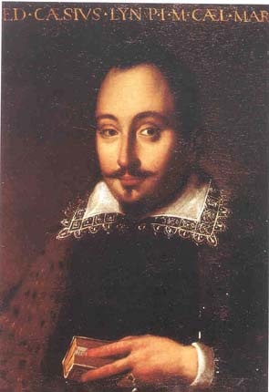
Founded by Duke
Federico Cesi in 1603

Slide 59

The first scientific publication
Galileo Galilei (1613)

Slide 60
Galileo Galilei
Father of
The Scientific Method

Slide 61
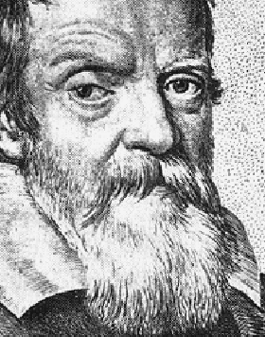
Galileo Galilei
“I have never met
a man so ignorant
that I couldn’t learn something from him”

Slide 62
The Scientific Method
Observation
Hypothesis
Testing

Slide 63
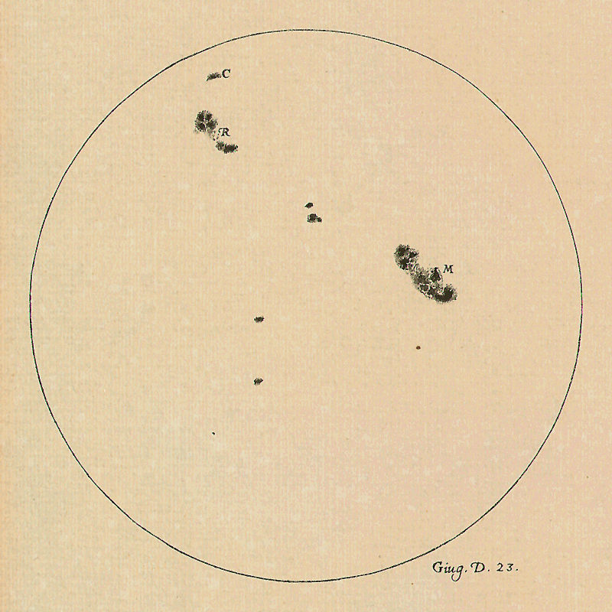
First:
Observe

Slide 64
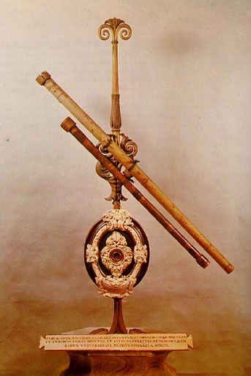
Build
Tools if necessary

Slide 65
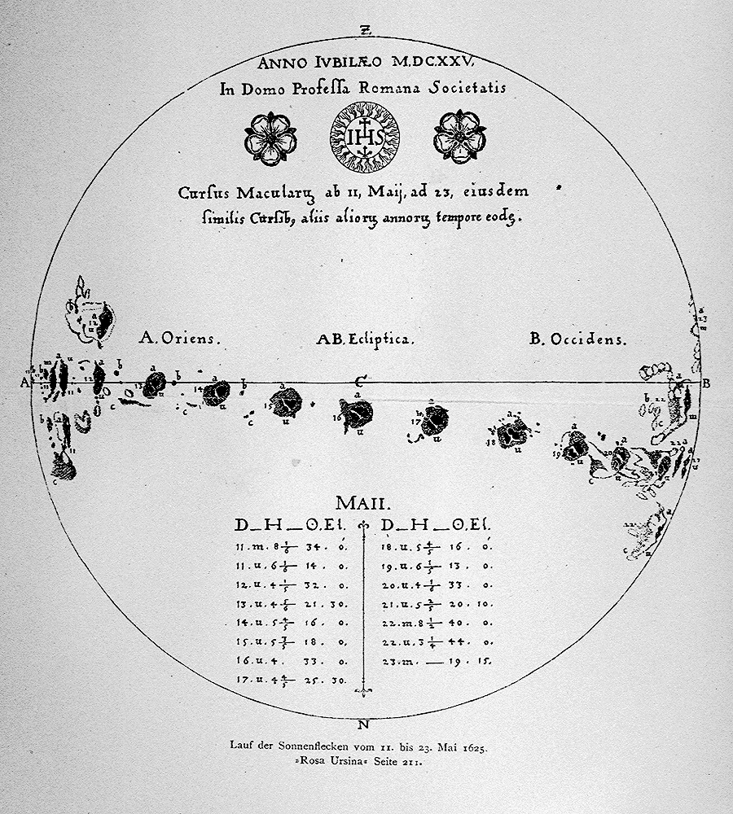
Second:
Formulate
Hypothesis

Slide 66

Third:
Testing

Slide 67
Testing
REPRODUCIBILITY
Positive Evidence
Negative Evidence
Accumulate
Support
Disproof
Hypothesis

Slide 68
"My dear Kepler, what would you say of the learned here, who, replete with the pertinacity of the asp, have steadfastly refused to cast a glance through the telescope?
What shall we make of this?
Shall we laugh, or shall we cry?"
Letter from Galileo Galilei to Johannes Kepler

Slide 69
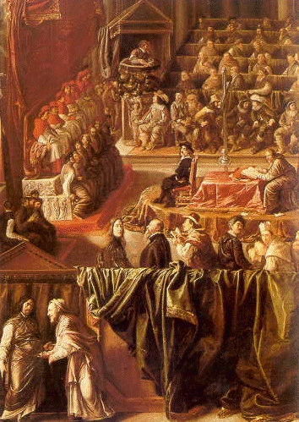
Galileo before
the Holy Office
in 1633

Slide 70
…after an injunction had been judicially intimated to me by this Holy Office, to the effect that I must altogether abandon the false opinion that… the sun is the centre of the world and immovable, and that the earth is not the center of the world, and moves,

Slide 71
Los Angeles Times, October 31, 1992
The Roman Catholic Church has admitted erring these past 359 years in formally condemning Galileo Galilei for entertaining scientific truths it long denounced as anti-scriptural heresy.

Slide 72
Importance of
“Peer-Review”

Slide 73
Reviewer Profile
President Royal Society of London
Mechanical Engineer
Clerk of a public office (Ph.D.)
Surveyor (no college degree)

Slide 74
Reviewer Profile
Lord Kelvin
Wilbur and Orville Wright
Albert Einstein
Anthony Leeuwenhoek

Slide 75
Authority and Reputation in Science

Slide 76
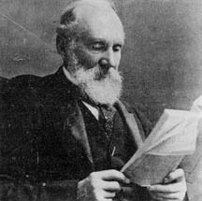
Lord Kelvin
Elected fellow of the Royal Society in 1851.
Served as its president from 1890 to 1895.
Published more than 600 papers
Was granted dozens of patents

Slide 77
"Heavier-than-air flying machines are impossible."
Lord Kelvin
president of the Royal Society of London, 1885

Slide 78
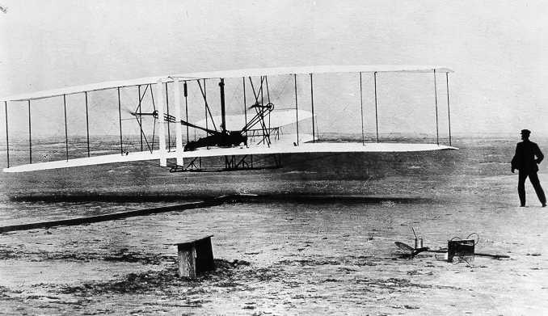
Wilbur and Orville Wright, Kitty Hawk, North Carolina
December 17 1903 (just 18 years later)

Slide 79
Lord Kelvin (1824-1907)
Wilbur Wright (1867-1912)
Orville Wright (1871-1948)
Albert Einstein (1879-1955)

Slide 80
Timeline
Lord Kelvin
Orville Wright
W. Wright
Albert Einstein
1800
1850
1900
1950

Slide 81
Lord Kelvin 61 years old
Wilbur Wright 18 years old
Orville Wright 14 years old
Albert Einstein 6 years old
In 1885 they were

Slide 82
An Expert’s Opinion…

Slide 83
“There is nothing new to be discovered in physics now.”
“All that remains is more and more precise measurement."
Lord Kelvin
Address to an assemblage of physicists at the
British Association for the
Advancement of Science in 1900

Slide 84
The Theory of Special Relativity was published in 1905.
Albert Einstein
A 26-years old clerk working at
the patent office in Bern, Switzerland.

Slide 85
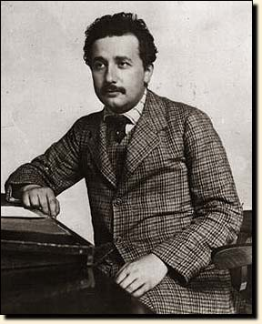
“A practical profession is a salvation for a man of my type;
an academic career compels a
young man to scientific production,
and only strong characters can resist
the temptation of superficial analysis."
Albert Einstein
at the patent office in Bern, Switzerland.

Slide 86
Einstein’s Five Papers in Four Months
Electrodynamics of moving bodies
(special relativity)
Avogadro’s Number
Quanta of Light (photons)
Brownian Motion
Photoelectric effect (Nobel Prize)
http://www.physik.uni-augsburg.de/annalen/history/

Slide 87
Another Expert’s opinion

Slide 88
“Lord Kelvin also calculated the age of the earth from its cooling rate and concluded that:
It was too short to fit with Lyell's theory of gradual geological change or Charles Darwin's theory of the evolution of animals though natural selection.”

Slide 89
Bacteria
Blood cells
Ciliates
Nematodes
Foraminifera
Anthony Leeuwenhoek (1632-1723)

Slide 90
“. . . my work, which I've done for a long time, was not pursued in order to gain the praise I now enjoy, but chiefly from a craving after knowledge, which I notice resides in me more than in most other men.
And therewithal, whenever I found out anything remarkable, I have thought it my duty to put down my discovery on paper, so that all ingenious people might be informed thereof.”
Real Scientific Publishing:
Antony van Leeuwenhoek. Letter of June 12, 1716

Slide 91
The Open Access
Revolution

Slide 92
Rationale
No journal enforces REPRODUCIBILITY
No journal publishes CODE, DATA and PARAMETERS
No journal publishes NEGATIVE results
No journal publishes REPLICATION of work

Slide 93
Rationale
Current time to publication is too long ( 1 ~ 2 years)
Actual time spent in peer-review does not justify two years
of not returning $400K to taxpayers.
Code reimplementation is a waste of time.

Slide 94
Insight Solution
Open Source
Open Science
Insight
Journal
Agile Publishing
Agile Programming

Slide 95
Submission
PDF doc
Journal CVS
Repository
Code
Input
Data
Author
Web
Site
Build
Machines
Results
Data

Slide 96
Review
Reviewer
Selected
Papers
Reviewer
Web Site
Checked
Paper
Checked
Paper
Checked
Paper
Checked
Paper
Checked
Paper

Slide 97
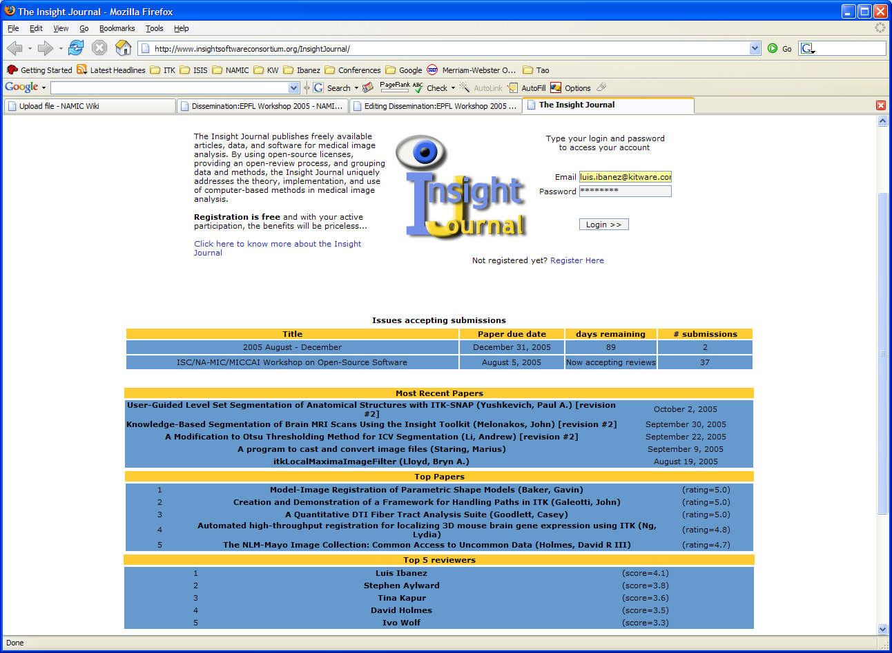

Slide 98
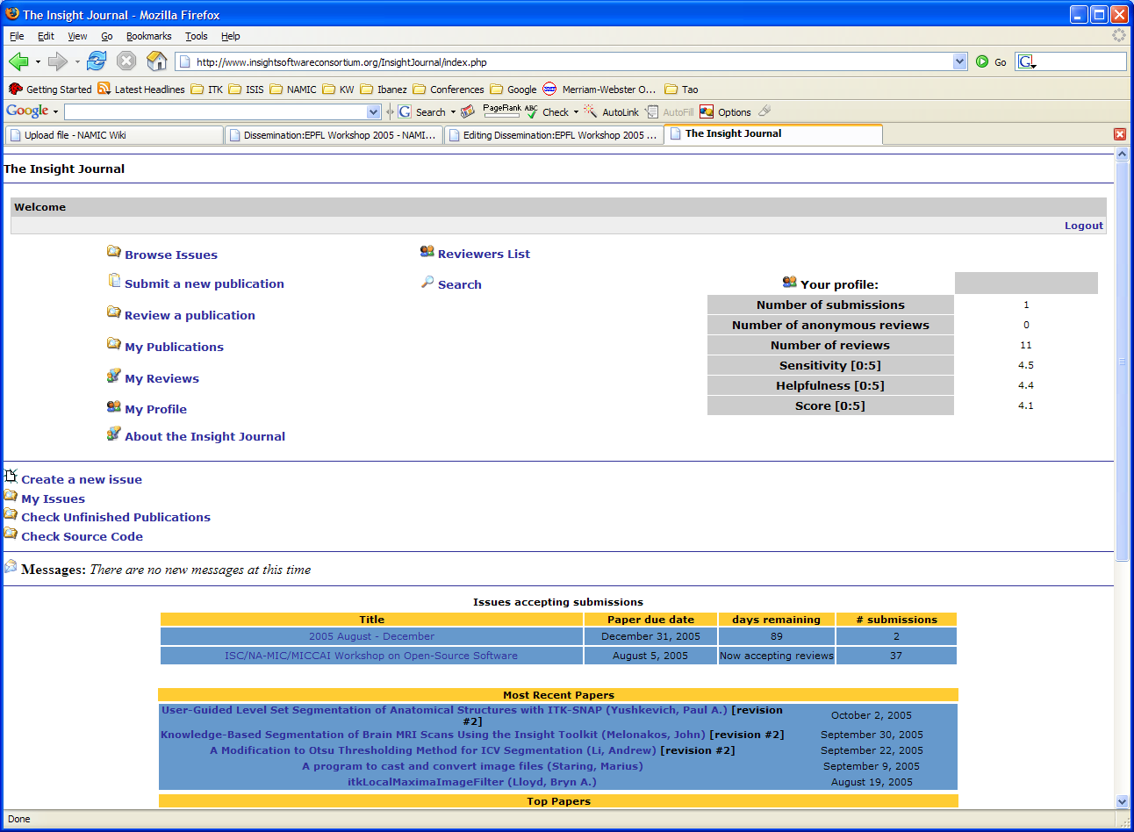

Slide 99
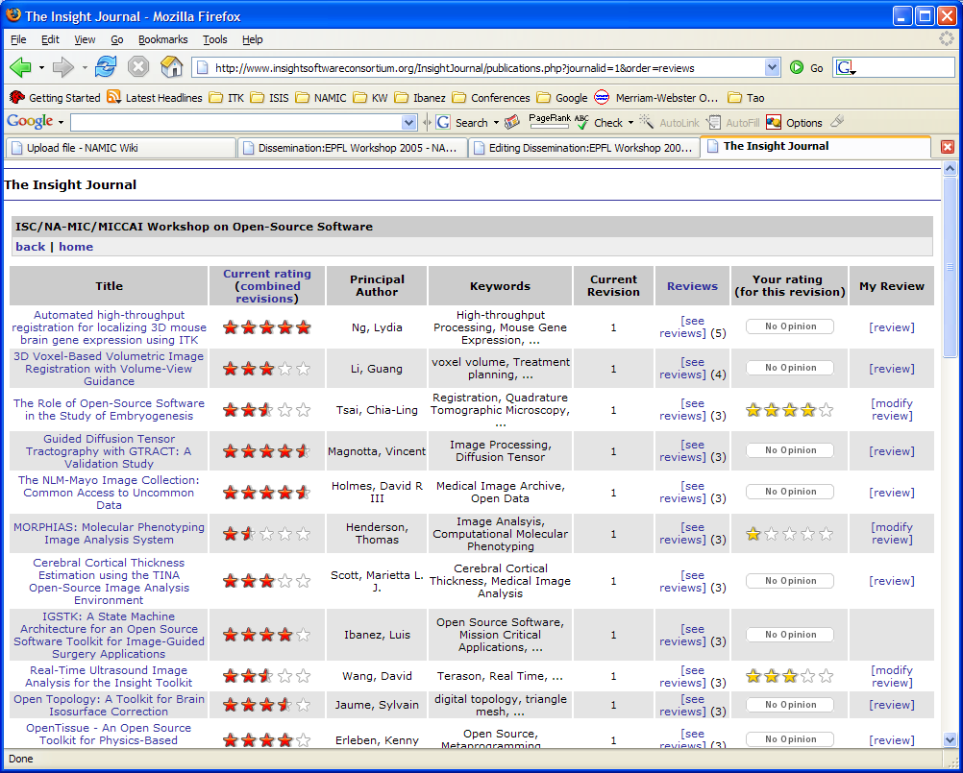

Slide 100
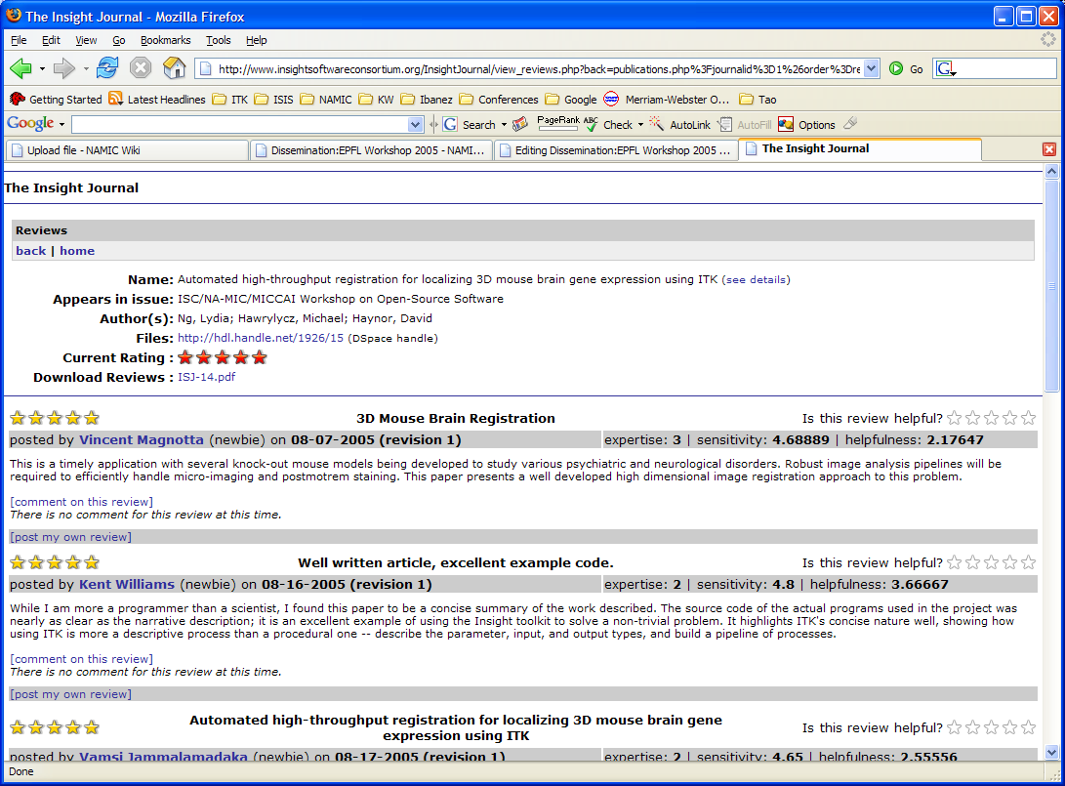

Slide 101
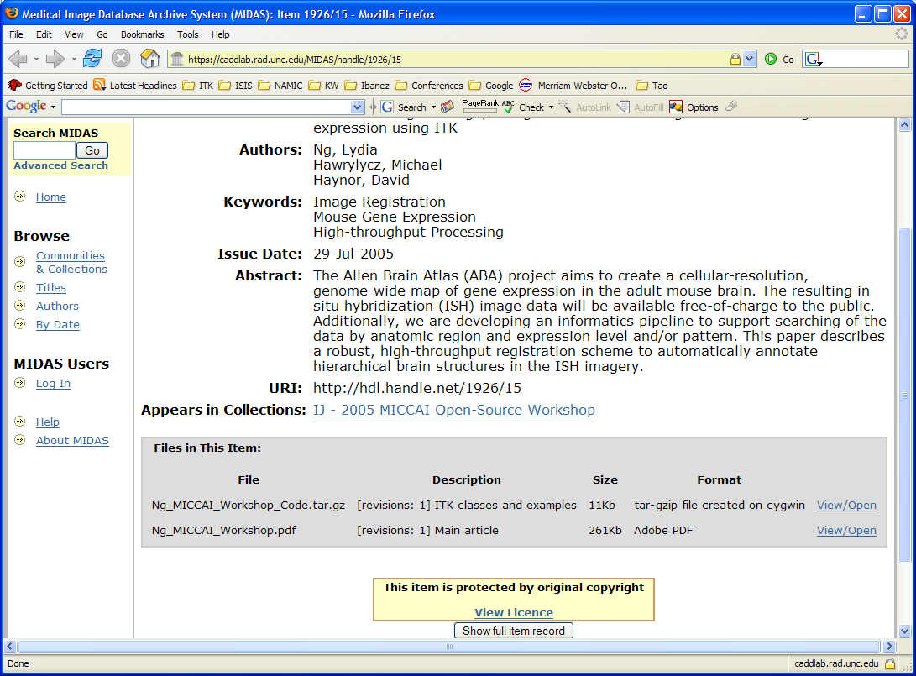

Slide 102
The Open Access
Revolution

Slide 103
Imagine a World where
Government Agencies are more revolutionary than Scientific Communities

Slide 104
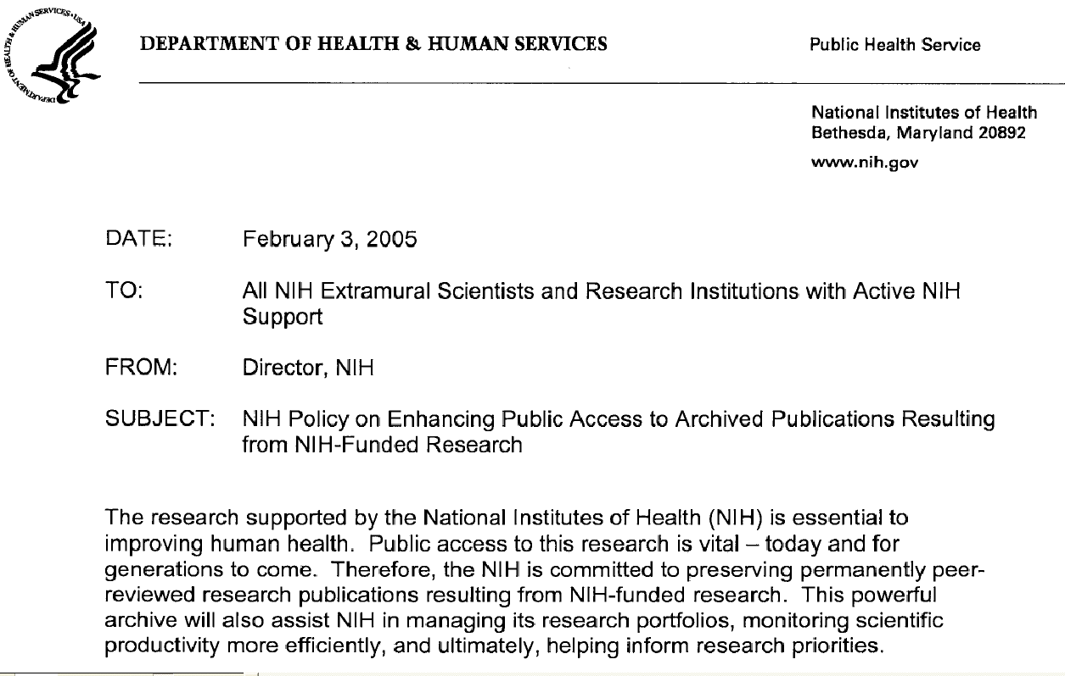
Memo from Elias A. Zerhouni, M.D.

Slide 105
NIH Policy on Public Access
Beginning May 2, 2005, NIH-funded investigators are requested to submit to the NIH National Library of Medicine's (NLM) PubMed Central (PMC) an electronic version of the author's final manuscript upon acceptance for publication, resulting from research supported, in whole or in part, with direct costs from NIH. The author's final manuscript is defined as the final version accepted for journal publication, and includes all modifications from the publishing peer review process.
http://www.nih.gov/about/publicaccess/index.htm

Slide 106
NIH Policy on Public Access
This policy applies to all research grant and career development award mechanisms, cooperative agreements, contracts, Institutional and Individual Ruth L. Kirschstein National Research Service Awards, as well as NIH intramural research studies.
http://www.nih.gov/about/publicaccess/index.htm

Slide 107
This Policy is intended to:
create a stable archive of peer-reviewed research publications resulting from NIH-funded research to ensure the permanent preservation of these vital published research findings;
secure a searchable compendium of these peer-reviewed research publications that NIH and its awardees can use to manage more efficiently and to understand better their research portfolios, monitor scientific productivity, and ultimately, help set research priorities; and
make published results of NIH-funded research more readily accessible to the public, health care providers, educators, and scientists.

Slide 108
NIH Policy on Public Access
The Policy now requests and
strongly encourages that authors
specify posting of their final manuscripts
for public accessibility as soon as possible
(and within 12 months of the publisher's
official date of final publication).
http://www.nih.gov/about/publicaccess/index.htm

Slide 109
NIH Policy on Public Access
“It is estimated that the results
of NIH-supported research were
described in 60,000 – 65,000
published papers in 2003”
http://www.nih.gov/about/publicaccess/index.htm

Slide 110
Research Results (yearly)
$27 billion
NIH
65,000 papers

Slide 111
Research Results
1 Paper = $ 415,384
Tax-Payers Money

Slide 112
John Smith (taxpayer) says:
“I want to read the paper
that cost me $ 415,384”
Researcher answers:
“Sure, just wait two years until it is
published, and then pay $30 more
to get a copy from the Journal.”

Slide 113
Return to the Source
“The U.S. Congressional committee
with budgetary oversight of the National
Institutes of Health (NIH), has urged the
institutes to provide for public access to
NIH-research results paid for with U.S.
taxpayer funds. ”
http://www.taxpayeraccess.org/congress.html

Slide 114
U.S. House of Representatives Report 108-636
“The Committee is very concerned that there is
insufficient public access to reports and data
resulting from NIH-funded research. ”
“This situation, which has been exacerbated by
the dramatic rise in scientific journal subscription
prices, is contrary to the best interests of the U.S.
taxpayers who paid for this research. ”
http://thomas.loc.gov/cgi-bin/cpquery/?&db_id=cp108&r_n=hr636.108&sel=TOC_338641&

Slide 115
U.S. House of Representatives Report 108-636
“The Committee is aware of a proposal to make
the complete text of articles and supplemental
materials generated by NIH-funded research
available on PubMed Central (PMC), the digital
library maintained by the National Library of
Medicine (NLM).”
http://thomas.loc.gov/cgi-bin/cpquery/?&db_id=cp108&r_n=hr636.108&sel=TOC_338641&

Slide 116
U.S. House of Representatives Report 108-636
“The Committee supports this proposal and
recommends that NIH develop a policy, to apply
from FY 2005 forward, requiring that a complete
electronic copy of any manuscript reporting work
supported by NIH grants or contracts be provided
to PMC upon acceptance of the manuscript for
publication in any scientific journal listed in the
NLM's PubMed directory.”
http://thomas.loc.gov/cgi-bin/cpquery/?&db_id=cp108&r_n=hr636.108&sel=TOC_338641&

Slide 117
U.S. House of Representatives Report 108-636
“NIH is instructed to submit a report to the
Committee by December 1, 2004 about how it
intends to implement this policy, including how it
will ensure the reservation of rights by the NIH
grantee, if required, to permit placement of the
article in PMC and to allow appropriate public
uses of this literature.”
http://thomas.loc.gov/cgi-bin/cpquery/?&db_id=cp108&r_n=hr636.108&sel=TOC_338641&

Slide 118
Other Initiatives

Slide 119
UNESCO Headquarters, Fontenoy Room II
Paris, France - 10-11 March 2003
"International Symposium on
Open Access and the Public Domain
in Digital Data and Information for Science"
http://www.codata.org/archives/2003/03march/
http://www7.nationalacademies.org/usnc-codata/OpenAccessWorkshop.html

Slide 120
The United Kingdom Parliament
House of Commons
Science and Technology
Tenth Report
July 2004

Slide 121
UK Parliament Report
“the amount of public money invested
in scientific research and its outputs is
sufficient to merit Government involvement
in the publishing process. "
http://www.publications.parliament.uk/pa/cm200304/cmselect/cmsctech/399/39902.htm

Slide 122
UK Parliament Report
“This Report recommends that all UK higher
education institutions establish institutional
repositories on which their published output
can be stored and from which it can be
read, free of charge, online. "
http://www.publications.parliament.uk/pa/cm200304/cmselect/cmsctech/399/39902.htm

Slide 123
UK Parliament Report
“It is not for either publishers or
academics to decide who should,
and who should not, be allowed
to read scientific journal articles. "
http://www.publications.parliament.uk/pa/cm200304/cmselect/cmsctech/399/39902.htm

Slide 124
UK Parliament Report
“Government invests a significant amount of
money in scientific research, the outputs of
which are expressed in terms of journal articles.
It is accountable for this expenditure to the public.
We were dismayed that the Government
showed so little concern about where public
money ended up."
http://www.publications.parliament.uk/pa/cm200304/cmselect/cmsctech/399/39902.htm

Slide 125
UK Parliament Report
“Publishers should publicly acknowledge the contribution of unpaid peer reviewers to the publishing process.
We recommend that they provide modest financial rewards to the departments in which the reviewers are based.
These rewards could be fed back into the system, helping to fund seminars or further research. ."
http://www.publications.parliament.uk/pa/cm200304/cmselect/cmsctech/399/39902.htm

Slide 126
UK Parliament Report
“ We do not doubt the central importance of peer review to the STM publishing process.
Nonetheless, we note a tendency for publishers to inflate the cost to them of peer review in order to justify charging high prices.
This lack of transparency about actual costs hampers informed debate about scientific publishing. ."
http://www.publications.parliament.uk/pa/cm200304/cmselect/cmsctech/399/39902.htm

Slide 127
UK Parliament Report
“Academic authors currently lack sufficient motivation to self-archive in institutional repositories.
We recommend that the Research Councils and other Government funders mandate their funded researchers to deposit a copy of all their articles in their institution's repository within one month of publication or a reasonable period to be agreed following publication, as a condition of their research grant. "
http://www.publications.parliament.uk/pa/cm200304/cmselect/cmsctech/399/39902.htm

Slide 128
UK Parliament Report
“Institutional repositories should
accept for archiving articles based
on negative results, even when
publication of the article in a journal
is unlikely. "
http://www.publications.parliament.uk/pa/cm200304/cmselect/cmsctech/399/39902.htm

Slide 129
UK Parliament Report
“We see this as a great opportunity for
the UK to lead the way in broadening
access to publicly-funded research findings
and making available software tools and
resources for accomplishing this work."
http://www.publications.parliament.uk/pa/cm200304/cmselect/cmsctech/399/39902.htm

Slide 130
UK Parliament Report
“Peer review is a key element in the
publishing process and should be a
pillar of institutional repositories."
http://www.publications.parliament.uk/pa/cm200304/cmselect/cmsctech/399/39902.htm

Slide 131
UK Parliament Report
“We recommend that SHERPA agree a
kite mark with publishers that can be used
to denote articles that have been published
in a peer-reviewed journal ."
http://www.publications.parliament.uk/pa/cm200304/cmselect/cmsctech/399/39902.htm

Slide 132
Open Access is not only for publicly funded research

Slide 133
“In the Bethesda Statement on
Open Access Publishing,
major private funders of
biomedical research
committed to open access.”
http://www.earlham.edu/%7Epeters/fos/bethesda.htm

Slide 134
The Howard Hughes Medical Institute (HHMI),
announced its support of open access
HHMI will reimburse investigators
up to $3,000
in FY2004 for the costs of
open access publishing.
http://www.earlham.edu/%7Epeters/fos/bethesda.htm

Slide 135
The Howard Hughes Medical Institute
103 National Academy of Science members.
10 Nobel prize winners.
2699 employees
$ 564 Million operating budget
http://www.hhmi.org/press/

Slide 136
Wells Fund
103 National Academy of Science members.
10 Nobel prize winners.
2699 employees
$ 564 Million operating budget
http://www.hhmi.org/press/

Slide 137
The Revolution already started !

Slide 138
Imagine a World with
756 different
Open Access Journals http://www.doaj.org

Slide 139
Public Library of Science (PLoS)
PLoS Biology
PLoS Medicine
PLoS Clinical Trials
PLoS Computation Biology
PLoS Genetics
PLoS Pathogens
http://www.plos.org

Slide 140
PLoS License
You are free:
to copy, distribute, display, and perform the work
to make derivative works
to make commercial use of the work
Under the following conditions: Attribution
You must give the original author credit.
For any reuse or distribution, you must make
clear to others the license terms of this work.
Any of these conditions can be waived if you
get permission from the author.
http://www.plos.org/journals/license.html

Slide 141
The Dark Ages are Over…

Slide 142
Embrace Open Science !

