Slide 1

Software Toolkits
Building
Communities
Luis Ibáñez
KITWARE, Inc.

Slide 2
If a tree falls in a forest… and nobody is around to hear it, does it make a sound?

Slide 3
No Users
=
No Toolkit

Slide 4
How to sustain a Toolkit
Developers Mailing List
Moderator
CVS Repository
Gatekeeper
CMake Configuration
Guru
Dart Dashboard
Bad Guy
Bug Tracking
Czar
Doxygen Documentation
Volunteer

Slide 5
How to sustain a Toolkit
Writing Tests
XTreme
Writing Applications
Outsider
Tutorials
Prophet
License
Lawyer

Slide 6
CVS
Read / Write
Read Only
Repository
Developer X
User 1
Developer W
User 2
Developer Z
User 3
Developer Y
User 4
Developer M
User 5

Slide 7
CVS
For every change in the code,
CVS provides an answer to
Who ?
When ?
What ?
Why ?
Also: Compare with old versions,
and Restore old versions

Slide 8
CVS
First step:
Provide CVS literacy,
Tutorials,
Set up a fake repository for practice

Slide 9
CMake
Build configuration
LibraryA.lib
Source1.cxx
LibraryM.lib
Source2.cxx
LibraryK.lib
Source3.cxx
Source4.cxx
LibraryH.lib
LibraryM.lib
Source5.cxx
Source6.cxx
Executable1.exe
Source7.cxx

Slide 10
CMake
Generating Project Files
CMakeLists.txt
CMake
CMakeLists.txt
CMakeLists.txt
NMake
Makefiles
CMakeLists.txt
VC++ 7.0
Project.sln
VC++ 6.0
Project.dsw
Unix
Makefiles
Borland
Makefiles

Slide 11
CMake
Functionalities
CMakeLists.txt
FindOpenGL.cmake
Test Versions
FindITK.cmake
FindVTK.cmake
Options
FindJPEG.cmake
Static / Shared
Use / NotUse
TRY_COMPILE
TRY_RUN
Dart-Tests
COPY

Slide 12
Dart
Every line of code is presumed broken
until proven correct
If it is not being compiled and tested
chances are that is broken

Slide 13
Dart
Dart
Server
Platform X
Mac OS
Platform X
Mac OS
Platform M
Sun, GCC
Platform X
Mac OS
Platform M
Sun, GCC
Platform M
Sun, GCC
Platform Z
Linux, GCC 3.3
Platform Z
Linux, GCC 3.3
Platform Z
Linux, GCC 3.3
Platform Z
Linux, GCC 3.3
Platform W
Win XP, VC7
Platform Y
Linux, ICC
Platform W
Win XP, VC7
Platform Y
Linux, ICC
Platform W
Win XP, VC7
Platform Y
Linux, ICC
Platform Y
Linux, ICC

Slide 14
Dart
Dart
Web Page
Compare tests
Across platforms
CVS
Aware
Navigate
Dates
Doxygen
Code
Coverage
Purify
Valgrind
Regression
Testing

Slide 15
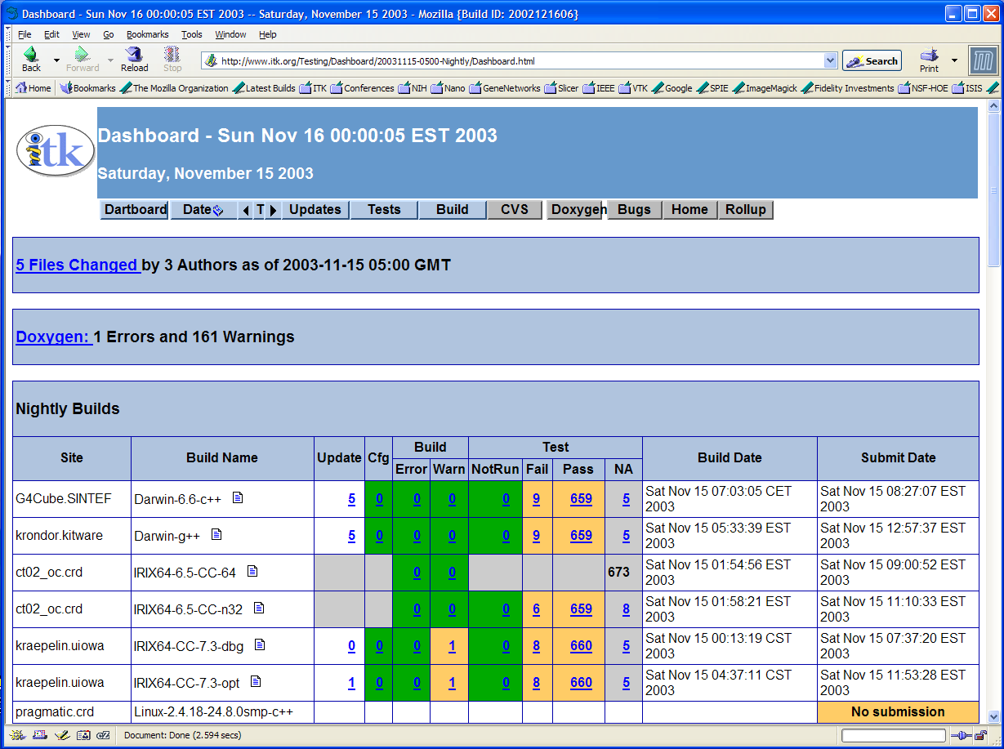
Dart - Dashboard

Slide 16
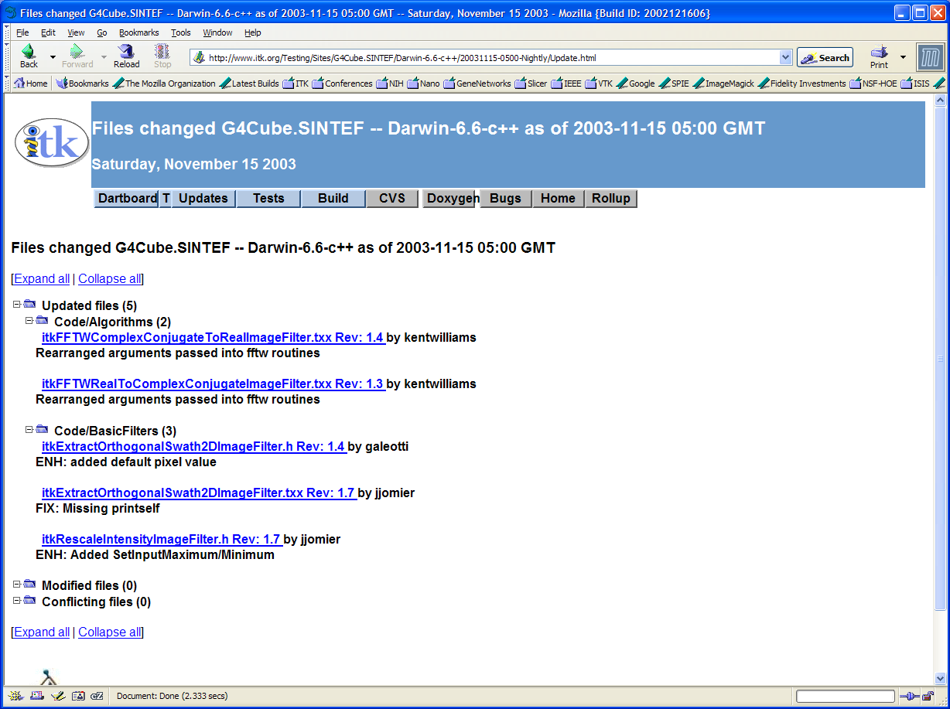
Dart - Dashboard

Slide 17
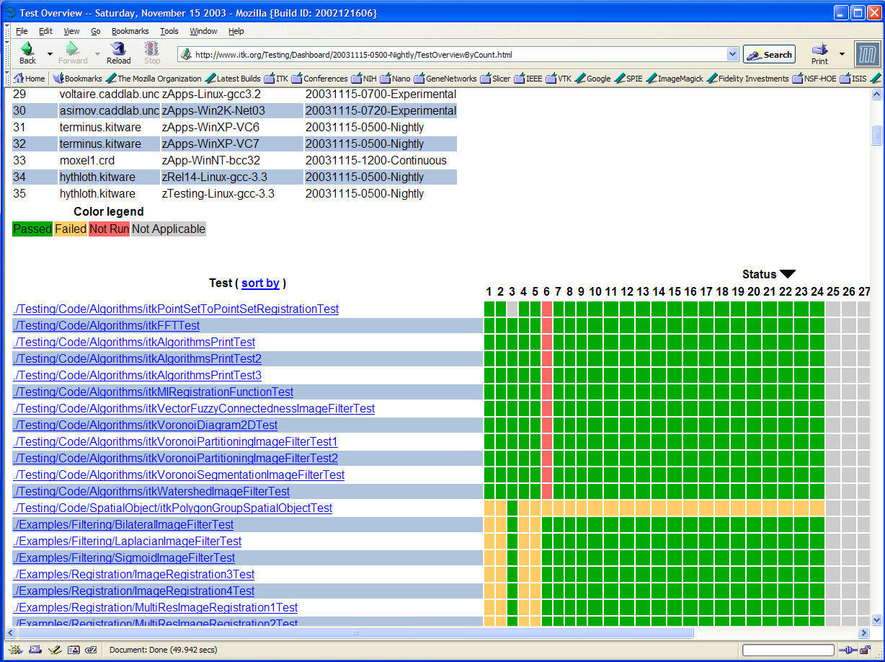
Dart - Dashboard

Slide 18
Bug Tracking
Categories
Bug Tracker
Feature Request
User 1
Documentation
User 2
Incorrect Code
Performance Issues
User 3
CVS Comments
reference Bug-ID
Developer A
Developer B
Developer C

Slide 19
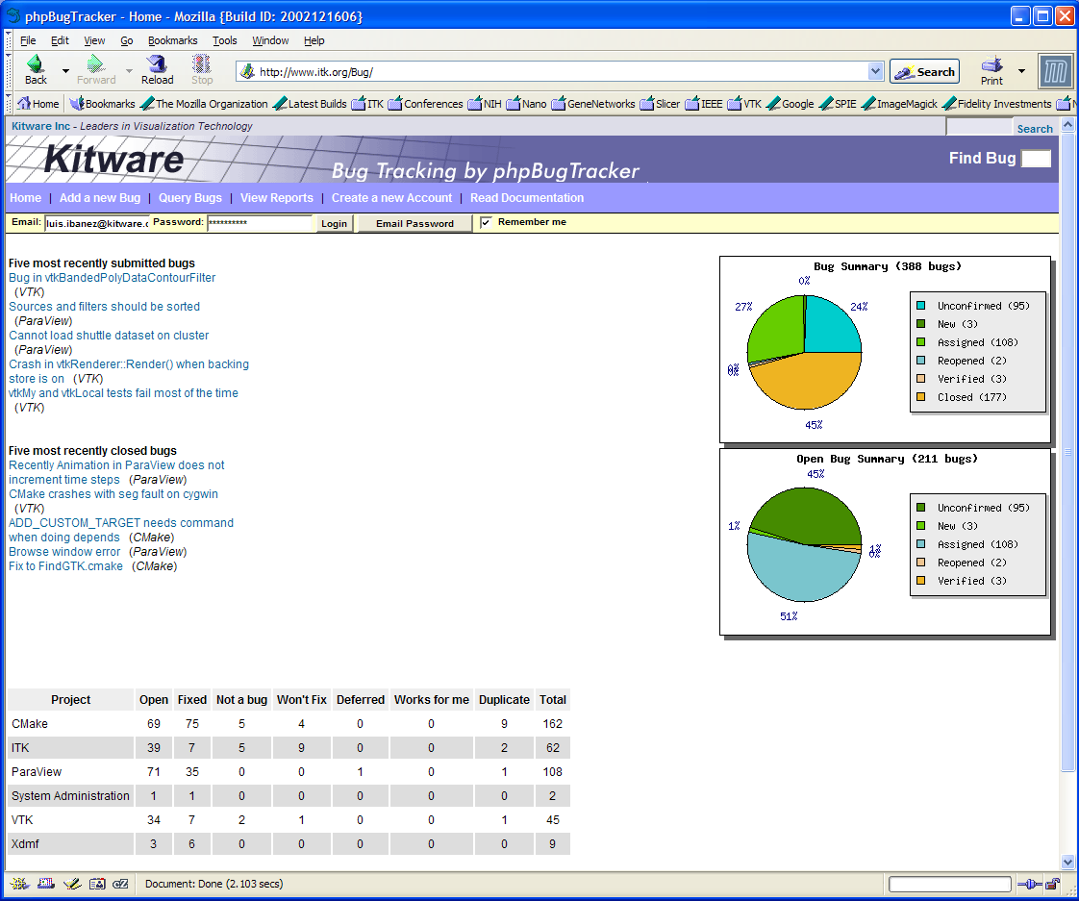
Bug Tracking

Slide 20
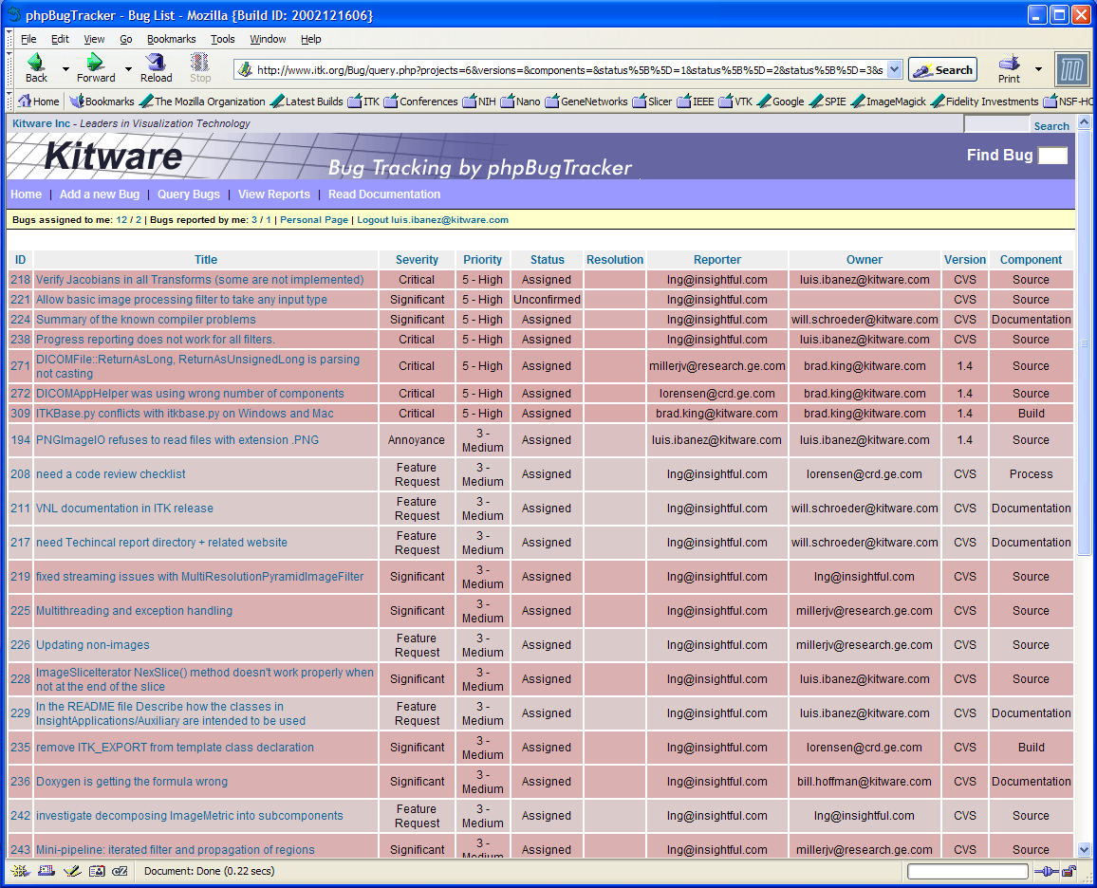
Bug Tracking

Slide 21
Project Management
Who is doing what
Avoid duplication of effort
Inform users about future developments
Track progress of sub-projects
But: requires some discipline

Slide 22
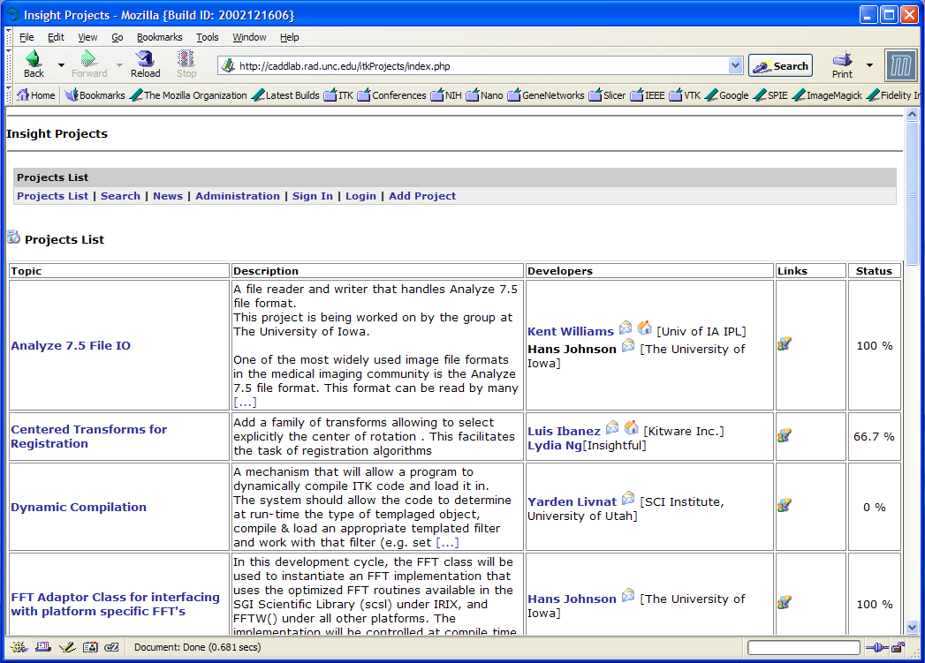
Project Management

Slide 23
Making Releases
Time
Freezing
Coverage
80%
Bug
Tracker
Clearance
Tests
Passing
Packaging
.tar.gz
.zip
CDs

Slide 24
Doxygen
Generating Documentation from Code
Doxygen
ClassA.h
ClassB.h
ClassC.h
Windows
Help
ClassD.h
ClassE.h
RTF
LaTeX
HTML
PostScript
PDF

Slide 25
Doxygen
Generating Documentation from Code
/** This is
documentation */
class A
{
/** Convergence criterion */
void SetTolerance( float );
};
Doxygen
Article
Pages
Equations
Images
UML
Class
Diagrams
UML
Collaboration
Diagrams
Conceptual
Grouping
List of
Methods
List of
Classes

Slide 26
Communications
FTP
for Data
Weekly
TCons
BOF at
Conferences
Dev. Mailing
List
Developers
Users
Tutorials at
Conferences
Tele
Conference
NetMeeting
Instant
Messaging
Developers
Meetings
Users Mailing
List

Slide 27
Users Mailing List
Treat the first users very well.
Use:
maybe, perhaps, it seems, it looks like, you may want to.
Train users to report:
platform, compiler, version.
Assume first that the user is right
Don’t say it works until you test it.
Collect Frequently Asked Questions (FAQ)

Slide 28
Meta Documents
White Papers
Journal Papers
Diagrams
Slides Presentations
Books

Slide 29
Teaching by Example
Start from Scratch
Then simple examples
showing only one feature
Progress toward functional examples
Provide examples that can be used as tools
Regression testing examples

Slide 30
Are we there yet ?

