Slide 1

ITK
Deformable Registration
B-Splines
Free-Form

Slide 2
Deformable Registration
Deformable Registration

Slide 3
Deformable Transforms
BSplines

Slide 4
Deformable Transformation
y
y
Transform
x
x
Fixed Image
Moving Image

Slide 5


Deformable Transformation
y
y
Transform
x
x
Fixed Image
Moving Image

Slide 6
Deformable Transformation
y
x

Slide 7
Deformable Transformation
y
x

Slide 8
Image Resampling
Fixed
Image
Interpolator
Resample
Image
Filter
Moving
Image
BSpline
Transform
Deformed
Image
Transform

Slide 9
Deformable Transforms
BSplines in
Geometrical Terms

Slide 10
BSplines
Order Zero
-2
-1
0
1
2

Slide 11
BSplines
Order Zero
Piece-Wise
Y = 1
-2
-1
0
1
2

Slide 12
BSplines
Convolution
-2
-1
0
1
2

Slide 13
BSplines
Area under the
product curve
-2
-1
0
1
2

Slide 14
BSplines
-2
-1
0
1
2

Slide 15
BSplines
Order One
-2
-1
0
1
2

Slide 16
BSplines
Order One
Piece-Wise
Y = ( X + 1 )
Y = ( 1 - X )
-2
-1
0
1
2

Slide 17
BSplines
Convolution
-2
-1
0
1
2

Slide 18
BSplines
Convolution
-2
-1
0
1
2

Slide 19
BSplines
Order Two
-2
-1
0
1
2

Slide 20
BSplines
Order Two
Piece-Wise
Y = ( 1 – 2 X² )
Y = ( X + 3/2 )² / 2
Y = ( X – 3/2 )² / 2
-2
-1
0
1
2

Slide 21
BSplines
Convolution
-2
-1
0
1
2

Slide 22
BSplines
Convolution
-2
-1
0
1
2

Slide 23
BSplines
Order Three
-2
-1
0
1
2

Slide 24
BSplines
Order Three
Piece-Wise
Y = ( - 3X³ - 6X² + 4 )/6
Y = ( 3X³ - 6X² + 4 )/6
Y = (2+X)³ / 6
Y = (2-X)³ / 6
-2
-1
0
1
2

Slide 25
BSplines
Interpolating
with
BSplines

Slide 26
BSplines Interpolation
Zero Order
Nearest Neighbor
-2
-1
0
1
2

Slide 27
BSplines Interpolation
Zero Order
Nearest Neighbor
-2
-1
0
1
2

Slide 28
BSplines Interpolation
Zero Order
Nearest Neighbor
-2
-1
0
1
2

Slide 29
BSplines Interpolation
Zero Order
Nearest Neighbor
-2
-1
0
1
2

Slide 30
BSplines Interpolation
First Order
Linear Interpolation
-2
-1
0
1
2

Slide 31
BSplines Interpolation
First Order
Linear Interpolation
-2
-1
0
1
2

Slide 32
BSplines Interpolation
First Order
Linear Interpolation
-2
-1
0
1
2

Slide 33
BSplines Interpolation
First Order
Linear Interpolator
-2
-1
0
1
2

Slide 34
BSplines Interpolation
Second Order
Quadratic Interpolation
-2
-1
0
1
2

Slide 35
BSplines Interpolation
Second Order
Quadratic Interpolation
-2
-1
0
1
2

Slide 36
BSplines Interpolation
Second Order
Quadratic Interpolation
-2
-1
0
1
2

Slide 37
BSplines Interpolation
Second Order
Quadratic Interpolator
-2
-1
0
1
2

Slide 38
BSplines Interpolation
Third Order
Cubic Interpolation
-2
-1
0
1
2

Slide 39
BSplines Interpolation
Third Order
Cubic Interpolation
-2
-1
0
1
2

Slide 40
BSplines Interpolation
Third Order
Cubic Interpolation
-2
-1
0
1
2

Slide 41
BSplines Interpolation
Third Order
Cubic Interpolator
-2
-1
0
1
2

Slide 42
BSplines
Cubic BSplines
in
Two Dimensions

Slide 43
BSplines in 2D
Tensor Product

Slide 44
BSplines in 2D
Tensor Product

Slide 45
BSplines in 2D
Tensor Product
Separable

Slide 46
BSplines in 2D
Support
Nodes in Region of Influence
#Nodes = 4^{N}

Slide 47
BSplines in 2D
Interpolation
BSpline
Grid
Resampling
Grid

Slide 48
BSplines in 2D
Interpolation
BSpline
Grid
Resampling
Grid

Slide 49
Sampling Grid
y
x

Slide 50
BSpline Grid
y
BSpline
Grid
Resampling
Grid
x

Slide 51
BSplines Grid & Image Grid

Slide 52
BSplines Grid & Image Grid
BSpline
Grid

Slide 53
BSplines Grid & Image Grid
BSpline
Grid
Valid
Region

Slide 54
BSplines Grid & Image Grid
BSpline
Grid

Slide 55
BSplines Grid & Image Grid
BSpline
Grid
Valid
Region

Slide 56
BSplines Interpolation
Interpolating
Vectors

Slide 57
Interpolating Vectors
y
BSpline
Grid
Resampling
Grid
x

Slide 58
Interpolating Vectors
y
BSpline
Grid
X
Compo-
nents
Resampling
Grid
x

Slide 59
Interpolating Vectors
y
BSpline
Grid
X
Compo-
nents
Resampling
Grid
x

Slide 60
Interpolating Vectors
y
BSpline
Grid
Y
Compo-
nents
Resampling
Grid
x

Slide 61
Interpolating Vectors
y
BSpline
Grid
X
Compo-
nents
Resampling
Grid
x

Slide 62
Feeding the BSpline Transform
Z
Grid
Y
Grid
N
Grid
X
Grid
…..
Dimension N
BSpline
Transform
Input
Point
Output
Point
x

Slide 63
Feeding the BSpline Transform
Array of Parameters
BSpline
Transform
Input
Point
Output
Point
x

Slide 64
Feeding the BSpline Transform
x₁ x₂ x₃ x₄ x_{5...} y₁ y₂ y₃ y₄ y_{5 ….….} z₁ z₂ z₃ z_{4….…}
Array of Parameters
BSpline
Transform
Input
Point
Output
Point
x

Slide 65
Feeding the BSpline Transform
x₁y₁z₁ x₂y₂z₂ x₃y₃z₃ x₄y₄z_{4 ….} x_{N}y_{N}z_{N}
Input File
Parameters Array
x₁ x₂ x₃ x₄ x_{5...} y₁ y₂ y₃ y₄ y_{5 ….….} z₁ z₂ z₃ z_{4….…}
BSpline
Transform
Input
Point
Output
Point
x

Slide 66
BSplines Interpolation
Image Resampling
BSpline Warping

Slide 67
Image Resampling
Fixed
Image
Interpolator
Resample
Image
Filter
Moving
Image
Deformed
Image
Transform

Slide 68
BSplines Interpolation
Original Lena

Slide 69

BSplines Interpolation
Deformed with BSpline Transform

Slide 70
BSplines Interpolation
Deformed Lena
Original Lena

Slide 71
Deformable Registration
Image Registration
BSpline Transform

Slide 72
Image Registration Framework
Fixed
Image
Metric
Moving
Image
Interpolator
Optimizer
Transform
Parameters Array

Slide 73
BSplines Deformable Registration
Deformed with BSpline Transform

Slide 74

BSplines Deformable Registration
Registered with BSpline Transform

Slide 75
BSplines Deformable Registration
Original Lena

Slide 76
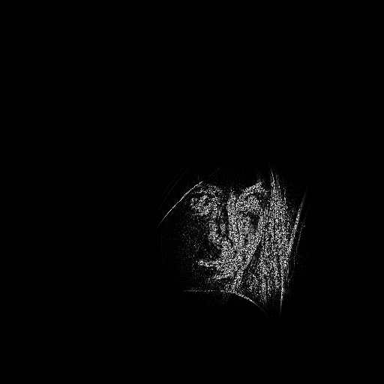

BSplines Deformable Registration
Difference Before Registration
Difference After Registration

Slide 77
Enjoy ITK !

