Slide 1

ITK Segmentation Methods
Kitware Inc.

Slide 2
Overview
Region Growing
  ConfidenceConnected
  ConnectedThreshold
  IsolatedConnected
Watersheds
Level Sets
  FastMarching
  ShapeDetection
  GeodesicActiveContours
  ThresholdSegmentation
  CannySegmentationLevelSet

Slide 3
Region Growing
Segmentation Methods

Slide 4
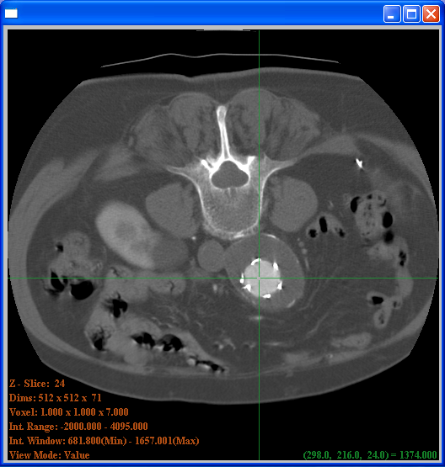
Confidence Connected
Intensity
Upper bound
X Multiplier
Standard
Deviation
Mean
Lower bound
Seed Point

Slide 5
Confidence Connected
typedef itk::Image< unsigned char , 2 > ImageType;
typedef itk::ConfidenceConnectedImageFilter<
ImageType, ImageType > FilterType;
FilterType::Pointer filter = FilterType::New();
filter->SetMultiplier( 1.5 );
filter->SetNumberOfIterations( 5 );
filter->SetInitialNeighborhoodRadius ( 2 );
filter->SetReplaceValue( 255 );
FilterType::IndexType index;
index[0] = 123; index[1] = 235;
filter->SetSeed( index );
filter->SetInput( reader->GetOutput() );
writer->SetInput( filter->GetOutput() );
writer->Update()

Slide 6
Connected Threshold
Intensity
Upper bound
Seed
Lower bound
Seed Point

Slide 7
Connected Threshold
typedef itk::Image< unsigned char , 2 > ImageType;
typedef itk::ConnectedThresholdImageFilter<
ImageType, ImageType > FilterType;
FilterType::Pointer filter = FilterType::New();
filter->SetLower( 155 );
filter->SetUpper( 235 );
filter->SetReplaceValue( 255 );
FilterType::IndexType index;
index[0] = 123; index[1] = 235;
filter->SetSeed( index );
filter->SetInput( reader->GetOutput() );
writer->SetInput( filter->GetOutput() );
writer->Update()

Slide 8
Isolated Connected
Intensity
Seed 2
UpperValueLimit
Isolated Value
Seed 1
Lower
2 Seed Points

Slide 9
Isolated Connected
typedef itk::Image< unsigned char , 2 > ImageType;
typedef itk::IsolatedConnectedImageFilter<
ImageType, ImageType > FilterType;
FilterType::Pointer filter = FilterType::New();
filter->SetLower( 155 );
filter->SetUpperValueLimit( 235 );
filter->SetReplaceValue( 255 );
filter->SetSeed1( index1 );
filter->SetSeed2( index2 );
filter->SetInput( reader->GetOutput() );
writer->SetInput( filter->GetOutput() );
writer->Update()

Slide 10
Exercise 12

Slide 11
Watershed
Segmentation

Slide 12
Watershed Concept
Intensity
Water
Level

Slide 13
Watershed Segmentation
typedef itk::Image< float , 2 > ImageType;
typedef itk::WatershedImageFilter<
ImageType
> WatershedFilterType;
WatershedFilterType::Pointer filter = WatershedFilterType::New();
filter->SetThreshold( 0.001 );
filter->SetLevel( 0.15 );
filter->SetInput( reader->GetOutput() );
filter->Update()

Slide 14
Colour Encoding the Output
typedef itk::ScalarToRGBPixelFunctor< unsigned long > FunctorType;
typedef WatershedFilterType::OutputImageType LabeledImageType;
typedef itk::UnaryFunctorImageFilter< ImageType,
LabeledImageType,
FunctorType
> ColorFilterType;
ColorFilterType::Pointer colorFilter = ColorFilterType::New();
colorFilter->SetInput( filter->GetOutput() );
writer->SetInput( colorFilter->GetOutput() );
writer->Update()

Slide 15
Creating Edges
typedef itk::GradientMagnitudeRecursiveGaussianImageFilter<
ImageType, ImageType > EdgeFilterType;
EdgeFilterType::Pointer edgeFilter = EdgeFilterType::New();
edgeFilter->SetInput( reader->GetOutput() );
edgeFilter->SetSigma( 1.0 );
filter->SetInput( edgeFilter->GetOutput() );
writer->Update()

Slide 16
Exercise 13

Slide 17
Level Set
Segmentation Methods

Slide 18
Level Set Concept
F(x,y) < 0
F(x,y) > 0
Zero set: F(x,y)=0

Slide 19
Level Set Evolution
PDE = Restricted Cellular Automata
F(x,y,t)
F(x,y,t+1)

Slide 20

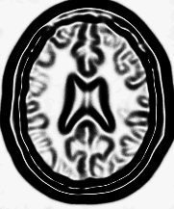
Fast Marching
Front propagation
Δx = V . Δt
Sigmoid
Gradient Magnitude
Speed Image

Slide 21
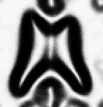
Fast Marching
Δx
Speed Image
Time-Crossing Map
Δx = V . Δt

Slide 22
Fast Marching
typedef itk::Image< float , 2 > ImageType;
typedef itk::FastMarchingImageFilter<
ImageType,
ImageType > FilterType;
FilterType::Pointer fastMarching = FilterType::New();
fastMarching->SetInput ( speedImage );
fastMarching->SetOutputSize(
speedImage->GetBufferedRegion().GetSize() );
fastMarching->SetStoppingValue( 100.0 );

Slide 23
Fast Marching
typedef FilterType::NodeContainer NodeContainer;
typedef FilterType::NodeType NodeType;
NodeContainer::Pointer seeds = NodeContainer::New();
seeds->Initialize();
NodeType seed;
seed.SetValue( 0.0 );
seed.SetIndex( index );
seeds->InsertElement( 0, seed );

Slide 24
Fast Marching
fastMarching->SetTrialPoints( seeds );
thresholder->SetInput( fastMarching->GetOutput() );
thresholder->SetLowerThreshold( 0.0 );
thresholder->SetUpperThreshold( timeThreshold );
thresholder->Update();

Slide 25
Exercise 14

Slide 26
Shape Detection
Zero set, time = t+1
Zero set, time = t
Speed
Curvature
PDE Includes a curvature term
Prevents leaking

Slide 27
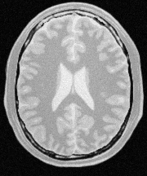


Shape Detection
Gradient
Sigmoid
Input
Image
Gradient
Magnitude
Feature
Image
Input
Feature
output
LevelSet
Shape
Detection
Input
LevelSet
Smooth
Rescale
Threshold
Binary
Mask
Positive
LevelSet
Balanced
[-0.5,0.5]

Slide 28
Shape Detection
typedef itk::Image< float , 2 > ImageType;
typedef itk::ShapeDetectionLevelSetImageFilter<
ImageType,
ImageType > FilterType;
FilterType::Pointer shapeDetection = FilterType::New();
shapeDetection->SetInput( inputLevelSet );
shapeDetection->SetFeatureImage( speedImage );
shapeDetection->SetPropagationScaling( 1.0 );
shapeDetection->SetCurvatureScaling( 0.05 );

Slide 29
Shape Detection
shapeDetection->SetMaximumRMSError( 0.001 );
shapeDetection->SetMaximumIterations( 400 );
shapeDetection->Update();
std::cout << shapeDetection->GetRMSChange() << std::endl;
std::cout << shapeDetection->GetElapsedIterations() << std::endl;
thresholder->SetInput( shapeDetection->GetOutput() );
thresholder->SetLowerThreshold( -1e7 );
thresholder->SetUpperThreshold( 0.0 );

Slide 30
Exercise 15

Slide 31
Geodesic Active Contour
Intensity Profile
ZeroSet
Displacement
X axis
Advection term added

Slide 32

Geodesic Active Contour
Vector
Field
Computed
Internally

Slide 33
Geodesic Active Contour
typedef itk::Image< float , 2 > ImageType;
typedef itk::GeodesicActiveContourLevelSetImageFilter<
ImageType,
ImageType > FilterType;
FilterType::Pointer geodesicActiveContour = FilterType::New();
geodesicActiveContour->SetInput( inputLevelSet );
geodesicActiveContour->SetFeatureImage( speedImage );
geodesicActiveContour->SetPropagationScaling( 1.0 );
geodesicActiveContour->SetCurvatureScaling( 0.05 );
geodesicActiveContour->SetAdvectionScaling( 8.0 );

Slide 34
Geodesic Active Contours
geodesicActiveContour->SetMaximumRMSError( 0.001 );
geodesicActiveContour->SetMaximumIterations( 400 );
geodesicActiveContour->Update();
std::cout << geodesicActiveContour->GetRMSChange() << std::endl;
std::cout << geodesicActiveContour->GetElapsedIterations() << std::endl;
thresholder->SetInput( geodesicActiveContour );
thresholder->SetLowerThreshold( -1e7 );
thresholder->SetUpperThreshold( 0.0 );

Slide 35
Exercise 16

Slide 36

Threshold Level Set
Advection term added controlled by a threshold
LevelSet equivalent
of a connected
components method
inside a threshold
but… with options
for preventing leaks

Slide 37
Threshold Segmentation
typedef itk::Image< float , 2 > ImageType;
typedef itk::ThresholdSegmentationLevelSetImageFilter<
ImageType,
ImageType > FilterType;
FilterType::Pointer thresholdSegmentation = FilterType::New();
thresholdSegmentation->SetInput( inputLevelSet );
thresholdSegmentation->SetFeatureImage( inputImage );
thresholdSegmentation->SetPropagationScaling( 1.0 );
thresholdSegmentation->SetCurvatureScaling( 5.0 );
thresholdSegmentation->SetAdvectionScaling( 2.0 );

Slide 38
Threshold Segmentation
thresholdSegmentation->SetMaximumRMSError( 0.001 );
thresholdSegmentation->SetMaximumIterations( 400 );
thresholdSegmentation->SetLowerThreshold( 210 );
thresholdSegmentation->SetUpperThreshold( 250 );
thresholdSegmentation->SetIsoSurface( 0.0 ); // zero set
thresholdSegmentation->SetUseNegativeFeaturesOn();
thresholdSegmentation->Update();

Slide 39
Exercise 17

Slide 40
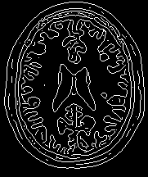
Canny Level Set
Advection term added controlled by edges
Canny edges attract
the zero set

Slide 41
Canny Segmentation
typedef itk::Image< float , 2 > ImageType;
typedef itk::CannySegmentationLevelSetImageFilter<
ImageType,
ImageType > FilterType;
FilterType::Pointer cannySegmentation = FilterType::New();
cannySegmentation->SetInput( inputLevelSet );
cannySegmentation->SetFeatureImage( inputImage );
cannySegmentation->SetPropagationScaling( 0.0 );
cannySegmentation->SetCurvatureScaling( 1.0 );
cannySegmentation->SetAdvectionScaling( 2.0 ); // canny edges

Slide 42
Canny Segmentation
cannySegmentation->SetMaximumRMSError( 0.01 );
cannySegmentation->SetMaximumIterations( 400 );
cannySegmentation->SetThreshold( 2.0 );
cannySegmentation->SetVariance( 1.0 );
cannySegmentation->SetIsoSurface( 127.0 ); // zero set
cannySegmentation->SetUseNegativeFeaturesOn();
cannySegmentation->Update();

Slide 43
Exercise 18

Slide 44
Enjoy ITK !

Slide 45
www.paraview.org

