Slide 1

ITK Registration Methods
Kitware Inc.

Slide 2
Overview
Image Resampling
Registration Framework
Multi-Modality
Multi-Resolution
Deformable registration

Slide 3
Image Resampling

Slide 4
Why Resampling ?
Resampling
is the Essence
of Intensity-Based
Image Registration

Slide 5
What is an Image ?
An Image is
a sampling of a
continuous field
using a discrete grid

Slide 6
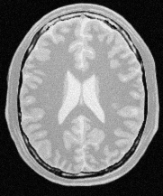
Image Origin & Spacing
Spacing (Sx)
y
x
Spacing (Sy)
Origin (Ox,Oy)

Slide 7
Image Sampling Grid
Spacing (Sx)
Spacing (Sy)
Origin (Ox,Oy)

Slide 8
Image Pixel
Spacing (Sx)
Pixel Value
Pixel Region
Spacing (Sy)
Origin (Ox,Oy)

Slide 9
Image Indices
Spacing (Sx)
[0,7]
[4,7]
Pixel Index
[0,6]
[0,5]
[0,4]
[0,3]
[0,2]
Spacing (Sy)
[0,1]
Origin (Ox,Oy)
[0,0]
[1,0]
[2,0]
[3,0]
[4,0]
[5,0]

Slide 10
Index to Physical Coordinates
Spacing (Sx)
[0,7]
[4,7]
Pixel Index
[0,6]
[0,5]
P[0] = Index[0] x Spacing[0] + Origin[0]
P[1] = Index[1] x Spacing[1] + Origin[1]
[0,4]
Index[0] = floor( ( P[0] - Origin[0] ) / Spacing[0] + 0.5 )
[0,3]
Index[1] = floor( ( P[1] - Origin[1] ) / Spacing[1] + 0.5 )
[0,2]
Spacing (Sy)
[0,1]
Origin (Ox,Oy)
[0,0]
[1,0]
[2,0]
[3,0]
[4,0]
[5,0]

Slide 11
Image Region
Spacing (Sx)
Pixel Value
Image Region
Pixel Region
Spacing (Sy)
Origin (Ox,Oy)

Slide 12
Image Region
Spacing (Sx)
Image Region
Region Size
[3,5]
Starting Index
[2,3]
Spacing (Sy)
Origin (Ox,Oy)

Slide 13
Basic Resampling
Resampling
Trivial Cases

Slide 14
Sub-Sampling by Half
Spacing ( 2 x Sx )
Spacing (Sx)
Image Region
Spacing
( 2 x Sy )
Spacing (Sy)
Origin (Ox,Oy)

Slide 15
Sub-Sampling by Half
New Spacing
S’x
New Spacing
S’y
New Origin
(O’x,O’y)
Origin (Ox,Oy)

Slide 16
Super-Sampling by Double
Spacing ( Sx/2 )
Spacing (Sx)
Spacing ( Sy/2 )
Image Region
Spacing (Sy)
Origin (Ox,Oy)

Slide 17
Super-Sampling by Double
New Spacing
S’x
New Origin
(O’x,O’y)
New Spacing
S’y
Origin (Ox,Oy)

Slide 18
Resampling in ITK
itk::ResampleImageFilter

Slide 19
Resampling in ITK
Origin
Spacing
Region Size
Resample Filter
Input Image
Transform
Region Start
Output Image
Interpolator

Slide 20
Resample Image Filter
#include "itkImage.h"
#include "itkResampleImageFilter.h"
#include "itkIdentityTransform.h“
#include "itkLinearInterpolateImageFunction.h"
typedef itk::Image< char, 2 > ImageType;
ImageType::Pointer inputImage = GetImageSomeHow();
typedef itk::ResampleImageFilter< ImageType > FilterType;
FilterType::Pointer resampler = FilterType::New();
ImageType::SizeType size;
size[0] = 200;
size[1] = 300;
ImageType::IndexType start;
start[0] = 0;
start[1] = 0;

Slide 21
Resample Image Filter
ImageType::PointType origin;
origin[0] = 10.0; // millimeters
origin[1] = 25.5; // millimeters
ImageType::SpacingType spacing;
spacing[0] = 2.0; // millimeters
spacing[1] = 1.5; // millimeters
resampler->SetOutputSpacing( spacing );
resampler->SetOutputOrigin( origin );
resampler->SetSize( size );
resampler->SetOutputStartIndex( start );
resampler->SetDefaultPixelValue( 100 );
resampler->SetInput( inputImage );

Slide 22
Resample Image Filter
typedef itk::LinearInterpolateImageFunction<
ImageType,
double > InterpolatorType;
InterpolatorType::Pointer interpolator = InterpolatorType::New();
typedef itk::TranslationTransform< double, 2 > TransformType;
TransformType::Pointer transform = TransformType::New();
transform->SetIdentity();
resampler->SetInterpolator( interpolator );
resampler->SetTransform( transform );
resampler->Update();
const ImageType * outputImage = resampler->GetOutput();

Slide 23
Basic Registration

Slide 24

Coordinate System Conversions
j
j
i
i
Image Grid
Image Grid
y
y’
y
x
Space Transform
x
x’
Physical Coordinates
Physical Coordinates

Slide 25

Things I will not do…
I will not register images in pixel space
I will not register images in pixel space
I will not register images in pixel space
I will not register images in pixel space
I will not register images in pixel space
I will not register images in pix

Slide 26
Fixed Image & Moving Image
j
j
i
i
Fixed Image Grid
Moving Image Grid
y
y’
Space Transform
x
x’
Fixed Image
Physical Coordinates
Moving Image
Physical Coordinates

Slide 27
Selecting Moving & Fixed Images
In principle the denomination of
Fixed Image & Moving Image
is arbitrary
In practice the moving image
is the one that will be resampled
into the fixed image
coordinate system

Slide 28
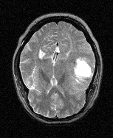
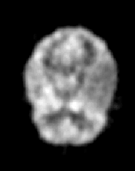
Quiz #1
Images from the same patient
MRI-T2
PET
Moving Image ?
Fixed Image ?
256 x 256 pixels
128 x 128 pixels
Images provided as part of the project: “Retrospective Image Registration Evaluation”,
NIH, Project No. 8R01EB002124-03, Principal Investigator, J. Michael Fitzpatrick, Vanderbilt University, Nashville, TN.

Slide 29
Quiz #2
Images from the same patient
MRI-T2
PET
Scaling Transform
What scale factor ?
2.0
1.0
0.5
256 x 256 pixels
128 x 128 pixels
Images provided as part of the project: “Retrospective Image Registration Evaluation”,
NIH, Project No. 8R01EB002124-03, Principal Investigator, J. Michael Fitzpatrick, Vanderbilt University, Nashville, TN.

Slide 30
Things I will not do…
I will not register images in pixel space
I will not register images in pixel space
I will not register images in pixel space
I will not register images in pixel space
I will not register images in pixel space
I will not register images in pix

Slide 31
Registration in ITK
Image
Registration
Framework
Multi
Resolution
Registration
Framework
Components
PDE
Based
Registration
FEM
Based
Registration

Slide 32
Registration Framework

Slide 33
Components
Registration Method
Fixed
Image
Metric
Optimizer
Interpolator
Moving
Image
Transform

Slide 34
Image Metrics
Mean Squares
Normalized Correlation
Mean Reciprocal Square Difference
Mutual Information
- Viola-Wells
- Mattes
- Histogram based
- Histogram normalized

Slide 35
Transforms
Translation
Scaling
Rotation
Rigid3D
Rigid2D
Affine
BSplines
Splines: TPS, EBS, VS

Slide 36
Optimizers
Gradient Descent
Regular Step Gradient Descent
Conjugate Gradient
Levenberg-Marquardt
One plus One Evolutionary Algorithm

Slide 37
Interpolators
Nearest Neighbor
Linear
BSpline

Slide 38
Exercise 20

Slide 39
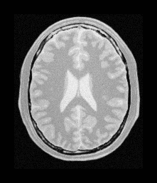
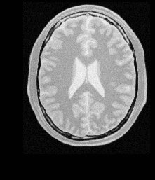
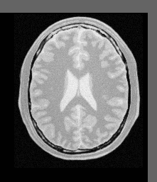
Image Registration
Fixed Image
Registered Moving Image
Moving Image

Slide 40
Image Registration
#include ”itkImageRegistrationMethod.h”
#include ”itkTranslationTransform.h”
#include ”itkMeanSquaresImageToImageMetric.h”
#include ”itkLinearInterpolateImageFunction.h”
#include ”itkRegularStepGradientDescentOptimizer.h”
#include ”itkImage.h”
#include ”itkImageFileReader.h”
#include ”itkImageFileWriter.h”
#include ”itkResampleImageFilter.h”

Slide 41
Image Registration
const unsigned int Dimension = 2;
typedef unsigned char PixelType;
typedef itk::Image< PixelType , Dimension > FixedImageType;
typedef itk::Image< PixelType , Dimension > MovingImageType;
typedef itk::TranslationTransform< double, Dimension > TransformType;
typedef itk::RegularStepGradientDescentOptimizer OptimizerType;
typedef itk::LinearInterpolateImageFunction<
MovingImageType , double > InterpolatorType;
typedef itk::MeanSquaresImageToImageMetric<
FixedImageType , MovingImageType > MetricType;
typedef itk::ImageRegistrationMethod<
FixedImageType , MovingImageType > RegistrationType;

Slide 42
Image Registration
TransformType::Pointer transform = TransformType::New();
OptimizerType::Pointer optimizer = OptimizerType::New();
InterpolatorType::Pointer interpolator = InterpolatorType::New();
MetricType::Pointer metric = MetricType::New();
RegistrationType::Pointer registrator = RegistrationType::New();
registrator->SetTransform( transform );
registrator->SetOptimizer( optimizer );
registrator->SetInterpolator( interpolator );
registrator->SetMetric( metric );
registrator->SetFixedImage( fixedImageReader->GetOutput() );
registrator->SetMovingImage( movingImageReader->GetOutput() );

Slide 43
Image Registration
registrator->SetFixedImageRegion(
fixedImageReader->GetOutput()->GetBufferedRegion() );
typedef RegistrationType::ParametersType ParametersType;
transform->SetIdentity();
registrator->SetInitialTransformParameters(
transform->GetParameters() );
optimizer->SetMaximumStepLength( 4.00 );
optimizer->SetMinimumStepLength( 0.01 );
optimizer->SetNumberOfIterations( 100 );
optimizer->MaximizeOff();

Slide 44
Image Registration
try
{
registrator->StartRegistration ();
}
catch( itk::ExceptionObject & excp )
{
std::cerr << “Error in registration” << std::endl;
std::cerr << excp << std::endl;
}
transform->SetParameters(
registrator->GetLastTransformParameters() );

Slide 45
Image Registration
typedef itk::ResampleImageFilter<
FixedImageType , MovingImageType > ResamplerType;
ResamplerType ::Pointer resampler = ResamplerType::New();
resampler->SetTransform ( transform );
resampler->SetInput( movingImageReader->GetOutput() );
FixedImageType ::Pointer fixedImage = fixedImageReader->GetOutput();
resampler->SetOrigin( fixedImage->GetOrigin() );
resampler->SetSpacing( fixedImage->GetSpacing() );
resampler->SetSize(
fixedImage->GetLargestPossibleRegion()->GetSize() );
resampler->Update();

Slide 46
Tracking the
Registration Process

Slide 47
Observing Registration
#include ”itkCommand.h”
class CommandIteration : public itk::Command {
public:
typedef CommandIteration Self;
typedef itk::Command SuperClass;
typedef itk::SmartPointer< Self > Pointer;
itkNewMacro( Self );
protected:
CommandIteration() {};
public:
typedef itk::RegularStepGradientDescentOptimizer OptimizerType;
typedef const OptimizerType * OptimizerPointer;

Slide 48
Observing Registration
void Execute( itk::Object * caller, const itk::EventObject & event )
{
this-> Execute( (const itk::Object *) caller, event );
}
void Execute( const itk::Object * caller, const itk::EventObject & event )
{
OptimizerPointer optimizer =
dynamic_cast< OptimizerPointer >( caller );
if( typeid( event ) == typeid( itk::IterationEvent ) )
{
std::cout << optimizer->GetCurrentIteration() << “ : “;
std::cout << optimizer->GetValue() << “ : “;
std::cout << optimizer->GetCurrentPosition() << std::endl;
}
}

Slide 49
Image Registration
CommandIteration::Pointer observer = CommandIteration::New();
optimizer->AddObserver( itk::IterationEvent(), observer )
try
{
registrator->StartRegistration ();
}
catch( itk::ExceptionObject & excp )
{
std::cerr << “Error in registration” << std::endl;
std::cerr << excp << std::endl;
}

Slide 50
Image Similarity Metrics

Slide 51
Image Metrics
How similar is
image A to image B ?

Slide 52
Image Metrics
Does Image B
matches Image A better
than Image C ?

Slide 53
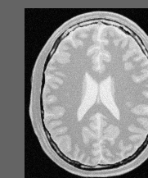

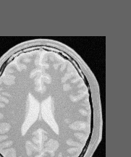
Image Metrics
>
<
Match( A , B )
Match( A , C )
Image B
Image A
Image C

Slide 54
Image Metrics
Match( A , B )
Simplest Metric
Mean Squared Differences

Slide 55
Mean Squared Differences
For each pixel in A
Image A
Image B
Difference( index ) = A( index ) – B( index )
Sum += Difference( index ) ²
Match( A , B ) = Sum / numberOfPixels

Slide 56
For each pixel in the Fixed Image
j
j
i
i
Fixed Image Grid
Moving Image Grid
y
y’
Space Transform
x
x’
Fixed Image
Physical Coordinates
Moving Image
Physical Coordinates

Slide 57
Image Metrics
Fixed
Image
Metric
Value
Moving
Image
Interpolator
Transform
Parameters

Slide 58
Mean Squared Differences
#include "itkImage.h"
#include "itkMeanSquaresImageToImageMetric.h"
#include "itkLinearInterpolateImageFunction.h"
#include "itkTranslationTransform.h"
typedef itk::Image< char, 2 > ImageType;
ImageType::ConstPointer fixedImage = GetFixedImage();
ImageType::ConstPointer movingImage = GetMovingImage();
typedef itk::LinearInterpolateImageFunction<
ImageType,
double >
InterpolatorType;
InterpolatorType::Pointer interpolator = InterpolatorType::New();
typedef itk::TranslationTransform< double, 2 > TransformType;
TransformType::Pointer transform = TransformType::New();

Slide 59
Mean Squared Differences
typedef itk::MeanSquaresImageToImageMetric<
ImageType, ImageType > MetricType;
MetricType::Pointer metric = MetricType::New();
metric->SetInterpolator( interpolator );
metric->SetTransform( transform );
metric->SetFixedImage( fixedImage );
metric->SetMovingImage( movingImage );
MetricType::TransformParametersType translation( Dimension );
translation[0] = 12;
translation[1] = 27;
double value = metric->GetValue( translation );

Slide 60
Mean Squared Differences
MetricType::TransformParametersType translation( Dimension );
double value[21][21];
for( int dx = 0; dx <= 20; dx++)
{
for( int dy = 0; dy <= 20; dy++)
{
translation[0] = dx;
translation[1] = dy;
value[dx][dy] = metric->GetValue( translation );
}
}

Slide 61
Evaluating many matches
y
y
Transform
x
x
Fixed Image
Moving Image

Slide 62
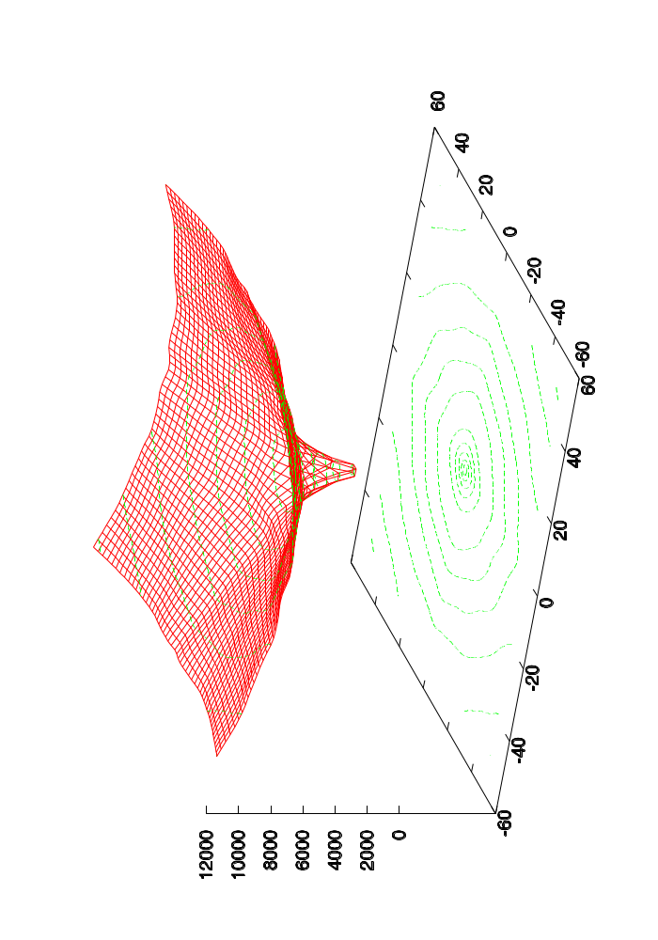
Plotting the Metric
Mean Squared Differences
Transform Parametric Space

Slide 63
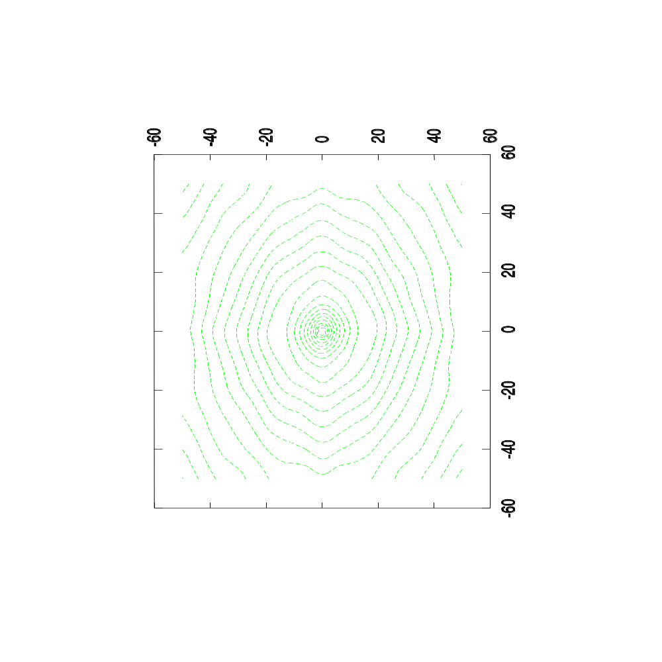
Plotting the Metric
Mean Squared Differences
Transform Parametric Space

Slide 64
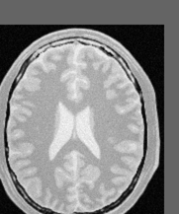
Evaluating many matches
y
y
Transform
(-15,-25) mm
x
x
Fixed Image
Moving Image

Slide 65
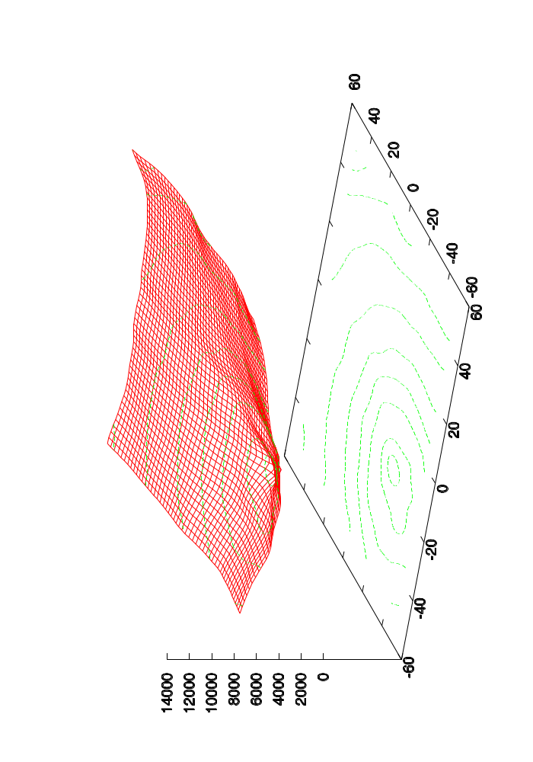
Plotting the Metric
Mean Squared Differences
Transform Parametric Space

Slide 66
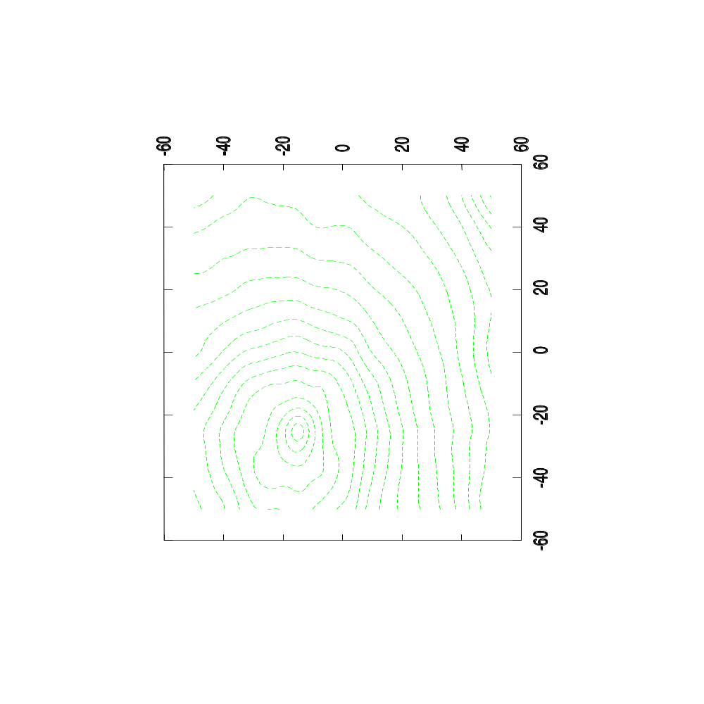
Plotting the Metric
Mean Squared Differences
Transform Parametric Space

Slide 67
The Best Transform Parameters
Evaluation of the
full parameter space
is equivalent to performing
optimization by
exhaustive search

Slide 68
The Best Transform Parameters
Very Safe
but
Very Slow

Slide 69
The Best Transform Parameters
Better Optimization Methods
for example
Gradient Descent

Slide 70
Image Registration Framework
Fixed
Image
Metric
Moving
Image
Interpolator
Optimizer
Transform
Parameters

Slide 71
Gradient Descent Optimizer
f( x , y )
S = Step
L = Learning
Rate
G( x , y ) =
∆
f( x , y )
S = L ∙ G( x , y )

Slide 72
Gradient Descent Optimizer
f( x , y )
G( x , y ) =
∆
f( x , y )
S = L ∙ G( x , y )

Slide 73
Gradient Descent Optimizer
f( x , y )
L too large
G( x , y ) =
∆
f( x , y )
S = L ∙ G( x , y )

Slide 74
Gradient Descent Optimizer
f( x , y )
L too small
G( x , y ) =
∆
f( x , y )
S = L ∙ G( x , y )

Slide 75
Gradient Descent Optimizer
What’s wrong with this algorithm ?

Slide 76
Gradient Descent Optimizer
S Units ?
= millimeters
f(x,y) Units ?
= intensity
G(x,y) Units ?
= intensity / millimeters
S = L ∙ G( x , y )
L Units ?
= millimeters² / intensity

Slide 77
Gradient Descent Optimizer
f( x )
S = L ∙ G( x )
1
1

Slide 78
Gradient Descent Optimizer
f( x )
S = L ∙ G( x )
S = Large in high gradients
S = Small in low
gradients
1
1

Slide 79
Gradient Descent Optimizer
f( x )
S = L ∙ G( x )
Works great with this function
Works badly with this function

Slide 80
Gradient Descent Variant
Driving Safe !

Slide 81
Regular Step Gradient Descent
f( x )
^
S = D ∙ G( x )
If G changes direction
D_{i} = D_{i-1} / 2.0
D₁
D₁
D₂
D₁

Slide 82
Regular Step Gradient Descent
f( x )
^
S = D ∙ G( x )
User Selects D₁
User Selects D_{stop}
User Selects G_{stop}
D₁
D₁
D₂
D₁

Slide 83
Optimizers are like a car
Watch while you are driving !

Slide 84
Watch over your optimizer
Example:
Optimizer registering an image with itself starting at (-15mm, -25mm)

Slide 85
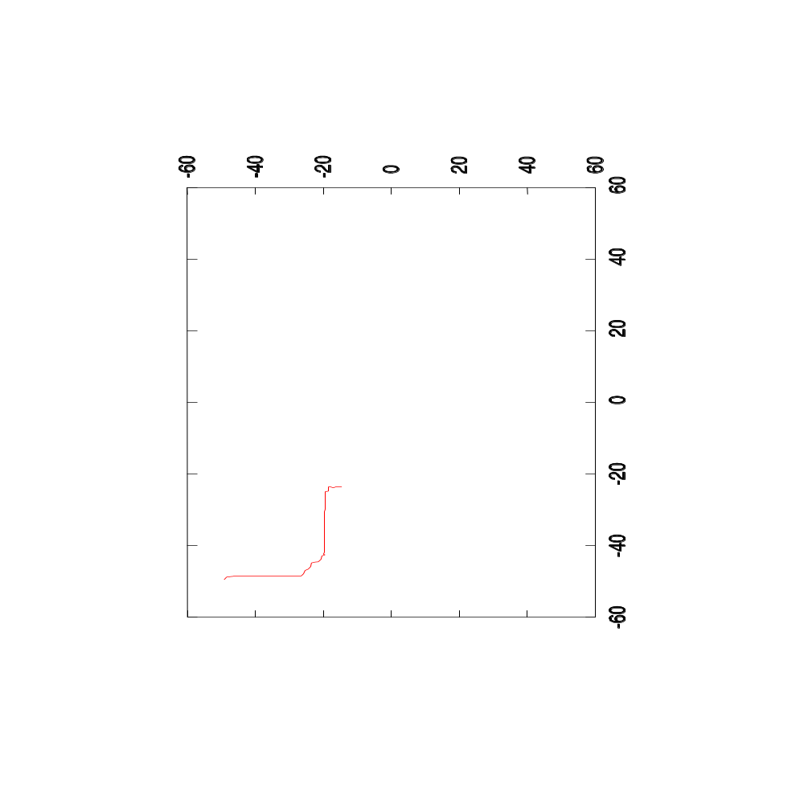
Plotting the Optimizer’s Path
Mean Squared Differences
Step Length = 1.0 mm

Slide 86
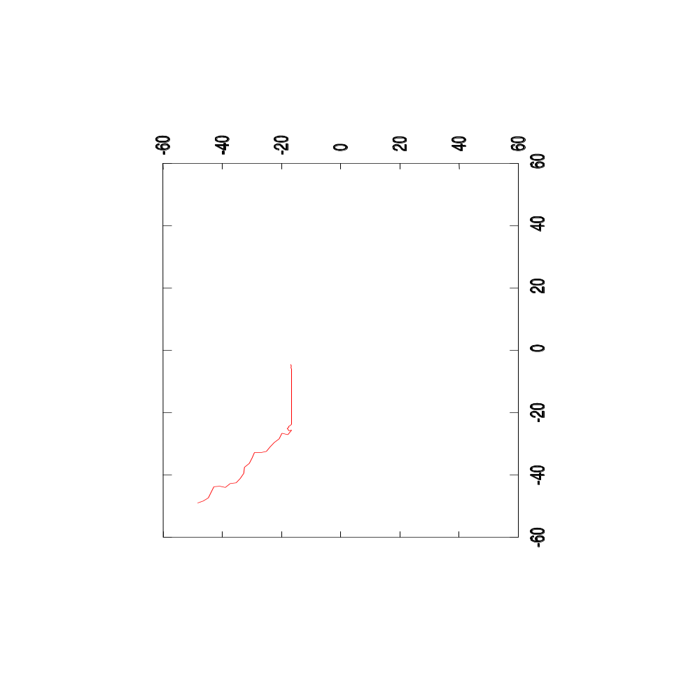
Plotting the Optimizer’s Path
Mean Squared Differences
Step Length = 2.0 mm

Slide 87
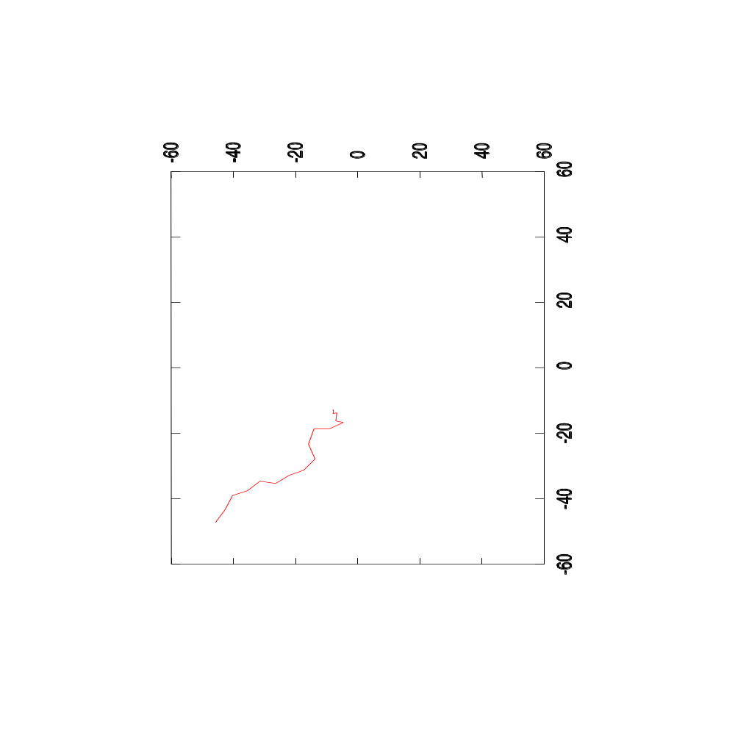
Plotting the Optimizer’s Path
Mean Squared Differences
Step Length = 5.0 mm

Slide 88
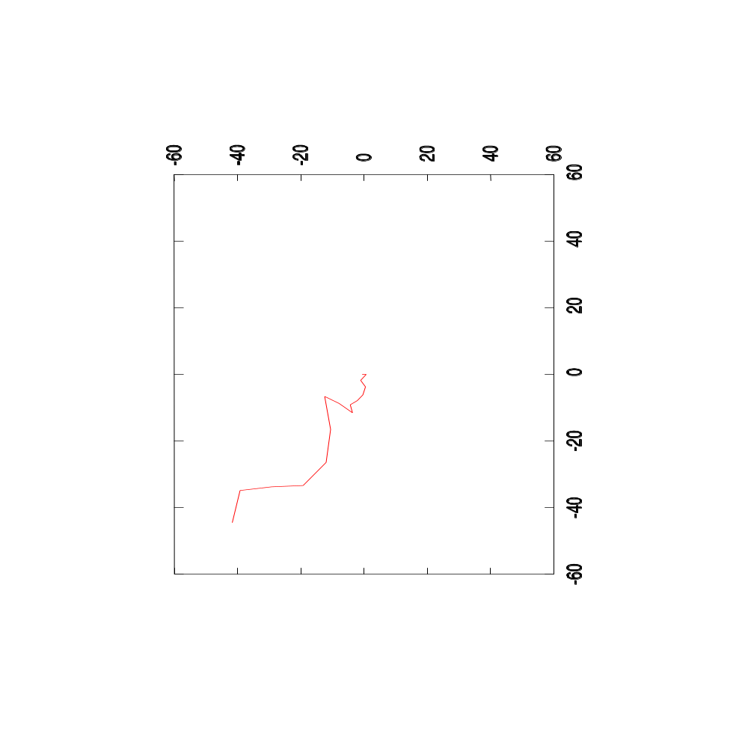
Plotting the Optimizer’s Path
Mean Squared Differences
Step Length = 10.0 mm

Slide 89
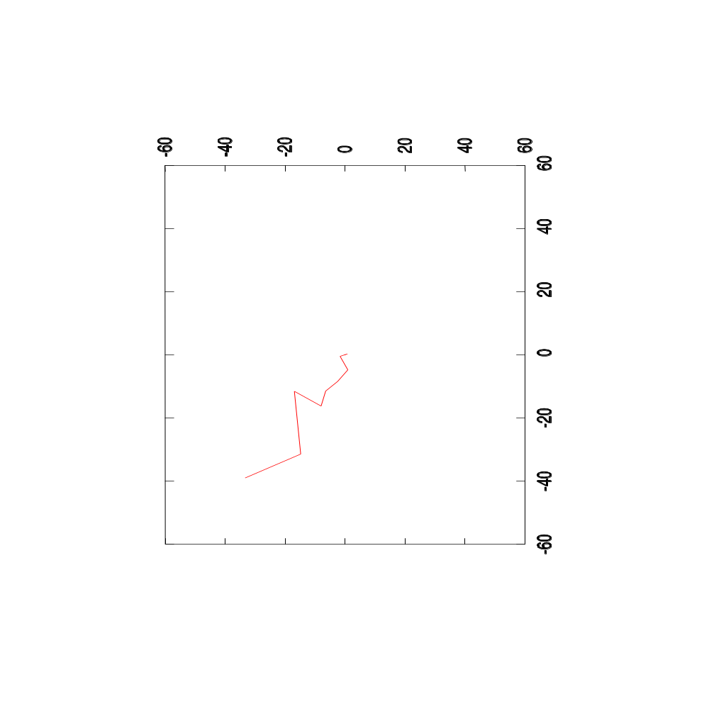
Plotting the Optimizer’s Path
Mean Squared Differences
Step Length = 20.0 mm

Slide 90
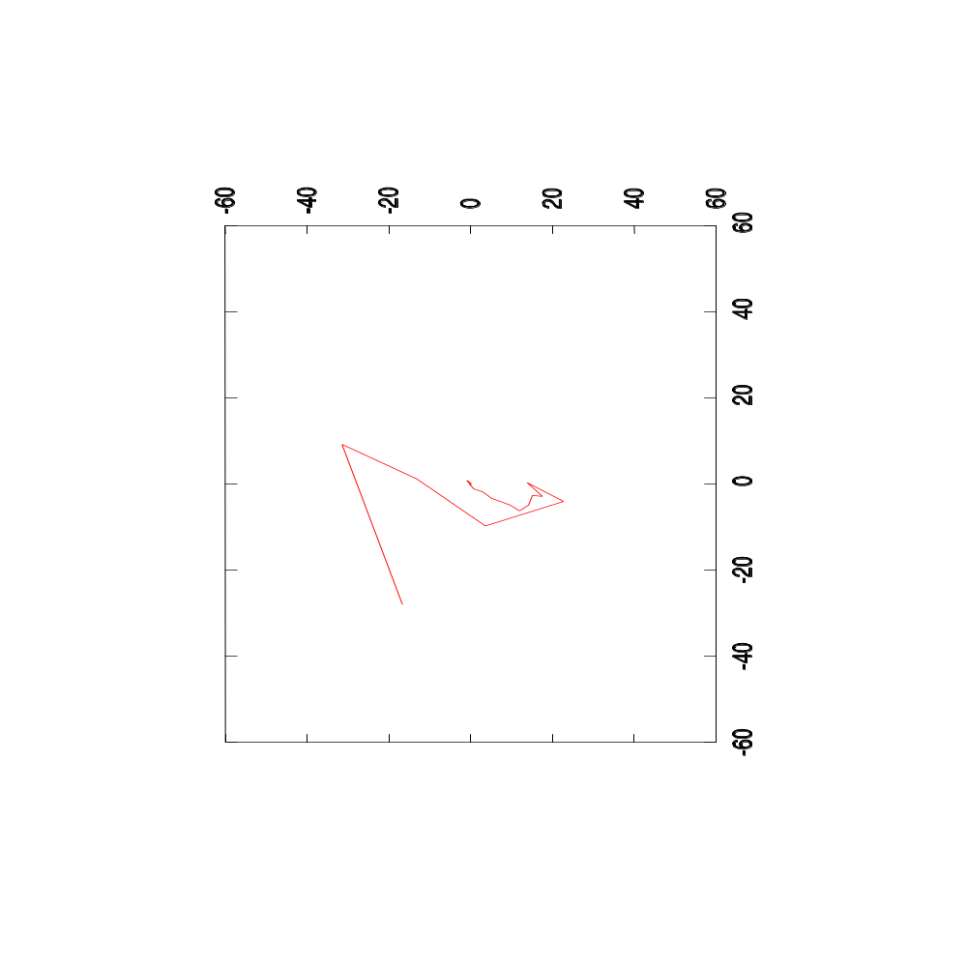
Plotting the Optimizer’s Path
Mean Squared Differences
Step Length = 40.0 mm

Slide 91
Watch over your optimizer
Example:
Optimizer registering an image shifted by (-15mm, -25mm)
The optimizer starts at (0mm,0mm)

Slide 92
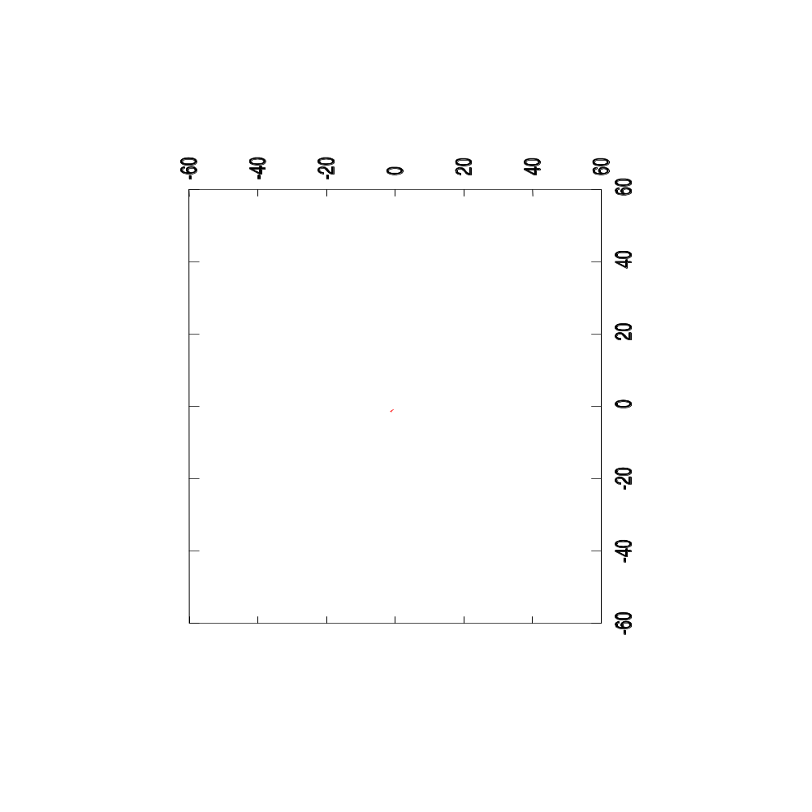
Plotting the Optimizer’s Path
Mean Squared Differences
Step Length = 1.0 mm

Slide 93
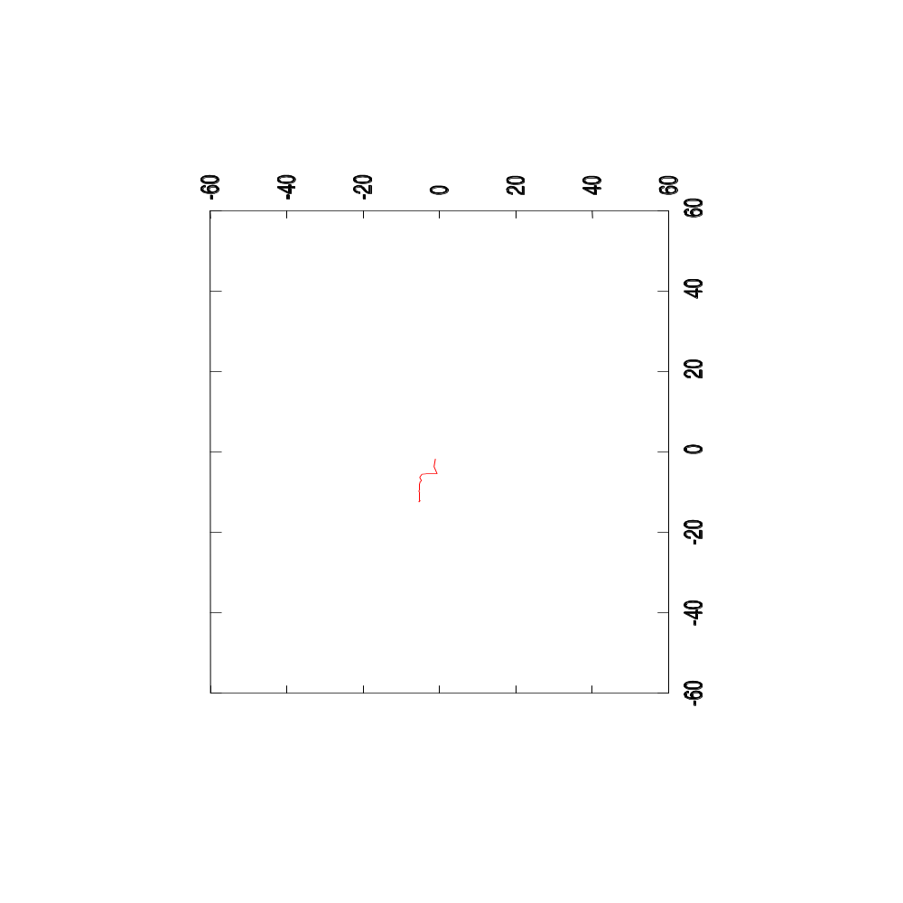
Plotting the Optimizer’s Path
Mean Squared Differences
Step Length = 2.0 mm

Slide 94

Plotting the Optimizer’s Path
Mean Squared Differences
Step Length = 5.0 mm

Slide 95
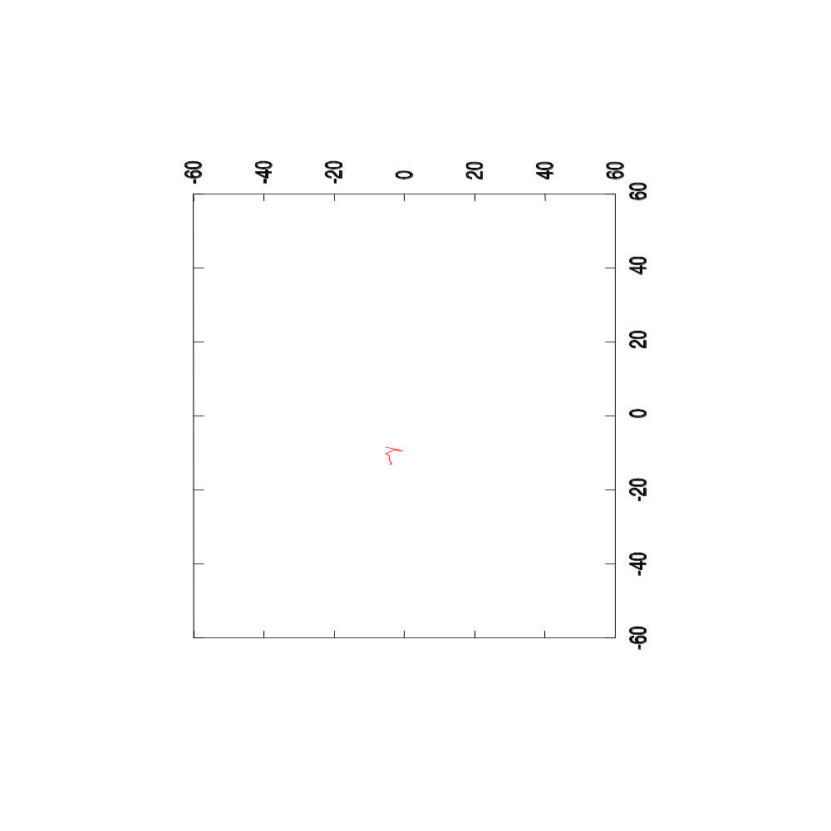
Plotting the Optimizer’s Path
Mean Squared Differences
Step Length = 10.0 mm

Slide 96
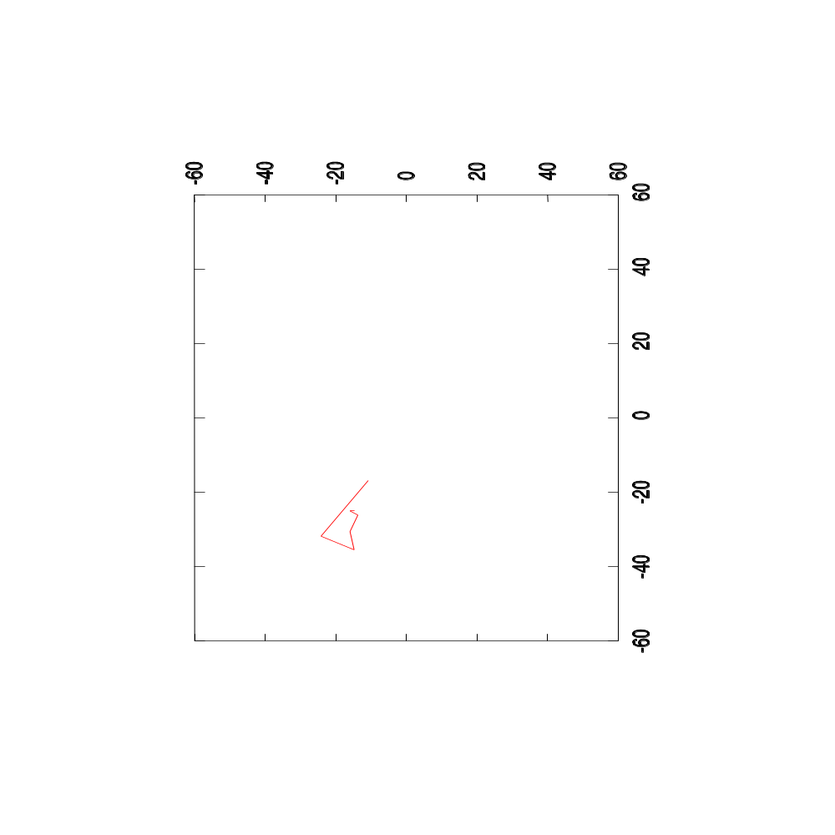
Plotting the Optimizer’s Path
Mean Squared Differences
Step Length = 20.0 mm

Slide 97
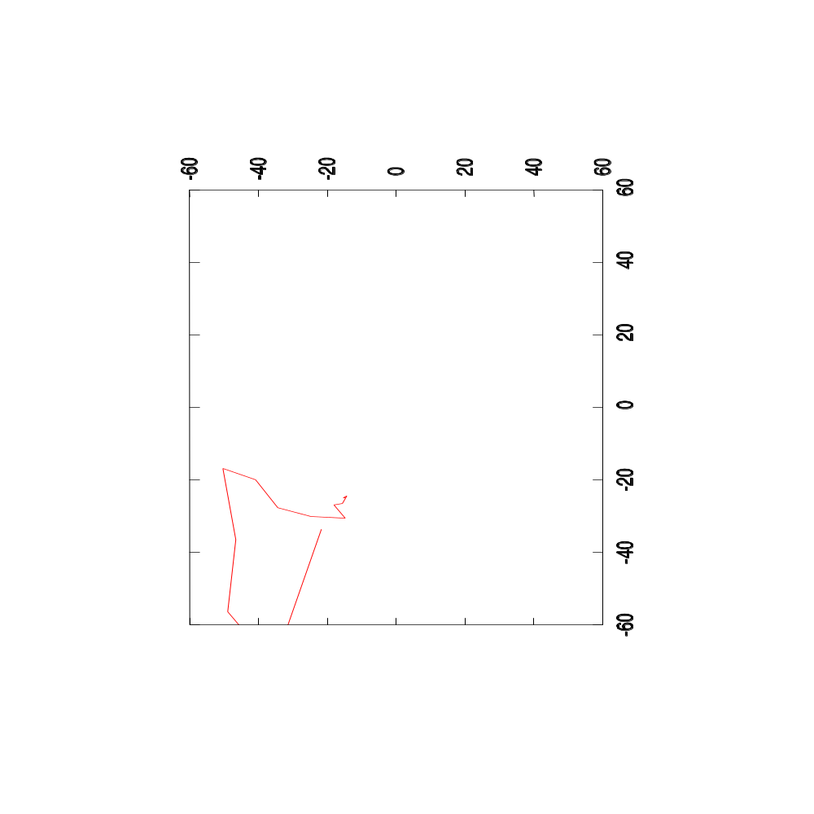
Plotting the Optimizer’s Path
Mean Squared Differences
Step Length = 40.0 mm

Slide 98
Multi - Modality

Slide 99
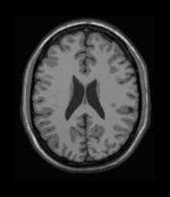

Multi-Modality Registration
Moving Image
Registered Moving Image
Fixed Image

Slide 100
Multiple Image Modalities
Number of pairs

Slide 101
Multiple Image Modalities
More possible pairs

Slide 102
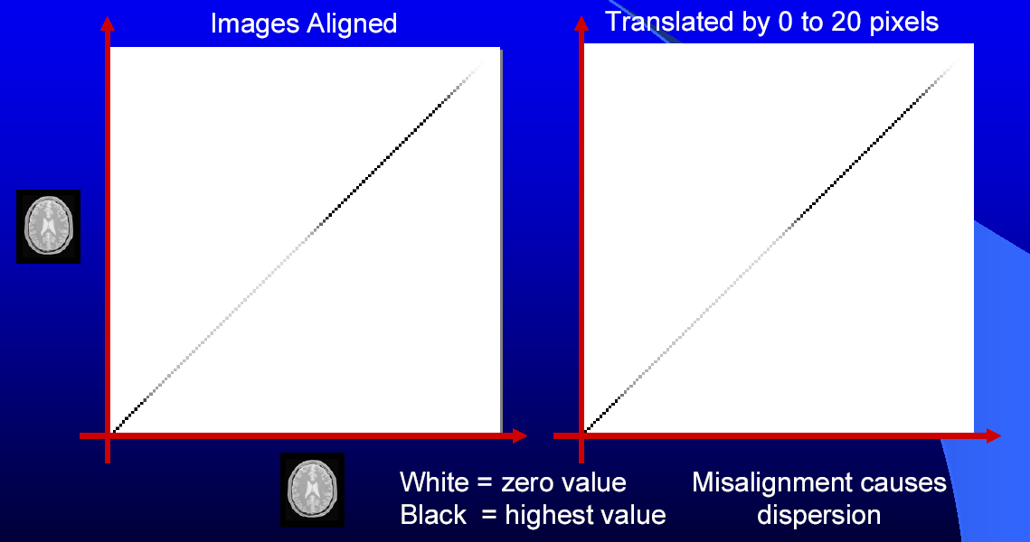
Mutual Information

Slide 103
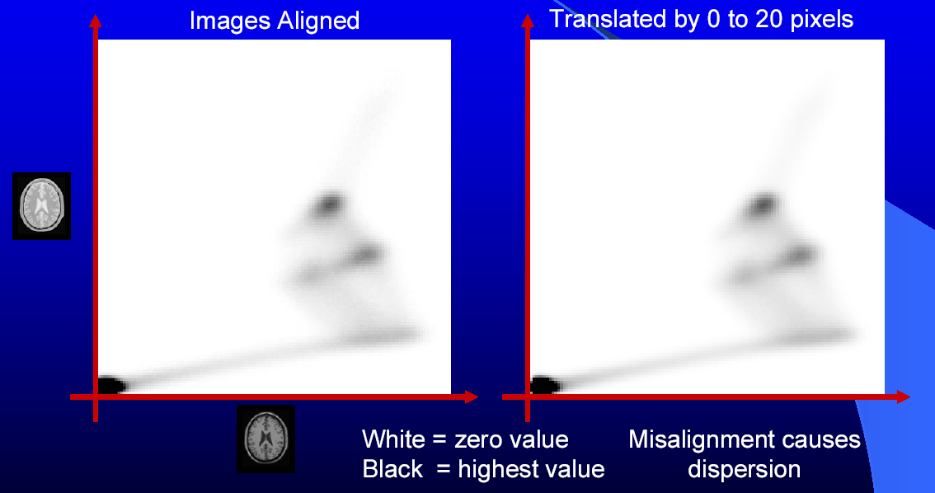
Mutual Information

Slide 104
Exercise 21

Slide 105
Image Registration
Moving Image
Registered Moving Image
Fixed Image

Slide 106
Image Registration
#include ”itkImageRegistrationMethod.h”
#include ”itkTranslationTransform.h”
#include ”itkMattesMutualInformationImageToImageMetric.h”
#include ”itkLinearInterpolateImageFunction.h”
#include ”itkRegularStepGradientDescentOptimizer.h”
#include ”itkImage.h”
#include ”itkImageFileReader.h”
#include ”itkImageFileWriter.h”
#include ”itkResampleImageFilter.h”

Slide 107
Image Registration
const unsigned int Dimension = 2;
typedef unsigned char PixelType;
typedef itk::Image< PixelType , Dimension > FixedImageType;
typedef itk::Image< PixelType , Dimension > MovingImageType;
typedef itk::TranslationTransform< double, Dimension > TransformType;
typedef itk::RegularStepGradientDescentOptimizer OptimizerType;
typedef itk::LinearInterpolateImageFunction<
MovingImageType , double > InterpolatorType;
typedef itk::MattesMutualInformationImageToImageMetric<
FixedImageType , MovingImageType > MetricType;
typedef itk::ImageRegistrationMethod<
FixedImageType , MovingImageType > RegistrationType;

Slide 108
Image Registration
TransformType::Pointer transform = TransformType::New();
OptimizerType::Pointer optimizer = OptimizerType::New();
InterpolatorType::Pointer interpolator = InterpolatorType::New();
MetricType::Pointer metric = MetricType::New();
RegistrationType::Pointer registrator = RegistrationType::New();
registrator->SetTransform( transform );
registrator->SetOptimizer( optimizer );
registrator->SetInterpolator( interpolator );
registrator->SetMetric( metric );
registrator->SetFixedImage( fixedImageReader->GetOutput() );
registrator->SetMovingImage( movingImageReader->GetOutput() );

Slide 109
Image Registration
registrator->SetFixedImageRegion(
fixedImageReader->GetOutput()->GetBufferedRegion() );
typedef RegistrationType::ParametersType ParametersType;
transform->SetIdentity();
registrator->SetInitialTransformParameters(
transform->GetParameters() );
optimizer->SetMaximumStepLength( 4.00 );
optimizer->SetMinimumStepLength( 0.05 );
optimizer->SetNumberOfIterations( 200 );
optimizer->MaximizeOn();

Slide 110
Image Registration
metric->SetNumberOfHistogramBins( 20 ); // Metric specific
metric->SetNumberOfSpatialSamples( 10000 ); // Metric specific
try
{
registrator->StartRegistration ();
}
catch( itk::ExceptionObject & excp )
{
std::cerr << “Error in registration” << std::endl;
std::cerr << excp << std::endl;
}
transform->SetParameters(
registrator->GetLastTransformParameters() );

Slide 111
Image Registration
typedef itk::ResampleImageFilter<
FixedImageType , MovingImageType > ResamplerType;
ResamplerType ::Pointer resampler = ResamplerType::New();
resampler->SetTransform ( transform );
resampler->SetInput( movingImageReader->GetOutput() );
FixedImageType ::Pointer fixedImage = fixedImageReader->GetOutput();
resampler->SetOrigin( fixedImage->GetOrigin() );
resampler->SetSpacing( fixedImage->GetSpacing() );
resampler->SetSize(
fixedImage->GetLargestPossibleRegion()->GetSize() );
resampler->Update();

Slide 112
Rotation – Translation
Parameter Scaling

Slide 113
Exercise 22

Slide 114
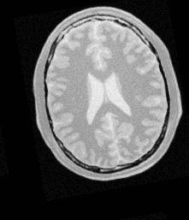
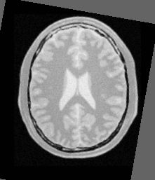
Image Registration
Registered Moving Image
Fixed Image
Moving Image

Slide 115
Image Registration
#include ”itkImageRegistrationMethod.h”
#include ”itkCenteredRigid2DTransform.h”
#include ”itkMeanSquaresImageToImageMetric.h”
#include ”itkLinearInterpolateImageFunction.h”
#include ”itkRegularStepGradientDescentOptimizer.h”
#include ”itkCenteredTransformInitializer.h”
#include ”itkImage.h”
#include ”itkImageFileReader.h”
#include ”itkImageFileWriter.h”
#include ”itkResampleImageFilter.h”

Slide 116
Image Registration
const unsigned int Dimension = 2;
typedef unsigned char PixelType;
typedef itk::Image< PixelType , Dimension > FixedImageType;
typedef itk::Image< PixelType , Dimension > MovingImageType;
typedef itk::CenteredRigid2DTransform< double > TransformType;
typedef itk:: CenteredTransformInitializer<
TransformType ,
FixedImageType ,
MovingImageType
> InitializerType;

Slide 117
Image Registration
TransformType::Pointer transform = TransformType::New();
InitializerType::Pointer initializer = InitializerType::New();
OptimizerType::Pointer optimizer = OptimizerType::New();
InterpolatorType::Pointer interpolator = InterpolatorType::New();
MetricType::Pointer metric = MetricType::New();
RegistrationType::Pointer registrator = RegistrationType::New();
registrator->SetTransform( transform );
registrator->SetOptimizer( optimizer );
registrator->SetInterpolator( interpolator );
registrator->SetMetric( metric );
registrator->SetFixedImage( fixedImageReader->GetOutput() );
registrator->SetMovingImage( movingImageReader->GetOutput() );

Slide 118
Image Registration
registrator->SetFixedImageRegion(
fixedImageReader->GetOutput()->GetBufferedRegion() );
initializer->SetTransform ( transform );
initializer->SetFixedImage( fixedImageReader->GetOutput() );
initializer->SetMovingImage( movingImageReader->GetOutput() );
initializer->MomentsOn();
initializer->InitializeTransform();
registrator->SetInitialTransformParameters(
transform->GetParameters() );

Slide 119
Image Registration
typedef OptimizerType::ScaleType OptimizerScalesType;
OptimizerScalesType optimizerScales(
optimizer->SetMaximumStepLength() );
const double translationScale = 1.0 / 1000.0 ;
optimizerScales[ 0 ] = 1.0;
optimizerScales[ 1 ] = translationScale;
optimizerScales[ 2 ] = translationScale;
optimizerScales[ 3 ] = translationScale;
optimizerScales[ 4 ] = translationScale;
optimizer->SetScales( optimizerScales );

Slide 120
Image Registration
try
{
registrator->StartRegistration ();
}
catch( itk::ExceptionObject & excp )
{
std::cerr << “Error in registration” << std::endl;
std::cerr << excp << std::endl;
}
transform->SetParameters(
registrator->GetLastTransformParameters() );

Slide 121
Image Registration
typedef itk::ResampleImageFilter<
FixedImageType , MovingImageType > ResamplerType;
ResamplerType ::Pointer resampler = ResamplerType::New();
resampler->SetTransform ( transform );
resampler->SetInput( movingImageReader->GetOutput() );
FixedImageType ::Pointer fixedImage = fixedImageReader->GetOutput();
resampler->SetOrigin( fixedImage->GetOrigin() );
resampler->SetSpacing( fixedImage->GetSpacing() );
resampler->SetSize(
fixedImage->GetLargestPossibleRegion()->GetSize() );
resampler->Update();

Slide 122
Multi - Resolution

Slide 123
Multi-Resolution
Registration Framework
Improve speed
Accuracy
Robustness

Slide 124
Multi-Resolution
Registration Framework
Registration
Registration
Registration
Fixed Image
Moving Image

Slide 125
Multi-Resolution
Registration Framework
Flexible framework allows change of
Parameters
Components
between resolution levels

Slide 126
Enjoy ITK !

