Slide 1

Getting Started with ITK + VTK
Kitware Inc.

Slide 2
What is ITK
Image Processing
Segmentation
Registration
No Graphical User Interface (GUI)
No Visualization

Slide 3
How to Integrate ITK in you application
C++ Glue Code
GUI
{MFC,Qt,
wxWin
FLTK}
ITK
Image
Processing
Visualization
{OpenGL, VTK}

Slide 4
Step 1. Download VTK
Stability
Release tar
files
Live on the
Edge
CVS
http://www.vtk.org
Tarball
CVS anonymous

Slide 5


Step 2. Configuring VTK
Source Tree
Binary Tree
Out
Source Build
VTK
VTKb
Recommended !
Common
Common
Filtering
Filtering
Graphics
Graphics
Hybrid
In
Source
Build
Hybrid
IO
IO

Slide 6
Step 2. Configuring VTK
Run CMake
Select the SOURCE directory
Select the BINARY directory
Select your Compiler (same used for ITK)

Slide 7
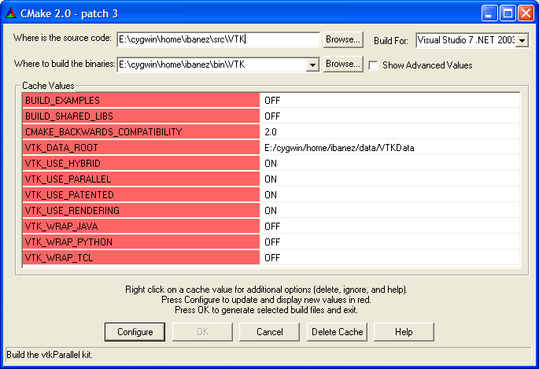
Step 2. Configuring VTK

Slide 8
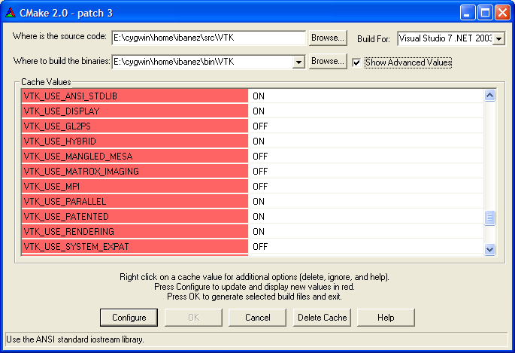
Step 2. Configuring VTK
Advanced variables

Slide 9
Step 2. Configuring VTK
Disable BUILD_EXAMPLES
Disable BUILD_SHARED
Disable BUILD_TESTING
Enable VTK_USE_ANSI_STDLIB
Enable VTK_USE_HYBRID
Enable VTK_USE_RENDERING
Enable VTK_USE_PATENTED

Slide 10
Step 2. Configuring VTK
leave unchanged CMAKE_CXX_FLAGS
leave unchanged DART_ROOT
leave unchanged VTK_DATA_ROOT
leave unchanged
CMAKE_BACKWARD_COMPATIBILITY

Slide 11
Step 3. Build VTK
Open VTK.dsw in the Binary Directory
Select ALL_BUILD project
Build it
…It will take about 90 minutes …

Slide 12
Step 4. Verify the Built
Libraries and test Executables
will be found in
VTK_BINARY / bin / { Debug, Release }

Slide 13
Step 4. Verify the Built
The following libraries should be there
vtkCommon
vtkFiltering
vtkImaging
vtkGraphics
vtkHybrid
vtkParallel
vtkPatented
vtkexpat
vtkfreetype
vtkftgl
vtkjpeg
vtkpng
vtktiff
vtkzlib

Slide 14
Starting your own project with ITK + VTK
Create a clean new directory
Write a CmakeLists.txt file
Write a simple .cxx file
Configure with CMake
Build
Run

Slide 15
Step 5. Writing CMakeLists.txt
PROJECT( myProject )
FIND_PACKAGE ( ITK )
IF ( ITK_FOUND )
INCLUDE( ${USE_ITK_FILE} )
ENDIF( ITK_FOUND )
FIND_PACKAGE ( VTK )
IF ( VTK_FOUND )
INCLUDE( ${USE_VTK_FILE} )
ENDIF( VTK_FOUND )
(continue...)

Slide 16
Step 5. Writing CMakeLists.txt
(continue...)
INCLUDE_DIRECTORIES(
${myProject_SOURCE_DIR}
)
ADD_EXECUTABLE( myProject myProject.cxx )
TARGET_LINK_LIBRARIES ( myProject
ITKBasicFilters ITKCommon ITKIO
vtkRendering vtkGraphics vtkHybrid
vtkImaging vtkIO vtkFiltering vtkCommon
)

Slide 17
Step 6. Writing myProject.cxx
ITK
VTK
ITK
Reader
ITK to VTK
ImageFilter
VTK
ImageViewer
VTK
Render
Window
Interactor

Slide 18
Step 6. Writing myProject.cxx
#include "itkImage.h"
#include "itkImageFileReader.h"
#include "itkImageToVTKImageFilter.h"
#include "vtkImageViewer.h"
#include "vtkRenderWindowInteractor.h"
int main( int argc, char **argv ) {
typedef itk::Image< unsigned short, 2 > ImageType;
typedef itk::ImageFileReader<ImageType> ReaderType;
typedef itk::ImageToVTKImageFilter< ImageType> FilterType;
ReaderType::Pointer reader = ReaderType::New();
FilterType::Pointer connector = FilterType::New();

Slide 19
Step 6. Writing myProject.cxx
reader->SetFileName( argv[1] );
connector->SetInput( reader->GetOutput() );
vtkImageViewer * viewer = vtkImageViewer::New();
vtkRenderWindowInteractor * renderWindowInteractor =
vtkRenderWindowInteractor::New();
viewer->SetupInteractor( renderWindowInteractor );
viewer->SetInput( connector->GetOutput() );
viewer->Render();
viewer->SetColorWindow( 255 );
viewer->SetColorLevel( 128 );
renderWindowInteractor->Start();
return 0;
}

Slide 20
Exercise 19

Slide 21
ITK Image To VTK Image
ITK
VTK
itk::VTKExport
vtkImport
vtkImageData
itk::Image

Slide 22
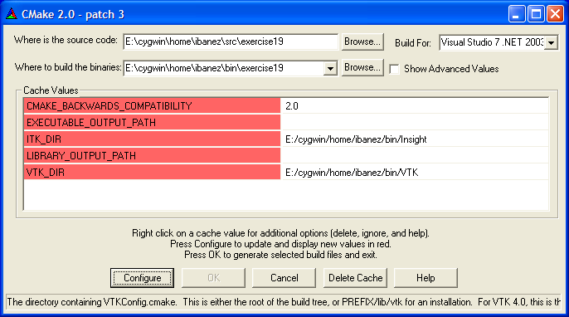
Step 7. Configure with CMake

Slide 23
Step 7. Configure with Cmake
Set ITK_DIR to the
binary directory where ITK was built
Set VTK_DIR to the
binary directory where VTK was built

Slide 24
Step 7. Configure with CMake
Leave Unchanged
EXECUTABLE_OUTPUT_PATH
LIBRARY_OUTPUT_PATH
CMAKE_BACKWARDS_COMPATIBILITY

Slide 25
Step 8. Build Sample Project
Open myProject.dsw
generated by CMake
Select ALL_BUILD project
Build it
…It will take about 30 seconds …

Slide 26
Step 9. Run the example
Locate the file myProject.exe
Run it with a 2D image as argument
myProject.exe BrainSlice.png
It should display the image in a window

Slide 27
Step 10. Add more ITK
ITK
Reader
ITK
VTK
ITK
CurvatureFlow
ImageFilter
ITK to VTK
ImageFilter
VTK
ImageViewer
VTK
Render
Window
Interactor

Slide 28
Step 10. Add more ITK
#include "itkSmoothingRecursiveGaussianImageFilter.h"
...
typedef itk::Image< unsigned short , 2 > ImageType;
...
typedef itk::SmoothingRecursiveGaussianImageFilter<
ImageType, ImageType > SmoothingFilterType;
SmoothingFilterType::Pointer smoother = SmoothingFilterType::New();
smoother->SetInput( reader->GetOutput() );
connector->SetInput( smoother->GetOutput() );
viewer->SetInput( connector->GetOutput() );
smoother->SetSigma( 3.0 );
smoother->SetNormalizeAcrossScale( true );
...

Slide 29
Step 11. Run with more ITK
This code is in Example19
Configure with Cmake
Open the project and build it
Locate the executable
Run it with a 2D image
myProjectAnswer.exe BrainSlice.png
It should display the smoothed image

Slide 30
Enjoy ITK + VTK !

