Slide 1

Pipeline specific instructions for :MultiModalityRigidRegistration.module
  Laboratory of NeuroImaging
  UCLA

Slide 2
After Loading Module

Slide 3

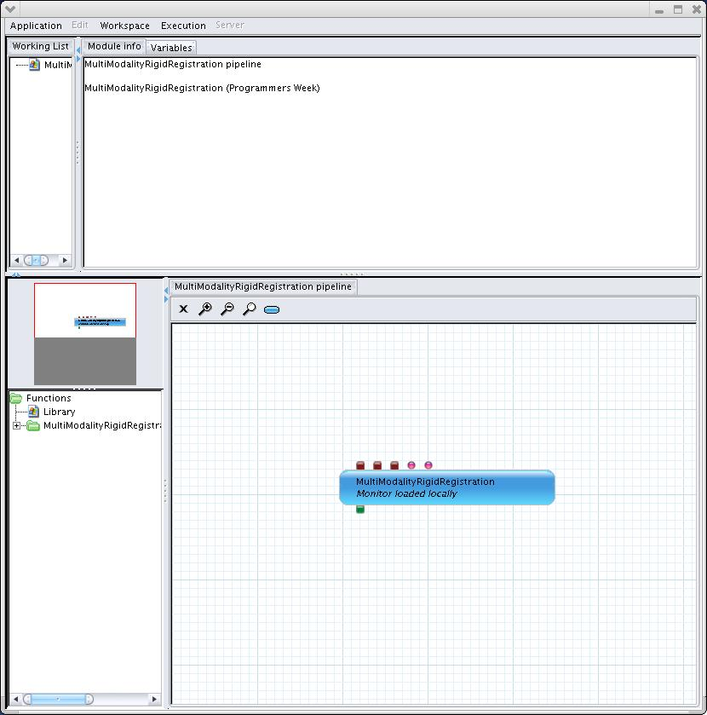

Slide 4
Changing the URL for executable

Slide 5
Right-Click anywhere on Module to Edit

Slide 6
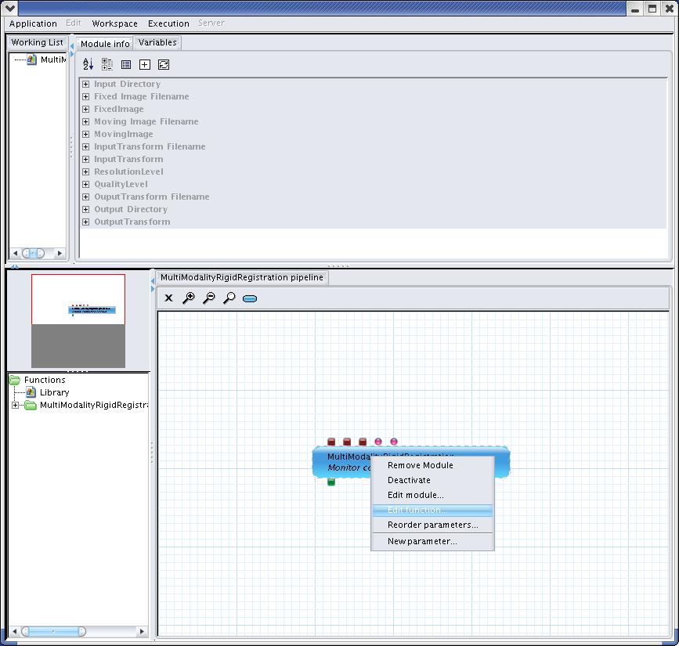

Slide 7
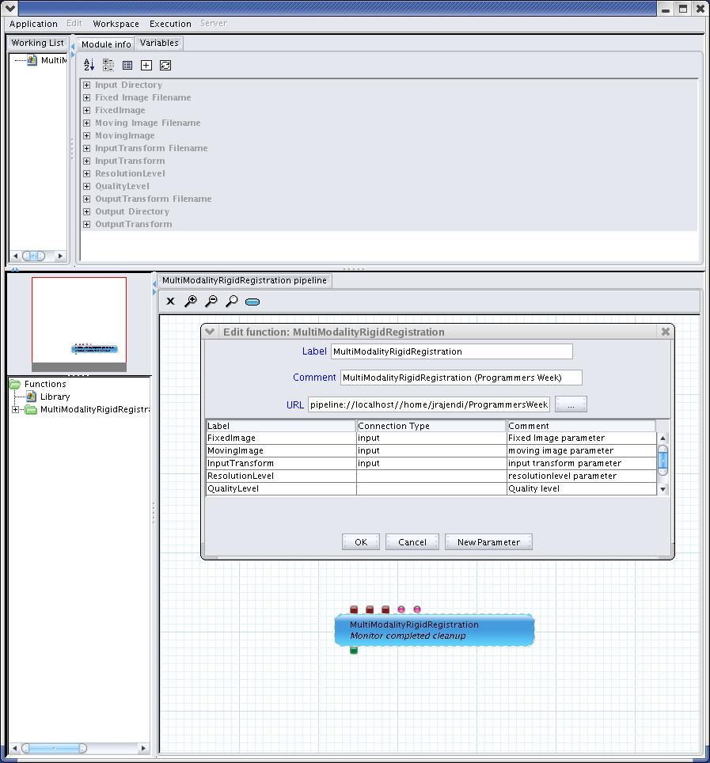


Slide 8
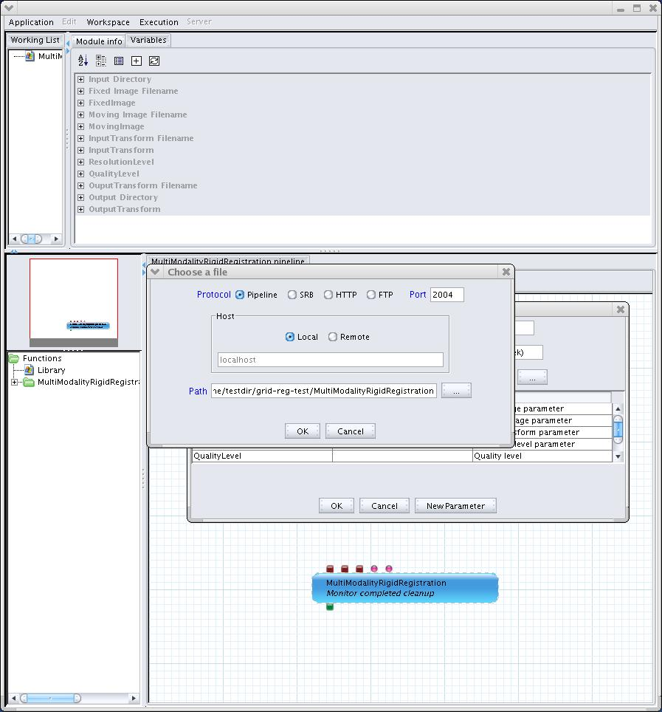

Slide 9
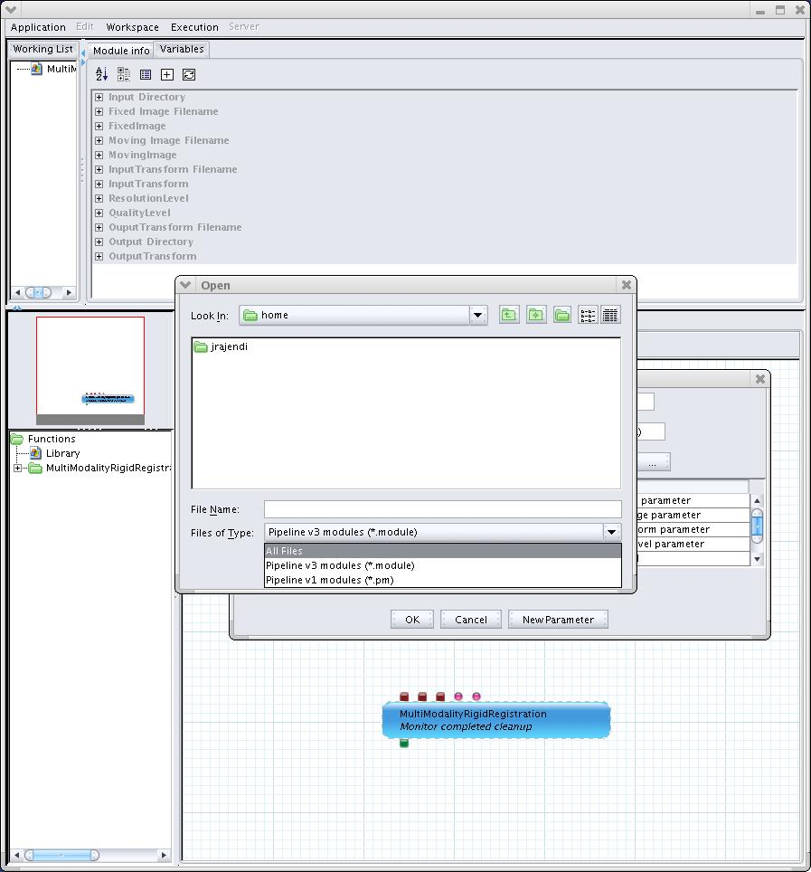

Slide 10
Editing the URL for Variable named
'Input Directory'

Slide 11
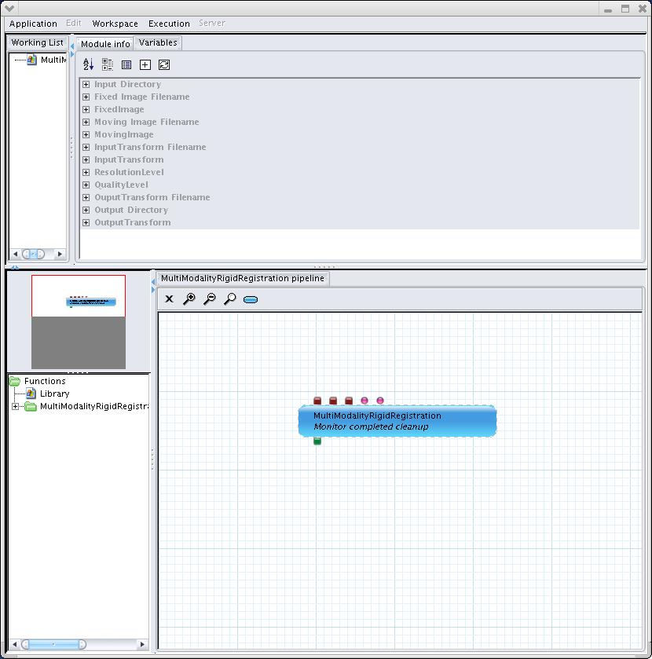
Variables Tab

Slide 12
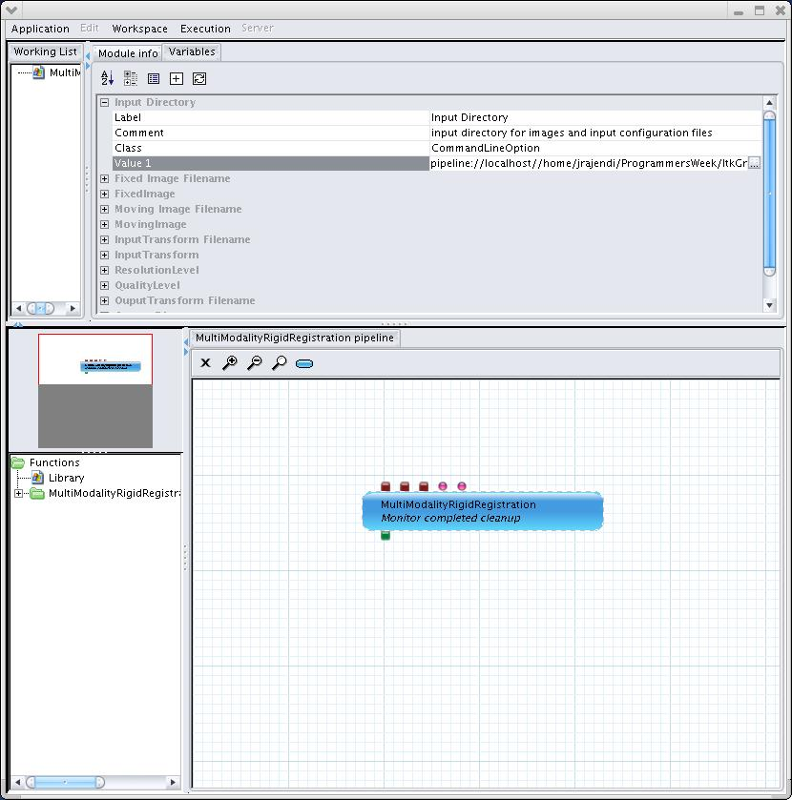
Click on + to Expand
Click on Right Column (for ) field: 'Value 1'
Click on enabled-
ellipsis at the end

Slide 13
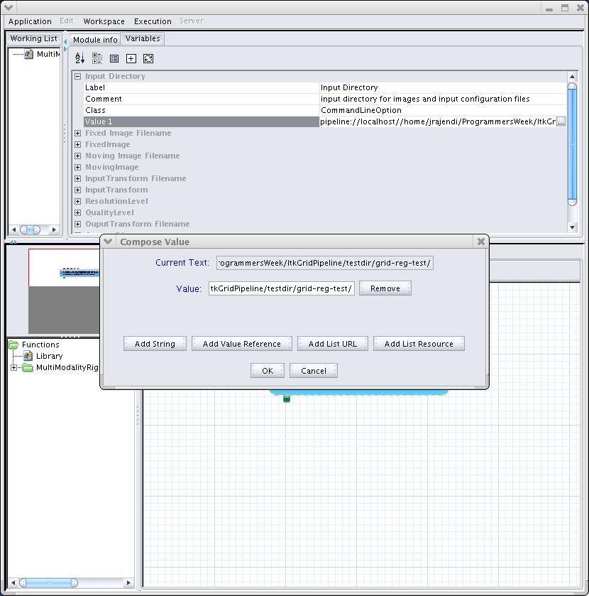

Slide 14
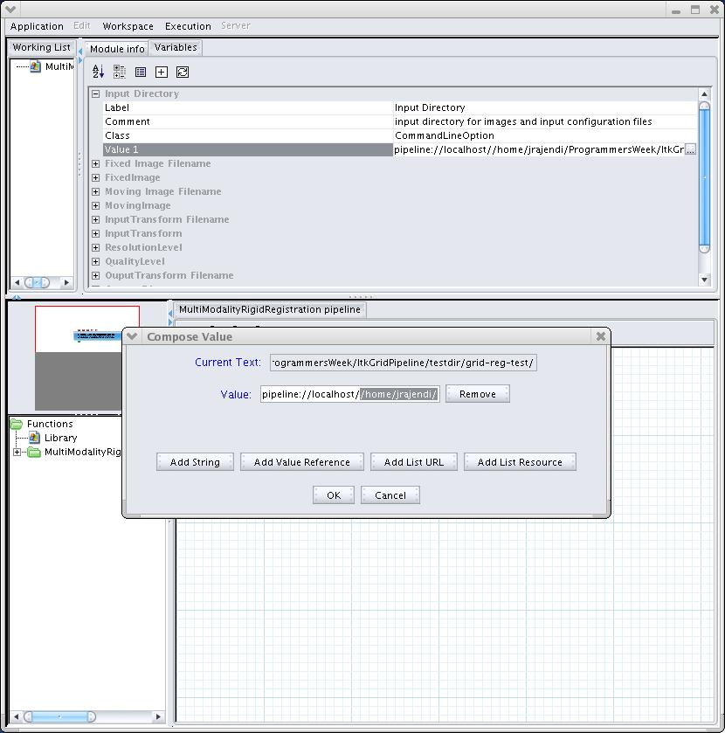
Replace /home/jrajendi... (shown in gray) with path containing input files (*.img and *.nhdr files)
Make sure you leave
'pipeline://localhost/' untouched

Slide 15
Editing the URL for Variable named
'Output Directory'

Slide 16
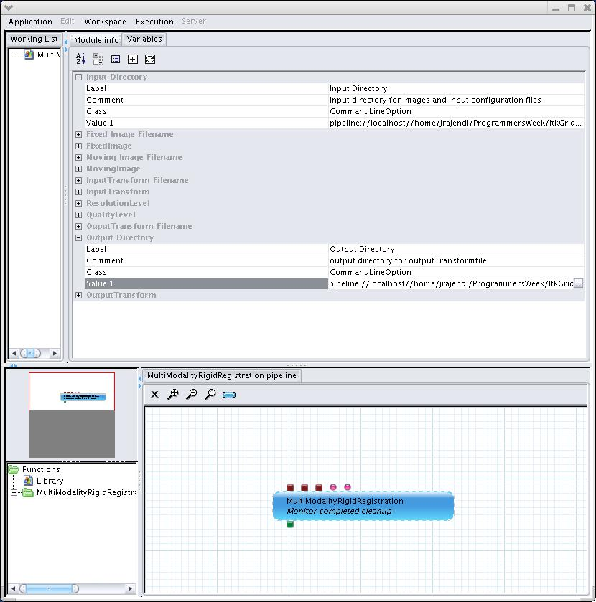
Replace /home/jrajendi... (shown in gray) with path to output directory (*.nrrd files)
Make sure you leave
'pipeline://localhost/' untouched

Slide 17
Execute and Run

Slide 18
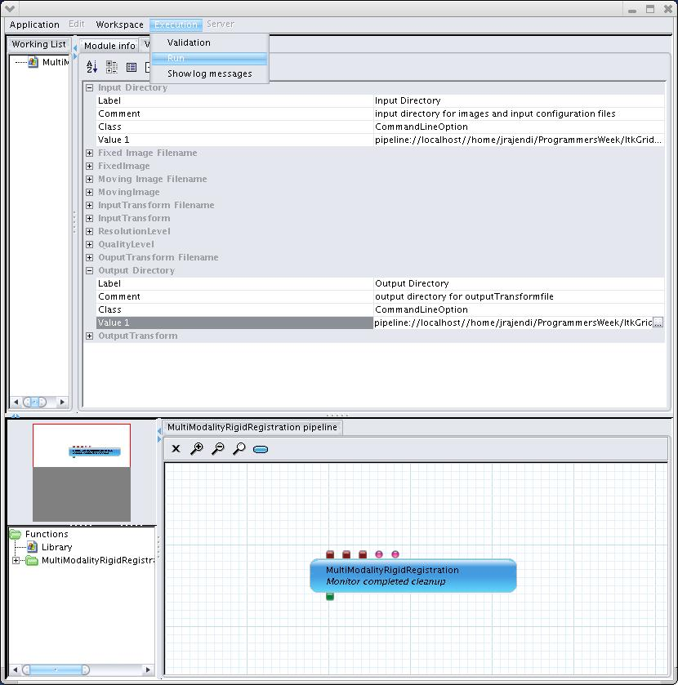

Slide 19
Final State (Execution is complete)

Slide 20
