Slide 1




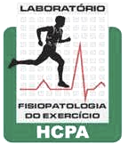
Federal University of Rio Grande do Sul
Graduation Program on Cardiology and Cardiovascular Sciences
Hospital de Clinicas de Porto Alegre
Exercise Pathophysiology Laboratory
Quality of reporting on case report and case series
The CARE Guideline and an analysis of DKA under SGLT2i regimen on diabetes mellitus.
Lucas Helal
Open Science Framework: osf.io/6xzyf
GitHub: https://github.com/lhelal
lucas.helal@ufrgs.br

Slide 2
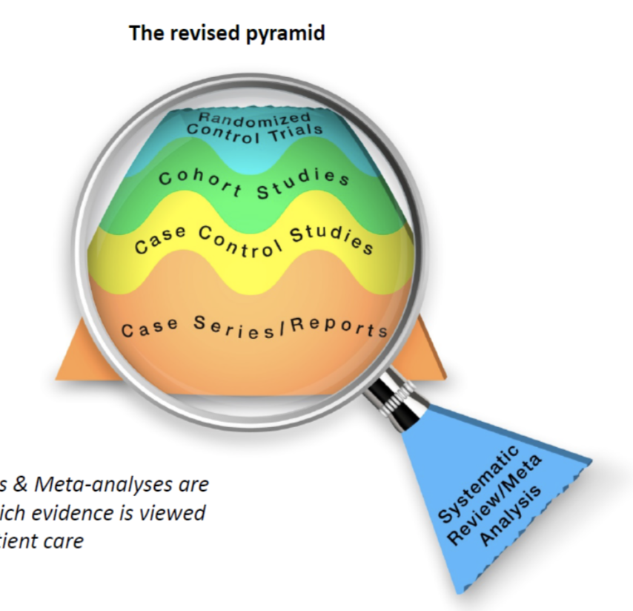
The CARE Guideline
What is a case report/series and what is it for?
Case report: detailed and narrative → description of a medical problem experienced by one or several patients
To generate hypothesis
To appraise rare diseases
To address specific events
To communicate an unusual clinical situation
Gagnier JJ, Kienle G, Altman DG, Moher D, Sox H, Riley D and the CARE Group. J Med Case Reports. 2013,7:223.

Slide 3
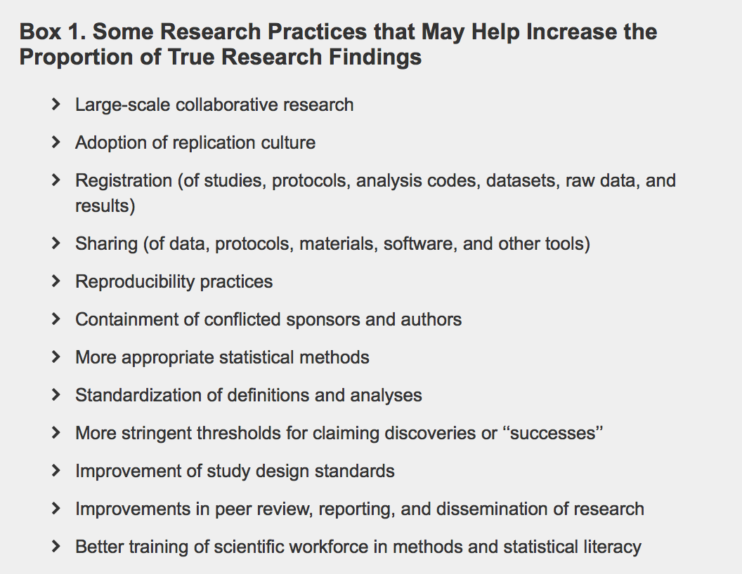
The CARE Guideline
Why the most published findings are false and how to make more research true?
Ioannidis JP. PLoS Med, 2014;11(10):e1001747.
Ioannidis JP. PLoS Med, 2005;e10013453.

Slide 4
The CARE Guideline
Quality of reporting on case reports/series designs
Low prevalence:
Co-morbidity conditions, patient’s medications, co-interventions, side effects, generalizability (Richason et al., 2009)
Patients medical history, co-morbitidy, previous treatment, drug dosage, prognostic variables (Kaszkin-Bettag et al., 2012)
Quality of reporting works:
When mandatory → reporting improved (Turner et al., 2012)
Case reports/series:
Lack of literature
Turner L, Shamseer L, Altman D, Schulz KD, Moher D. Does the use of the CONSORT Statement impact the completeness of reporting of randomized controlled trials published in medical journals? A Cochrane Review. Syst Rev, 2012;60.
Richason TP, Paulson SM et al. Case reports describing treatments in the emergency medicine literature: missing and misleading information. BMC Emerg Med, 2009;9:10.
Kaszkin-Bettag M, Hildebrandt W. Case reports on cancer therapies: the urgent need to improve the reporting quality. Glob Adv Health Med, 2012;1(2):8-10.

Slide 5
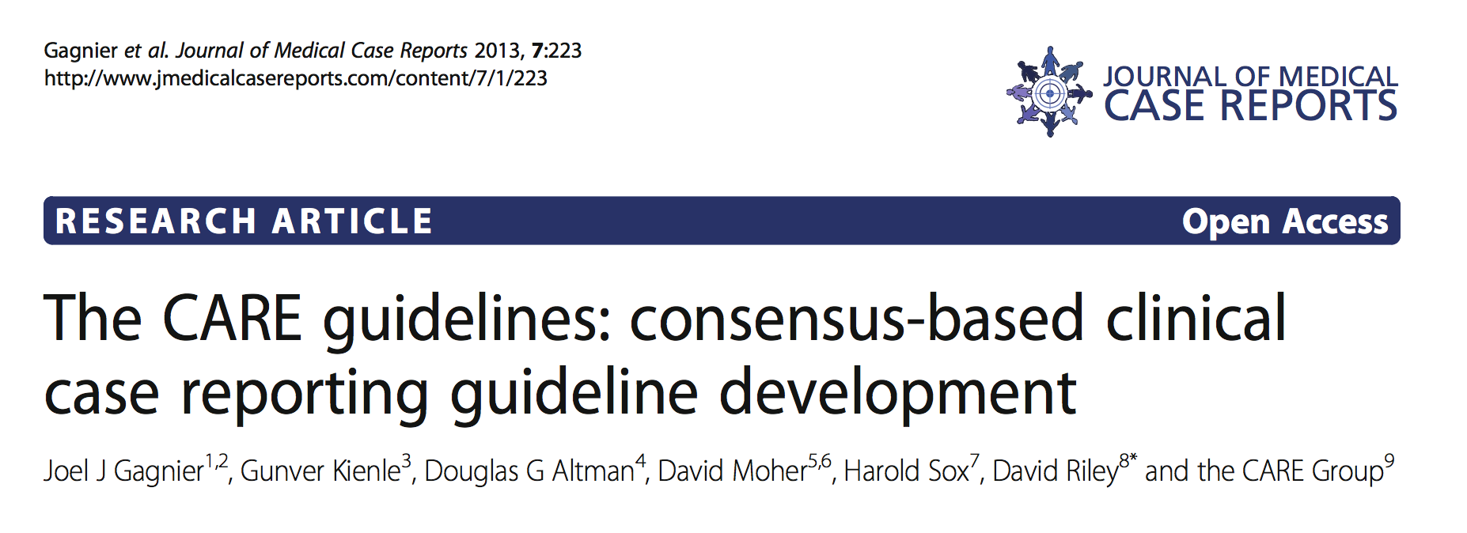
The CARE Guideline
CAse REport guide
Gagnier JJ, Kienle G, Altman DG, Moher D, Sox H, Riley D and the CARE Group. J Med Case Reports. 2013,7:223.

Slide 6
The CARE Guideline
CAse REport guide – core components
Key components
Objectively identifiable
Subjectively identifiable
Item #1 – Case report/series on title
Item #4 – Introduction refering relevant medical literature
Item #2 – Keywords
Item #3 – Structured abstract
Item #6 – Relevant physical examination findings
Item #5 – Patient information
Item #8 – Diagnostic assessment
Item #7 – Timeline and important dates and times
Item #9 – Therapeutic intervention
Item #10 – Follow-up and outcomes
Item #11 – Discussion
Item #12 – Patient perspective
Item #13 – Informed consent
Umpierre D, Helal L, Bock PB, Santos LP. Adherence to CONSORT items on physical activity randomized clinical trials on top 5 sports medicine literature journals, 2017. (under submission)
Gagnier JJ, Kienle G, Altman DG, Moher D, Sox H, Riley D and the CARE Group. J Med Case Reports. 2013,7:223.

Slide 7
The CARE Guideline
CAse REport guide – Delphi-based development process
After recognizing the need for a guideline (step 1):
2
3
4
5
#2: Pre-meeting activities: review literature, identify researchers, receive suggestions by phone (blind)
#3: Face-to-face meeting: appraise blinded suggestions, discuss open-label suggestions, build a draft, discuss publications and autorship
#4: Post-meeting activities: Develop the statement, test the checklist, develop publication strategy
#5: Post-publication activities: translate into other languages, evaluate adherence, consider updatings.
Moher D, Schulz KF, Simera I, Altman DG. Guidance for developers of health research reporting guidelines. PLoS Med, 7(2), 2010

Slide 8
The CARE Guideline
CAse REport guide – limitations
Focused on core reporting items not related to causality – case report
Despite methodized, it is still expert-based opinion
Disclosures, de-identification of patient, IRB approval → consider to be addressed previously by journals
Moher D, Schulz KF, Simera I, Altman DG. Guidance for developers of health research reporting guidelines. PLoS Med, 7(2), 2010

Slide 9
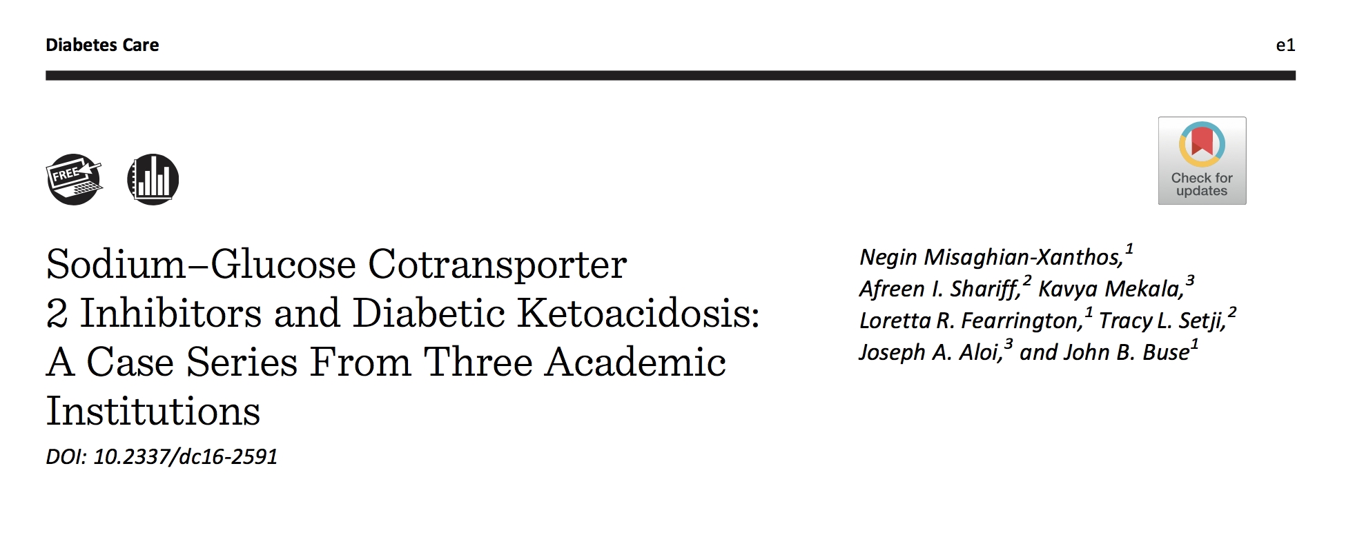
The CARE Guideline
CAse REport guide – appraising Misaghian-Xanthos et al., 2016
Case series
DKA on SGLT2i regimen
Multi-institution
Misaghian-Xanthos N, Shariff AI, Mekala K et al. Sodium-glucose cotransporter 2 inhibitors and diabetic ketoacidosis: a case-series from three academic institutions. Diabetes Care, 2017.

Slide 10
YES
NO
NO
NO
NO
NO
YES
YES
YES
YES
YES
YES
YES
YES
NO
NO
NO
YES
YES
NO
YES
YES
NO
YES
YES
NO
YES
YES
NO/NOT APPLICABLE
UNCLEAR

Slide 11
Federal University of Rio Grande do Sul
Graduation Program on Cardiology and Cardiovascular Sciences
Hospital de Clinicas de Porto Alegre
Exercise Pathophysiology Laboratory
Quality of reporting on case report and case series
The CARE Guideline and an analysis of DKA on SGLT2i regimen.
Lucas Helal
Open Science Framework: osf.io/6xzyf
GitHub: https://github.com/lhelal
lucas.helal@ufrgs.br

