Slide 1
An Overview of (some) Active-object Languages
Ludovic Henrio – CNRS/I3S – Scale project (Sophia Antipolis -- France) FM4CPS Workshop – Sophia Antipolis
Sept 2017

Slide 2
Introduction
Actors and active objects
Programming languages for distributed and concurrent systems
Safe and easy programming
About this talk:
Presentation “by feature” rather than “by language”
Not all combinations of features are possible or interesting

Slide 3
Actors and Active Objects General Principles

Slide 4


Principles
……….
……
……
…….
……..
……….
……
……
…….
……..
An actor does one thing at a time.
No parallelism inside an actor.
Erlang
Rebecca
Jcobox
ProActive/ASP
Akka
……….
……
……
…….
……..
Encore
……….
……
……
…….
……..
Salsa
ABS
Creol
Joelle
Orleans
Scala actors

Slide 5

Principles: actor communication
……….
……
……
…….
……..
……….
……
……
…….
……..

Slide 6
Principles: replying to an external request
I will reply later
Here is the result
Future
……….
……
……
…….
……..
……….
……
……
…….
……..

Slide 7
Actors or active objects?
Actors were here first
Active objects can be seen as an adaptation of the actor model to OOP:
Communication = method invocation
Use future to deal with method result
Nowadays the distinction is much less clear, e.g.:
Akka has both actors and active objects (OO language)
« Akka Typed Actors is an implementation of the Active Objects pattern. Essentially turning method invocations into asynchronous dispatch …. »
ABS
Here: focus on active objects (mostly)
Notes:
TODO: add usual shift of terminology :
message send = method invocation
Service
Object = actor
Method result = future

Slide 8
Criteria 1: Which Objects are Active? Have a « thread »? Can be accessed from any object?

Slide 9
1 – ALL objects are actors (uniform model)
AO A
AO B
Creol, Rebeca, …
Actors do not share memory
Used in modelling languages / verification tools
A lot of parallelism
Very convenient abstraction
Scaling might be an issue (non-trivial implementation)
Data localisation?

Slide 10
2 - Some objects are active, other passive (non-uniform)
ProActive, Joelle
No data shared
Closed to real implementation, programmer can control granularity, convenient for distribution (RMI)
Consistency issues, useless copies can be inefficient
Request invocation
α
β
result=beta.foo(b)
foo
ASP

Slide 11
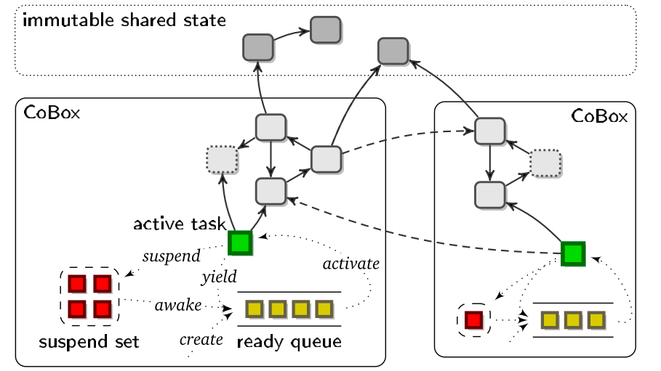
3 – Object groups (COGs / Cobox / …)
Jcobox, ABS
All objects are accessible from any objects,
They receive asynchronous invocations
All objects in the same Cobox/COG share a single thread
a single object is active at a time (in a cog)
JCobox
Convenient abstraction, easy reasoning
no problem of consistency
Scaling might be an issue (non-trivial implementation)
Distribution is difficult (addressing)

Slide 12
Criteria 2: What happens inside an activity?

Slide 13
1 – One thread at a time, non-interrupted
ProActive, Rebeca, actors
The handling of a message runs until completion
Easy to reason about (no interleaving),
The local behaviour is sequential
Can deadlock if any other form of synchronization (e.g. futures)
……….
……
……
…….
……..

Slide 14
2 - Cooperative multithreading
Creol, ABS, and Jcobox
All requests served at the same time
But only one thread active at a time
Explicit release points in the code (await for a future)
More difficult to program: less transparency
More or less deadlock-free if programmed “correctly”
Possible interleaving of thread (no data-race but local race-conditions)
Complex race-conditions if not programmed “correctly”
JCobox
Conflict!

Slide 15
3 – Local multithreading
IDEA: partially remove the single-threaded constraint of the actor model:
Allow the creation of several threads inside an actor
Controlled and localised parallelism
Two directions
Parallel service of requests
Intra-request parallelism

Slide 16
3 – Local multithreading I: Multi-active objects
Mixes local parallelism and distribution
Execute several requests in parallel but in a controlled manner (compatibility)
Efficient local parallelism(less copy)
less deadlocks (blocked threads)
Data races possible, if wrong compatibility
The programmer defines compatibility annotations
join()
Provided add, add and monitor are compatible
add() {
…
}
add() {
…
… }
monitor(){…
… }
MultiASP

Slide 17
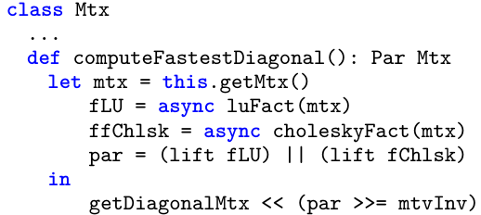
3 – Local multithreading II: Parallel combinators in Encore
Collection of asynchronous operations and values
With synchronisation and parallel primitives to compose them (pipeline, combine and compose parallel workflows)
Some local parallelism restricted to synchronisation aspects (~skeletons); inside a single message handling
Add rich synchronization patterns
Well integrated with active objects: futures, asynchronous mehtod calls
Multithreading is more
restricted than multiactive
objects
Encore

Slide 18
Criteria 3: Operations available on Futures

Slide 19
Futures in actors?
Originally, in actors, there is no “future”
Communication is message sending without result
Sending result is triggered by an explicit callback
No deadlock (no synchronization)
Inversion of control (programming more difficult, no synchronization)
Need to encode the callback
Often futures are added to actor frameworks (e.g. Akka)

Slide 20
Explicit future handling
wait: check + release thread? (cooperative multithreading)
get: access the future value
handle in lambda(fut): A handle component y h x associates a handle y to a future x, so that y can be used to assign a value to x.
COG
COG
obj
A a = new cog A();
B b = new cog B();
b!foo(a);b!foo(a);
obj
obj
obj
obj
obj
ABS
foo(A a) {
Fut<V> vFut = a!bar(p);
await vFut?;
V v = vFut.get;
}
foo(A a) {
Fut<V> vFut = a!bar(p);
await vFut?;
V v = vFut.get;
}

Slide 21
Asynchronous futures
In Encore:
Future chaining
« ~> » registers a callback anonymous function that will be executed when the future is available
In ambientTalk and Akka
No synchronization: a call on a future is an asynchronous invocation / an asynchronous continuation
No deadlock (no synchronization)
Kind of automatic callback
Inversion of control (less intuitive, no synchronization)

Slide 22
Implicit futures
In ProActive
Future created automatically upon asynchronous invocation -- method call on an active object.
No future type
No explicit future operation
First class futures

Slide 23

First Class Futures and wait-by-necessity
ASP
α
β
f
delta.snd(result)
δ
Transparent
Data-flow synchronization: efficient and less deadlocks
Difficult to know where futures are ➔ to find deadlocks
result.check()
WBN

Slide 24
A word on transparency
What can be transparent/explicit?
Asynchronous method calls
o!m() in ABS and Encore – versus o.m()
o.m() in ProActive – is o an active of passive object?
Futures
In ABS: Fut<int> f = o!m() ; await f? ; x=f.get ; x.foo()
In ProActive: x=o.m(); x.foo()

Slide 25
Conclusion: Two results

Slide 26
From Modelling to Systematic Deployment of Distributed Active Objects
Systematic translation of cooperative active objects into multi-threaded active objects
Instantiation on ABS and ProActive specifically
Faithful simulation
Show the expressiveness of multiactive objects
Show the differences between active object languages ≠semantics for future access
SHALLOW TRANSLATION
ABS requests
1
1
MultiASP requests
ABS COGs
1
1
MultiASP activities
ABS objects
1
1
MultiASP objects
+ copies
ABS futures
1
1
MultiASP futures

Slide 27
Deadlock analysis for transparent futures (with Uni Bologna)
Behavioural types were used to statically find deadlocks in ABS
Extension to transparent first-class futures is not trivial
Because of the data-flow nature: an unbound number of method behaviours may have to be unfolded at the synchronization point
We exhibit an analysis for transparent futures
Harder than for explicit futures
Even more useful as deadlocks are more difficult to find manually

Slide 28
Latest news and current/future directions
A survey paper
De Boer, Serbanescu, Hähnle, Henrio, Rochas, Chang Din , Broch Johnsen, Sirjani, Khamespanah, Fernandez-Reyes, Mingkun Yang
To be published in ACM Computing Survey
ABS as a programming language (not only modelisation, more efficient implementations) (CWI + ?)
Encore being developed (Uni Uppsala + others)
Study on the different possible semantics and type systems for futures. (ongoing – I3S)
+ Numerous directions in verification and formal methods (Uni Oslo, Uni Madrid, TUD)

Slide 30
Formalisation: Theorems and Proofs
Theorem #1: The translation simulates all possible ABS executions
Theorem #2: A reduction of the translation corresponds to a valid ABS execution
Proof
Weak simulation
Silent actions (not observable)
MultiASP
Async. call
≈
Sync. call
Async. call
silent
actions
Return sync.
ABS
Assignment

Slide 31
Futures: Dataflow synchronization ≠ explicit (control-flow) synchronization
Restriction for Theorem #1 (The translation simulates all possible ABS executions)
A future value cannot be a future (too strong restriction)
Not observable in MultiASP
Simulation is impossible
In ABS one can observe the end of a method execution, in ASP one can only observe the availability of some data
fut( f, f ’ )
≠
fut( f, ⏊ )
fut( f ’, ⏊ )
ABS fut(name, value)

Slide 32
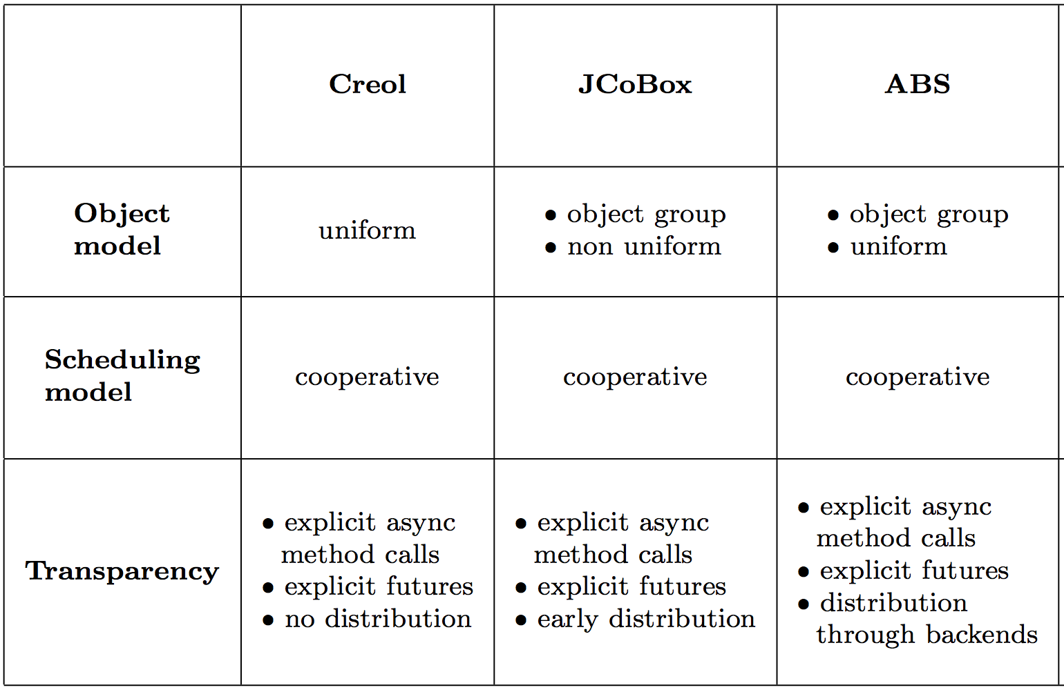
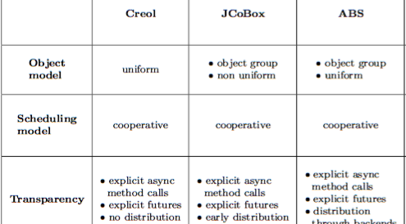

Slide 33
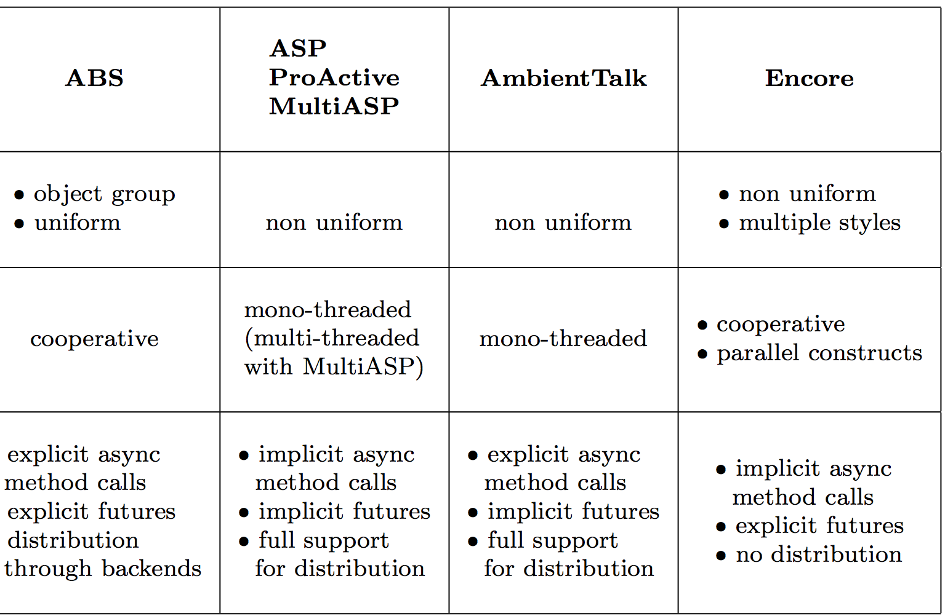

Slide 34
Some dimensions to compare them
Degree of synchronisation: Futures, Communication timing, cooperative scheduling, multi-threading
Degree of transparency: What is exposed to the programmer? Futures, active objects, synchronous vs. Asynchronous invocations
Data sharing and communication

