Slide 1

Multi-threaded Active Objects
Ludovic Henrio, Fabrice Huet, Zsolt Istvàn
June 2013 – Coordination@Florence

Slide 2
Agenda
Introduction: Active Objects
Issues and Existing Solutions
Multi-active Objects: Principles
Experiments and Benchmarks
Conclusion and Future Works

Slide 3
ASP and ProActive
Active objects
Asynchronous method calls / requests
With implicit transparent futures
A beta = newActive (“A”, …);
V foo = beta.bar(param);
…..
foo.getval( );
α
β
f
foo.getval( )
foo.getval( )
foo.getval( )
foo = beta.bar(p)
WBN!!
Caromel, D., Henrio, L.: A Theory of Distributed Object. Springer-Verlag (2005)

Slide 4

First Class Futures
α
β
f
delta.snd(foo)
δ
Active objects are the unit of distribution and concurrency (one thread per AO / no data shared)
ProActive is a Java library implementing ASP

Slide 5
Agenda
Introduction: Active Objects
Issues and Existing Solutions
Multi-active Objects: Principles
Experiments and Benchmarks
Conclusion and Future Works

Slide 6
Active Objects – Limitations
AO1
AO2
No data sharing – inefficient local parallelism
Parameters of method calls/returned values are passed by value (copied)
No data race-condition simpler programming + easy distribution
Risks of deadlocks, e.g. no re-entrant calls
Active object are single threaded
Re-entrance: Active object deadlocks by waiting on itself (except if first-class futures)
Solution: Modifications to the application logic difficult to program
Notes:
No data sharing
* active object location transparent – must pass by value
* even if deploying several AO on a multi-core, still data copy overhead
No re-entrant calls
* deadlocking because of single-threaded nature
* must rewrite application (at least tail recursive)

Slide 7
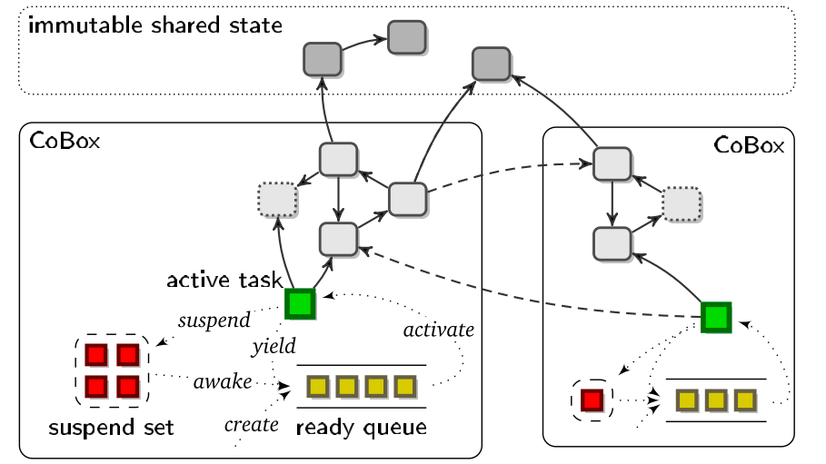
Related Work (1): Cooperative multithreading
Creol, ABS, and Jcobox:
Active objects & futures
Cooperative multithreading
All requests served at the same time
But only one thread active at a time
Explicit release points in the code
can solve the re-entrance problem
More difficult to program: less transparency
Possible interleaving still has to be studied

Slide 8
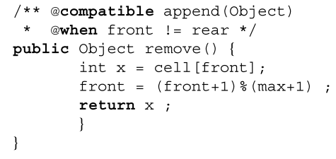
Related Work (2): JAC
Declarative parallelization in Java
Expressive (complex) set of annotations
“Reactive” objects
Simulating active objects is possible but not trivial
Our alternative view: new multithreaded AOs
A simple version of JAC for simple active objects à la ASP ➔ multi-active objects
efficient and easy to program

Slide 9
Agenda
Introduction: Active Objects
Issues and Existing Solutions
Multi-active Objects: Principles
Experiments and Benchmarks
Conclusion and Future Works

Slide 10
Multi-active objects
A programming model that mixes local parallelism and distribution with high-level programming constructs
Execute several requests in parallel but in a controlled manner
join()
Provided add, add and monitor are compatible
add() {
…
}
add() {
…
… }
monitor(){…
… }
Note: monitor is compatible with join

Slide 11
Scheduling Requests
An « optimal » request policy that « maximizes parallelism »:
Schedule a new request as soon as possible (when it is compatible with all the served ones)
Serve it in parallel with the others
Serves
Either the first request
Or the second if it is compatible with the first one (and the served ones)
Or the third one …
Compatibility =
requests can execute at the same time
and can be re-ordered
compatible

Slide 12


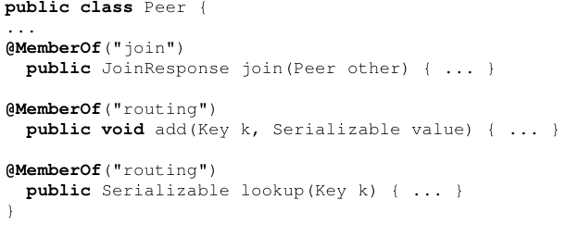
Declarative concurrency by annotating request methods
Groups
(Collection of related methods)
Rules
(Compatibility relationships between groups)
Memberships
(To which group each method belongs)
Notes:
Pairwise relation tedious if many methods.
Inheritance very problematic.

Slide 13
More efficiency: Thread management
Too many threads can be harmful:
memory consumption,
too much concurrency wrt number of cores
Possibility to limit the number of threads
Hard limit: strict limit on the number of threads
Soft limit: prevents deadlocks Limit the number of threads that are not in a WBN

Slide 14
Dynamic compatibility: Principle
Compatibility may depend on object’s state or method parameters
join()
Provided the parameters of add are different
(for example)
add(int n) {
…
}
add(int n) {
…
… }

Slide 15

Dynamic compatibility: annotations
Define a common parameter for methods in a group
a comparison function between parameters (+local state) to decide compatibility
Returns true if requests compatible

Slide 16
Hypotheses and programming methodology
We trust the programmer: annotations supposed correct
static analysis or dynamic checks should be applied in the future
Without annotations, a multi-active object runs like an active object
If more parallelism is required:
Add annotations for non-conflicting methods
Declare dynamic compatibility
Protect some memory access (e.g. by locks) and add new annotations
Easy to program
Difficult to program
More parallelism ➔ More complex code / better performance

Slide 17
Agenda
Introduction: Active Objects
Issues and Existing Solutions
Multi-active Objects: Principles
Experiments and Benchmarks
Conclusion and Future Works

Slide 18
Experiment #1: NAS parallel benchmark
Pure parallel application (Java)
No distribution
Comparison with hand-written concurrent code
Shows that with multi-active objects, parallel code
Is simpler and shorter
With similar performance

Slide 19
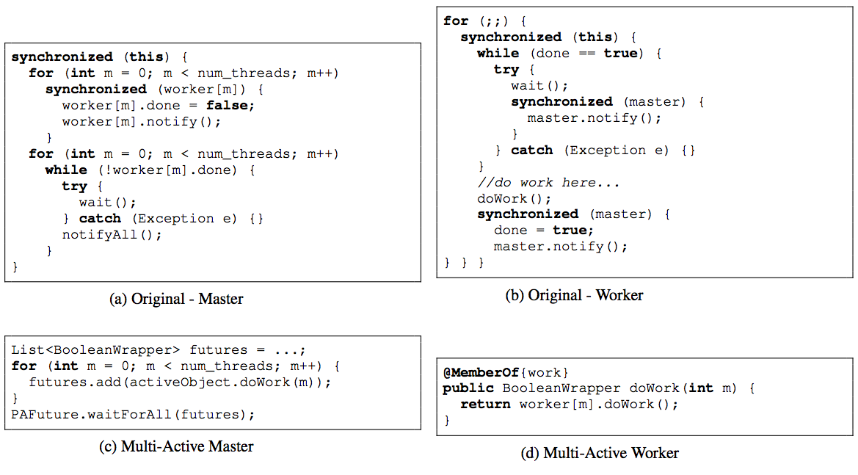
Multi-active objects are simpler to program
Original vs. Multi-active object master/slave pattern for NAS

Slide 20
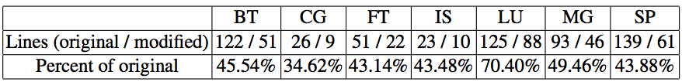
NAS results
Less synchronisation/concurrency code
With similar performances

Slide 21
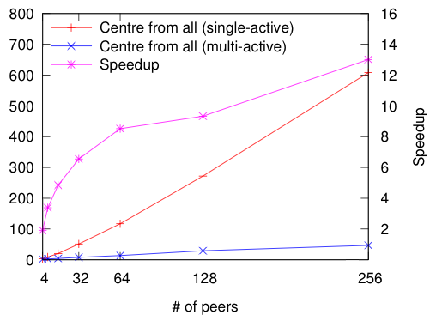
Experiment #2: CAN
Each peer is implemented by a (multi) active object and placed on a machine
Parallel and distributed
Parallel routing

Slide 22
Experiment #2: CAN
Significant speedup due to parallelisation of communications, while controlling which communications are performed in parallel
With only a few annotations !

Slide 23
Agenda
Introduction: Active Objects
Issues and Existing Solutions
Multi-active Objects: Principles
Experiments and Benchmarks
Conclusion and Future Works

Slide 24
Conclusion (1/2): a new programming model
Active object model
Easy to program
Support for distribution
Local concurrency and efficiency on multi-cores
Transparent multi-threading
Simple annotations
Possibility to write non-blocking re-entrant code
Parallelism is maximised:
Two requests served by two different threads are compatible
Each request is incompatible with another request served by the same thread (that precede it)
A programming model for locally concurrent and globally distributed objects

Slide 25
Conclusion (2/2): Results and Status
Implemented multi-active objects above ProActive
Dynamic compatibility rules and thread limitation
Case studies/benchmarks: NAS, CAN
Specified SOS semantics and proved « maximal parallelism »
Next steps:
Use the new model (new use-cases and applications)
Prove stronger properties, mechanised formalisaiton
Static guarantees / verification of annotations

Slide 26
Thank you
Ludovic Henrio, Fabrice Huet, Zsolt Istvàn
Ludovic.henrio@cnrs.fr
Fabrice.huet@inria.fr
zsolt.istvan@gmx.net
NB: The greek subtitles (i.e. the operational semantics) can be found in our paper

Slide 28
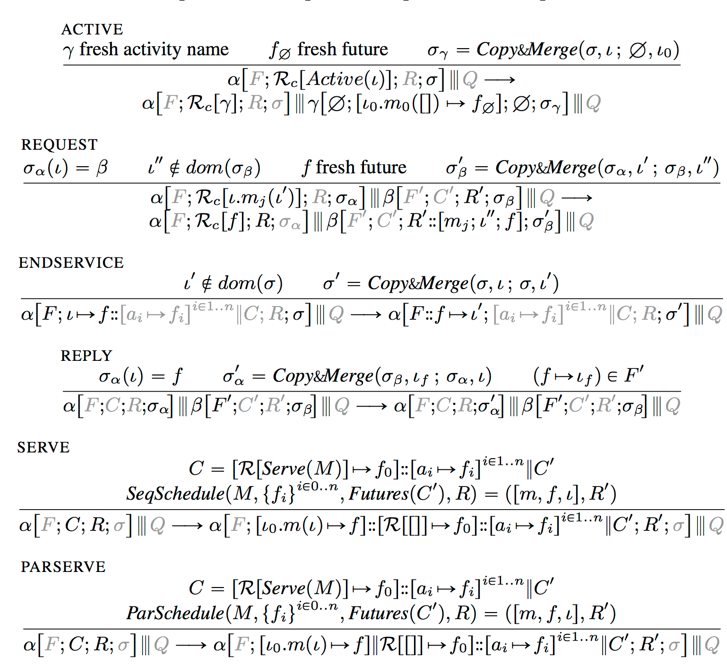

Slide 29
Active Objects
Asynchronous communication with futures
Location transparency
Composition:
An active object (1)
a request queue (2)
one service thread (3)
Some passive objects (local state) (4)
4
1
2
3
Notes:
Active objects
* coarse grained structuring entities of distributed apps.
* part of a design pattern to decouple method invocation from execution
* this is done by the help of asynch calls and futures
* thanks to futures, location is transparent
Internal structure
* request arrives into queue (invocation of method)
* executed one by one on the thread
* plain object is at base

