Slide 1
ASYNCHRONOUS AND DETERMINISTIC OBJECTS
Denis CAROMEL, Ludovic HENRIO, Bernard Paul SERPETTE
ASP: Asynchronous Sequential Processes
Distributed objects
Asynchronous method calls
Futures and Wait-by-necessity
Determinism properties
I3S - INRIA - Univ Nice Sophia-Antipolis

Slide 2
Context
ς-calculus
  Objects, not concurrent
  Some concurrent extensions, not our way to determinism
π-calculus
  Communications, channel based, not object structured
  Linear(ized) channels(πoβλ), no implicit synchronization
Process Networks
  Processes, channel based, not object oriented
  Determinism, no implicit synchronization
Context

Slide 3
Contents
1 - ASP Principles
2 - Syntax and Semantics
3 - Confluence and Determinacy
4 - Conclusion

Slide 4
Structure
α
β
foo
f2
f1
foo
δ
γ
f3
Active(a)
1- ASP Principles

Slide 5
Sending Requests ( REQUEST )
α
β
beta.foo(b)
foo
result=beta.foo(b)
1- ASP Principles

Slide 6

Sending Requests ( REQUEST )
α
β
beta.foo(b)
result
foo
result=beta.foo(b)
1- ASP Principles

Slide 7
Serving Requests ( SERVE )
α
β
Serve(foo);...
beta.foo(b)
result
bar
foo
Serve(foo);...
1- ASP Principles

Slide 8

Serving Requests ( SERVE )
α
β
Serve(foo)
beta.foo(b)
result
foo
...
bar
foo
Serve(foo);...
1- ASP Principles

Slide 9
End of Service ( ENDSERVICE )
α
β
value
...
foo
1- ASP Principles

Slide 10
End of Service ( ENDSERVICE )
α
β
...
foo
1- ASP Principles

Slide 11
Sending Results ( REPLY )
α
β
foo
1- ASP Principles

Slide 12
Sending Results ( REPLY )
α
β
foo
1- ASP Principles

Slide 13
Wait by Necessity
α
β
delta.send(result)
δ
1- ASP Principles

Slide 14
Wait by Necessity
α
β
delta.send(result)
result.bar()
result.bar()
δ
1- ASP Principles

Slide 15
Wait by Necessity
α
β
delta.send(result)
result.bar()
result.bar()
δ
1- ASP Principles

Slide 16
Wait by Necessity
α
β
Futures updates can
occur at any time
result.bar()
δ
1- ASP Principles

Slide 17
Contents
1 - ASP Principles
2 - Syntax and Semantics
3 - Confluence and Determinacy
4 - Conclusion

Slide 18
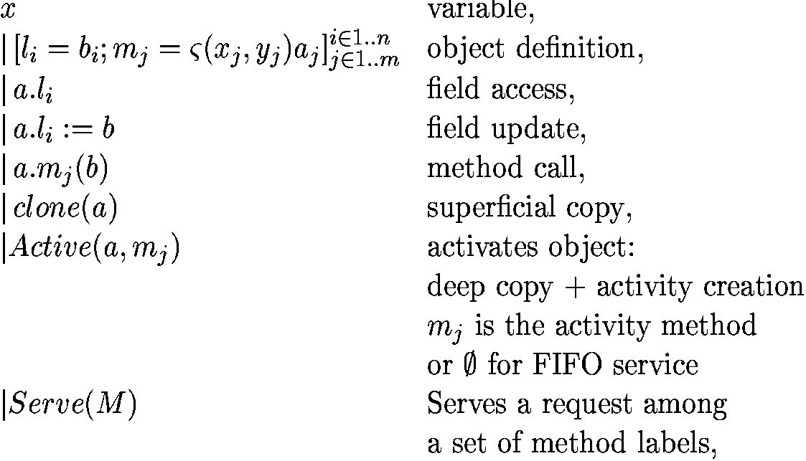

ASP Syntax : source terms
Imperative ς-calculus
ASP parallelism primitives
2- Syntax and Semantics

Slide 19
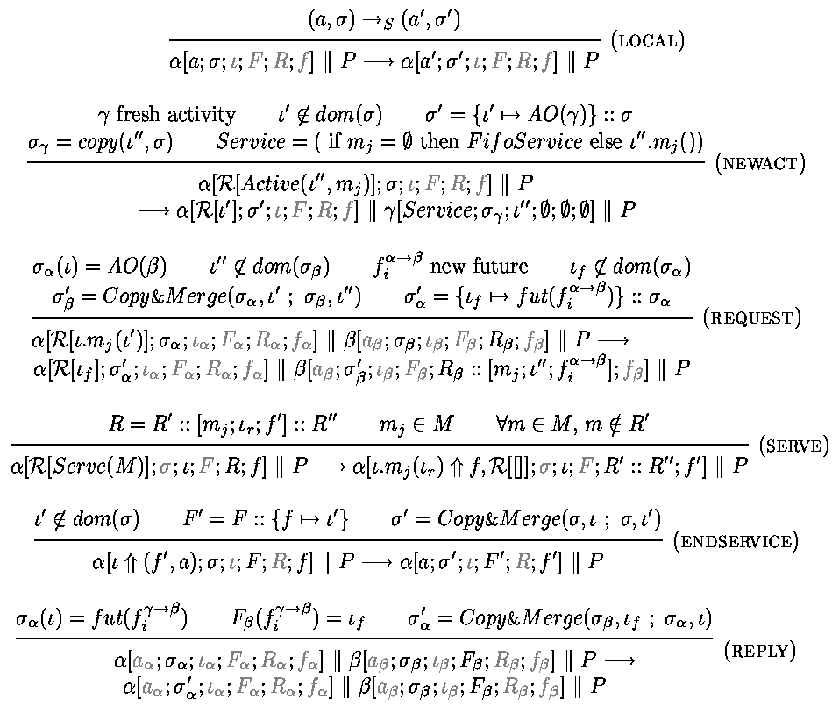
Local
Creating
Activity
Sending
request
Service
Receiving
replies
2- Syntax and Semantics

Slide 20
Contents
1 - ASP Principles
2 - Syntax and Semantics
3 - Confluence and Determinacy
4 - Conclusion

Slide 21

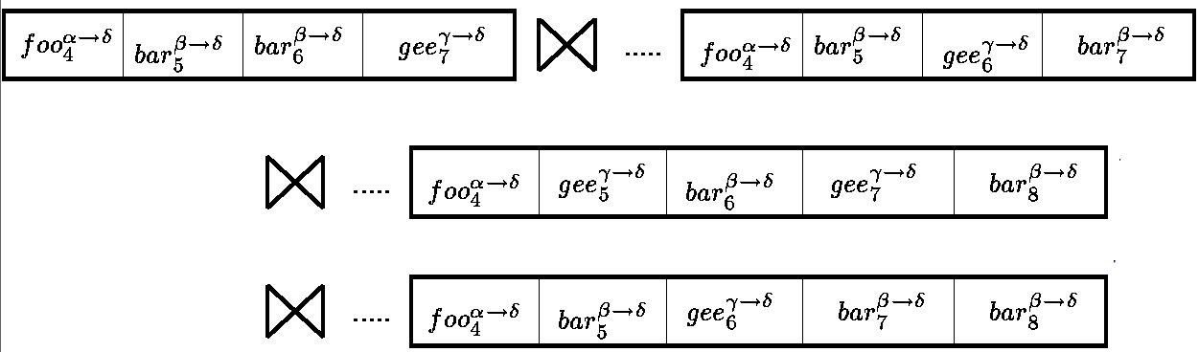
Compatibility
Serves the oldest
request on
foo OR bar
β
bar
δ
….
Serve(foo,bar)
…
Serve(foo,gee)
foo
α
γ
delta.foo()
gee
3- Confluence and Determinacy

Slide 22
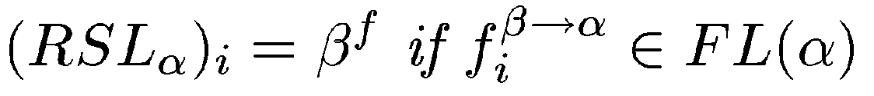
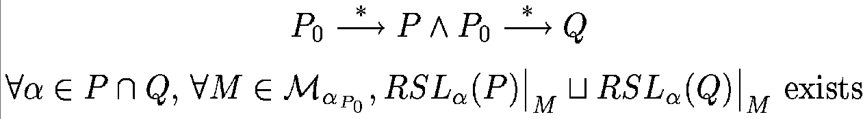
Confluence
P0
P
Q
Potential services:
R
Execution characterized
by the order of Request Senders
RSL definition:
Configuration Compatibility:
Compatibility ⇒ Confluence
3- Confluence and Determinacy

Slide 23
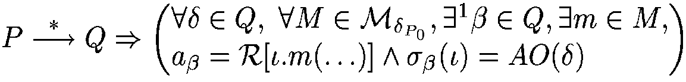
Deterministic Object Networks
γ
β
delta.gee(a)
bar
delta.bar(a)
gee
δ
{foo,bar} , {foo,gee}
{bar,gee} , {foo}
gee bar
bar gee
DON(P):
3- Confluence and Determinacy

Slide 24
Static DON
α
δ
f
{foo,bar} , {gee}
{gee}, {f,g}
{foo,bar} , {gee}
{f,g}
g
g
foo
γ
f
{foo,bar} , {gee}
g
{foo}, {bar}
bar
β
f
ε
{bar} , {gee}
{gee}, {f,g}
{gee}, {f,g}
gee
{gee}, {f,g}
3- Confluence and Determinacy

Slide 25
Contents
1 - ASP Principles
2 - Syntax and Semantics
3 - Confluence and Determinacy
4 - Conclusion

Slide 26
Conclusion
An Asynchronous Object Calculus :
  Structured asynchronous activities
  Structured communications with futures
  Data-driven synchronization
ASP ⇒ Confluence and Determinacy
Future updates can occur at any time
Execution characterized by the order of request senders
Determinacy of programs communicating over trees, …
Thank You
Any Question?
4- Conclusion

Slide 27
Perspectives
Approximation of confluence property
  Static analysis
Generalization of confluence property
  Functional behavior
  Scheduling of requests
Extensions of ASP
  Group communication
  Component calculus
  Mobility and other features

Slide 28
Related Work
Futures and Wait by Necessity:
  MultiLisp by Halstead
  Wait-By-Necessity by Caromel
Determinism:
  ποβλ by Jones, Linearized channels
  Process Networks by Kahn and MacQueen
Objects and concurrency:
  Obliq, Gordon-Hankin-Lassen
  Actors
  π-calculus, blue calculus, join-calculus

Slide 29
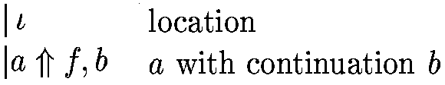



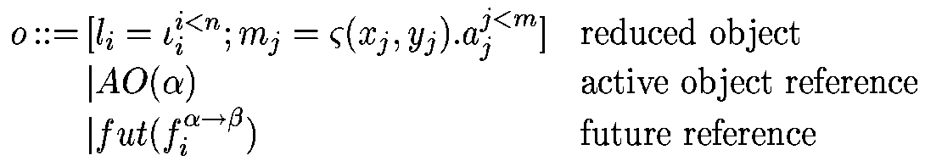
Intermediate Structures
Terms:
Configuration:
Request queue:
Futures list:
Store:

Slide 30
Static DON versus Process Networks
α
δ
f
{foo,bar} , {gee}
{gee}, {f},{g}
{foo,bar} , {gee}
{f},{g}
g
put
g
foo
γ
f
{foo,bar} , {gee}
{foo}, {bar}
bar
β
f
ε
get
{bar} , {gee}
{gee}, {f},{g}
gee
{gee}, {f},{g}

Slide 31
Activity Creation ( NEWACT )
α
γ
Active(a)
newact
β
newact=Active(a)

Slide 32
Objects Topology
α
β
γ
δ

Slide 33
Equivalence Modulo Futures Updates
α
f1
γ
β
f2
f3

Slide 34
More Futures
α
δ
...
result.bar()
γ
β

Slide 35
More Futures
α
δ
result.bar()
γ
β

Slide 36
More Futures
α
δ
result.bar()
γ
β

Slide 37
More Futures
α
δ
result.bar()
γ
β

Slide 38
More Futures
α
δ
Futures updates can
occur at any time
result.bar()
γ
β

Slide 39
Concurrent Constraint Programming
Constraint programming, different notion of store
Shared memory
No internal state in the store (functional agents)
Data-driven / constraint driven synchronization:
  Blocking Ask
Determinate case

Slide 40
Activity Creation ( NEWACT )
α
γ
Active(a,s)
newact=Active(a,s)

Slide 41
Activity Creation ( NEWACT )
α
γ
newact
ao.s()
Active(a,s)
newact=Active(a,s)

Slide 42
Equivalence Modulo Futures Updates
α
α
f1
f1
γ
β
γ
β
f2
f2
f3

Slide 43
Equivalence Modulo Futures Updates
α
α
f2
f1
f1
γ
β
γ
β
f1
f2
f3

Slide 44
Store Partitioning
β

Slide 45
Request Service ( SERVE )
β
Serve(foo)
bar
foo
Serve(foo);...

Slide 46
Request Service ( SERVE )
β
Serve(foo)
foo
...
bar
foo
Serve(foo);...

Slide 47
Objectives
Model of the following features
  Object orientation (activities, communications)
  Asynchronous communications with futures
  Service policy
Confluence and determinacy
  Identify sources of non-determinism
  Characterize equivalent executions
  Give general properties
  Find some properties easy to verify

Slide 48
End Of Service ( ENDSERVICE )
β
value
foo
...
bar

Slide 49
End Of Service ( ENDSERVICE )
β
value
...
foo
...
bar

Slide 50
