Slide 1



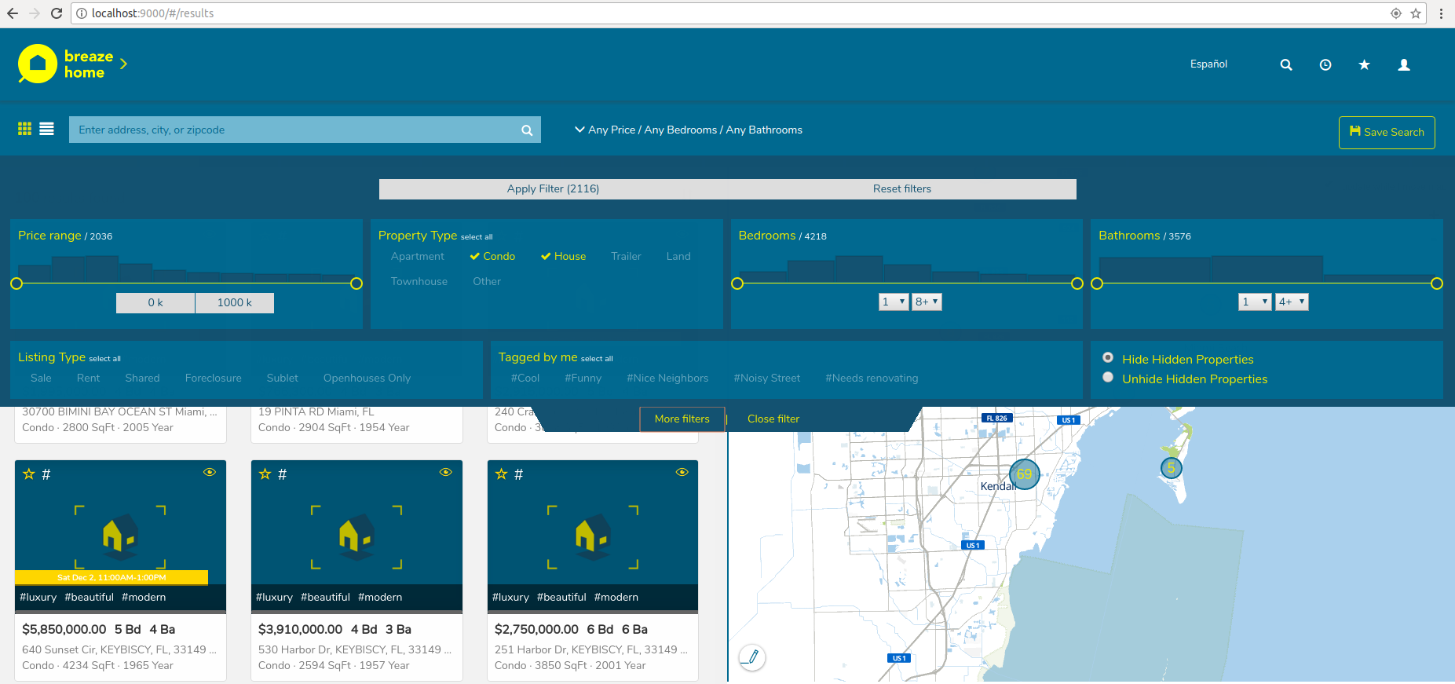
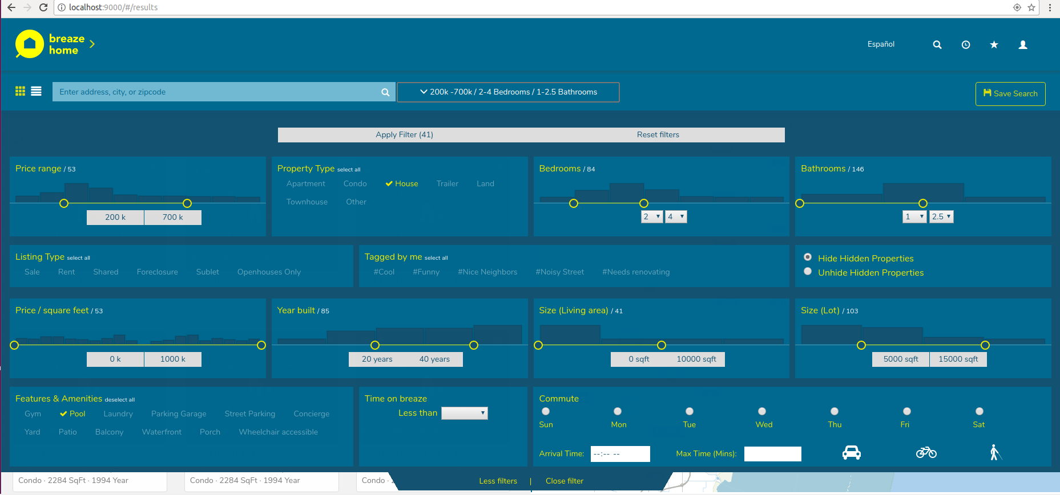


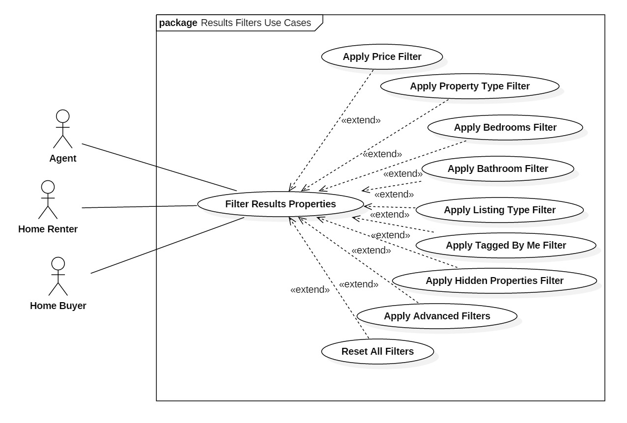
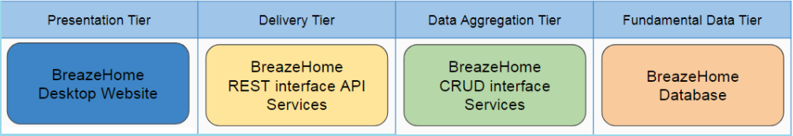
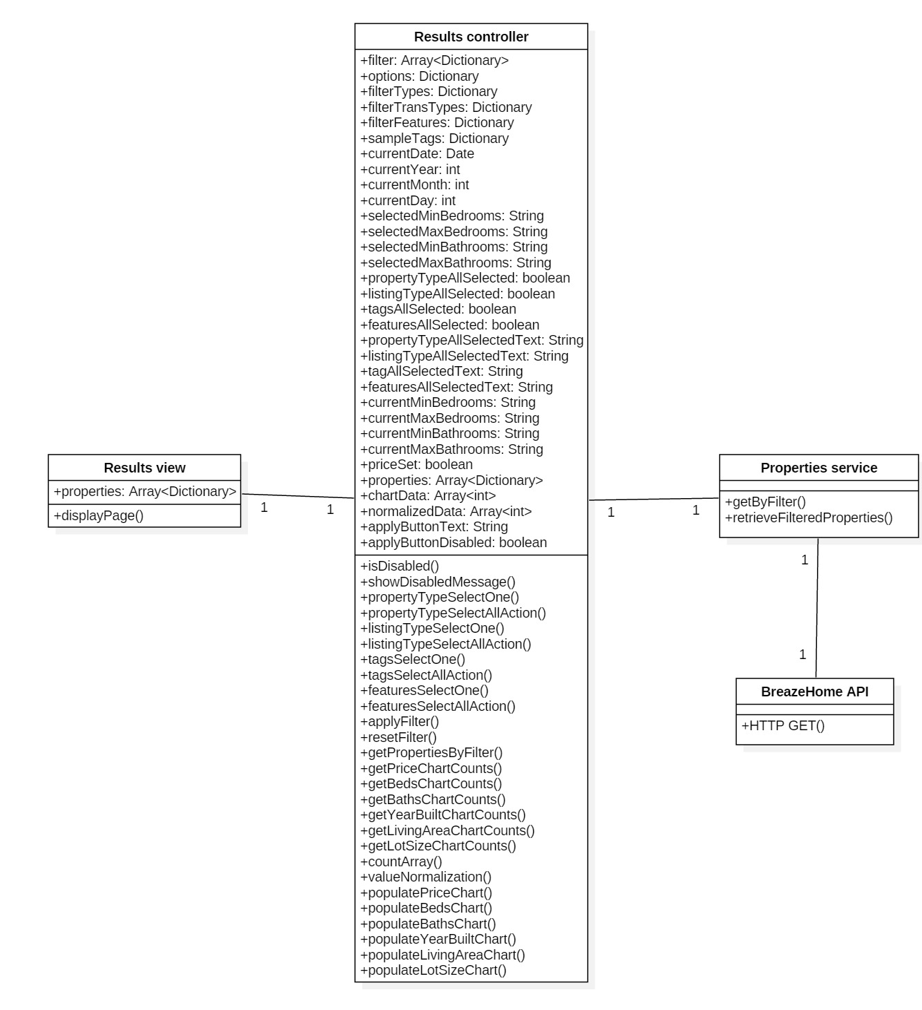
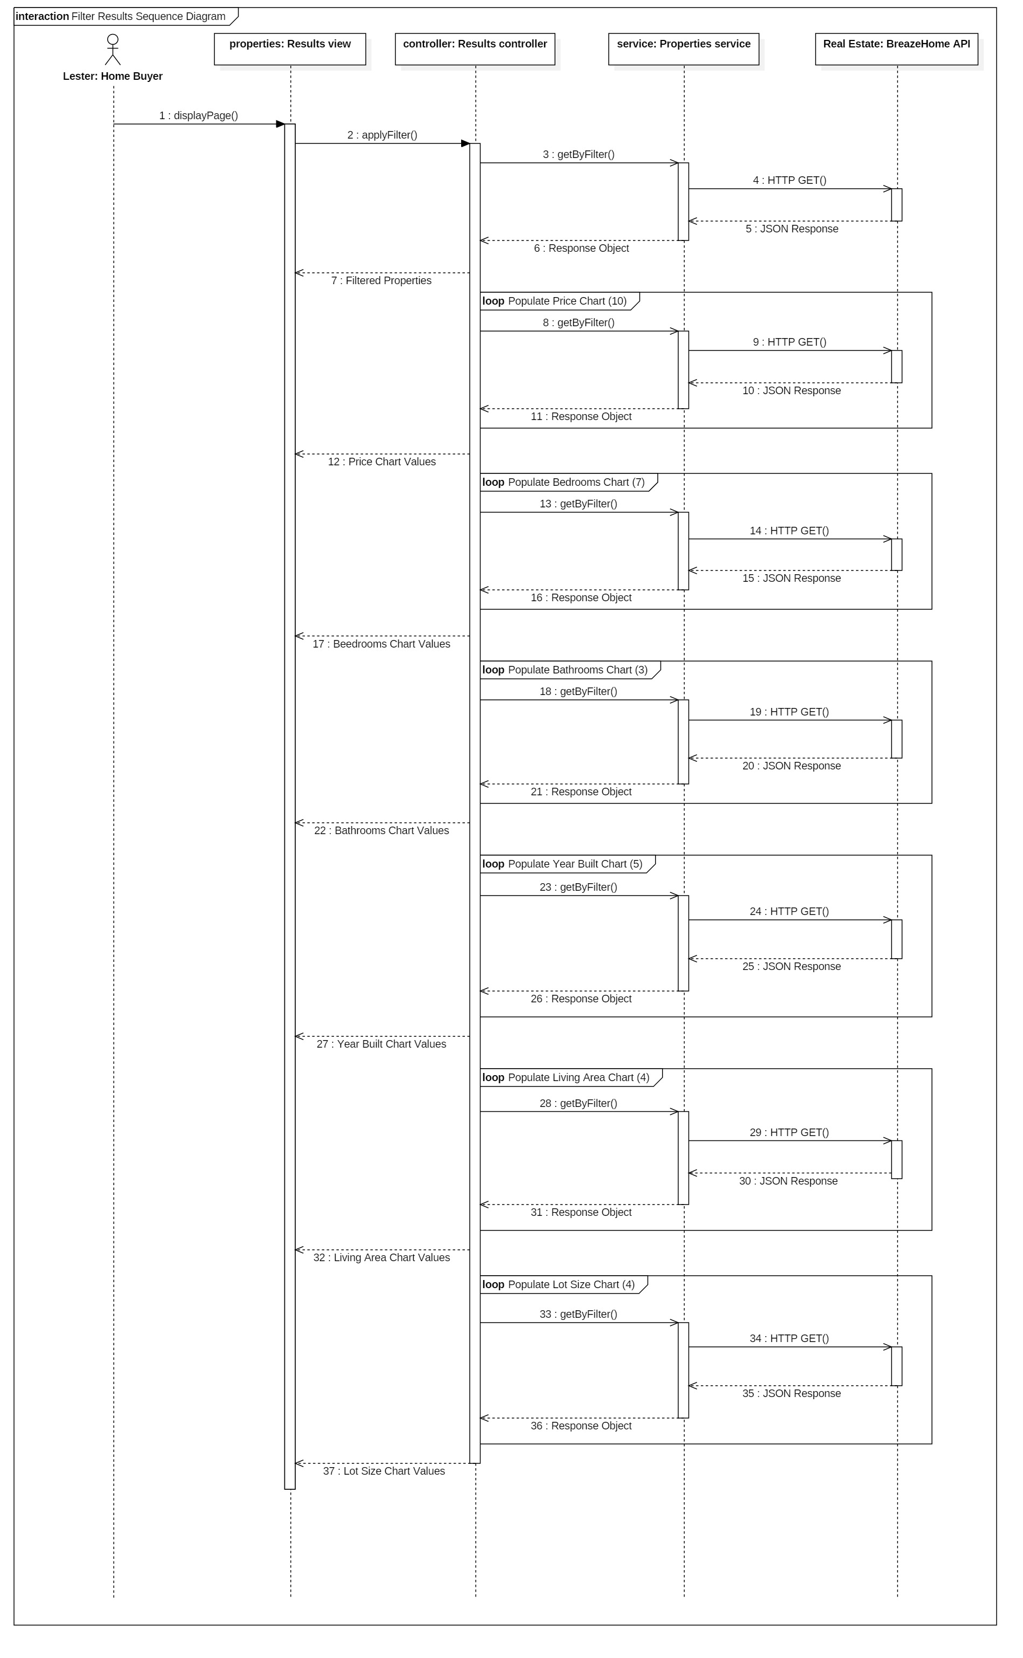
School of Computing & Information Sciences
Follow us @FIUSCIS
Senior Project, 2018, Spring
BreazeHome 4.0: Filters and Refined Search
Student: Lester Hernandez Alfonso, Florida International University
Mentor: Yuzhou (Aaron) Feng, Research Assistant, Florida International University
Professor: Dr. Masoud Sadjadi, Florida International University
Problem
BreazeHome is an academic project originated and lead by Dr. Masoud Sadjadi to help his students learn Agile Software Development in the context of a Web-based real-estate application that provides property information and services for home buyers, sellers, renters and realtors.
The UI to filter properties based on certain options was not implemented. Users would like a UI that is simple to use, and that also provides advanced options and features that are not available in other real estate websites.
Solution
Implement a filters UI that remains simple, but also includes advanced features. The UI is based on a predefined design that includes sliders, buttons, dropdowns, and density charts displaying the amount of properties in each set of intervals over the whole selectable range for each available filtering option.
Current System
The initial system had some very basic UI elements defined for the filters. Most elements were either not present or not compliant with the planned design. Backend queries for each filter option were also not implemented.
Screenshots
Finalized Feature
Basic Filters UI
Expanded Filters UI
Requirements
Model UI based on provided design.
Applying filters displays correct filtered properties list and map.
Applying filters displays correct density charts information and counts as described in provided design.
User can see selected filters for price, bedrooms and bathrooms.
User can reset all filters.
System Design and Implementation
Desktop Frontend: AngularJS (HTML, JavaScript, CSS)
Backend API: Django REST framework (Python)
Database: PostgreSQL
OS: Linux (Ubuntu)
Version control: git
Use Case Diagram
Software Architecture
Verification and Object Design
Summary
BreazeHome needed a way to filter properties in the results page.
The filters UI developed has a simple design, is easy to use, and also contains advanced options for more sophisticated users.
Density charts for numerical filter options and a commute time filter are the most valuable improvements encompassed by the filters UI.
Unit testing:
Covered all filter options.
Integration testing:
Covered conflicts with
other results page features.
Class Diagram
Sequence Diagram
Acknowledgement
The material presented in this poster is based upon the work supported by Dr. Masoud Sadjadi and Yuzhou Feng. I am thankful for the help that I received from my group members: Alex Dubuisson, Jorge Cura, Lyda Caballero, Eithel Sierra and Richard Roda.
Notes:
1

