Slide 1
Code and Consequences
Beginner programming and technology awareness
Week 6 self-guided Colab session

Slide 2
Today’s plan
Programming first, technology investigation after the second break
•
9:00–9:15 Arrive, sign in, and open Week 6
•
9:15–9:25 Secret Identity Generator
•
9:25–10:30 Notebook 1: Dictionary Arcade
•
10:30–10:40 Break
•
10:40–11:35 Notebook 2: Friendly Character Classes
•
11:35–11:45 Break and form groups of 2 or 3
•
11:45–12:15 Choose a technology topic and research
•
12:15–12:45 Share-outs and discussion
•
12:45–1:00 Individual exit ticket
02

Slide 3
Week 6 Colab links
Choose either route, then open the Week 6 README
LOCAL PROJECT
GITHUB WEBSITE
1. Open a terminal in the project folder
2. Run git pull
3. Open the Week 6 folder
4. Open README.md and click a Colab link
1. Paste the repository URL into a browser
2. Open week-06-dictionaries-classes-review
3. Open README.md
4. Click the notebook's Colab link
https://github.com/lhernandez-sudo/project-syncere-cs-2027.git
03

Slide 4
Secret Identity Generator
Individual and private, about 15 minutes
•
Run the generator to get a random draft
•
Reroll until a combination makes you laugh
•
Customize your alias, power, snack, and weakness
•
Run the check and repair any unfinished value
•
Save your identity card in your Drive copy
•
Sharing with one person is optional
04

Slide 5
Notebook 1: Dictionary Arcade
The notebook teaches the new material step by step
START
CHECK
Read the explanation and run the working example
Read the message and repair one issue
PRACTICE
CONTINUE
Change one small part using the shown pattern
Move forward only after the current check passes
Complete the guided practices and at least one challenge before the break.
05

Slide 6
Notebook 2: Friendly Character Classes
A second guided notebook before the technology investigation
•
Read the blueprint and object explanation
•
Run the working Player example
•
Complete the Character constructor
•
Add one method that changes an object
•
Check that two objects keep separate values
•
Attempt the PowerUp boss only if time permits
06

Slide 7
Break
10 minutes
Step away from the screen. Return at 10:40.
07

Slide 8
Break and group setup
11:35 to 11:45
Form a group of 2 or 3. Open the Tech Investigation notebook.
Choose one topic together. You may divide the work in any way.
08

Slide 9
Technology behind the screen
Common products raise questions about money, power, privacy, and safety
•
A free app can earn money from advertising
•
A subscription earns recurring revenue
•
An app store can charge fees on digital purchases
•
Design choices can influence user decisions
•
Market power can make competition difficult
•
Engineers help create the systems behind these choices
09

Slide 10
Legal language
Use precise words during the discussion
ALLEGATION
SETTLEMENT
A claim that has not yet been proven in court
The parties resolve a case without completing a trial
RULING
BUSINESS MODEL
A court's decision on a legal question
How a company earns revenue
Do not describe an allegation as a proven fact.
10

Slide 11
Investigation topics
Choose one topic from the notebook
TIKTOK
AMAZON
Advertising and children's privacy
Prime subscriptions and dark patterns
GOOGLE
APPLE
Search advertising and competition
The App Store and smartphone control
INSTAGRAM
GENERATIVE AI
Advertising and youth well-being
Training data and human creators
11

Slide 12
Research organizer
Complete one shared evidence note
•
Explain how the product makes money
•
Build a short timeline of what happened
•
Label claims as allegations, rulings, or settlements
•
Name at least two groups affected
•
Record two facts with source links
•
Recommend one next step and explain a tradeoff
12

Slide 13
Source path
Begin with the explainer; legal documents are optional
•
Read the AP, PBS NewsHour, or Reuters article first
•
Use it to understand the people, events, and disagreement
•
Open a legal document only when you want more detail
•
Check whether the case ended or remains open
•
Compare the government claim with the company response
•
Do not sign in or share private account information
13

Slide 14
Share-out and discussion
Each group has two minutes
•
Name the product and its business model
•
Explain the controversy accurately
•
Share the strongest evidence you found
•
Ask the class one question
•
Listen for a tradeoff or missing viewpoint
•
Disagree with ideas without attacking people
14

Slide 15
Individual exit ticket
Finish privately before 1:00 PM
•
Which business model surprised you most?
•
What fact can you verify with a reliable source?
•
What question do you still have?
•
What should engineers consider besides whether a product works?
Save your programming and investigation notebooks in Google Drive.
15

Slide 16
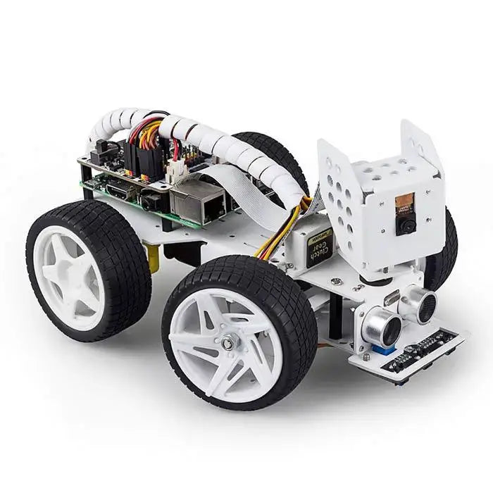
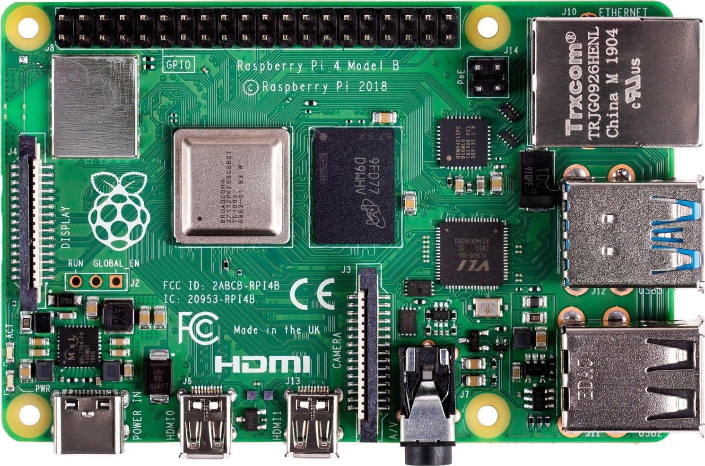
Next week: self-driving car capstone
Teams of 3 will combine Python, sensors, and hardware
•
Use a Raspberry Pi as the car's computer
•
Read camera, distance, and line sensor input
•
Write Python decisions for steering and stopping
•
Start the program remotely, test it, and improve it
•
Goal: navigate a small obstacle course in the gym
Each team will share the building, coding, testing, and demonstration work.
Images: SunFounder PiCar-X product page; ELMIR Raspberry Pi 4 product image
16

