Slide 1
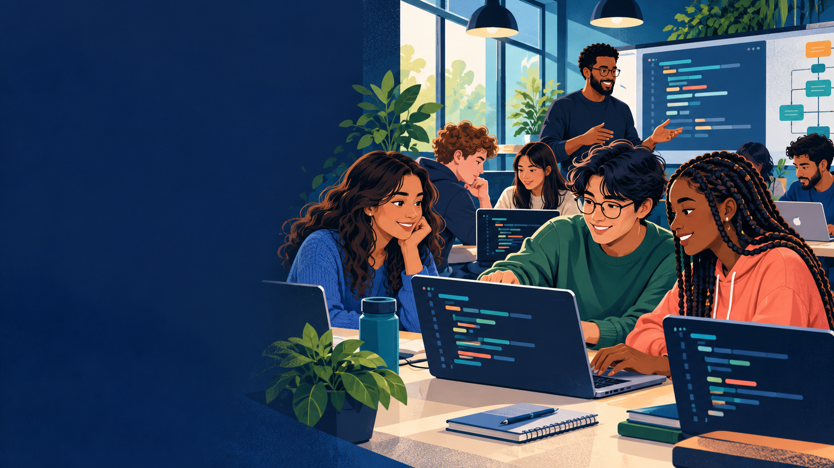
Python Basics
Week 1
Project Syncere Computer Science 2027
Notes:
Welcome students as they enter. Generated cover illustration; it is not a photograph of an actual Project Syncere class.

Slide 2
Today’s schedule
Saturday, 9:00 AM-1:00 PM
9:00
Administrative tasks
9:30
Welcome, community, and objectives
9:50
Computer science and the first Python program
10:25
Break
10:35
Guided Python lab
11:20
Break
11:30
Student introduction project
12:20
Share, debug, and reflect
Week 1 | Python Basics
Notes:
Source: project_syncere_python_foundations_3_saturdays.pdf, recurring Saturday schedule. Week 1 adapts the opening block to reserve 30 minutes for administrative tasks.

Slide 3
30 minutes
Attendance and required forms
Student accounts and GitHub access
Device distribution and charging
Internet, accessibility, and login support
Administrative setup
Keep your device open when you finish. Help a neighbor only after your own setup works.
Notes:
Use the setup checklist to identify students who need follow-up. Do not delay the entire class for one device. Pair those students with a working partner and continue troubleshooting during guided lab.

Slide 4
Learning objectives
By 1:00 PM, you should be able to...
Run a Python file from Visual Studio Code or PowerShell
Use print() to display text
Add comments that explain a program
Locate the useful line in a Python error message
Make and describe one Git commit
9:30-9:50 | Welcome and objectives
Notes:
Invite students to read the objectives silently. Ask which objective feels most familiar and which feels newest.

Slide 5
Input, process, output
A program turns information into a result
INPUT
PROCESS
OUTPUT
What the program receives
The steps the program follows
What the program produces
Example: your name
Combine it with a greeting
Hello, Maya!
9:50-10:25 | Lesson and live coding
Notes:
Source: project_syncere_python_foundations_3_saturdays.pdf, Saturday 1 core concept: Input -> Process -> Output. Ask students for a non-computer example before showing the name-and-greeting example.

Slide 6
Your first Python program
print("Hello, Project Syncere!")
print("Welcome to computer science.")
Predict first
What will appear when this program runs?
Then change one message and run it again.
Notes:
Live-code this example rather than only reading it. Narrate the quotation marks, parentheses, save action, and run command. Intentionally miss one quotation mark and read the error together.

Slide 7
Break
10:25-10:35
Step away from your screen. Return ready to code.
Notes:
Start a visible ten-minute timer. Use the break to check on unresolved account or device problems.

Slide 8
Guided Python lab
Work with the class first, then repeat the steps independently
Open the course repository in Visual Studio Code
Run setup/verify_setup.py
Run week-01-python-basics/examples/hello.py
Change every displayed message
Create one error, read it, and repair it
Command
python week-01-python-basics/
examples/hello.py
Ask for help with the complete error message visible.
10:35-11:20 | Guided lab
Notes:
Pause after each step and check that every student has the same result. Pair students intentionally. Students who finish early should explain an error message to a partner rather than racing ahead.

Slide 9
Break
11:20-11:30
After the break: build something that introduces you.
Notes:
Start a visible ten-minute timer. Confirm that students know where the assignment starter file is before they leave.

Slide 10
Project: introduce yourself
Create a short Python program for a classmate to run
Required
Start here
Your name
At least three facts about you
One goal for this course
At least two useful comments
A program that runs without errors
week-01-python-basics/
assignment/starter.py
Working and understandable beats complicated.
11:30-12:20 | Project and peer testing
Notes:
Keep the project deliberately small because Day 1 includes 30 minutes of administration. Require a working minimum version before students personalize formatting or add optional lines.

Slide 11
Peer test and share
Your partner runs the program on their computer
Run the program without editing it first
Describe what worked
Copy the complete error message if something failed
Suggest one improvement that keeps the project small
Return the program and let the author make the change
Share one debugging discovery with the class.
12:20-12:40 | Share, debug, and peer review
Notes:
Model feedback that is specific and kind. Ask two or three students to demonstrate a program or explain a bug they fixed. Do not require everyone to present on Day 1.

Slide 12
Exit ticket
Answer before you leave
1
What did you make today?
2
What error did you encounter or repair?
3
What support do you need next Saturday?
Save your work and show your instructor the exit ticket.
Notes:
Collect responses by 12:55 so students can save files and confirm their repository location. Record unresolved setup issues for follow-up before Week 2.

