Slide 1
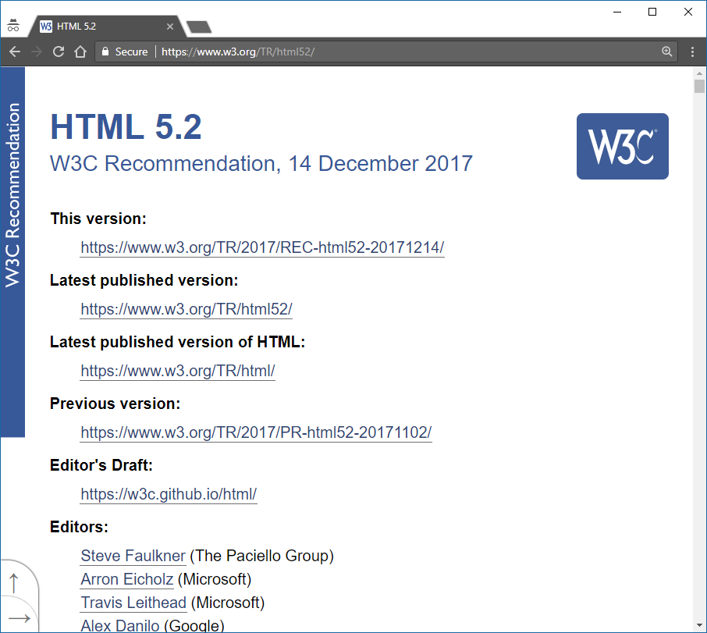
Standard
https://www.w3.org/TR/html/

Slide 2
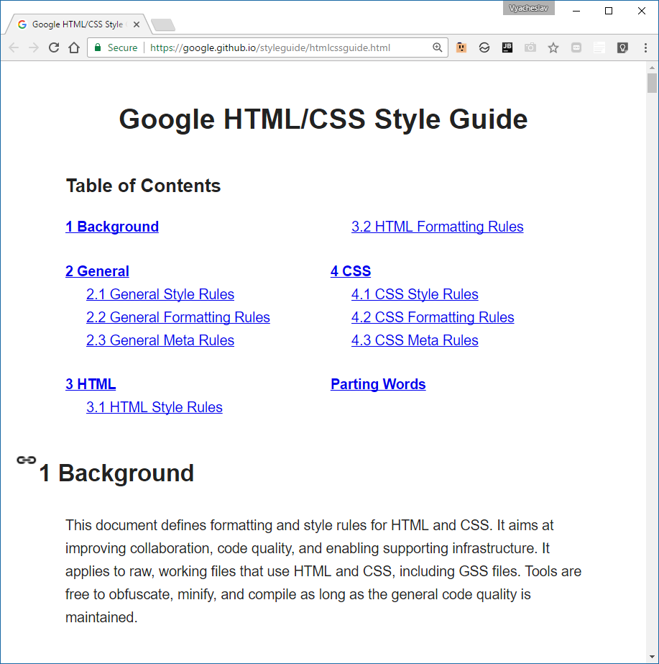
Google HTML/CSS/ Style Guide
https://google.github.io/styleguide/htmlcssguide.html

Slide 3

HTML Document
HTML document is a text document created to represent formatted information including text, vide, images, sounds
HTML document is created by tags and consists of sections
<!doctype html> <html lang="en"> <head> <meta charset="utf-8"> <title>Sample website</title> </head> <body> <p>Hello World!</p> </body> </html>
Notes:
Tip: Add your own speaker notes here.

