Slide 1
Optional Tags
<!doctype html> <html lang="en"> <head> <meta charset="utf-8"> <title>Sample website</title> </head> <body> <p>Hello World!</p> </body> </html>
<!doctype html> <title>Sample website</title> <p>Hello World!</p>
https://google.github.io/styleguide/htmlcssguide.html#Optional_Tags
Notes:
Tip: Add your own speaker notes here.

Slide 2
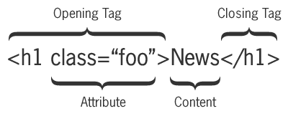
Tag Pairs
Tags are keywords that determine structure of an HTML page
Keyword is surrounded by angled brackets
Most tags come in pairs
Opening or start tag
Closing or end tag
<h1>Pet Care 101</h1>
Closing tag must have same case as opening tag
Notes:
Tip: Add your own speaker notes here.

Slide 3
Empty Tags
Empty tags don’t require an end tag
Examples:
<br> for a line break
<hr> for a horizontal line
Notes:
Tip: Add your own speaker notes here.

