Slide 1
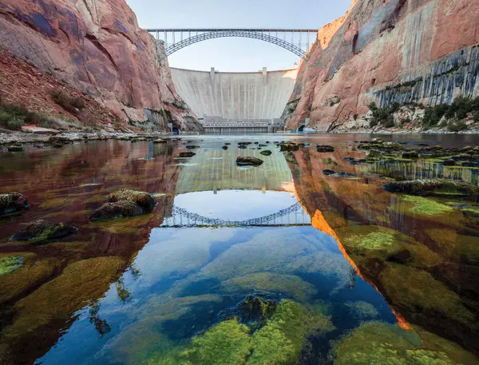
A Big Dam Problem:
Investigating the impacts of future dam construction on critical landscapes
Stephanie Shepherd & Lauren Herwehe
Image Source: https://www.nytimes.com/2016/05/22/opinion/unplugging-the-colorado-river.html

Slide 2
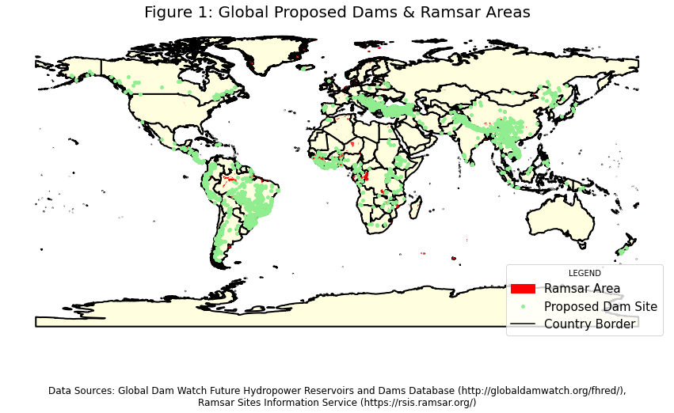
The Problem:
Dam construction is proceeding at a high rate across the globe
Reservoirs and Dams drastically alter the flux of water, sediment, and organisms in a watershed
Project Objective: Identify critical habitats (protected areas) that will be affected by future dam construction around the globe.

Slide 3
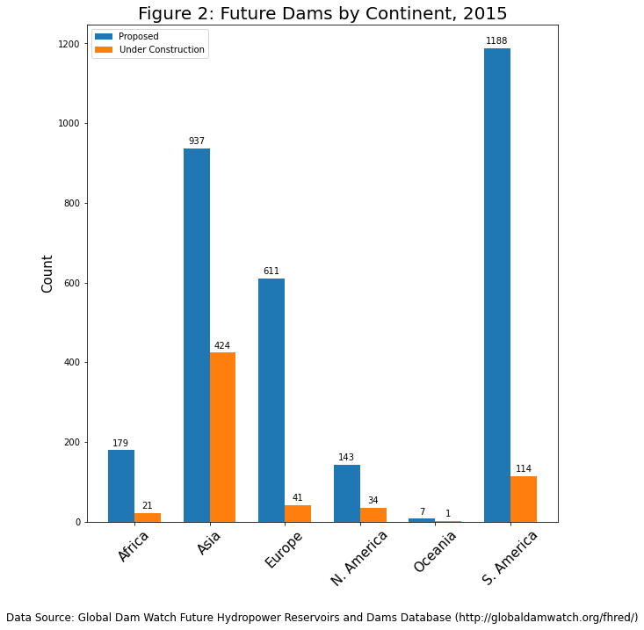
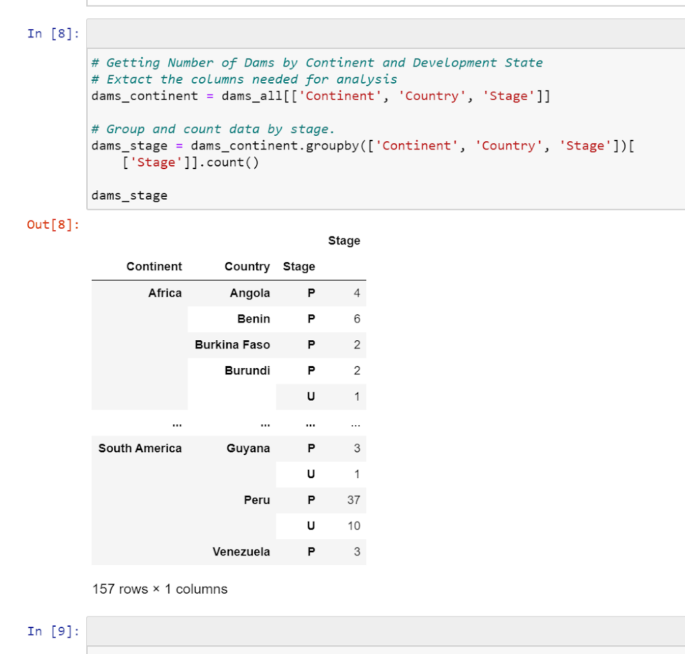

Slide 4
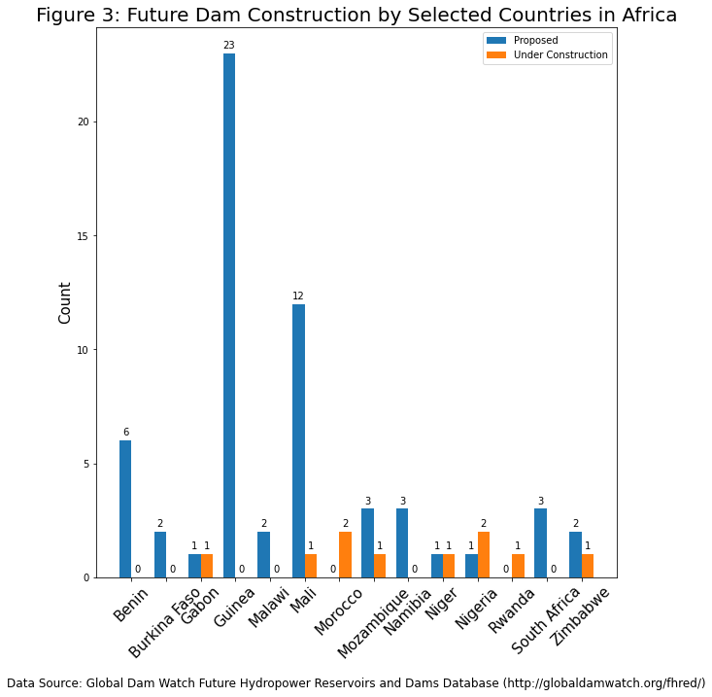

Slide 5
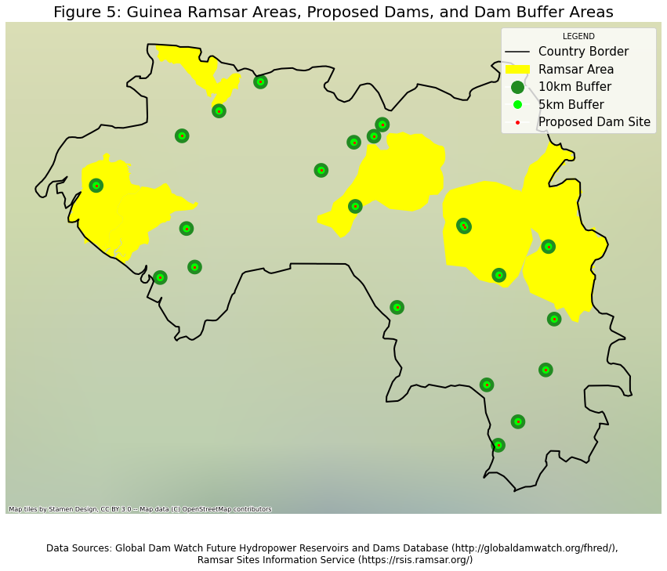
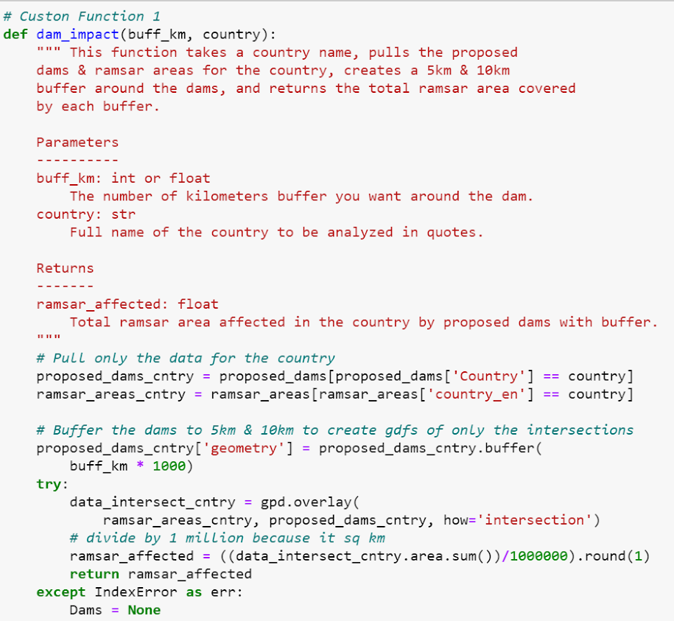
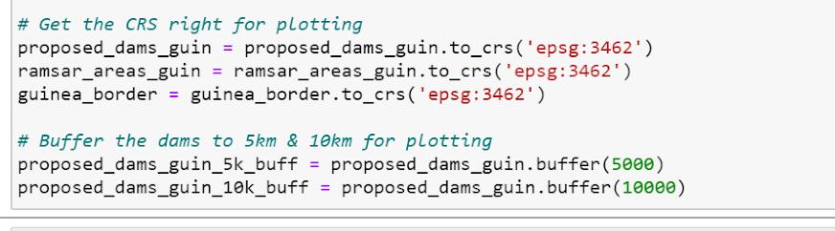

Slide 6
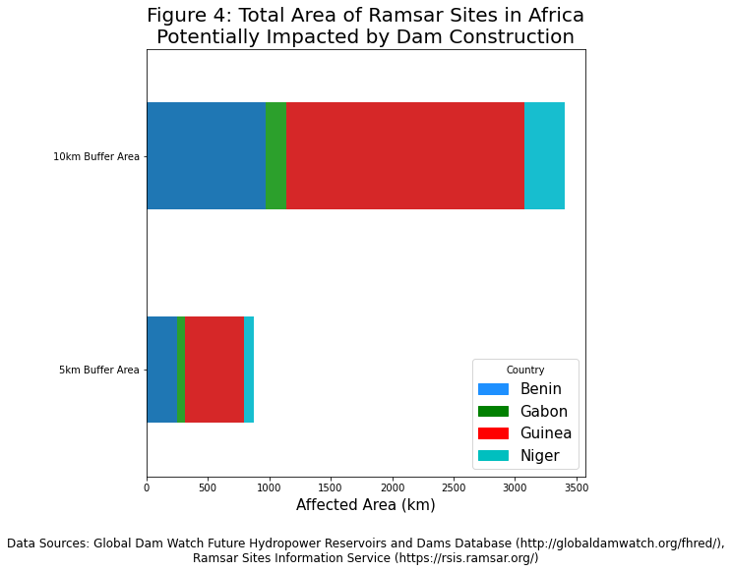
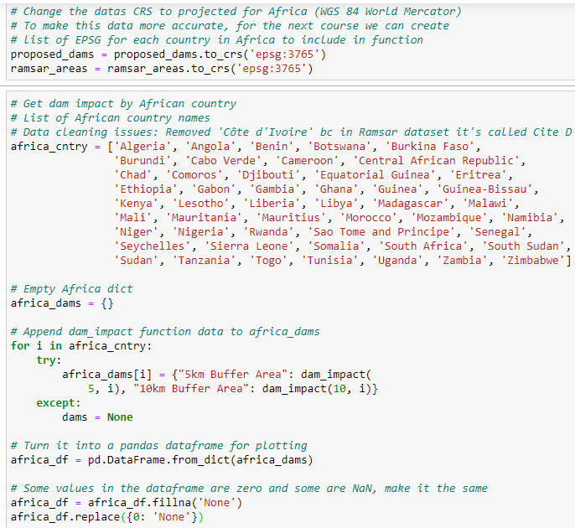

Slide 7
Next Steps
Create a more versatile buffer
Account for upstream vs downstream of the dam site.
Possibly rectangular to accommodate the natural geometry of a river valley.
Include other designated protected areas beyond Ramsar Areas, which only include wetlands.
World Database of Protected Areas (WDPA)
Expand the study to other continents.
Europe, Asia, and South America have many proposed dams so would be interesting to view.
Future Questions
Is there a relationship between dam type (purpose) and habitat impact
GRAnD database
Possibly use principal component analysis

Slide 8

Acknowledgments
Project Partner:
World Wildlife Fund, Jeff Opperman, Natalie Shahbol
Data Sources:
Global Dam Watch Future Hydropower Reservoirs and Dams
(http://globaldamwatch.org/fhred/)
Ramsar Site Information Service
(https://rsis.ramsar.org/?pagetab=0)

